Slide 1


Business Intelligence Report
Under the guidance of GUNEET KAUR SAWHNEY
N01479948 – Mona Shah

Slide 2

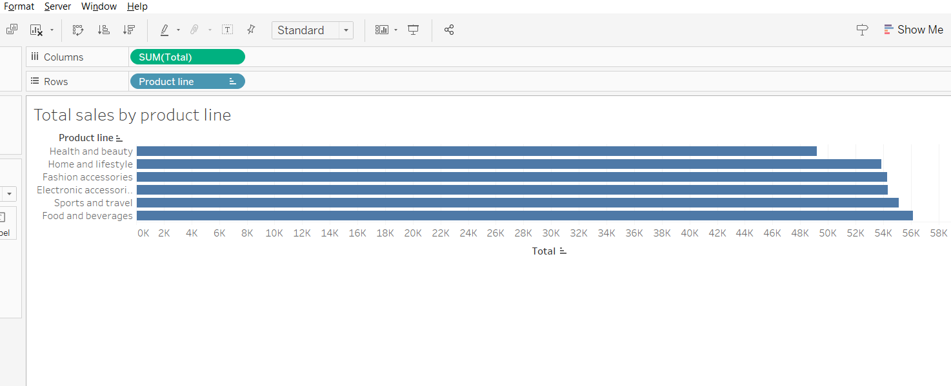



Total Sales By Product Line

Slide 3
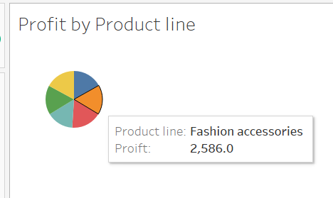
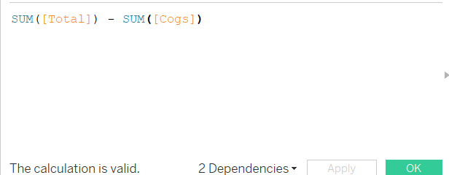
Profit By Product Line

Slide 4
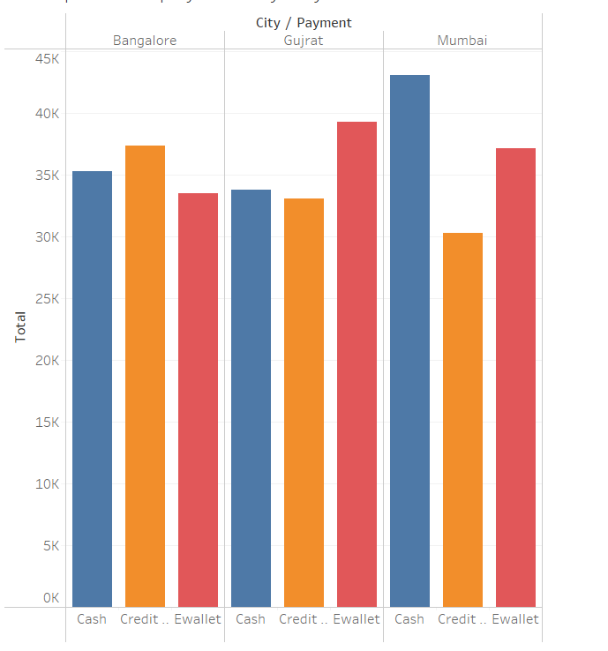
Most Preferred Payment Methods

Slide 5
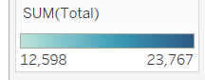
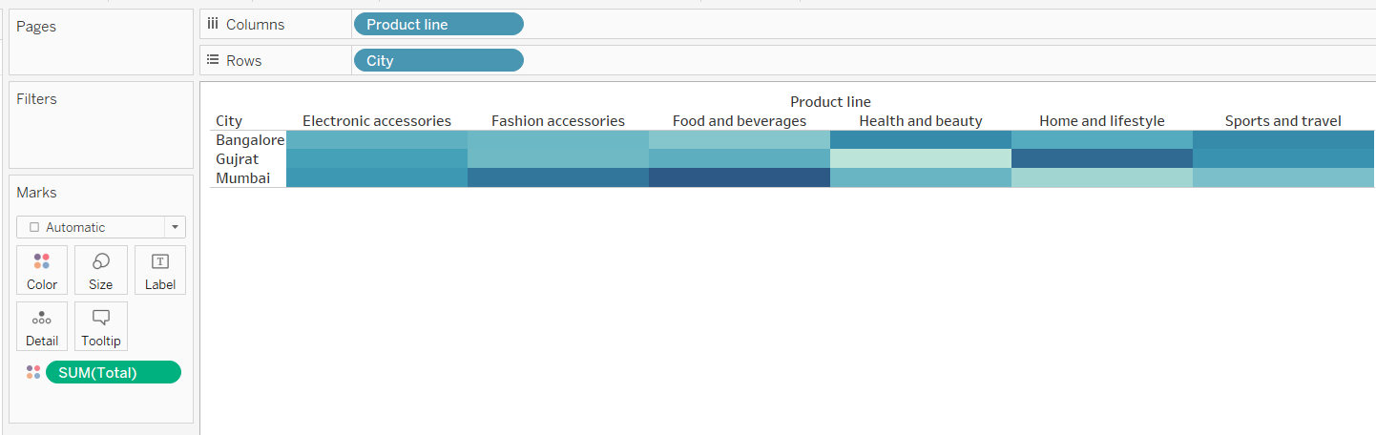
Distribution of sales by product line and city

Slide 6
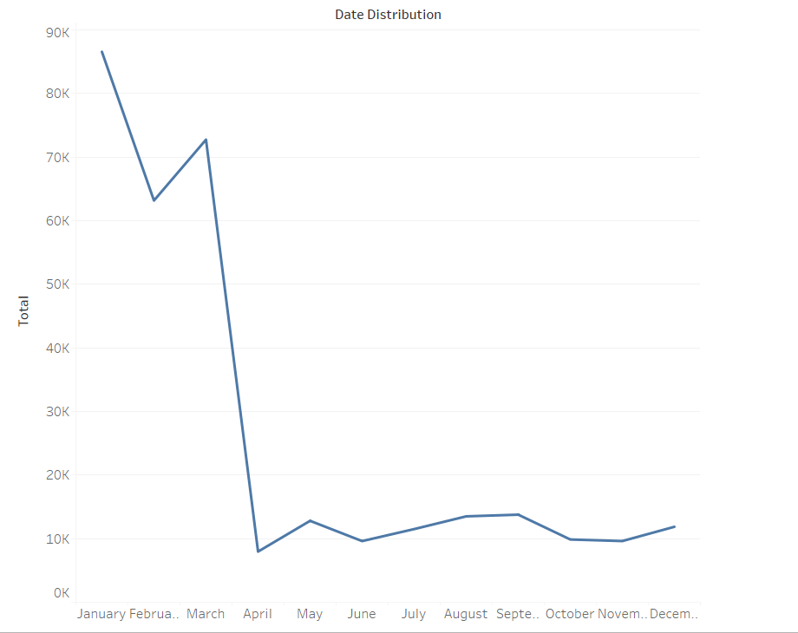
Monthwise Sales Report

Slide 7
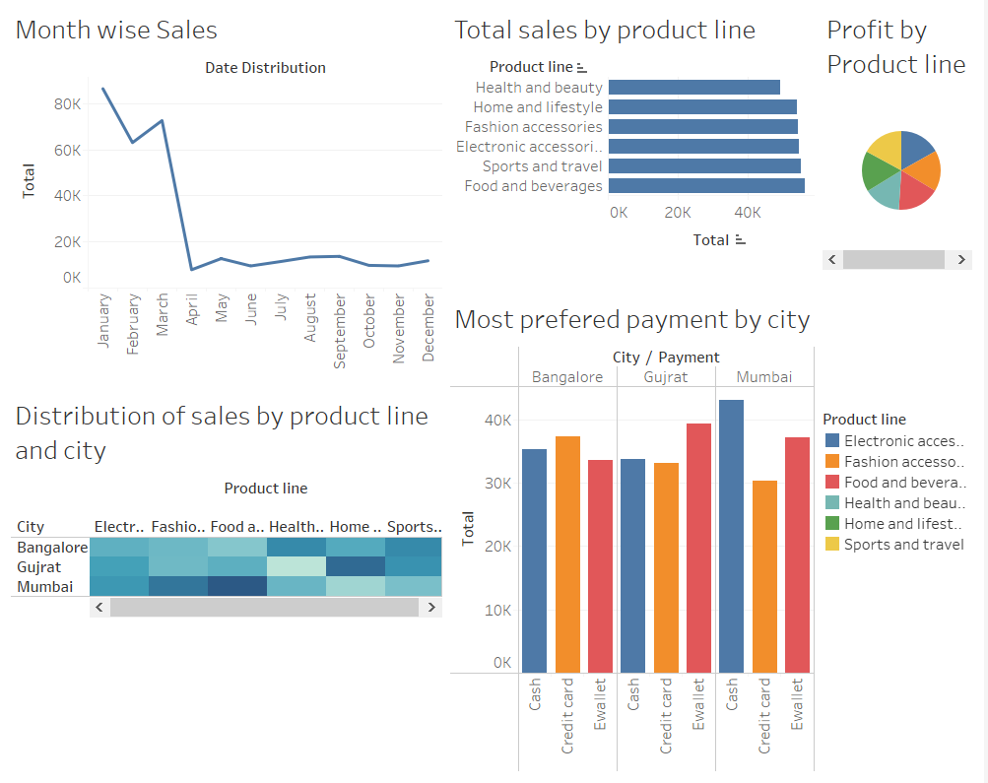
Final Dashboard

Slide 8


