Slide 1
Phishing Website Detection
Maksym Monastyrskyy

Slide 2
Problem Methodology Results
Detect whether a website is legitimate or phishing.
Using EDA, statistical inference, individual models, and ensembling.
Results: best model

Slide 3
Data
Known industry/academia signs of phishing
30 features (all categorical)
11,055 observations
No NA’s (even weirdly spelled ones)

Slide 4
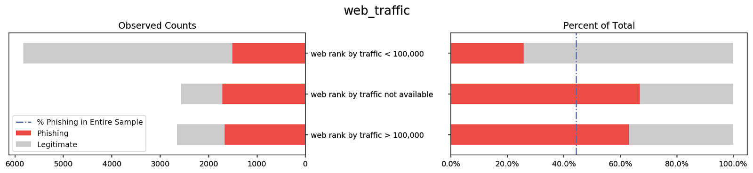
EDA - Overview

Slide 5
Statistical Inference
O(N) Space/Time?
Methodical way to look at ‘interesting’ columns
99.9% Bootstrap CI
Interesting columns with CI above sample proportion: ['ssl_final_state', 'web_traffic', 'url_contains_sub_domain']
Interesting columns with CI below sample proportion: ['links_pointing_to_page', 'url_of_anchor', 'sfh', 'links_in_tags']

Slide 6
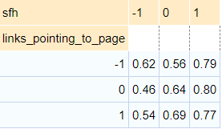
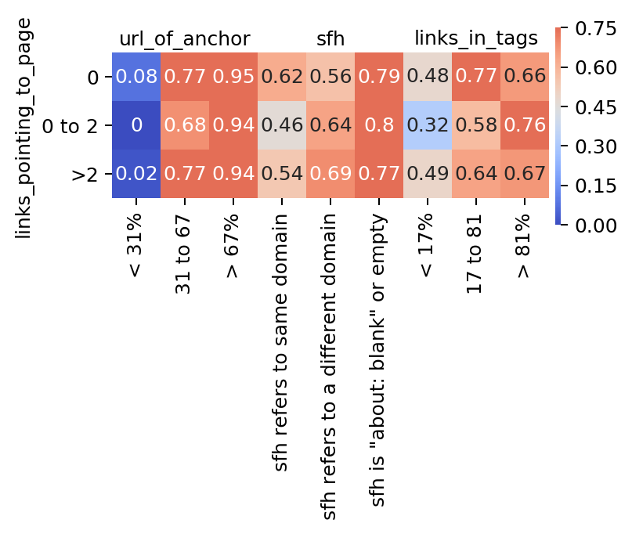
EDA – Closer Look

