Slide 1
PYTHON FOR DATA SCIENCE
PANDAS

Slide 2
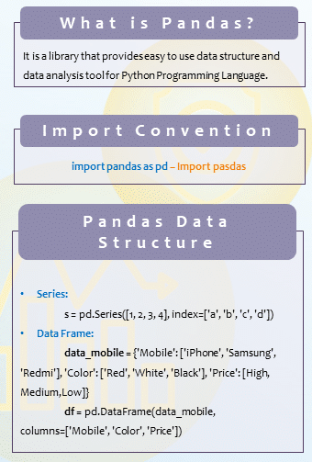
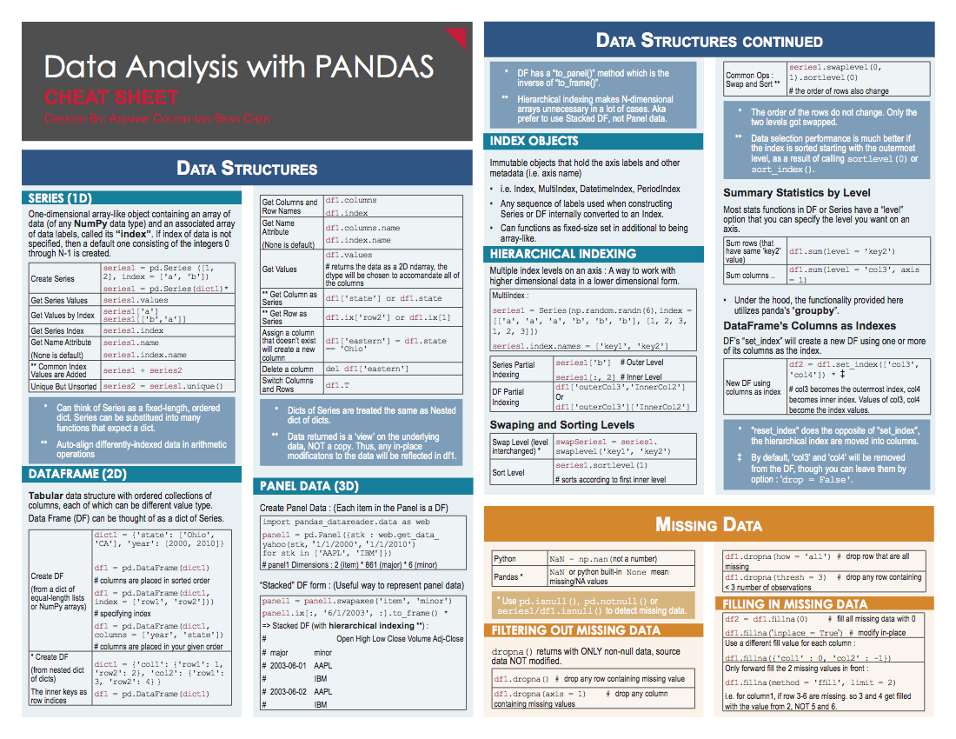

Slide 3
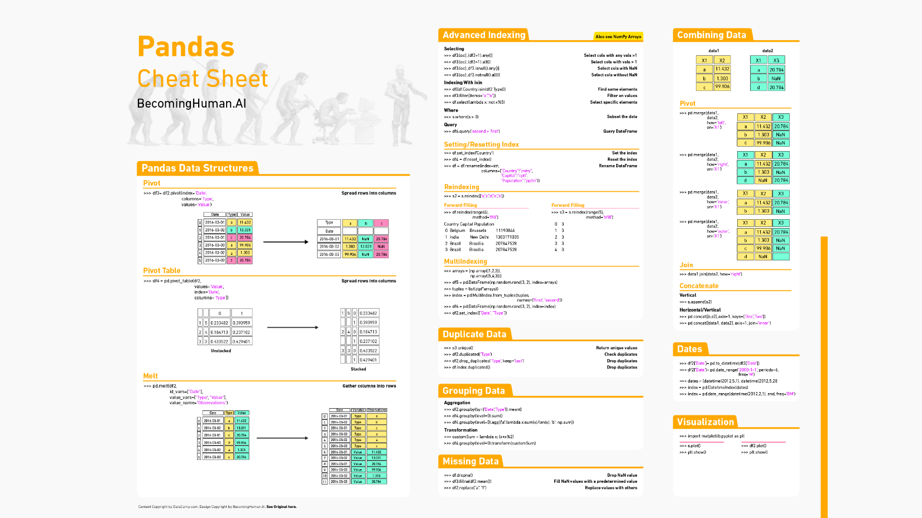

Slide 4


Slide 6
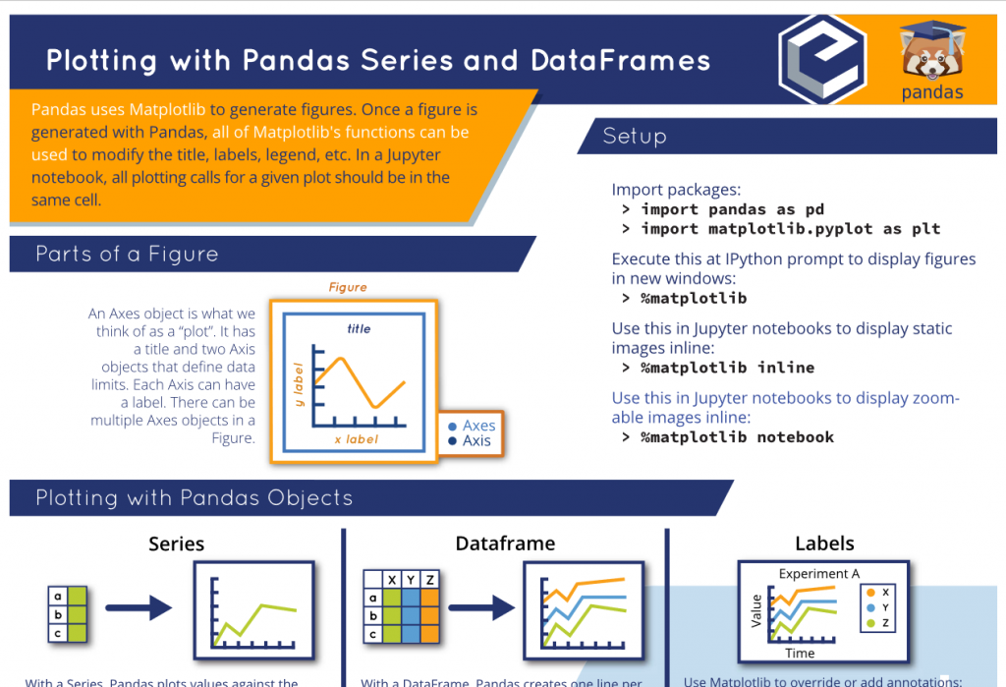

Slide 7
