Slide 1

ModelSim Installation and Licensing Guide

Slide 2
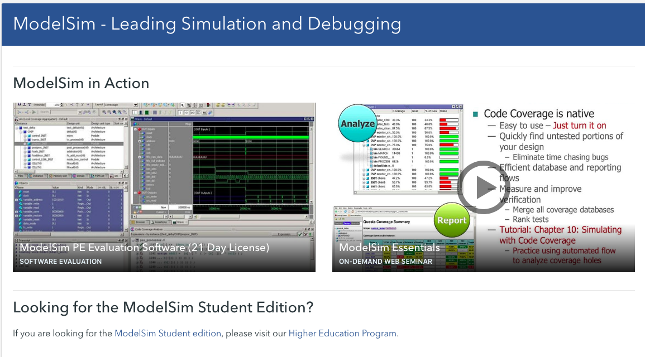
Go to ModelSim
http://www.mentor.com/products/fpga/model
Click ModelSim Student edition
click

Slide 3
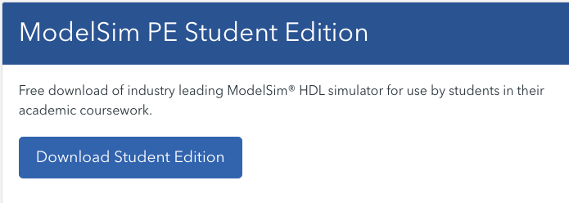
Download & Setup
Click here

Slide 4
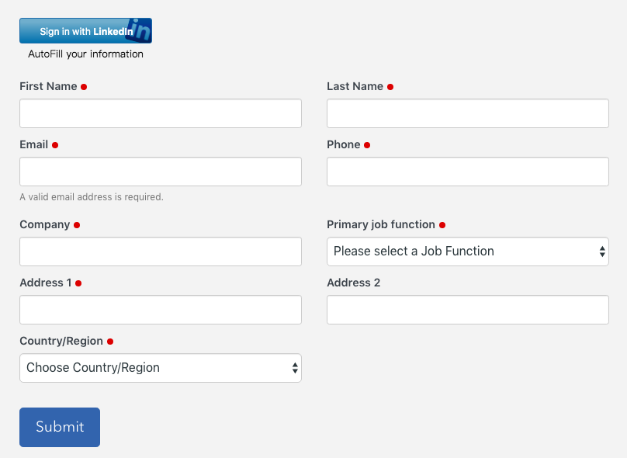
Registration
Fill in the registration form

Slide 5
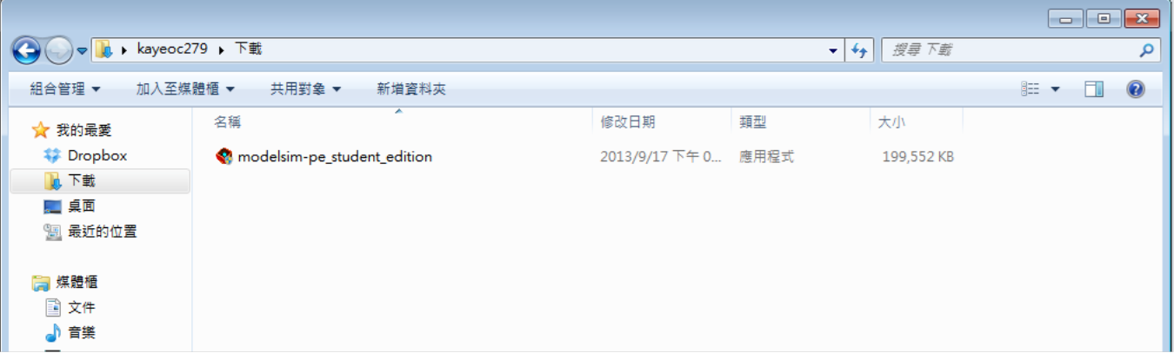
Download
You will receive an email with the file download location.
Use this to install

Slide 6
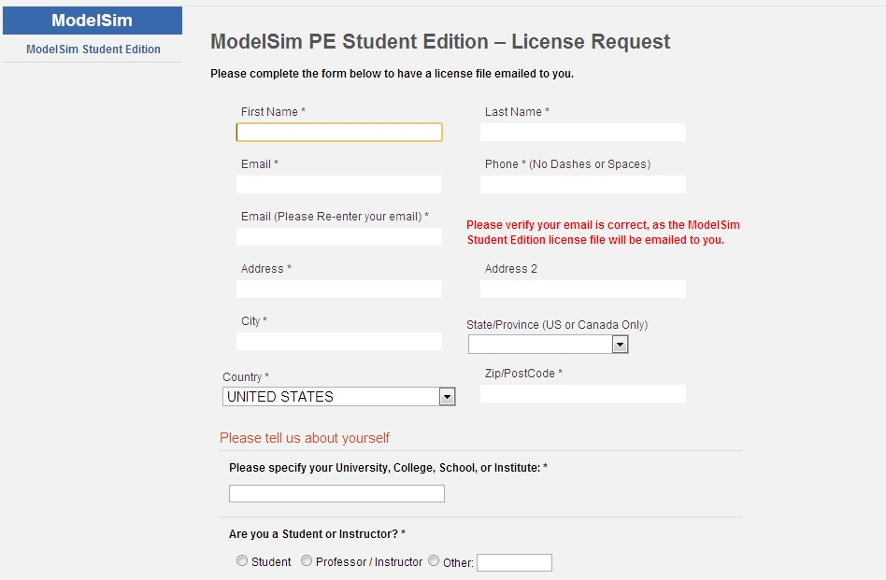
License Request
At the end of the installation process, select Finish and a browser window will open with the License Request form. Once your request has been received the ModelSim PE Student Edition license file will be generated, matched to your host computer and will be emailed to you along with license installation instructions.

Slide 7
Final installation instruction
1) Save the attached file with the name 'student_license.dat' to the top level
installation directory for ModelSim PE Student Edition (e.g., c:/modeltech_pe_edu).
This is the directory that contains that sub-directory 'win32pe_edu.'
2) Do not edit the file 'student_license.dat' in any way, or the license will not work.
3) You should now be able to run ModelSim PE Student Edition.

Slide 8
How to use modelsim

Slide 9
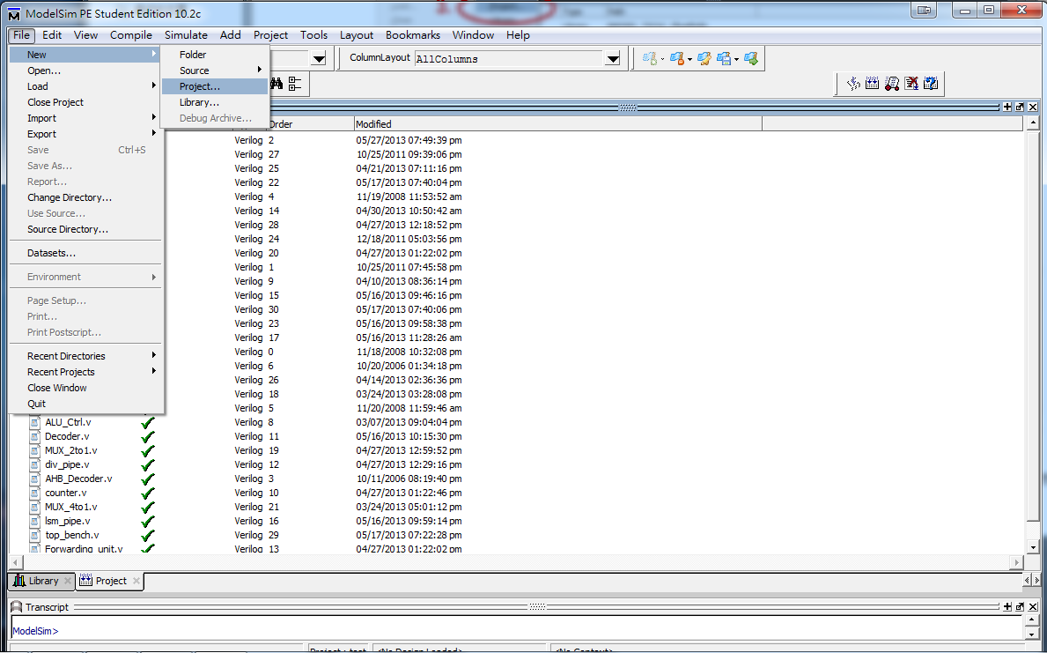
New a project

Slide 10
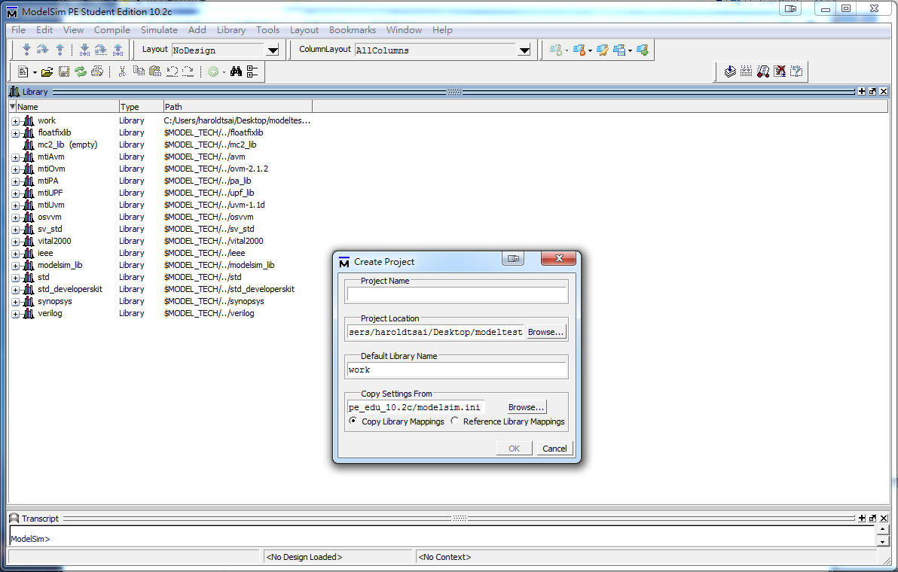
New a project
Project name
path

Slide 11
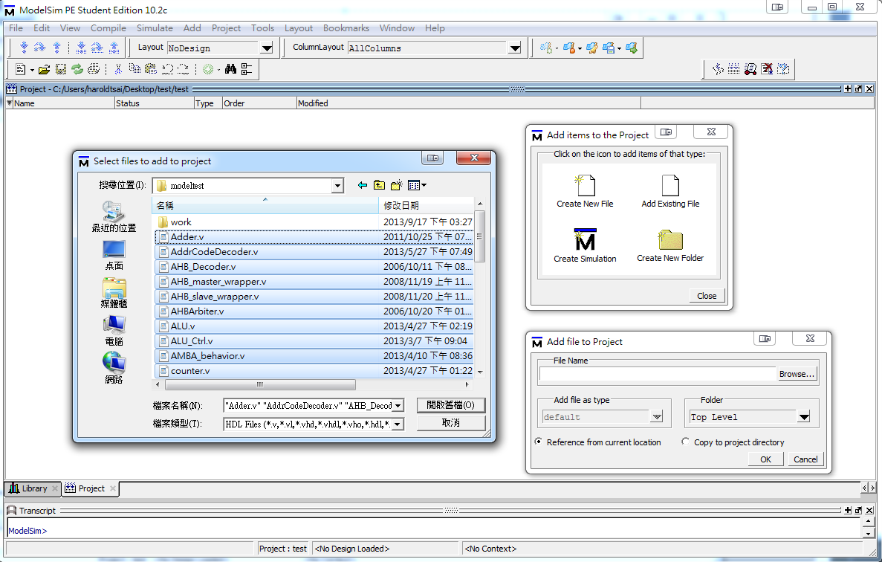
Add Files
2.
1.Add .v file you write
3.

Slide 12
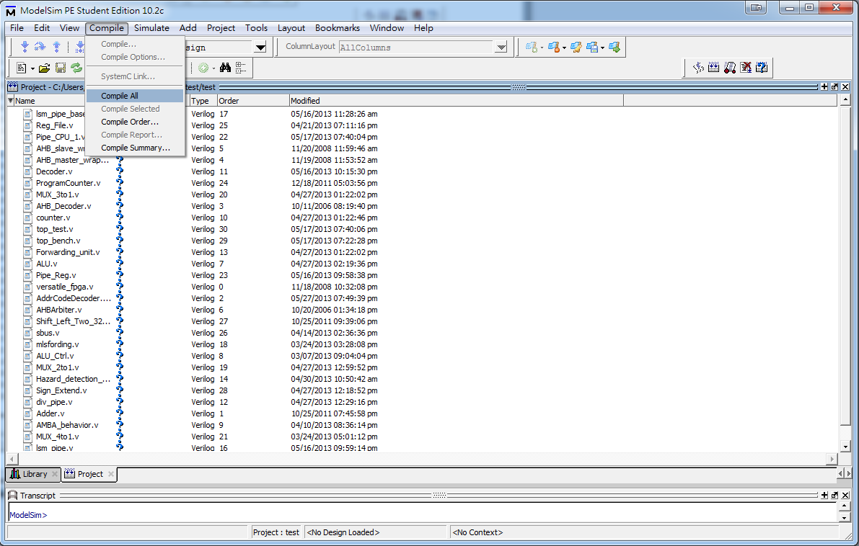
Compile
2.
3.
4.未編譯過的檔案會呈現?
若有語法錯誤會顯示X
5.會顯示哪份檔案有語法錯誤
1.

Slide 13
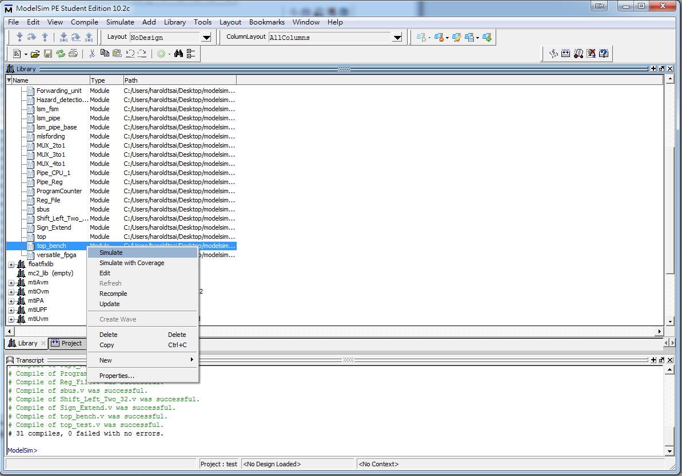
Simulate
2.在testbench上按滑鼠右鍵選“simulate”
1.

Slide 14
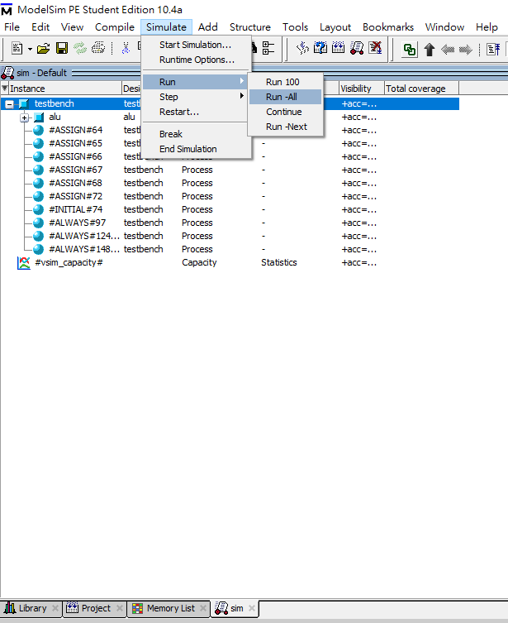
Simulate – Run all
將所有test data (*.txt)放到和project同一層資料夾 (project預設路徑為”C:\ Modeltech_pe_edu_10.4a \examples”)
2.

Slide 15
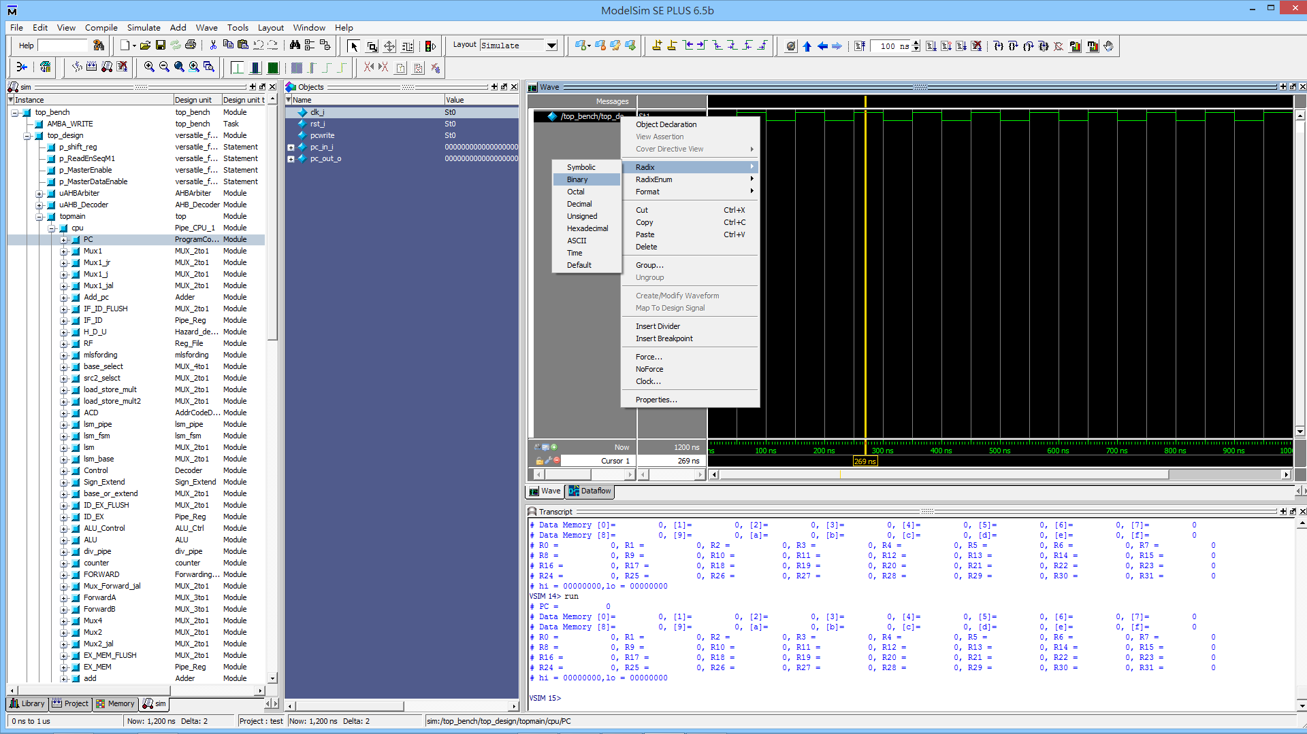
Simulate
4.在波型圖上點右鍵可選擇
output格式
2.可選擇特定
module 的特定
一條線觀察其波型
3.可由testbench
中print一些訊息
1.

