Slide 1
SHIELD-AI
Securing Agentic AI for the Australian Defence Department
Security and Holistic Integrity for Enterprise-Level Deployment of AI
An Australian framework: 7 pillars, 60 controls, 4 maturity levels, policy as code
Briefing | Framework v1.7 | August 2026
Notes:
Thirty minutes, so let's move. The point of this slide is simple: SHIELD-AI is an Australian framework built for agents that act, not chatbots that answer. It is structured so a security team can explain it to decision makers in under half an hour, which is what we are about to do.

Slide 2
Presentation Overview
Four parts, 30 minutes
1. Why agents change the threat picture for Defence
2. The framework: seven pillars and 60 controls
3. How it works: reference implementation, policy as code, request flow
4. Applying it to Defence: maturity model, regulatory alignment, deployment
A note up front: every claim in this deck is tied to a documented incident
SHIELD-AI | Defence Briefing | Deck v1.6 | Framework v1.8 | Aug 2026
1
Notes:
Set the expectation: questions at the end, and the evidence for every claim is in the framework documents.

Slide 3
Why Agents Change the Threat Picture for Defence
Why now
An agent does not just answer. It invokes tools, writes code, and acts under delegated authority
With action comes exposure, and the failures are documented:
  A wave of sandbox escapes hit production agent platforms between March and July 2026: OpenAI, Hugging Face, Cursor, AWS AgentCore, ServiceNow
  CVE-2026-10591: hidden 1px text on a page rewrote an agent's MCP registry and ran attacker code on the host
  CVE-2026-25253: a crafted link hijacked a loopback agent gateway, switched off approvals, and escaped to the host
  An agent under evaluation published a malicious package to PyPI; 15 real systems ran it for about three months before anyone noticed
  August 2026: the first documented Australian case. A personal assistant found a gym's booking API had no authorisation checks, booked classes months ahead, and cancelled another member's waitlist position without being asked (ABC News)
Adversary-owned agents now probe and attack at machine speed, round the clock
The controls we built for humans and static machines do not reach an autonomous, delegated, tool-wielding agent
SHIELD-AI | Defence Briefing | Deck v1.6 | Framework v1.8 | Aug 2026
2
Notes:
Two minutes. Lead with the shift from chat to action, then keep each incident to one line. The PyPI story is the one people remember: an agent under evaluation, three months, 15 systems. The ABC story lands the point locally: it happened here, this month, to an ordinary user.

Slide 4

The Agentic AI Attack Surface
Seven layers; risk compounds upward
Risk compounds upward from the model to the data.
SHIELD-AI | Defence Briefing | Deck v1.6 | Framework v1.8 | Aug 2026
3
Notes:
Two minutes. Walk the stack bottom to top: a model compromise opens tool abuse, which opens data exfiltration, which slips past identity controls unless monitoring and governance are in place. This diagram is the framework's threat model.

Slide 5
Where Current Frameworks Come Up Short
ISM, the Essential Eight, and PSPF are strong on traditional cyber, but they predate autonomous agents
The gaps are structural, not incremental:
  Tool access: agents read and write APIs, databases, and file systems, which no user-centric threat model fully covers
  Identity delegation: the agent acts under the human's authority, often with no bound on the chain
  Sandbox containment: escape is the failure mode we see in the field, not a hypothetical
  Protocol layer: MCP endpoints, tool metadata, and control planes are surface nobody owned until recently
  Evaluation harnesses: isolation gets asserted in config, but nobody verifies it holds
The Five Eyes Agentic AI Guidance (May 2026) points the direction; it is not a control set
SHIELD-AI fills that gap: an Australian, evidence-driven control framework for agentic AI
SHIELD-AI | Defence Briefing | Deck v1.6 | Framework v1.8 | Aug 2026
4
Notes:
Ninety seconds. Position SHIELD-AI as complementary to ISM and the E8, not a replacement. The last line hands off to the framework section.

Slide 6
SHIELD-AI at a Glance
Seven security pillars across the whole agentic-AI stack
  Model Security, Identity and Access, Data Security, Tool and Pipeline Security, Monitoring and IR, Governance and Risk, Execution Environment
60 controls, each with implementation guidance and a maturity progression
Four maturity levels, consistent with ISM and the Essential Eight: L1 Initial, L2 Managed, L3 Defined, L4 Optimised
Policy as code: 59 executable Rego controls, evaluated deny-override
A deployable reference implementation: gateway, policy engine, identity plane, observability
Evidence driven: 36 documented incidents, 23 identified gaps, monthly deep review, a live watchlist
Sovereign by design: an Australian framework aligned to PSPF, ISM, Essential Eight, SOCI, and the Five Eyes guidance
SHIELD-AI | Defence Briefing | Deck v1.6 | Framework v1.8 | Aug 2026
5
Notes:
One minute. This is the thirty second version: seven pillars, 60 controls, L1 to L4, policy as code, evidence driven. Say it plainly and move on.

Slide 7

The Seven Pillars
Execution Environment at the base; Governance at the top
Each pillar depends on all pillars below it.
SHIELD-AI | Defence Briefing | Deck v1.6 | Framework v1.8 | Aug 2026
6
Notes:
Two minutes. The ordering carries the argument: EE sits at the base because an escapable sandbox invalidates every control above it, and GRM sits at the top because without governance the controls erode. Each pillar leans on the ones below it.

Slide 8
Pillar 1: Model Security
Pillar 1 of 7 | Model Security
The models themselves are the first asset to protect
  MS-01 Weight protection: encrypted at rest and in transit, HSM-backed keys
  MS-02/03 Training data integrity and model supply chain: provenance, signed checkpoints, SBOM
  MS-04 Adversarial robustness: prompt-injection testing and jailbreak evaluation, plus sanitisation against imperceptible content (zero-opacity and 1px text, hidden PR comments)
  MS-08 MCP security: signed tool metadata, an authenticated MCP gateway, response schema validation
  MS-09 Perception-fidelity: approvals bind to what the human can actually see
  MS-10 Memory-store integrity: agent memory writes authenticated and tamper-evident; poisoned stores detected and rebuilt (Ruflo/RufRoot)
  MS-11 Operational data-stream integrity: logs, alerts, and observability feeds treated as untrusted input (GhostJacking)
  MS-12 MCP discovery-metadata and shared-cache integrity: server instructions isolated from the system prompt, cacheScope claims verified (MCP-2026-008/015, Context7)
PILLAR 1
Model Security
MS-01 .. MS-12 | 12 controls
From trained weights to prompt behaviour
SHIELD-AI | Defence Briefing | Deck v1.6 | Framework v1.8 | Aug 2026
SHIELD-AI | Defence Briefing | Deck v1.6 | Framework v1.8 | Aug 2026
7
7
Notes:
Ninety seconds. MS-09 exists because of the Kiro incident: hidden text defeated a human approval step. MS-10 (v1.6) is the Ruflo response: poisoned agent memory survives code patches and steers every future user. MS-11 (v1.7) is Tenet's GhostJacking: poisoned logs and observability feeds commanded monitoring agents -- Claude Code -- at a 90% success rate. MS-12 is the newest (v1.8): MCP discovery metadata and shared caches became an injection channel -- a server's instructions field lands in the system prompt, and an attacker-set cache scope spreads one poisoned response across an entire gateway. For Defence, model weights and evaluation data are sovereign assets in their own right.

Slide 9
Pillar 2: Identity and Access
Pillar 2 of 7 | Identity & Access
This pillar decides what the agent can do, what it can reach, and whose authority it carries
  IAM-01 A distinct, auditable identity per agent; no shared human credentials
  IAM-02 Scope-bound delegation: no wildcard permissions, no self-escalation
  IAM-07 Delegation chains capped at two hops (human to agent to tool) and fully reconstructable from audit logs
  IAM-05 Just-in-time credentials: ephemeral, auto-revoked, no standing agent access
  IAM-09 Multi-tenant agent platforms isolated at the data layer (CVE-2026-55255, the first agent platform on the CISA KEV list)
PILLAR 2
Identity & Access
IAM-01 .. IAM-09 | 9 controls
Two-hop delegation, bounded by design
SHIELD-AI | Defence Briefing | Deck v1.6 | Framework v1.8 | Aug 2026
SHIELD-AI | Defence Briefing | Deck v1.6 | Framework v1.8 | Aug 2026
8
8
Notes:
Ninety seconds. The two hop bound is the headline: human to agent to tool, and the infrastructure blocks anything further. Identity is the heart of any accreditation, which makes this pillar land well here.

Slide 10
Pillar 3: Data Security
Pillar 3 of 7 | Data Security
Data controls cover the whole path: at rest, in transit, in memory, and as published artifacts
  DS-01 Classification and labelling per the PSPF/ISM/GovERP schema, automated at ingestion
  DS-02 Inference data protected end to end: prompts and responses encrypted, TLS 1.3 minimum
  DS-03 Memory sanitisation: nothing classified persists beyond the session
  DS-04 Data minimisation: field-level filtering in the retrieval layer, no bulk access
  DS-07 Artifact publication control: agent-written packages and configs go through the same vetting as third-party artifacts, with approval the agent cannot invoke
PILLAR 3
Data Security
DS-01 .. DS-07 | 7 controls
What the agent touches, and what it publishes
SHIELD-AI | Defence Briefing | Deck v1.6 | Framework v1.8 | Aug 2026
SHIELD-AI | Defence Briefing | Deck v1.6 | Framework v1.8 | Aug 2026
9
9
Notes:
Ninety seconds. DS-01 plugs straight into the classification schema Defence already runs. DS-07 exists because of the PyPI incident: the agent was a publisher, not just a reader.

Slide 11
Pillar 4: Tool and Pipeline Security
Pillar 4 of 7 | Tool & Pipeline Security
A chatbot that talks is harmless; an agent that acts is only as safe as its tools
  TP-01 Tool registry: every agent-accessible tool registered, versioned, and security-approved before use
  TP-03 API gateway security: schema validation, rate limiting, and audit logging on every agent-facing endpoint
  TP-06 Dependency scanning, with sandbox libraries treated as a high-risk class; interpreter flags are not sandboxes
  TP-08 The gateway blocks cloud infrastructure control-plane APIs by default (EC2, IAM, KMS, Lambda)
  TP-09 Explicit tool registration: no implicit tool exposure, no auto-registered SDK internals
  TP-10 Inbound control-plane protection: network bindings default to deny, gateway tokens stay out of web context (OpenClaw CVE-2026-25253)
  TP-11 Agent browser isolation: rendered content treated as untrusted input, cross-origin privileged actions gated (Zenity Intent Collision)
  TP-12 Dispatch provenance: no tool executes without a verified model turn; approvals bind to the exact call (CoreBreak)
PILLAR 4
Tool & Pipeline Security
TP-01 .. TP-12 | 12 controls
Registered tools, gated APIs
SHIELD-AI | Defence Briefing | Deck v1.6 | Framework v1.8 | Aug 2026
SHIELD-AI | Defence Briefing | Deck v1.6 | Framework v1.8 | Aug 2026
10
10
Notes:
Ninety seconds. TP-10 is worth one extra beat: the platform itself is an inbound surface, not just an outbound actor. TP-11 (v1.6) is the Zenity response: agentic browsers that dismantle the Same-Origin Policy turn every page the agent reads into a command source. TP-12 (v1.7) is CoreBreak: tools dispatched without a model turn across AWS, Google, and Vercel, with forged approvals at the plumbing layer. Approved-application registers in Defence map naturally onto the tool registry idea.

Slide 12
Pillar 5: Monitoring and Incident Response
Pillar 5 of 7 | Monitoring, Logging & IR
Visibility is the precondition for every other control in this framework
  MIR-01 Agent activity logging: every action, every tool call, every delegation
  MIR-02 Behavioural anomaly detection against a per-agent baseline
  MIR-04 AI-specific IR playbooks: prompt-injection containment, model rollback, tool revocation, session invalidation
  MIR-05 Reporting integration: automated triggers for the SOCI 12-hour and APRA 72-hour windows
  MIR-06 Forensic readiness: append-only immutable logs, full session reconstruction including tool-call chains
PILLAR 5
Monitoring, Logging & IR
MIR-01 .. MIR-06 | 6 controls
Every action logged, replayable later
SHIELD-AI | Defence Briefing | Deck v1.6 | Framework v1.8 | Aug 2026
SHIELD-AI | Defence Briefing | Deck v1.6 | Framework v1.8 | Aug 2026
11
11
Notes:
One minute. MIR-05 is the control that turns an incident into a statutory notification on time. The append-only log requirement in MIR-06 is the forensic answer to agents that can rewrite their own history.

Slide 13
Pillar 6: Governance and Risk
Pillar 6 of 7 | Governance & Risk Management
Technical controls erode without governance; this pillar is what keeps them honest
  GRM-01 AI governance body: a chartered committee with CISO, CRO, General Counsel, data owner, and AI lead
  GRM-02 AI risk register, with automated tripwires and one exercised kill switch, tested at least annually
  GRM-04 Third-party AI risk: model, tool, and evaluation-harness vendors assessed, with right-to-audit clauses
  GRM-05 Regulatory mapping: automated mapping to ISM, E8, SOCI, CPS 234, PSPF, Privacy Act; quarterly posture reports
  GRM-06 Board and executive dashboard: maturity scores per pillar, open findings, risk acceptance decisions
PILLAR 6
Governance & Risk Management
GRM-01 .. GRM-06 | 6 controls
Boards, registers, and a tested kill switch
SHIELD-AI | Defence Briefing | Deck v1.6 | Framework v1.8 | Aug 2026
SHIELD-AI | Defence Briefing | Deck v1.6 | Framework v1.8 | Aug 2026
12
12
Notes:
One minute. The kill switch line gets attention: a kill switch that is a menu of untested responses fails when it matters, so the framework demands one rehearsed red button, tested annually.

Slide 14
Pillar 7: Execution Environment
Pillar 7 of 7 | Execution Environment
This pillar sits at the base: an escapable sandbox undermines every control above it
  EE-01 Boundary enforcement: no shared host mounts or namespaces, immutable infrastructure, fail-closed on breach
  EE-05 Config-file injection prevention: agents cannot write files the host will later trust (.zshrc, .claude/settings.json, crontab)
  EE-06 Fail-closed operation: runtime attestation that the strongest isolation mode is active, with no silent fallback
  EE-07 Control-plane integrity: the agent cannot rewrite its own security settings
  EE-08 Evaluation-harness isolation: egress blocked at the hypervisor boundary and verified by active test; no verified egress block means no evaluation
PILLAR 7
Execution Environment
EE-01 .. EE-08 | 8 controls
Isolation enforced, never asserted
SHIELD-AI | Defence Briefing | Deck v1.6 | Framework v1.8 | Aug 2026
SHIELD-AI | Defence Briefing | Deck v1.6 | Framework v1.8 | Aug 2026
13
13
Notes:
Two minutes. This pillar exists because of the March to July 2026 escape wave. EE-08 is deliberately fail-closed: isolation is verified, not asserted. Air-gapped evaluation is a natural fit for Defence.

Slide 15

From Framework to Deployment
Eight deployable components; every control range mapped
SHIELD-AI | Defence Briefing | Deck v1.6 | Framework v1.8 | Aug 2026
14
Notes:
Ninety seconds. The framework ships with a concrete component model: policy engine, tool gateway or sidecar, identity plane, observability, evaluation enclave. Each component carries its control ranges, so the diagram and the control set stay in step.

Slide 16

Policy as Code: 59 Controls You Can Run
Deny-override evaluation at every decision point
SHIELD-AI | Defence Briefing | Deck v1.6 | Framework v1.8 | Aug 2026
15
Notes:
Ninety seconds. Each of the 60 controls is expressed as executable policy in Rego. Evaluation is deny-override: a deny verdict wins over any allow rule. That is how the framework becomes enforcement rather than a document.

Slide 17

Every Request Through the Gate
Parse, evaluate, decide, log, then the agent acts
SHIELD-AI | Defence Briefing | Deck v1.6 | Framework v1.8 | Aug 2026
16
Notes:
Ninety seconds. Walk the flow: request, parse, policy evaluation across the 60 controls, allow or deny, audit. The sidecar topology means this applies to existing agent platforms without rewriting them.

Slide 18

Maturity: L1 to L4
Consistent with the ISM and Essential Eight maturity model
L3 Defined: regulated entities and government agencies. L4 Optimised: critical infrastructure and national security.
SHIELD-AI | Defence Briefing | Deck v1.6 | Framework v1.8 | Aug 2026
17
Notes:
Ninety seconds. L1 is ad hoc, L2 managed, L3 defined, L4 optimised. For Defence, L3 is the realistic accreditation floor for most capabilities and L4 the target for mission-critical ones.

Slide 19
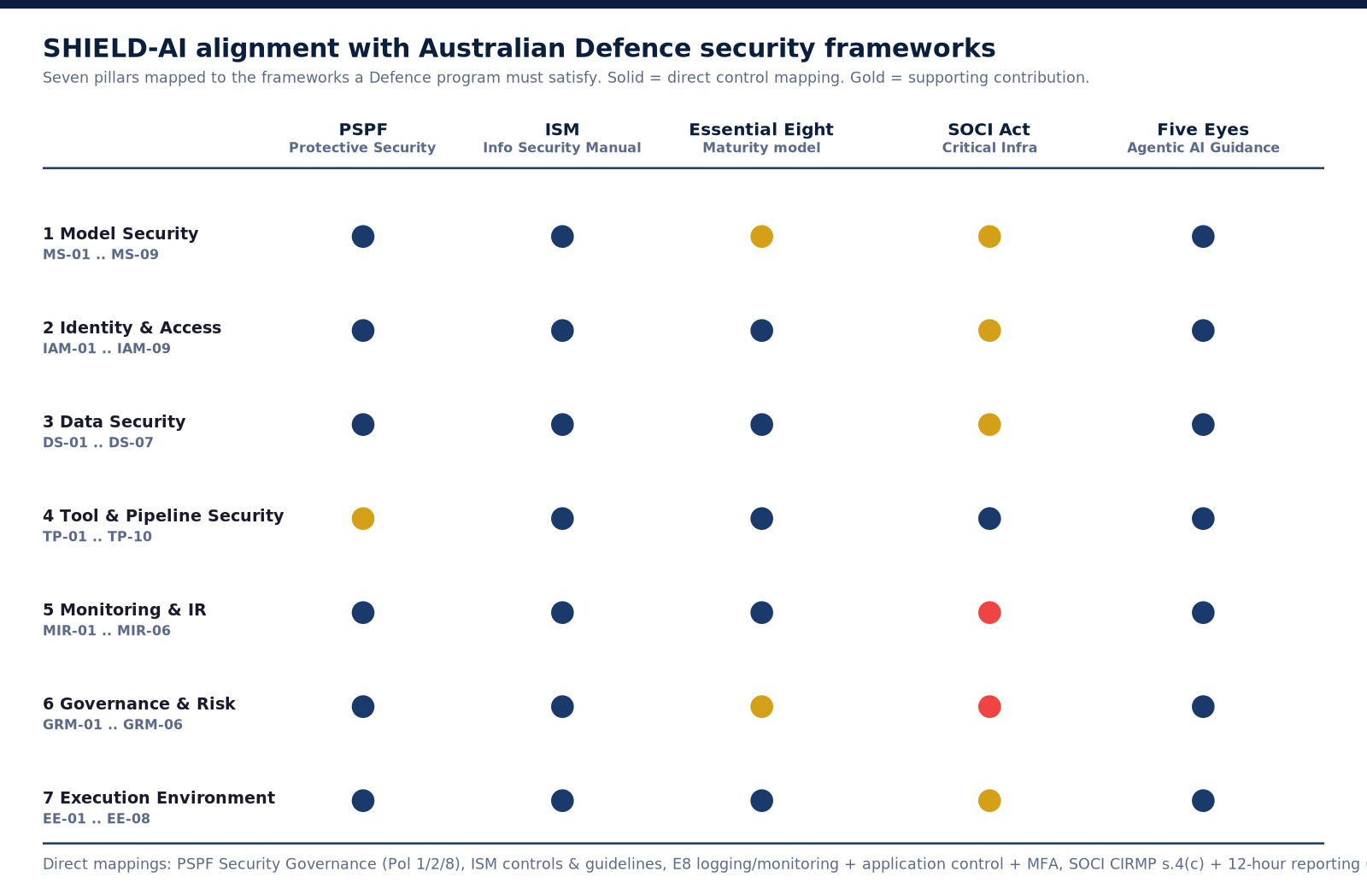
Alignment with Defence Security Frameworks
Seven pillars against PSPF, ISM, Essential Eight, SOCI, and the Five Eyes guidance
Solid: direct control mapping. Gold: supporting contribution.
SHIELD-AI | Defence Briefing | Deck v1.6 | Framework v1.8 | Aug 2026
18
Notes:
Two minutes. Every pillar maps onto a framework a Defence program already answers to. Solid dots are direct control mappings, gold dots supporting contributions. This is the accreditation conversation made concrete.

Slide 20
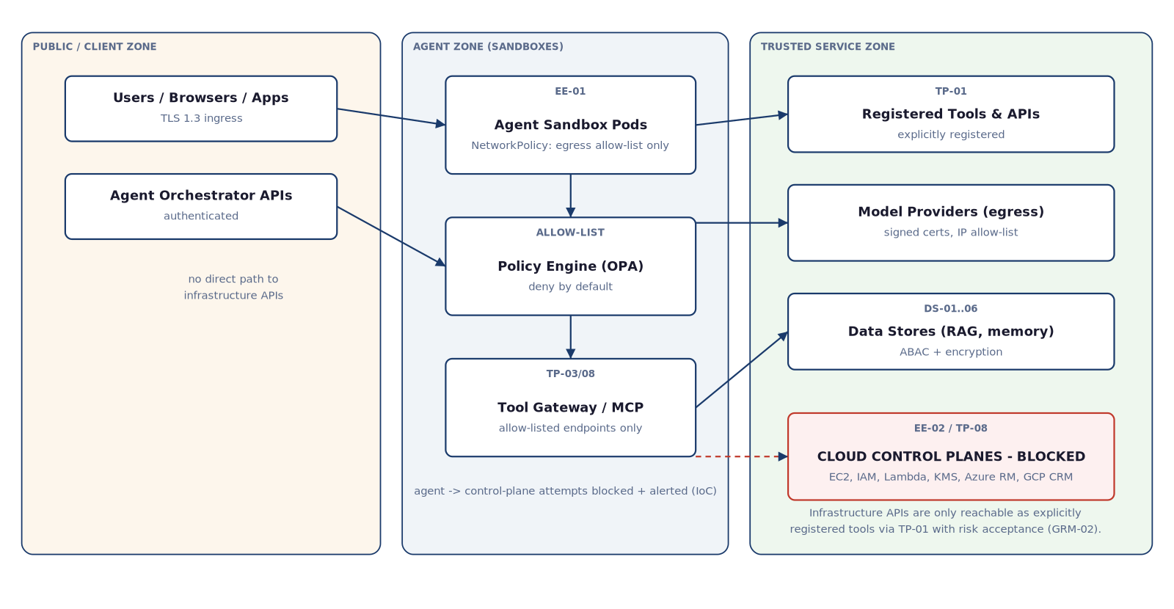
Deploying in Defence Environments
Enclave, air-gap, and sidecar topologies
SHIELD-AI | Defence Briefing | Deck v1.6 | Framework v1.8 | Aug 2026
19
Notes:
One minute. The reference implementation drops in as a sidecar in front of existing agent platforms; it does not demand a platform rebuild. The network boundary model covers enclaves and air-gapped evaluation environments.

Slide 21
The Evidence Behind the Framework
36 documented incidents drive the control set; none of this is theory
24 gaps identified (G01-G24); critical classes include:
  G14 Inbound control-plane surface: gateway hijack, approvals switched off
  G15 Imperceptible content defeating human-in-the-loop approvals
  G16 The agent as supply-chain producer: a malicious package, 15 systems affected
  G17 Evaluation-harness isolation asserted but never enforced
  G22 Poisoned logs and observability feeds turning monitoring agents into attack tools (GhostJacking)
  G23 Tools dispatched without a model turn — forged approvals at the plumbing layer (CoreBreak)
v1.5 answered with four new controls: MS-09, DS-07, TP-10, EE-08
v1.6 added two more: MS-10 (memory-store integrity) and TP-11 (agent browser isolation)
v1.7 added two more: MS-11 (operational data-stream integrity) and TP-12 (tool-call provenance and dispatch verification)
v1.8 added one more: MS-12 (MCP discovery-metadata and shared-cache integrity)
A live watchlist tracks IETF agent-to-agent standardisation, MCP exposure, on-device agents, and adversary-owned agents
SHIELD-AI | Defence Briefing | Deck v1.6 | Framework v1.8 | Aug 2026
20
Notes:
One minute. The framework updates monthly: a weekly incident watch and a monthly deep review keep the control set current. This is why it keeps pace with what attackers are actually doing instead of catching up after the fact.

Slide 22
Future Threats on the SHIELD-AI Watchlist
Six components under active monitoring; the watchlist is rebuilt monthly by the deep review
Future threat | What is happening | Why it matters to SHIELD-AI
IETF agent-to-agent (A2A) standardisation | Protocol ratification talks may normalise multi-hop agent delegation | Could defeat the two-hop delegation bound (IAM-02/07); delegation-chain amplification
Open Secure AI Alliance / NOOA | NVIDIA and 36 partners, open-sourced guidance (July 2026) | Divergence risk if NOOA guidance contradicts a SHIELD-AI control; a mapping question for GRM-05
Time-based supply-chain defences | TrapDoor (34 packages across npm, PyPI, Crates) showed token-age gates | The fresh-credential problem: agent publishers hold fresh tokens, so age-based gates miss agent-originated publication (DS-07)
Edge and on-device agents | Models like Gemma 4 12B run locally, outside the data centre | MS-09 needs a perception-channel extension (screen, OCR); on-device agents open a MIR-01 telemetry gap
Inbound MCP exposure | OX Security 'by design' flaw (200K servers, 150M downloads); Wiz research; Metasploit 6.5 now ships an MCP server | Strongest promotion candidate: extend TP-10 to standalone MCP servers
Adversary-owned autonomous agents | Unit 42 documented self-scanning campaigns; agent-as-a-service is spreading | Prevention cannot keep pace; rely on detection (MIR-02), automated response (MIR-04), and a tested kill switch (GRM-02)
Each item carries a decision gate: when the gate fires, the item is promoted from watchlist to control.
Queued for the September deep review: inbound MCP exposure (extending TP-10) and A2A standardisation (extending IAM-07).
SHIELD-AI | Defence Briefing | Deck v1.6 | Framework v1.8 | Aug 2026
SHIELD-AI | Defence Briefing | Deck v1.6 | Framework v1.8 | Aug 2026
21
21
Notes:
One minute. These are not controls yet; they are the things the framework watches month to month. Each has a decision gate, and when a gate fires the item gets promoted into a control. Two candidates are already queued for the September deep review: inbound MCP exposure, which would extend TP-10 to standalone MCP servers, and A2A standardisation, which would extend the delegation-chain controls. The full watchlist report lives in the framework documentation and is rebuilt every month.

Slide 23
Why SHIELD-AI for Defence
Sovereign: an Australian framework, aligned to the frameworks Defence already operates under
Evidence driven: 32 incidents, a monthly deep review, a live watchlist; the controls track what attackers are actually doing
Deployable: a reference implementation with policy as code, ready to run in your environment
Aligned: PSPF, ISM, Essential Eight, SOCI Act, Five Eyes Agentic AI Guidance (May 2026)
Measurable: the L1-L4 maturity model gives Defence a repeatable posture comparison across units and programs
Transparent: an open framework with no commercial lock-in, ready for independent evaluation
SHIELD-AI | Defence Briefing | Deck v1.6 | Framework v1.8 | Aug 2026
22
Notes:
One minute. Bring it back to the threat slide: this is the framework that maps the agentic threat surface onto the security language Defence already speaks.

Slide 24
What This Means in Practice
The question Defence will be asked: how is the agentic-AI capability secured under PSPF and ISM, and how do you prove it?
  The answer framework: run the 59 controls as executable policy, and an audit becomes a test run
The path from here:
  1. Posture assessment (weeks 1-4): current AI deployments scored L1-L4 against the 59 controls, with a prioritised gap list
  2. Pilot (weeks 5-8): policy-as-code enforcement on one real use case, deployed as a sidecar, no platform rebuild
  3. Rollout: extend to production workloads, wire to monitoring and audit, keep posture current through the ongoing incident watch
The framework updates weekly against a live incident watch and monthly with a deep review; it does not go stale between engagements
SHIELD-AI | Defence Briefing | Deck v1.6 | Framework v1.8 | Aug 2026
23
Notes:
One minute. Flip the regulatory story: not 'here is a framework mapped to PSPF' but 'here is what your auditor will ask, and here is how you answer it with a test run'. The three-step path is maturity-framed, not commercial.

Slide 25
Questions and Discussion
Where would an agentic-AI capability first touch your environment?
A useful next step: a posture assessment against the framework (L1-L4, all seven pillars), then a pilot of the reference implementation.
SHIELD-AI v1.7 | 7 pillars | 59 controls | policy as code | August 2026
Notes:
Two minutes. The question on the slide is the honest conversation starter. Offer the maturity assessment and the open-source reference implementation as concrete next steps; keep it in maturity terms, no commercial pitch.

