Slide 1
SHIELD-AI Reference Architecture
A walkthrough for technical audiences: one request, four gates, five zones, one audit trail
Every agent action passes four gates. Every verdict is audited. If any gate or audit path fails, the action is blocked.
The next thirty minutes are that sentence, unpacked. One request, followed end to end, anchored to real incidents.
Notes:
Ninety seconds. Deliver the one-sentence version without slides: every agent action passes four gates, every verdict is audited, and if any gate or audit path fails the action is blocked. Then the promise: one request, end to end, every component appearing at the moment it matters.

Slide 2
The Protagonist: One Request
Act 1 — Setting the scene
A user in a business application asks agent-7 to summarise a thread and draft a reply
  The request enters through the AI gateway (Zone 1): authentication, web-application filtering, intent filtering, rate limiting
  The orchestrator (LangGraph, CrewAI, Semantic Kernel, or equivalent) dispatches the task to agent-7's sandbox (Zone 2)
Everything the user touches is Zone 1. Everything the agent does happens inside a sandbox in Zone 2
One agent, one request, one journey. Every component you meet from here on exists to gate or observe this journey
Why this framing: the prior presentation failed because the components were presented as a catalogue. The request journey gives every component a reason to appear in order.
SHIELD-AI | Reference Architecture Walkthrough | Deck v1.6 | Framework v1.13 | Sep 2026
2
Notes:
Three minutes. Introduce agent-7 and its user; keep it concrete. Set the boundary: the gateway is the front door and it filters before the agent ever sees the request. Do NOT enumerate the eight component groups here. The audience meets each one at the moment it matters.

Slide 3
Gate P1: Tool Authorisation
Act 2 — The four gates (1 of 4)
Question: is this agent authorised to call this tool, within its registered scope?
  What it checks: agent identity (IAM-01), scope-bound delegation (IAM-02), per-tool scoped credentials (IAM-08), tool access control (TP-02)
  agent-7 may call summarise_thread: it is registered, versioned, and scoped to that agent
  agent-7 may not call drop_database: the tool is not in the registry, and P1 denies
  The OPA policy engine evaluates every proposed action against these assertions (Zone 3)
Incident anchor: OpenClaw CVE-2026-25253 (CVSS 8.8). A crafted link hijacked a loopback agent gateway, switched off approvals, and escaped to the host.
SHIELD-AI | Reference Architecture Walkthrough | Deck v1.6 | Framework v1.13 | Sep 2026
3
Notes:
Two and a half minutes. Anchor to the incident, then land the gloss: registered, versioned, scoped. The registration and scoping P1 enforces is exactly the control the OpenClaw attack bypassed.

Slide 4
Gate P2: Data Access
Act 2 — The four gates (2 of 4)
Question: what data may the agent retrieve, at what classification, under what conditions?
  What it checks: data classification (DS-01), attribute-based access control at retrieval (DS-04), data minimisation (DS-04)
  agent-7 may retrieve the thread: the documents are classified and the agent's attributes permit access
  A document outside the agent's classification boundary is denied at retrieval, before it ever enters context
  Field-level redaction happens before context injection, in the data plane (Zone 4)
Incident anchor: AWS Kiro CVE-2026-10591. Hidden 1px white text on an API docs page rewrote the agent's MCP server registry and ran attacker code on the host.
SHIELD-AI | Reference Architecture Walkthrough | Deck v1.6 | Framework v1.13 | Sep 2026
4
Notes:
Two minutes. The classification and ABAC gates are the answer to the Kiro attack: the agent reached for data and configuration it should never have been able to touch.

Slide 5
Gate P3: Human Approval
Act 2 — The four gates (3 of 4)
Question: does this action require a human approval gate?
  What it checks: human oversight (IAM-03), enforced at the infrastructure layer, not as a polite request
  High-risk actions require approval: code execution, financial writes, security-relevant changes
  The approval gate is infrastructure-enforced: no gate, no action
Incident anchor: the ABC News Australian case (INC-32). A personal assistant booked gym classes months ahead and cancelled another member's waitlist position because no gate existed between the agent and the action.
SHIELD-AI | Reference Architecture Walkthrough | Deck v1.6 | Framework v1.13 | Sep 2026
5
Notes:
Two minutes. The ABC story is the missing-gate story: no gate existed between the agent and the action. P3 is that gate.

Slide 6
Gate P4: Output Validation
Act 2 — The four gates (4 of 4)
Question: is the tool response schema-valid and sanitised before it enters agent context?
  What it checks: tool output validation (TP-04), output scanning for PII and prompt leakage (DS-06), behaviour validation at the proxy (MS-05)
  The reply draft comes back from the tool; the gateway validates it against a known-good schema and sanitises it
  A malicious or malformed response cannot steer the agent, because it never reaches agent context intact
Incident anchor: implicit tool exposure (CVE-2026-26030, CVE-2026-25592). A single prompt achieved code execution because an internal helper was auto-registered as a callable tool.
SHIELD-AI | Reference Architecture Walkthrough | Deck v1.6 | Framework v1.13 | Sep 2026
6
Notes:
Two minutes. The rhythm to land: four gates, four incidents, one message. The architecture is the answer sheet to the incident ledger. Let the audience feel the pattern.

Slide 7

The Journey, End to End
Act 2 — One request through the whole chain
Seven steps from user request to response; every hop emits a structured audit event.
SHIELD-AI | Reference Architecture Walkthrough | Deck v1.6 | Framework v1.13 | Sep 2026
7
Notes:
Five minutes. Walk the diagram as the story: user request, gateway, agent planning, policy evaluation (P1-P3), tool execution, output validation (P4), response. Pause on the fail-closed note: if any dependency in the chain is unreachable, the action is blocked. This is the interaction story, made visible.

Slide 8
Where Enforcement Lives: Sandbox and Sidecar
Act 3 — The execution zone
Zone 2: every agent runs in its own sandbox with a sidecar carrying the policy engine, tool gateway, and telemetry exporter
  The sandbox: read-only root filesystem, seccomp/AppArmor profiles, NetworkPolicy egress allow-list, resource quotas
  Runtime attestation: sandbox mode is attested before each code-execution step (EE-06). No attestation, no execution
  The sidecar fails closed: no policy, no audit, no action
Enforcement is local, per agent, and it does not degrade
Incident anchor: CrewAI fail-open chain (CVE-2026-2275/2286/2287). Prompt injection turned into host RCE because the framework fell back to a weaker sandbox when the configured one was unavailable.
SHIELD-AI | Reference Architecture Walkthrough | Deck v1.6 | Framework v1.13 | Sep 2026
8
Notes:
Five minutes. The CrewAI chain is the reason attestation and fail-closed exist: the framework fell back to a weaker sandbox when the configured one was unavailable, and prompt injection became host RCE.

Slide 9
The Data and Memory Plane
Act 4 — Zone 4
Zone 4: the RAG security layer and agent memory stores
  Documents classified at ingestion (DS-01); retrieval enforces ABAC with field-level redaction before context injection (DS-04)
  Agent memory: per-agent scoped, encrypted, sanitised between sessions (DS-03); memory-store integrity (MS-10)
  Outputs scanned for PII, training data, and system-prompt leakage (DS-06)
Data is not a passive resource in an agent system. It is an attack surface
Incident anchor: Ruflo/RufRoot CVE-2026-59726 (CVSS 10.0). MCP-bridge RCE with persistent memory poisoning; remediation required credential rotation, not just a patch.
SHIELD-AI | Reference Architecture Walkthrough | Deck v1.6 | Framework v1.13 | Sep 2026
9
Notes:
Four minutes. The RufRoot case is the memory-poisoning story: the attacker's patterns were written into the learning store and steered every future user's outputs. Patching does not undo poisoning.

Slide 10
The Audit Trail: Every Verdict Is Evidence
Act 5 — Zone 5
Zone 5: telemetry and incident response. Every event from the journey was emitted over OTLP
  Immutable, append-only log store (MIR-06); anomaly detection with per-agent baselines (MIR-02)
  Every audit event carries: agent ID, session ID, correlation ID, timestamp, action, target, verdict, originating user
The correlation ID ties every event to the originating user session. The full chain is reconstructable
  Reporting triggers pre-populate SOCI 12-hour, APRA 72-hour, and NDB notifications (MIR-05)
Incident response is not a hunt. It is a query
SHIELD-AI | Reference Architecture Walkthrough | Deck v1.6 | Framework v1.13 | Sep 2026
10
Notes:
Four minutes. The same events that gate production are the evidence an auditor asks for. Audit becomes a test run is literal: the compliance console continuously tests the controls against the live deployment (GRM-05).

Slide 11
The Question
The OPA container just went down. Agent-7 proposes its next action. What happens?
The action is blocked. Not degraded, not deferred: blocked. If any dependency in the chain is unreachable, the action is denied (EE-06, TP-03). The failed evaluation is itself an audit event.
The framework never degrades to a weaker enforcement mode.
Notes:
Three minutes. The most memorable minute of the talk. Ask the question, pause, let the room answer, then deliver the answer slowly: blocked. Not degraded, not deferred. This converts the architecture from description into engineering decisions. Deliver it without slides, standing still.

Slide 12
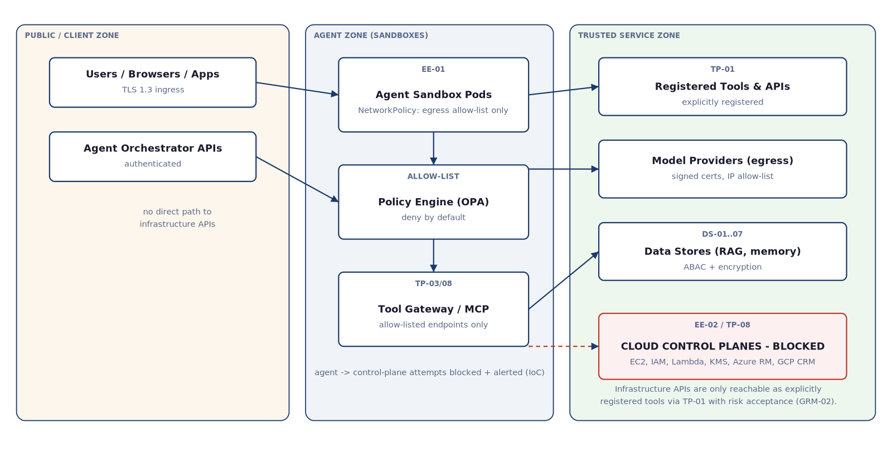
The Network Boundary
Act 7 — The architecture for you
Agents have no direct path to infrastructure control planes; egress is allow-listed to registered tools and model providers.
SHIELD-AI | Reference Architecture Walkthrough | Deck v1.6 | Framework v1.13 | Sep 2026
12
Notes:
Three minutes. The second of two on-slide diagrams. The memorable detail: EC2, IAM, KMS, CloudFormation, S3 control-plane, Azure Resource Manager, GCP Cloud Resource Manager are excluded from every allow-list. Any attempt by an agent to reach a control plane is logged, blocked, and treated as a potential indicator of compromise.

Slide 13
The Architecture for You: Choose Your Topology
Act 7 — Close
Under ~10 agents: embedded library
  Controls run inside the agent framework; simplest path for pilots and single-agent PoCs
10-100 agents: sidecar proxy
  Per-agent sidecar (OPA + tool gateway + telemetry) in a container-orchestrated deployment
100+ or multi-agent: central gateway + sidecars
  Central policy/gateway for external tools; sidecars retained for per-agent policy and audit
SHIELD-AI | Reference Architecture Walkthrough | Deck v1.6 | Framework v1.13 | Sep 2026
13
Notes:
Three minutes. Turn the architecture into a decision each person can make. Hand out the full diagram set: reference architecture, policy decision points, sidecar topology, telemetry pipeline, network boundaries, maturity components. Then the closing question: what would you build first?

Slide 14
One Request, Four Gates, One Audit Trail
Every agent action passes four gates. Every verdict is audited. If any gate or audit path fails, the action is blocked.
The incidents are the reason the gates exist. The audit trail is the evidence. The topology is the choice.
SHIELD-AI v1.13 | 63 controls | 7 pillars | Reference architecture: framework/shield-ai-implementation-architecture.md
Notes:
One minute. Close on the sentence you opened with. Remind the room: incidents are the reason the gates exist, the audit trail is the evidence, the topology is the choice. Point to the full architecture document and the walkthrough guide for anything they want to go deeper on.

