Slide 1
EventLoop을 이용한 WebServer 구현
2018.04.27
19조 Tmax
경영학부 박성우
컴퓨터공학부 데이비드
컴퓨터공학부 이승현

Slide 2
Contents
Problem Raised
Existing Problems
Approach
Architecture
Implementation Flow
Schedule
Development Environment
Current Status
Further Plan
Division of Work

Slide 3
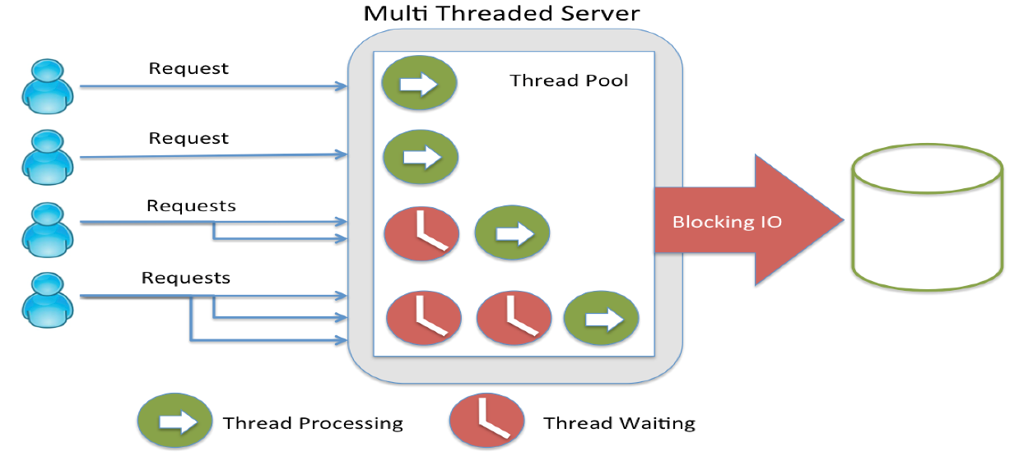
Problem Raised
1. Problem Raised
3 / 23
Vast concurrent connections to web server
• 얼마나 많은 클라이언트를 동시에 처리할 수 있는가?
• 다량의 socket이 연결될 때 하드웨어가 충분하더라도 I/O 처리방식 때문에
서버가 제대로 동작하지 않을 수 있다.

Slide 4
Existing Problems
2. Existing Problems
4 / 23
Limits of connection oriented model
• Thread pool 크기만큼의 client만을 동시에 처리 가능
• Blocking I/O로 인한 저조한 CPU utilization
• Context switch overhead로 인해 performance 저하

Slide 5
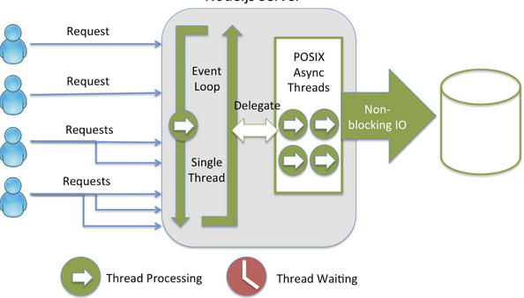
Approach
3. Approach
5 / 23
Improvements with single threaded model
• 하나의 event loop thread가 infinite loop를 돌면서 request를 전담
• Block을 유발하는 I/O는 worker thread가 대신 처리
• Context switch 없이 infinite loop를 돌면서 callback을 받아서 처리

Slide 6
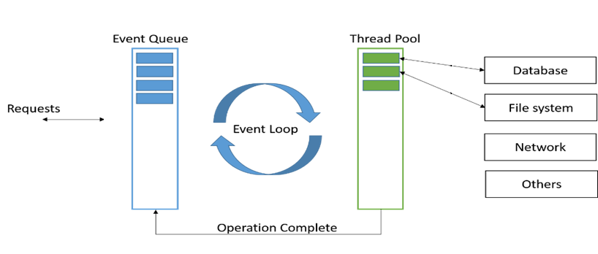
Architecture(1)
4. Architecture
6 / 23
Components of single threaded model
• Event queue ≒ to-do list
• Single event loop thread ≒ the exploited
• Internal multi thread pool ≒ helpers

Slide 7
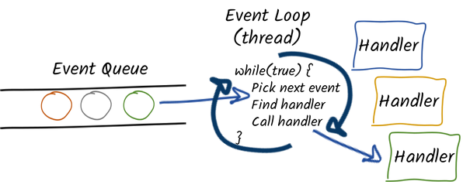
Architecture(2)
4. Architecture
7 / 23
Event loop based architecture
• Event loop는 loop를 돌 때마다 event queue에 쌓인 일을 하나씩 처리
• Blocking job은 worker thread에게 맡기고 곧바로 다른 job을 dequeue
• Worker thread가 I/O를 완료하면 다시 event queue에 enqueue

Slide 8
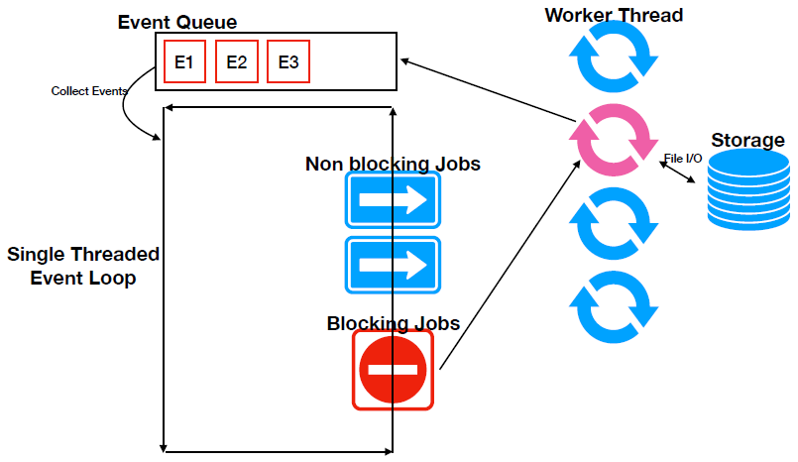
Architecture(3)
4. Architecture
8 / 23

Slide 9
Implementation Flow
5. Implementation Flow
9 / 23
HTTP Parser 구현
Request Interpreter 구현
Single Thread Loop 구현
Web Cache 구현
Socket Read & Write 구현
Event Queue 구현
Thread Pool 구현

Slide 10
Schedule
6. Schedule
10 / 23
스펙발표
중간발표
최종발표
Mar
Apr
May
Jun
스펙 구체화
HTTP Parser
Socket Connection
Request Interpreter
Event Queue
Event Loop
Thread Pool
Test
Cache
최종점검

Slide 11








Development Environment
7. Development Environment
11 / 23
운영체제 | 저장소 | 언어 | 테스트 툴 | 오픈소스

Slide 12
Current Status(1)
8. Current Status
12 / 23
Big Picture
Client
Request
Response
Server
Socket
HTTPParser
Message
Request Interpreter
Enqueue
EventQueue
Hit
ThreadPool
Cache
Analyze
Dispatch
Disk
Dequeue
 | …
EventLoop
Event
Callback
Miss

Slide 13
Current Status(2)
8. Current Status
13 / 23
Socket Binding
Client
Request
Server
Socket
HTTPParser
Message
• import java.net.ServerSocket
• import java.net.Socket
• accept(), bind(), listen(), …
Request Interpreter
Enqueue
EventQueue
Hit
ThreadPool
Cache
Analyze
Analyze
Disk
Dequeue
 | …
EventLoop
Event
Callback
Miss

Slide 14


Current Status(3)
8. Current Status
14 / 23
Socket Binding
Client
Request
Server
Socket
HTTPParser
Message
Request Interpreter
Server
Client
Enqueue
socket
socket
EventQueue
Hit
bind
ThreadPool
Cache
Disk
Dequeue
Analyze
Analyze
connect
accept
 | …
EventLoop
Event
send
receive
Callback
Miss

Slide 15

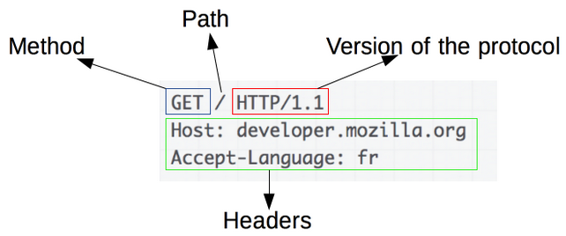
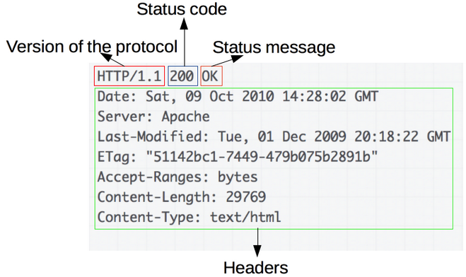
Current Status(4)
8. Current Status
15 / 23
Parser
Client
Request
Server
Socket
HTTPParser
• Event parse(Request)
• String makeResponse(respType, Event)
• respType = {supported response type}
• Event = {method, uri, connection, io}
Message
Request Interpreter
Enqueue
EventQueue
Hit
ThreadPool
Cache
Analyze
Analyze
Disk
Dequeue
 | …
EventLoop
Event
Callback
Miss

Slide 16
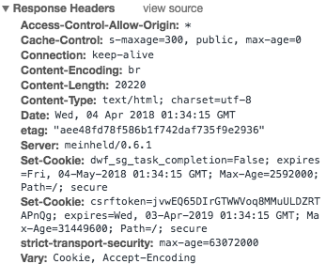
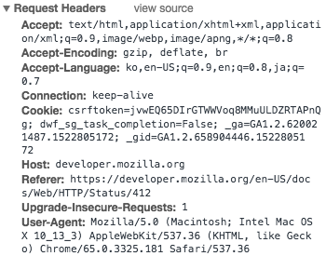
Current Status(5)
8. Current Status
16 / 23
Parser
Client
Request
Server
Socket
HTTPParser
Message
• Supported version : 1.0 / 1.1
• Supported response :
• Connection header : “keep-alive” stay connected
Request Interpreter
Enqueue
200(OK ), 304 (Not Modified )
400 (Bad Request ) , 404 (Not Found )
405 (Method Not Allowed )
500 (Service Unavailable )
EventQueue
Hit
ThreadPool
Cache
Analyze
Analyze
Disk
Dequeue
 | …
EventLoop
Event
Callback
Miss

Slide 17
Current Status(6)
8. Current Status
17 / 23
Interpreter
Client
Request
Server
Socket
HTTPParser
Message
Request Interpreter
Enqueue
Read
Request
Parse
Request
Find
Resource
File
Access
Make
Response
Socket Write
EventQueue
Hit
ThreadPool
Cache
Analyze
Analyze
Disk
Dequeue
• Job classification into 6 jobs
• 5 non blocking jobs + 1 blocking job
• Huge file access via DMA
 | …
EventLoop
Event
Callback
Miss

Slide 18
Current Status(7)
8. Current Status
18 / 23
EventQueue
Client
Request
Server
Socket
HTTPParser
Message
• void enqueue(Event)
• Event dequeue()
• int numTask(Event)
• boolean taskFinished(Event)
Request Interpreter
Enqueue
EventQueue
Hit
ThreadPool
Cache
Analyze
Analyze
Disk
Dequeue
 | …
EventLoop
Event
Callback
Miss

Slide 19
9. Further Plan
19 / 23
Further Plan(1)
Additional Implementation
Client
Request
Response
Server
Socket
HTTPParser
Message
Request Interpreter
Enqueue
EventQueue
Hit
ThreadPool
Cache
Analyze
Dispatch
Disk
Dequeue
 | …
EventLoop
Event
Callback
Miss

Slide 20
Further Plan(2)
9. Further Plan
20 / 23
Additional Implementation
Client
Request
Server
Socket
HTTPParser
Message
Request Interpreter
Enqueue
EventQueue
Hit
ThreadPool
Cache
Analyze
Dispatch
Disk
Dequeue
 | …
EventLoop
Event
Callback
Miss

Slide 21

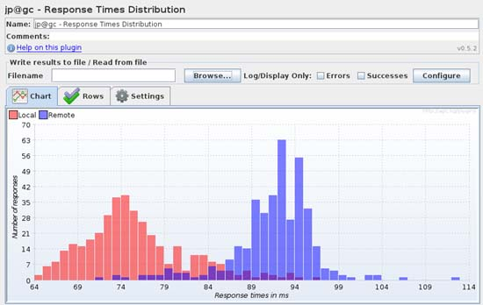
Further Plan(3)
9. Further Plan
21 / 23
Demo Plan(1)
• On browser test (Chrome) / using Apache Jmeter
• With famous asynchronous web serser
• Static file system access
• Cache policy : LRU / FIFO

Slide 22
Further Plan(4)
9. Further Plan
22 / 23
Demo Plan(2)
• Above 1MB file access : using DMA (transfer directly from disk)
• Below 1MB file access : using cache
• Load generation : number of clients
• Client Numbers : 1K, 5K, 10K, 50K, 100K, 500K, 1M, 5M, 10M, 50M
• Comparative index : average response time
• Target compare value : at least 80%

Slide 23
Division of Work
10. Division of Work
23 / 23
• 전반적인 프로젝트 관리와 일정 조율
• EventQueue 구현
• Connection header 이슈 처리
이승현
• 전반적인 프로젝트 관리와 일정 조율
• 소켓 프로그래밍 관련 이슈 담당
• HTTP Parser, Interpreter 구현
박성우
• 테스트 구성 및 오픈소스 코드 스크랩
• 소켓 프로토콜, 초기 개발환경 구축
• Job Classification 및 Type, 코드 리뷰
David

Slide 24
감사합니다

