Slide 1

within-host canine h3n2 project
Stock viruses and synthetic controls QC
07/22/2025

Slide 2
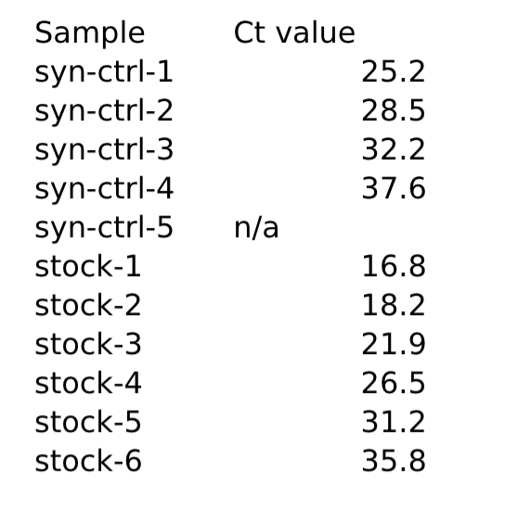
Stocks are labeled:
Canine H3N2 6/17/15 Expansion from NVSL stock

Slide 3
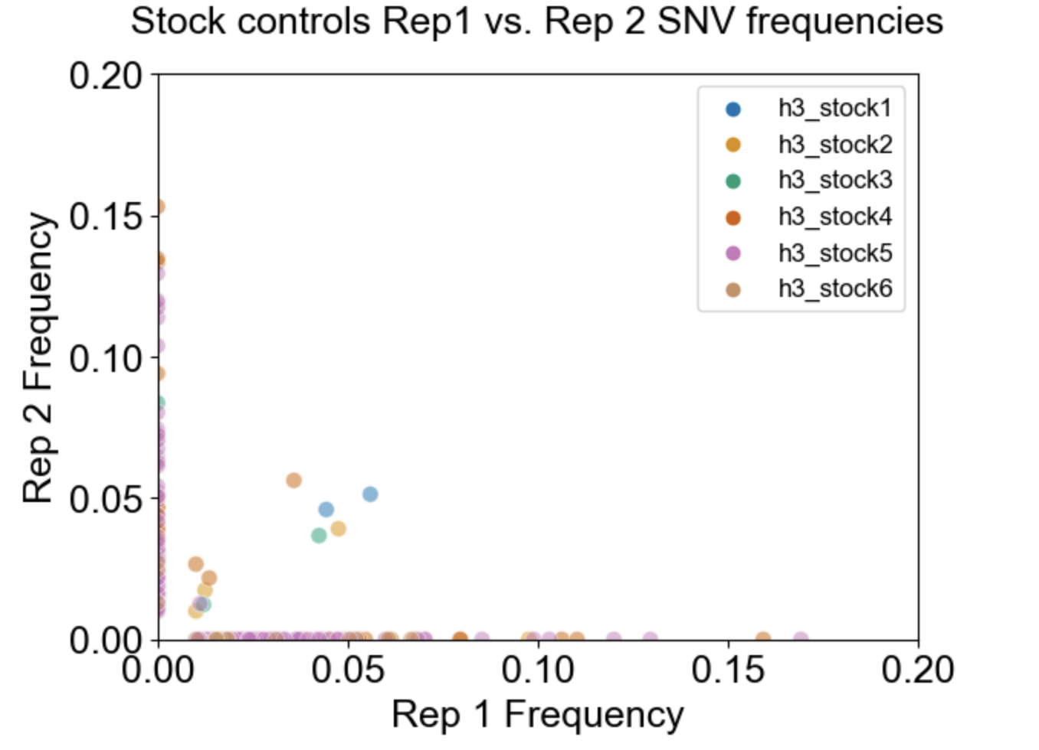
11 shared variants between stock virus replicates
High frequency single variants belong to higher diluted stock virus samples
= GOOD!

Slide 4
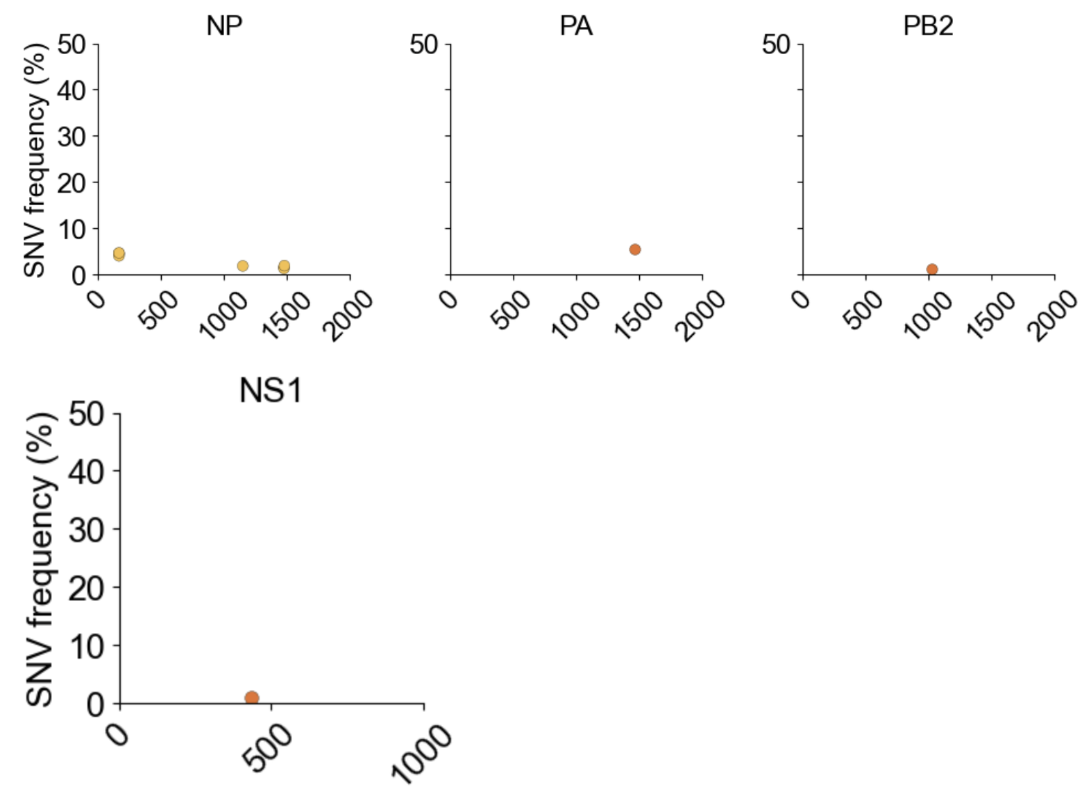
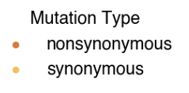
Shared SNVs between reps by gene

Slide 5
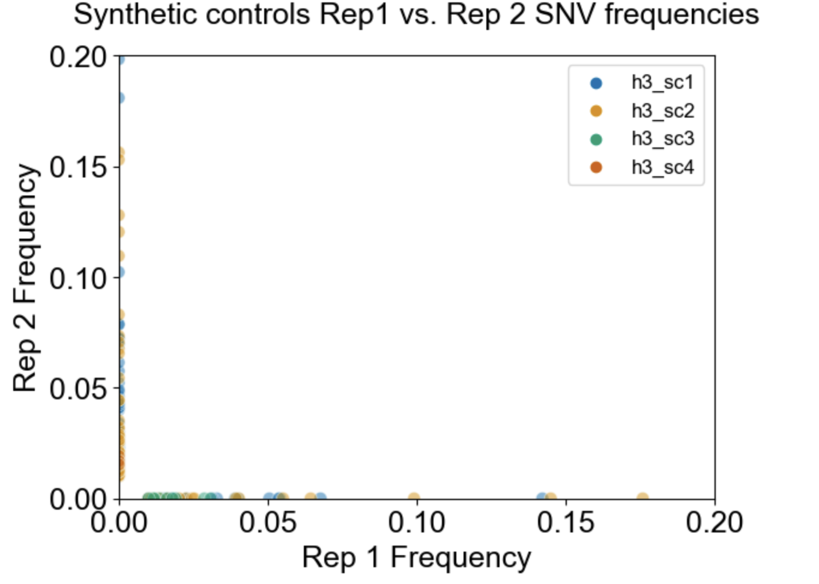
No shared variants between synthetic control reps = GOOD!
However, higher frequency single variants seem to belong to samples with lower dilutions

Slide 6
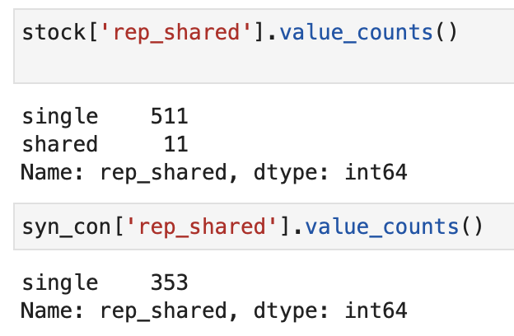
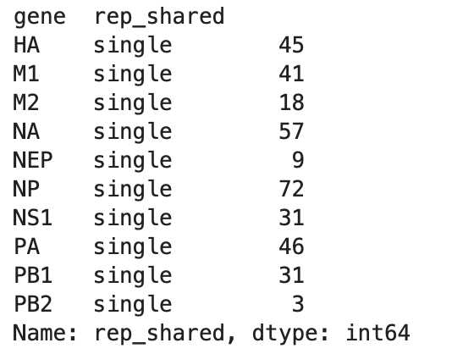
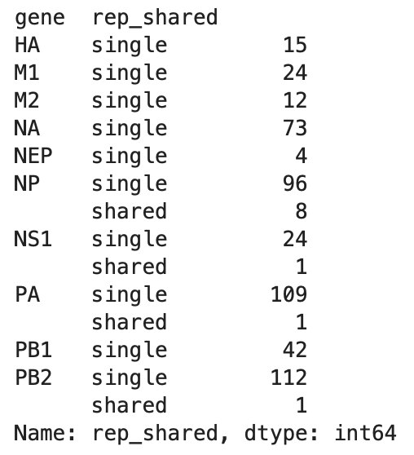
syn
stock

Slide 7
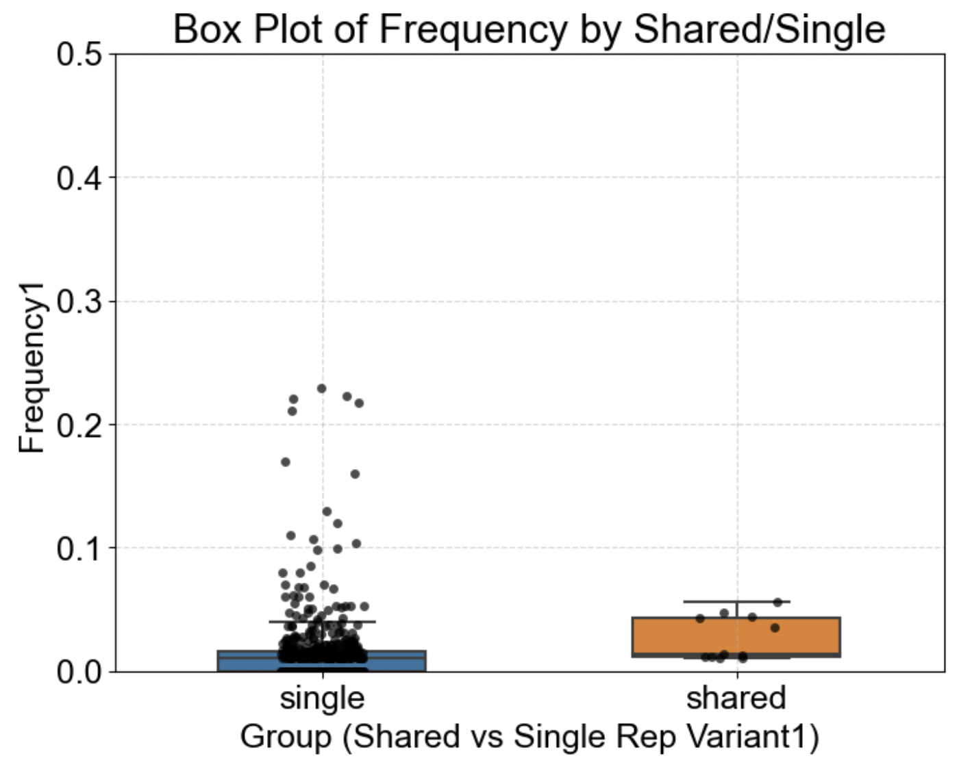
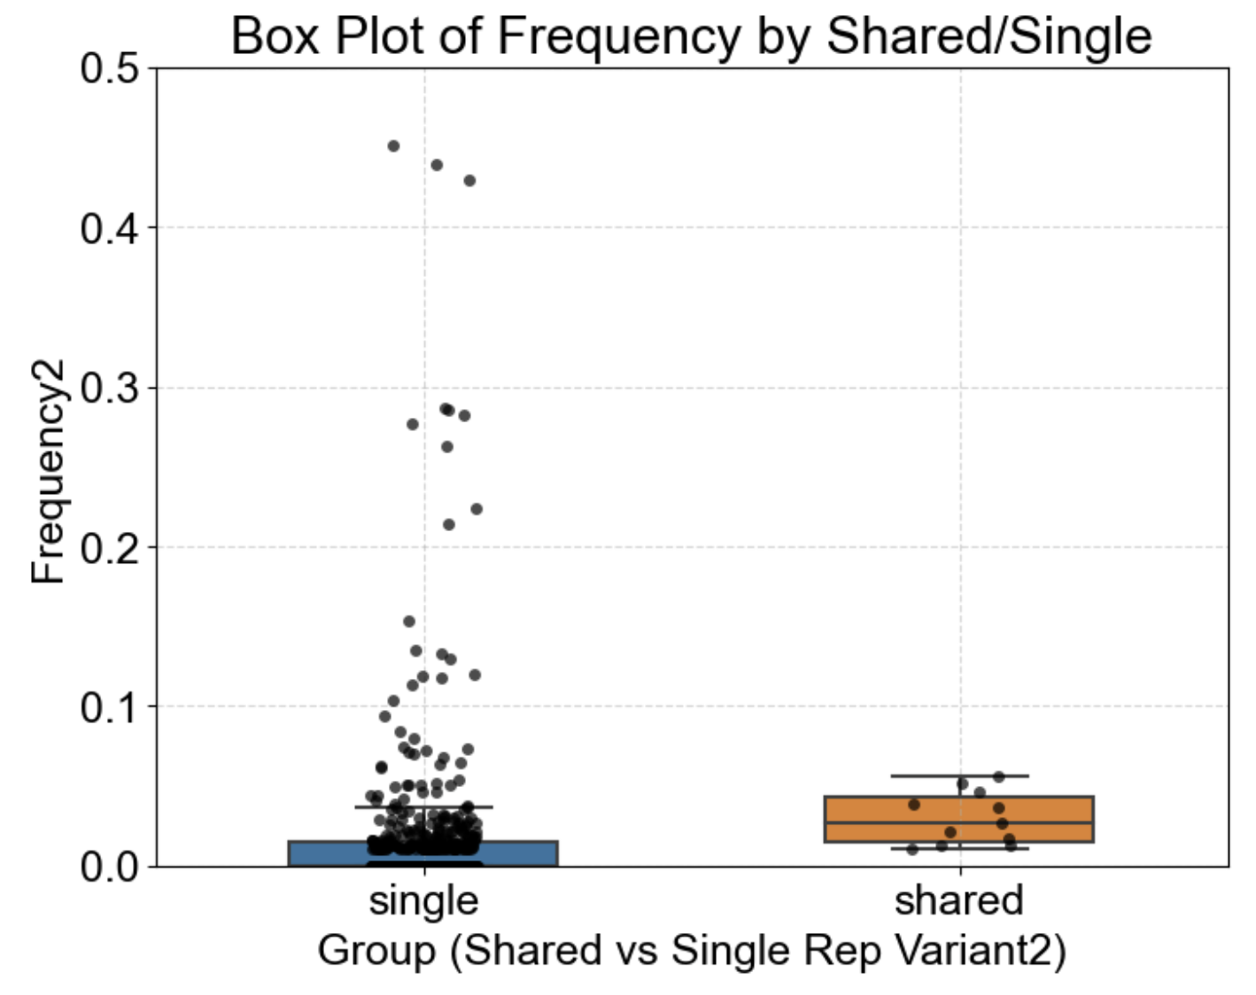
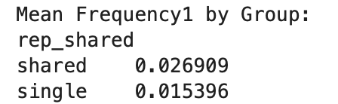
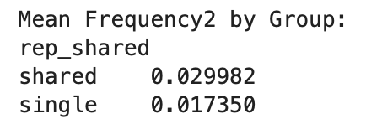
Frequency of variants per replicate
Notes:
stock

Slide 8
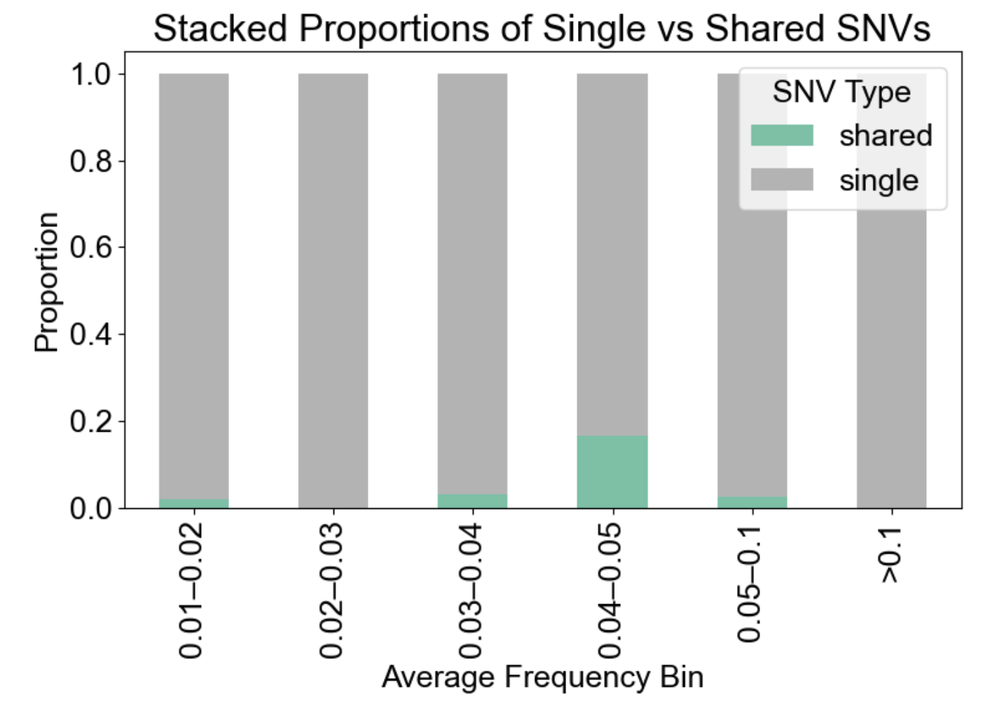

Slide 9
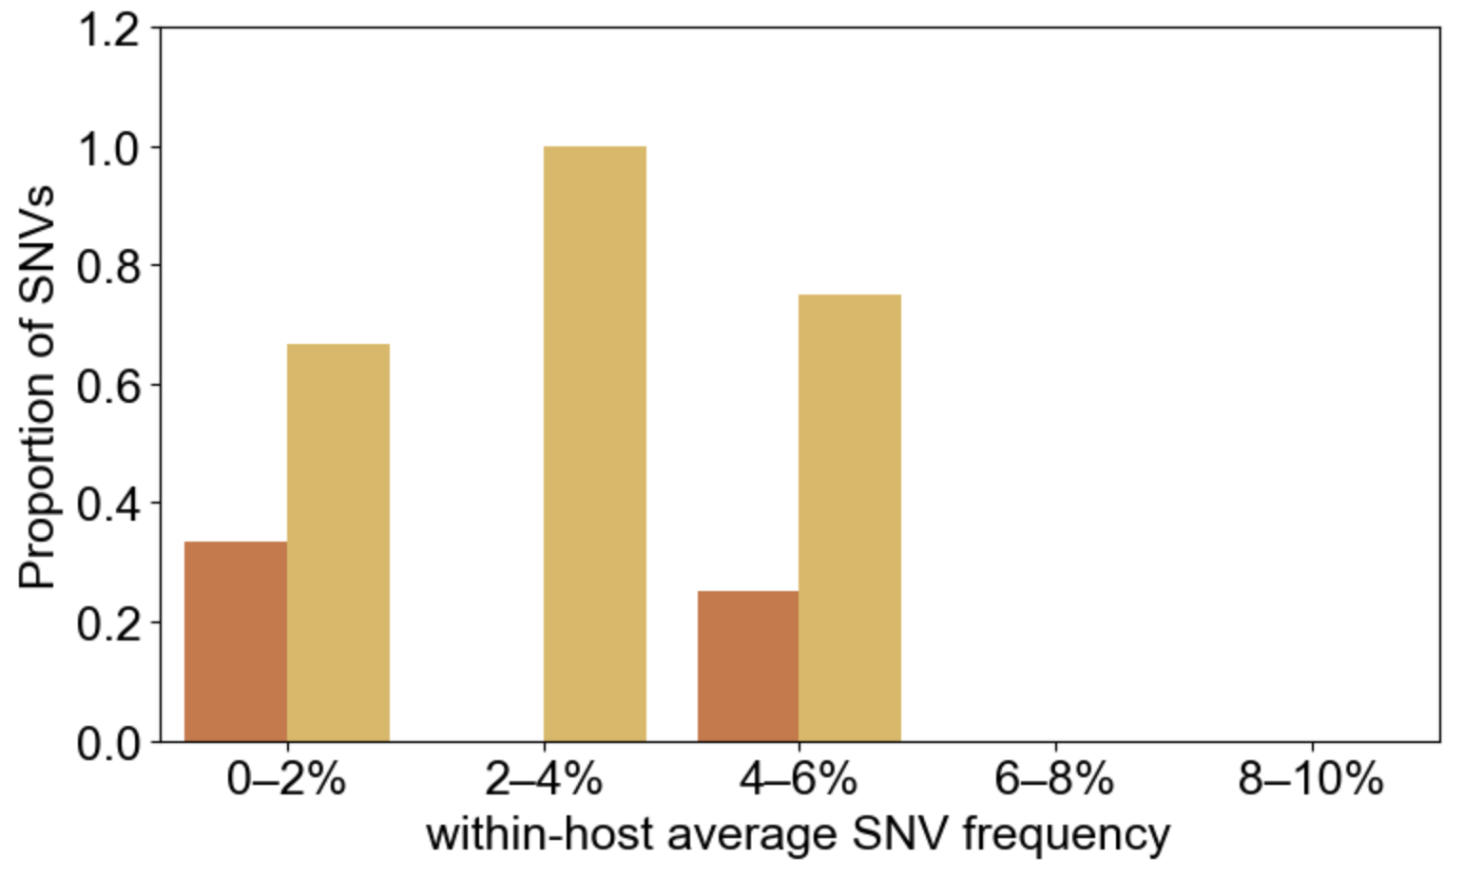
SNVs shared between replicates
nonsyn
syn

Slide 10
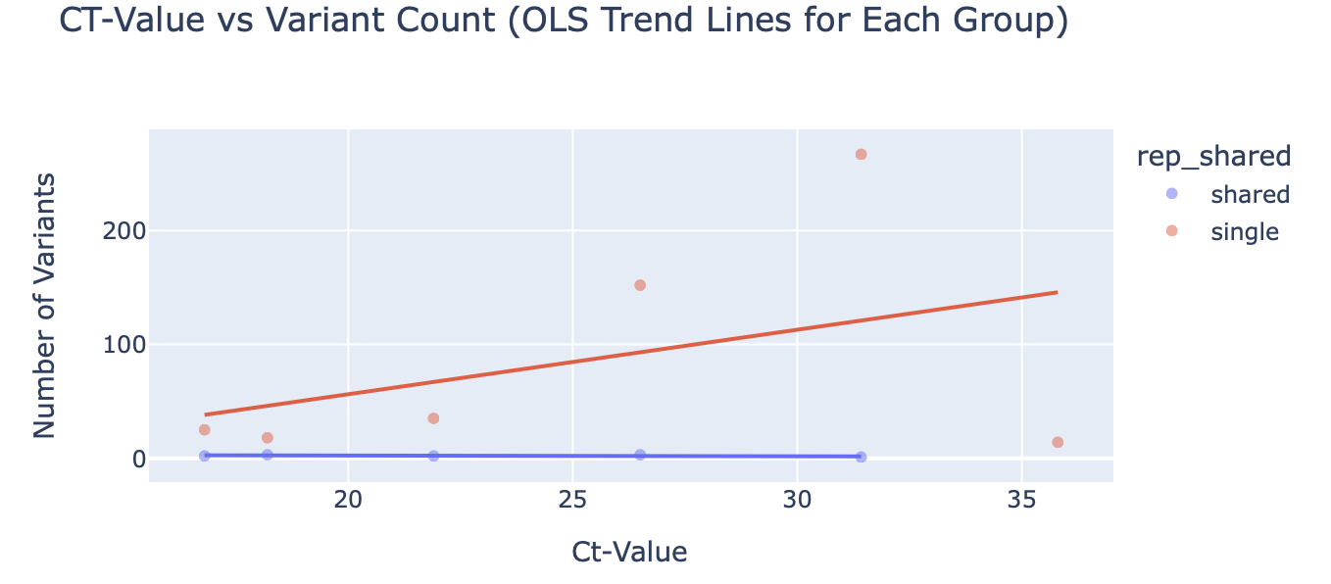
in stock viruses
As the ct-value goes up (less virus), the the amount of single variants also goes up! Which is what you want to see

Slide 11
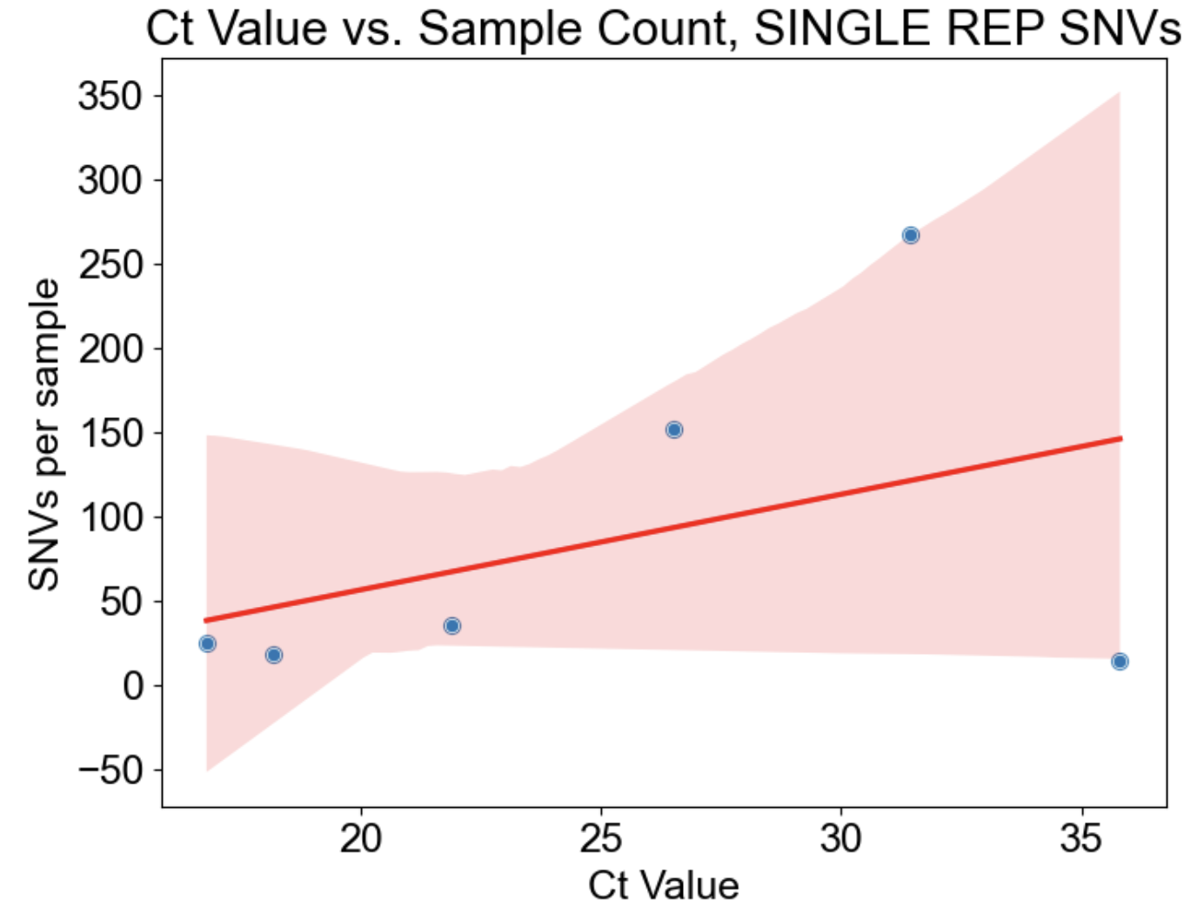
in stock viruses
As ct values go up, number of single variants goes up (except for last ct value)

Slide 12
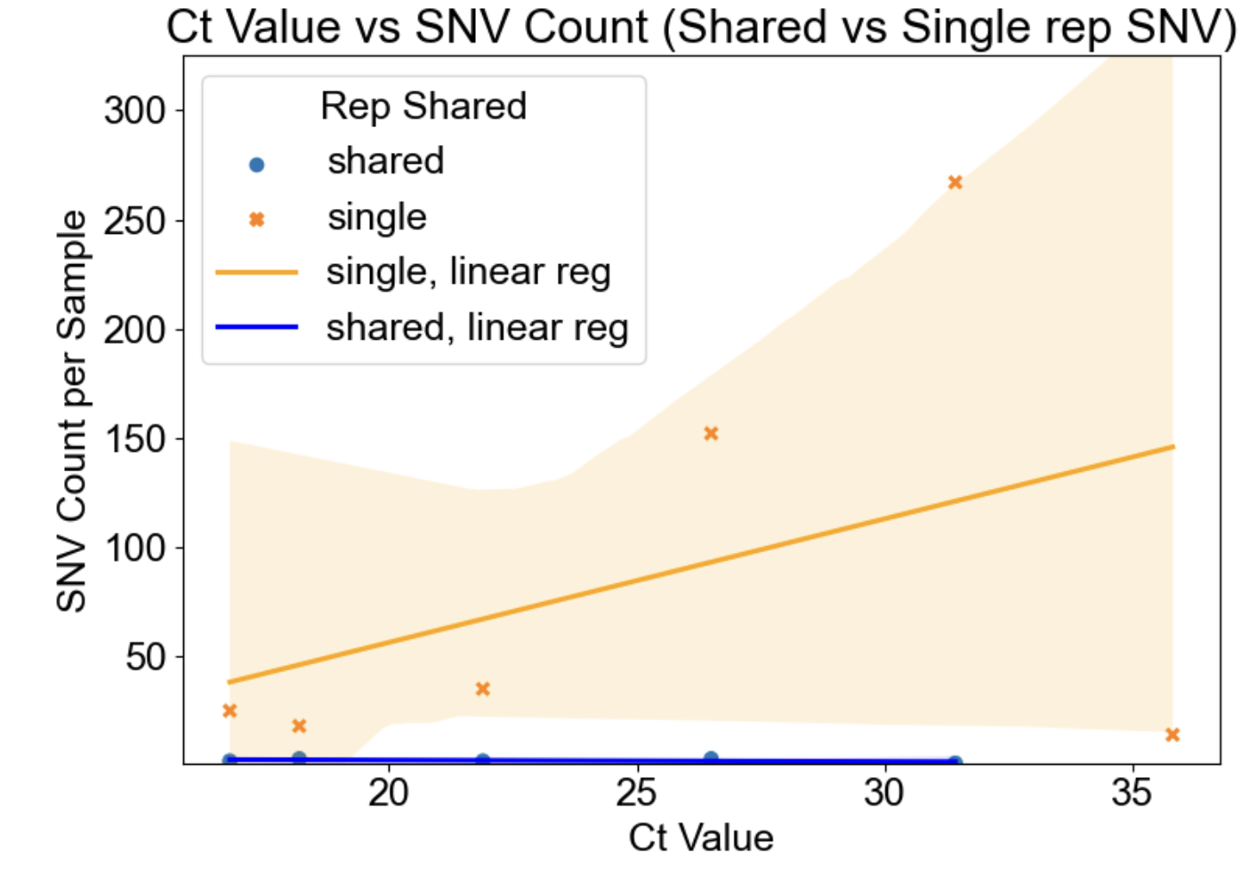
in stock viruses
Same plot as last slide but with shared variants as well

Slide 13
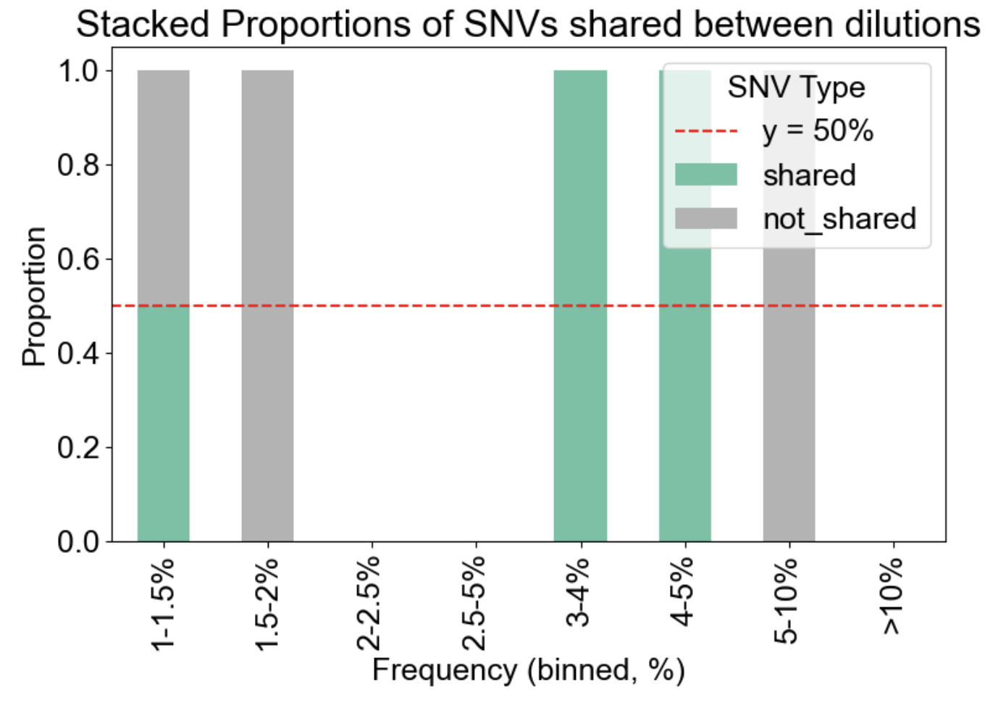
*there are only 11 shared variants
Looking at variants SHARED between replicated – are they also shared between different dilutions of the stock?
If a variant is real, it should be in the other dilutions as well since it is using the same stock virus

Slide 14
Only 2 shared variants between samples
NP_56 (shows up in 4 samples)
NP_493 (shows up in 2 samples)
['PA_489' 'NS1_145' 'NP_384' 'NP_494' 'PB2_342’] are variants shared between replicates but NOT shared between dilutions

