Slide 1
On-demand Traffic light control
-Content.
System description.
System design.
System flowchart.
Constraints.

Slide 2
1.System description.
This system is a simulation of the traffic
lights, with a pedestrian button to allow the pedestrian to cross the street, when the pedestrian press the button.

Slide 3
1.System description.
For the regular mood the traffic lights changed every 5 seconds sequentially.
CARS :green ,yellow (blink 1s) ,red.
Pedestrian:Red , yellow (blink 1s),green
If the Pedestrian Button is Pressed while the pedestrian red light is on the yellow light will Blinking for 5 s then the green led will be on for 5s if the pedestrian button is pressed again after 3s from turning the green led on it will reset the 5s again before the 3s it will do nothing.

Slide 4
1.System description.
If the Pedestrian Button is Pressed while the pedestrian yellow is blinking it will stay until the 5s is finished then the green light becomes on if the pedestrian button is pressed again after 3s from turning the green led on it will reset the 5s again before the 3s it will do nothing.
If the pedestrian green light is on and the button is pressed the 5s will reset again if the pedestrian button is pressed again after 3s from turning the green led on it will reset the 5s again before the 3s it will do nothing.

Slide 5
2.System design.
The system is designed by two main layers
.Microcontroller abstraction layer .Application layer.
Microcontroller abstraction layer.
this layer content of three Drivers (digital input-output ,external interrupt ,timer_0)

Slide 6
2.System design.
Application layer.
this layer content of two main functions initialization function that initializes the Drivers by calling the required functions from the MCAL layer, the second function is the ablation function is the app start function this function controls the output bins valued depending on which status is running. and two interrupt functions for the Pedestrian button and timer overflow interrupt function for counting the time.

Slide 7
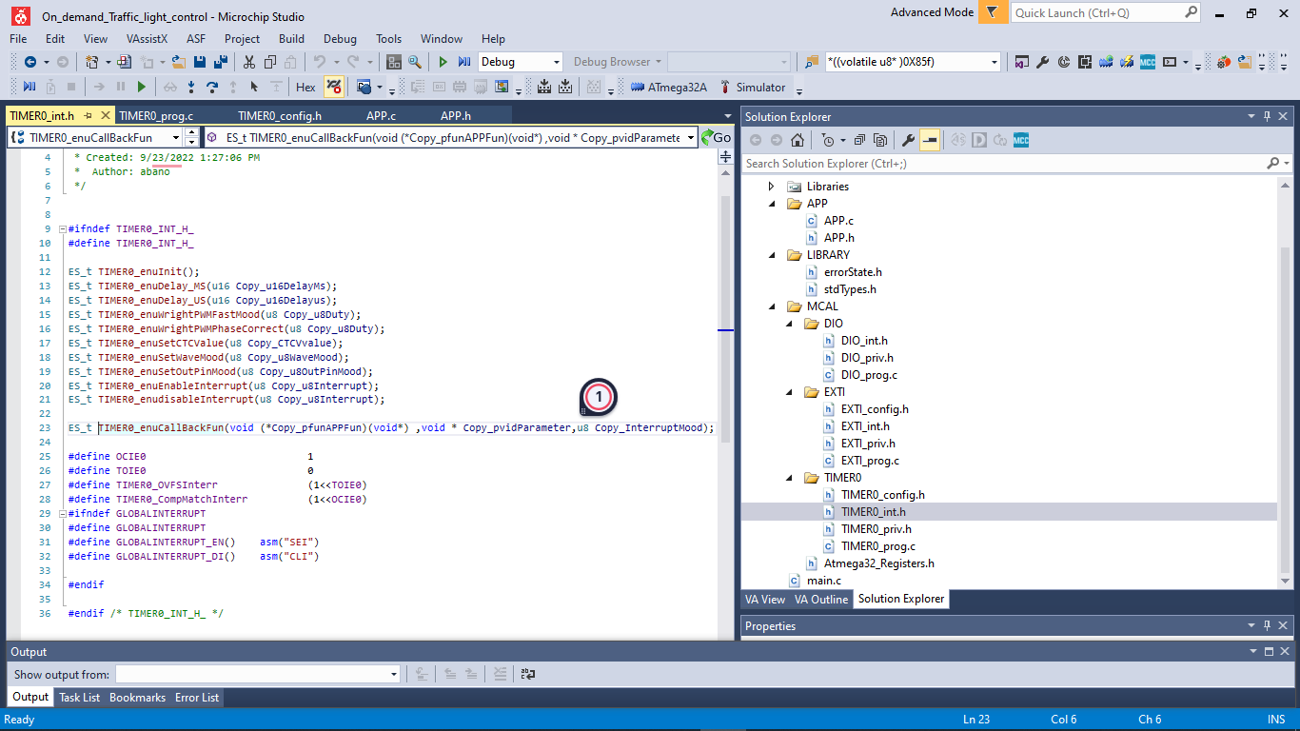
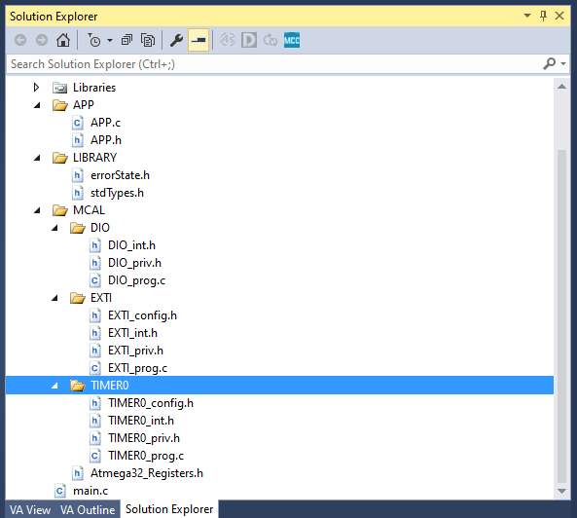
2.System design.

Slide 8
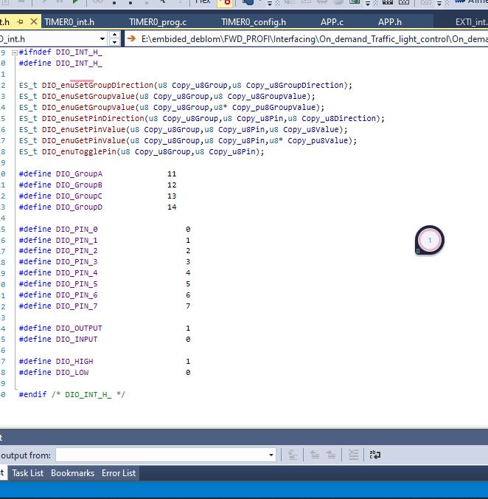
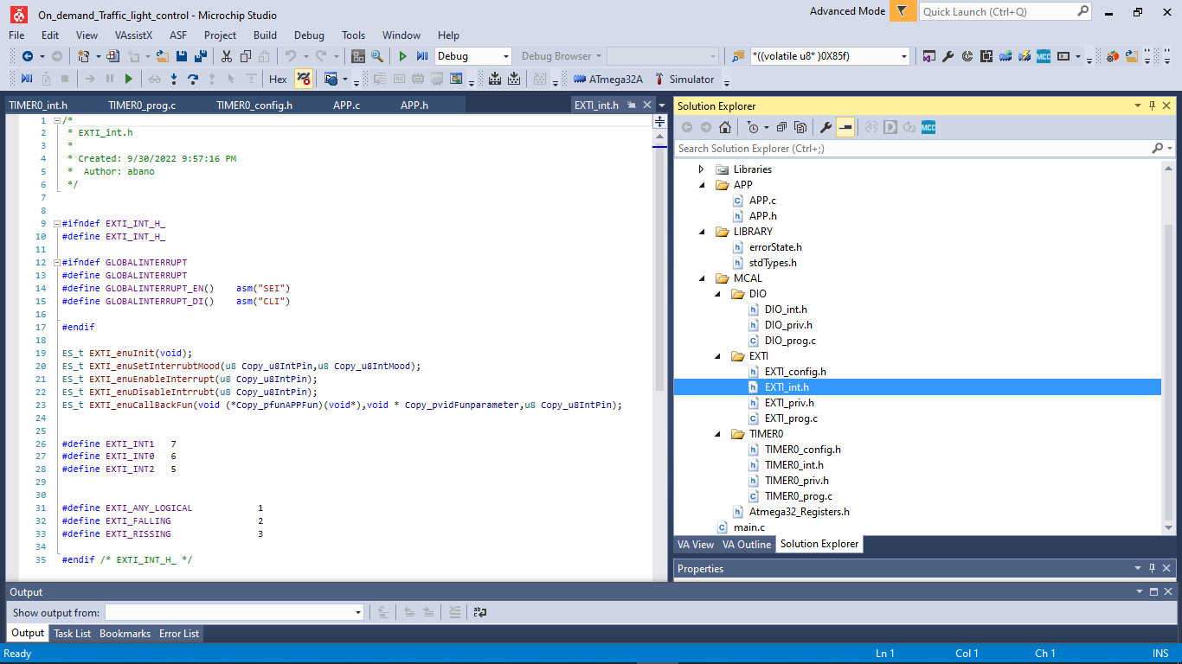
2.System design.

Slide 9
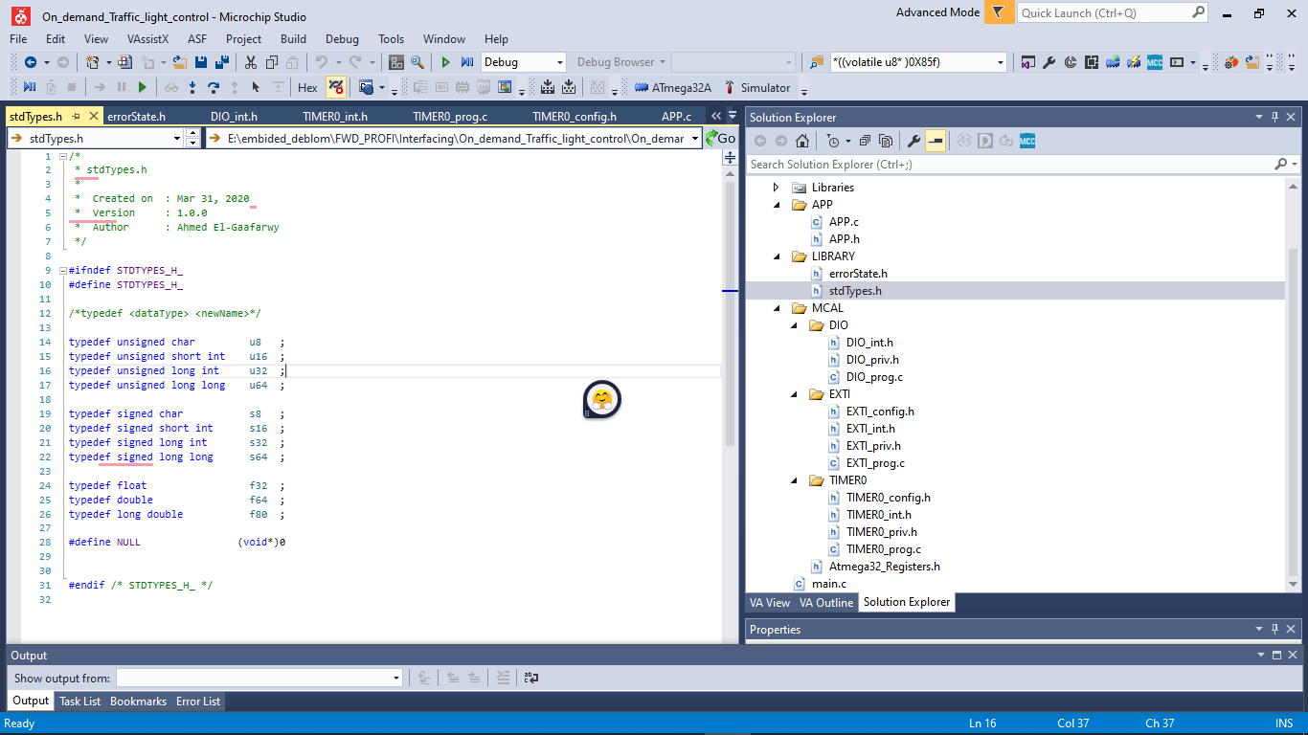
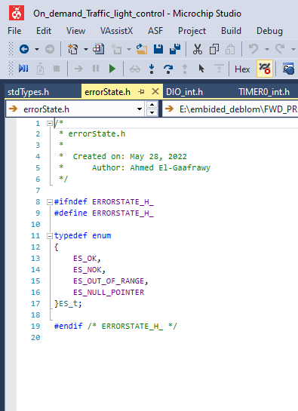
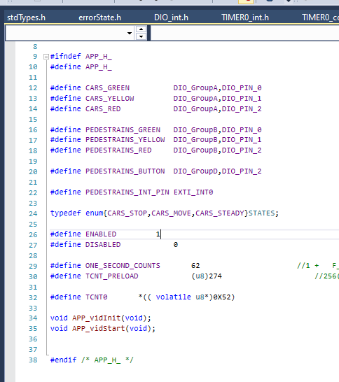
2.System design.

Slide 10
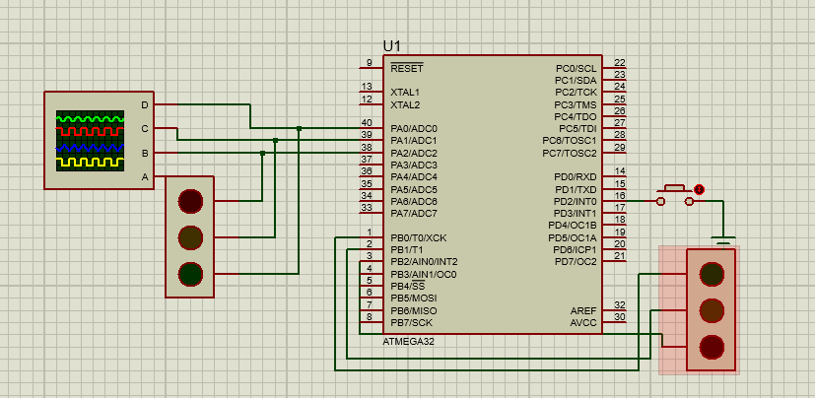
2.System design.

Slide 11
3.System flowchart.
OVF_ISR
CARS_GREEN_on
PEDESTRAINS_RED_on
Counting Ticks.
Delay 5 s
If (counts =1s)
CARS_YELLOW
PEDESTRAINS_YELLOW
Blinking
Blinking flag for the yellow led
Delay 5 s
Five sec--
PEDESTRAINS_GREEN_on
CARS_RED_on
If (5s =0)
Delay 5 s
Update one of the three states.

Slide 12
3.System flowchart.
INT0
If (green cars led on)
If yellow blink
If car red led on
Change to yellow blink and reset timer
Set the next state is car red led on
Reset the timer
Back to APP statr

Slide 13
4.System constraints .
If the user holds the pedestrian button the system will never go into pedestrian mode.
double click on the pedestrian button the first will operate all clicks that come after the first click will be neglected till the green light for the pedestrian is switched on for 3s.

