Slide 1



inputs
: WTSystem
id: WT1
name: Eolo
version: 1.0
params
param
output
outputs
: SystemParam
: WTCtrl
: SystemOutput
id: GeneratorCoolingTempLimit1
value: 100
id: CoolingFan1
type: FanCtrl
cycle: low
id: GeneratorFan1Activator
: SystemInput
input
id: GeneratorTemparature
input
: SystemParam
: WTCtrl
: SystemOutput
id: GeneratorCoolingTempLimit2 value: 120
id: CoolingFan2
type: FanCtrl
cycle: high
id: GeneratorFan2Activator
param
output
inputs
: WTSystem
inputs
: WTSystem
id: WT1
name: Eolo
version: 1.0
id: WT1
name: Eolo
version: 1.0
params
param
output
outputs
params
param
output
outputs
: SystemParam
: WTCtrl
: SystemOutput
: SystemParam
: WTCtrl
: SystemOutput
id: GeneratorCoolingTempLimit1
value: 100
id: CoolingFan1
type: FanCtrl
cycle: low
id: GeneratorFan1Activator
id: GeneratorCoolingTempLimit1
value: 100
id: CoolingFan1
type: FanCtrl
cycle: high
id: GeneratorFan1Activator
: SystemInput
input
cycle: high
: SystemInput
input
cycle: medium
id: GeneratorTemparature
input
id: GeneratorTemparature
: SystemParam
: WTCtrl
: SystemOutput
: SystemParam
: WTCtrl
: SystemOutput
id: GeneratorCoolingTempLimit2 value: 120
param
id: CoolingFan2
type: FanCtrl
cycle: high
id: GeneratorFan2Activator
id: GeneratorCoolingTempLimit2 value: 120
id: CoolingFan2
type: FanCtrl
cycle: high
id: GeneratorFan2Activator
output
: WTCtrl
: SystemOutput
param
id: CoolingPump
type: PumpCtrl
cycle: high
id: GeneratorPump2Activator
output

Slide 2
Original
inputs
: WTSystem
model: WT1
name: Eolo
version: 1.0
params
param
output
outputs
: SystemParam
: WTCtrl
: SystemOutput
id: GeneratorCoolingTempLimit1
value: 100
id: CoolingFan1
type: FanCtrl
cycle: high
id: GeneratorFan1Activator
: SystemInput
input
id: GeneratorTemparature
input
: SystemParam
: WTCtrl
: SystemOutput
id: GeneratorCoolingTempLimit2 value: 120
id: CoolingFan2
type: FanCtrl
cycle: high
id: GeneratorFan2Activator
param
output

Slide 3


Alice
inputs
: WTSystem
inputs
: WTSystem
model: WT1
name: Eolo
version: 1.0
model: #
name: #
version: #
params
param
output
outputs
params
param
: SystemParam
: WTCtrl
: SystemOutput
: SystemParam
: WTCtrl
id: GeneratorCoolingTempLimit1
value: 100
id: CoolingFan1
type: FanCtrl
cycle: high
id: GeneratorFan1Activator
id: GeneratorCoolingTempLimit1
value: 100
id: CoolingFan1
type: FanCtrl
cycle: low
: SystemInput
input
: SystemInput
input
cycle: high
id: GeneratorTemparature
input
id: GeneratorTemparature
input
: SystemParam
: WTCtrl
: SystemOutput
: SystemParam
: WTCtrl
id: GeneratorCoolingTempLimit2 value: 120
id: CoolingFan2
type: FanCtrl
cycle: high
id: GeneratorFan2Activator
id: GeneratorCoolingTempLimit2 value: 120
param
id: CoolingFan2
type: FanCtrl
cycle: high
param
output

Slide 4
Bob
inputs
: WTSystem
: WTSystem
model: WT1
name: Eolo
version: 1.0
model: #
name: #
version: #
params
param
output
outputs
params
param
output
outputs
: SystemParam
: WTCtrl
: SystemOutput
: SystemParam
: WTCtrl
: SystemOutput
id: GeneratorCoolingTempLimit1
value: 100
id: CoolingFan1
type: FanCtrl
cycle: high
id: GeneratorFan1Activator
id: GeneratorCoolingTempLimit1
value: 100
id: CoolingFan1
type: FanCtrl
cycle: high
id: GeneratorFan1Activator
: SystemInput
input
cycle: medium
id: GeneratorTemparature
input
: SystemParam
: WTCtrl
: SystemOutput
: SystemParam
: WTCtrl
: SystemOutput
id: GeneratorCoolingTempLimit2 value: 120
id: CoolingFan2
type: FanCtrl
cycle: high
id: GeneratorFan2Activator
id: GeneratorCoolingTempLimit2 value: 120
id: CoolingFan2
type: FanCtrl
cycle: high
id: GeneratorFan2Activator
param
output
: WTCtrl
: SystemOutput
param
id: CoolingPump
type: PumpCtrl
cycle: high
id: GeneratorPump2Activator
output

Slide 5
Gold Repository
http://mondo.inf.mit.bme.hu/svn/gold
User: admin, Password: admin
Contains 2 projects:
test.project.with.model
Stores a model
macl.project
Stores the access control policies
Only the admin has right to modify the policies
Start an eclipse and checkout the projects

Slide 6
Filtered models
Alice’s eclipse
Start Eclipse
Connect to svn
http://mondo.inf.mit.bme.hu/svn/front1
user: alice, pw: alice
Checkout projects
Bob’s eclipse
Start Eclipse
Connect to svn
http://mondo.inf.mit.bme.hu/svn/front2
user: alice, pw: alice
Checkout projects

Slide 7

Commit new changes
In Alice’s eclipse
Open model file
Modify the model
Save
In Admin’s eclipse
Update project
Right click on project / Team / Update
Open model
Check the changes

Slide 8
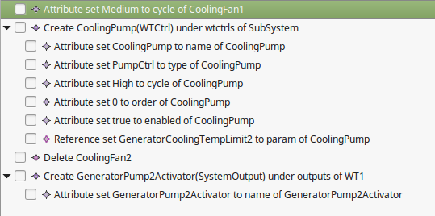
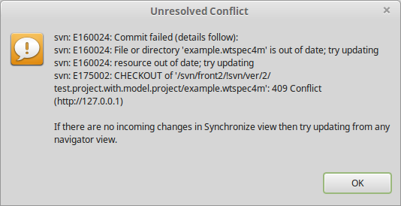
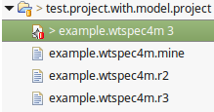
Create conflict
In Bob’s eclipse
Open model file
Modify the model (don’t forget to set the id of new objects)
SaveRight click on project / Team /Commit
Right click on project / Team / Update

Slide 9
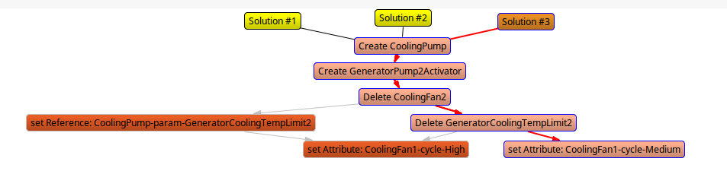
Resolve conflicts
In Bob’s eclipse
Right click on file / Team / Edit Conflicts
Select all local and remote changes
Calculate Solutions
Select a solution
Click on Solution #3 (Zest View), then click on the “Apply” button
Right click on a solution (Tree view) “select solution”
Save
Right click on the file / Team / Mark as merged
Right click on the file / Team / Commit

Slide 10
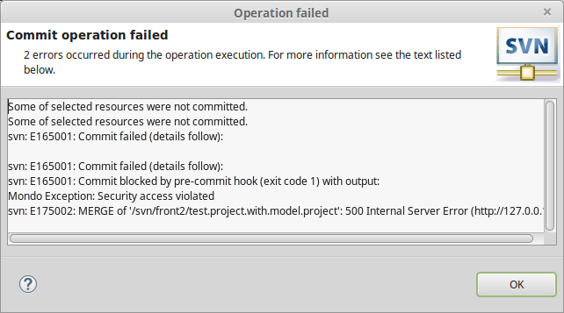
Violate security access rules
In Bob’s eclipse
Open the model
Add a new “System Input” object to the model
Right click on the file / Team / Commit

Slide 11
Server configuration
Ssh: root@mondo.inf.mit.bme.hu
Svn config:
/etc/subversion/
access.control -> access control settings
svn.users -> users and their password
add user -> sudo htpasswd –m /etcsubversion/svn.users <username>
/etc/httpd/conf.d/subversion.conf

Slide 12
Mondo Configuration
Mondo scripts
~/mondo/scripts/mondo-server-utils/svn
create-repositories.sh <config.properties> <front_list.properties>
delete-repositories.sh <path to gold repo>
add-front-repositories.sh <config.properties> <front_list.properties>
remove-front-repositories.sh <path to front repo> [path to another one]
Example properties files
~/mondo/scripts/mondo-server-utils/svn/config.properties
~/mondo/scripts/mondo-server-utils/svn/front_list.properties

