Slide 1
Data Stories: Introduction - R examples

Slide 2
Setup your environment
As I said in class, you have to worry a bit about your working environment. The following chunck shows you how you could change that. However, I have simplified things a bit (from what you saw in class) to make it easier for to begin with.
For that to work you have to keep all your data files in a directory called that and all the code files (such as this one) in a directory that sits in the same sub directory. e.g. if you have a directory “data stories course” you want to have in there a directory called “data”" with the data files and a directory “code” with the code files.
Note that by default in a markdown document (i.e. an Rmd document…things are a bit different in a R document) the default active working directory is always the directory where the document is stored. So below when I load data, this is what I assume; e.g. I will load “../data/foreigners.dta”. Note that this tells the computer that to find the file you need to go one level up (that’s what “..” means) and then you go down again in the “data” directory
print("hello world")
## [1] "hello world"
7/6
## [1] 1.166667
when we print something shows up
#mydir=paste0(dropbox_path,'/teaching/data stories') # set this according to what applies on your computer mydir=getwd() print(mydir)
## [1] "C:/Users/Ralf Martin/Dropbox/datastories/datastorieshub/code"
# e.g. mydir="c:/user/Rproject1/" setwd(mydir) # This is how you set a working directory in normal R code getwd()
## [1] "C:/Users/Ralf Martin/Dropbox/datastories/datastorieshub/code"
knitr::opts_knit$set(root.dir = getwd(), verbose = TRUE) # This makes sure you keep the same directory in subsequent chuncks of code

Slide 3
Some playing
v1=runif(100) v2=runif(100)+v1 plot(v1,v2)

Slide 4
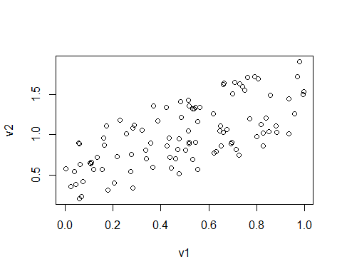

Slide 5
Migrants
Since they gained power in 2010 the UK Tory Junta have led a relentless campaign of scapegoating immigrants for their policy failures. Part of this is the suggestion that increased levels of immigration lead to more crime. Here we explore to what extent there is actually any evidence in the data for this.
Load the Data
getwd()
## [1] "C:/Users/Ralf Martin/Dropbox/datastories/datastorieshub/code"
library(haven) # make sure libraries such as this are installed. If not go to Tools -> Install Packages #df=read_dta("../data/foreigners.dta") #ralf<-read_dta("../data/foreigners.dta") df=read.csv("https://www.dropbox.com/s/g1w75gkw7g91zef/foreigners.csv?dl=1")
some stuff I wrote…
print(3/7)
## [1] 0.4285714
Prepare Data
newv=runif(20) #df['test']=newv/df$pop11 summary(df)
## X crimes11 b_migr11 pop11 ## Min. : 1.00 Min. : 1134 Min. : 2.241 Min. : 2203 ## 1st Qu.: 87.75 1st Qu.: 107618 1st Qu.: 4.899 1st Qu.: 94263 ## Median :174.50 Median : 160556 Median : 7.603 Median : 125746 ## Mean :174.50 Mean : 236988 Mean :11.226 Mean : 161434 ## 3rd Qu.:261.25 3rd Qu.: 309377 3rd Qu.:12.382 3rd Qu.: 200247 ## Max. :348.00 Max. :1714295 Max. :55.161 Max. :1072372 ## NA's :24 NA's :9 NA's :9 ## area ## : 9 ## Adur : 1 ## Allerdale : 1 ## Amber Valley: 1 ## Arun : 1 ## Ashfield : 1 ## (Other) :334
summary(df$crimes11)
## Min. 1st Qu. Median Mean 3rd Qu. Max. NA's ## 1134 107618 160556 236988 309377 1714295 24
summary(df$pop11)
## Min. 1st Qu. Median Mean 3rd Qu. Max. NA's ## 2203 94263 125746 161434 200247 1072372 9
crimes11=df$crimes11 summary(crimes11)
## Min. 1st Qu. Median Mean 3rd Qu. Max. NA's ## 1134 107618 160556 236988 309377 1714295 24
df['crimesPc']=df$crimes11/df$pop11
Look at data
A scatter plot
plot(df$b_migr11,df$crimesPc) library(ggplot2)

Slide 6
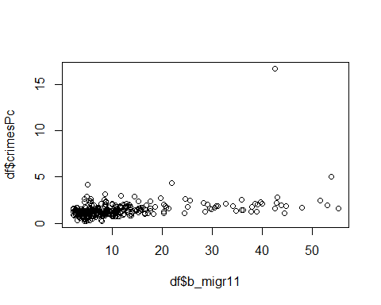

Slide 7
ggplot(df, aes(x = b_migr11, y = crimesPc)) + geom_point()+theme_minimal()+ xlab("% foreign born")+ylab("# of crimes per capita")
## Warning: Removed 24 rows containing missing values (geom_point).

Slide 8
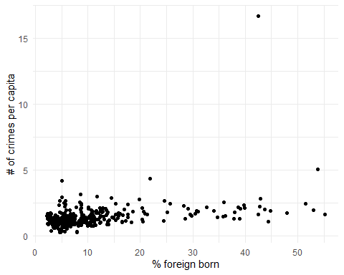

Slide 9
How about leaving the City of London out?
df[df$crimesPc>5,"area"]
## [1] <NA> <NA> <NA> <NA> <NA> ## [6] <NA> <NA> <NA> <NA> <NA> ## [11] <NA> <NA> <NA> <NA> <NA> ## [16] City of London Westminster <NA> <NA> <NA> ## [21] <NA> <NA> <NA> <NA> <NA> ## [26] <NA> ## 340 Levels: Adur Allerdale Amber Valley Arun Ashfield ... York
df[df$crimesPc>4.5,"area"]
## [1] <NA> <NA> <NA> <NA> <NA> ## [6] <NA> <NA> <NA> <NA> <NA> ## [11] <NA> <NA> <NA> <NA> <NA> ## [16] City of London Westminster <NA> <NA> <NA> ## [21] <NA> <NA> <NA> <NA> <NA> ## [26] <NA> ## 340 Levels: Adur Allerdale Amber Valley Arun Ashfield ... York
df[df$crimesPc>4.5,c("area","crimesPc")]
## area crimesPc ## NA <NA> NA ## NA.1 <NA> NA ## NA.2 <NA> NA ## NA.3 <NA> NA ## NA.4 <NA> NA ## NA.5 <NA> NA ## NA.6 <NA> NA ## NA.7 <NA> NA ## NA.8 <NA> NA ## NA.9 <NA> NA ## NA.10 <NA> NA ## NA.11 <NA> NA ## NA.12 <NA> NA ## NA.13 <NA> NA ## NA.14 <NA> NA ## 285 City of London 16.690982 ## 317 Westminster 5.030381 ## NA.15 <NA> NA ## NA.16 <NA> NA ## NA.17 <NA> NA ## NA.18 <NA> NA ## NA.19 <NA> NA ## NA.20 <NA> NA ## NA.21 <NA> NA ## NA.22 <NA> NA ## NA.23 <NA> NA
dfx = df[df$crimesPc<10,] ggplot(dfx, aes(x = b_migr11, y = crimesPc)) + geom_point()+theme_minimal()+ xlab("% foreign born")+ylab("# of Crimes per capita")
## Warning: Removed 24 rows containing missing values (geom_point).

Slide 10
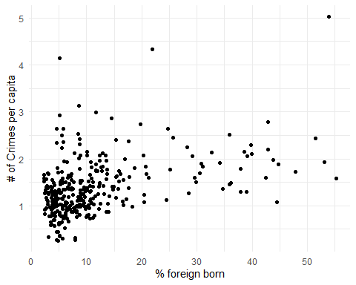

Slide 11
What about a correlation?
library(dplyr)
## ## Attaching package: 'dplyr'
## The following objects are masked from 'package:stats': ## ## filter, lag
## The following objects are masked from 'package:base': ## ## intersect, setdiff, setequal, union
#summary(ralf$crimes11) cor(df[,c("crimes11","crimesPc","b_migr11")],use="complete.obs")
## crimes11 crimesPc b_migr11 ## crimes11 1.0000000 0.3101539 0.4874797 ## crimesPc 0.3101539 1.0000000 0.3810661 ## b_migr11 0.4874797 0.3810661 1.0000000
cor(dfx[,c("crimesPc","b_migr11")],use="complete.obs")
## crimesPc b_migr11 ## crimesPc 1.0000000 0.4331594 ## b_migr11 0.4331594 1.0000000
df %>% select(crimesPc,b_migr11) %>% cor(use="complete.obs")
## crimesPc b_migr11 ## crimesPc 1.0000000 0.3810661 ## b_migr11 0.3810661 1.0000000
library(corrr) test=df %>% select(crimesPc,b_migr11) df %>% select(crimesPc,b_migr11) %>% correlate()
## ## Correlation method: 'pearson' ## Missing treated using: 'pairwise.complete.obs'
## # A tibble: 2 x 3 ## rowname crimesPc b_migr11 ## <chr> <dbl> <dbl> ## 1 crimesPc NA 0.381 ## 2 b_migr11 0.381 NA
Or trend line?
library(ggplot2) ggplot(df, aes(x = b_migr11, y = crimesPc)) + geom_smooth(method = "lm", se = FALSE) + geom_point()+theme_minimal()+ xlab("% foreign born")+ylab("# of Crimes per capita")
## `geom_smooth()` using formula 'y ~ x'
## Warning: Removed 24 rows containing non-finite values (stat_smooth).
## Warning: Removed 24 rows containing missing values (geom_point).

Slide 12
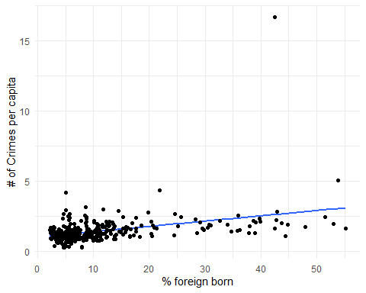

Slide 13
reg1=lm(crimesPc~b_migr11,df) reg1_df=df[-reg1$na.action,] # get rid of missing values summary(reg1)
## ## Call: ## lm(formula = crimesPc ~ b_migr11, data = df) ## ## Residuals: ## Min 1Q Median 3Q Max ## -1.5886 -0.3789 -0.1038 0.2046 14.0988 ## ## Coefficients: ## Estimate Std. Error t value Pr(>|t|) ## (Intercept) 0.992957 0.079387 12.508 < 2e-16 *** ## b_migr11 0.037630 0.005088 7.396 1.23e-12 *** ## --- ## Signif. codes: 0 '***' 0.001 '**' 0.01 '*' 0.05 '.' 0.1 ' ' 1 ## ## Residual standard error: 0.9674 on 322 degrees of freedom ## (24 observations deleted due to missingness) ## Multiple R-squared: 0.1452, Adjusted R-squared: 0.1426 ## F-statistic: 54.7 on 1 and 322 DF, p-value: 1.226e-12
summary(df$b_migr11)
## Min. 1st Qu. Median Mean 3rd Qu. Max. NA's ## 2.241 4.899 7.603 11.226 12.382 55.161 9
#summary(lm(crimesPc~b_migr11,dfx))
Notice that the residulas from a regression are not correlated
reg1_df['residuals']= reg1$residuals cor(reg1_df[,c("residuals","b_migr11")],use="complete.obs")
## residuals b_migr11 ## residuals 1.000000e+00 -2.474525e-17 ## b_migr11 -2.474525e-17 1.000000e+00
ggplot(reg1_df, aes(x = b_migr11, y = residuals)) + geom_smooth(method = "lm", se = FALSE) + geom_point()+theme_minimal()+ xlab("% foreign born")+ylab("Regression residuals")
## `geom_smooth()` using formula 'y ~ x'

Slide 14
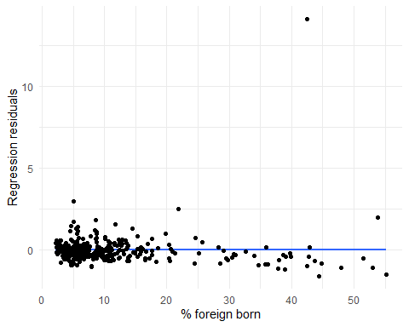

Slide 15
Some further perspectives on the data
Just some basic numbers
#library(psych) #describe(df$crimesPc) #describe(df$b_migr11) library(Hmisc)
## Loading required package: lattice
## Loading required package: survival
## Loading required package: Formula
## ## Attaching package: 'Hmisc'
## The following objects are masked from 'package:dplyr': ## ## src, summarize
## The following objects are masked from 'package:base': ## ## format.pval, units
Hmisc::describe(df[,c("b_migr11","crimesPc")])
## df[, c("b_migr11", "crimesPc")] ## ## 2 Variables 348 Observations ## -------------------------------------------------------------------------------- ## b_migr11 ## n missing distinct Info Mean Gmd .05 .10 ## 339 9 339 1 11.23 9.593 3.013 3.687 ## .25 .50 .75 .90 .95 ## 4.899 7.603 12.382 25.201 38.024 ## ## lowest : 2.240523 2.279650 2.342227 2.361519 2.373362 ## highest: 47.886591 51.521316 53.043116 53.820812 55.161434 ## -------------------------------------------------------------------------------- ## crimesPc ## n missing distinct Info Mean Gmd .05 .10 ## 324 24 324 1 1.425 0.7209 0.6406 0.7759 ## .25 .50 .75 .90 .95 ## 0.9905 1.2901 1.6582 2.1164 2.4465 ## ## lowest : 0.2544352 0.2669489 0.2685578 0.3042361 0.3114384 ## highest: 3.1323595 4.1454223 4.3277037 5.0303810 16.6909820 ## ## Value 0.2 0.4 0.6 0.8 1.0 1.2 1.4 1.6 1.8 2.0 2.2 ## Frequency 3 7 12 32 64 46 49 38 22 17 10 ## Proportion 0.009 0.022 0.037 0.099 0.198 0.142 0.151 0.117 0.068 0.052 0.031 ## ## Value 2.4 2.6 2.8 3.0 3.2 4.2 4.4 5.0 16.6 ## Frequency 9 5 3 2 1 1 1 1 1 ## Proportion 0.028 0.015 0.009 0.006 0.003 0.003 0.003 0.003 0.003 ## ## For the frequency table, variable is rounded to the nearest 0.2 ## --------------------------------------------------------------------------------
summary(df$b_migr11)
## Min. 1st Qu. Median Mean 3rd Qu. Max. NA's ## 2.241 4.899 7.603 11.226 12.382 55.161 9
summary(df$crimesPc)
## Min. 1st Qu. Median Mean 3rd Qu. Max. NA's ## 0.2544 0.9905 1.2901 1.4251 1.6582 16.6910 24
library(scales) library(magrittr) ggplot(data = df, aes(b_migr11)) + geom_histogram( bins=30, aes(y = ..density.., fill=..count..)) + geom_density()+theme_minimal()
## Warning: Removed 9 rows containing non-finite values (stat_bin).
## Warning: Removed 9 rows containing non-finite values (stat_density).

Slide 16
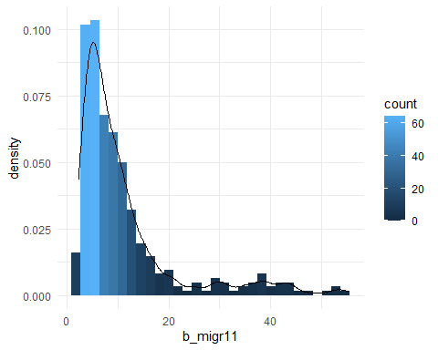

Slide 17
ggplot(data = df, aes(crimesPc)) + geom_histogram( bins=30, aes(y = ..density.., fill=..count..)) + geom_density()+theme_minimal()
## Warning: Removed 24 rows containing non-finite values (stat_bin).
## Warning: Removed 24 rows containing non-finite values (stat_density).

Slide 18
