Slide 1

Predicting Personal Loan Acceptance
An End-to-End Machine Learning Pipeline — from raw customer data to real-time prediction at scale.

Slide 2
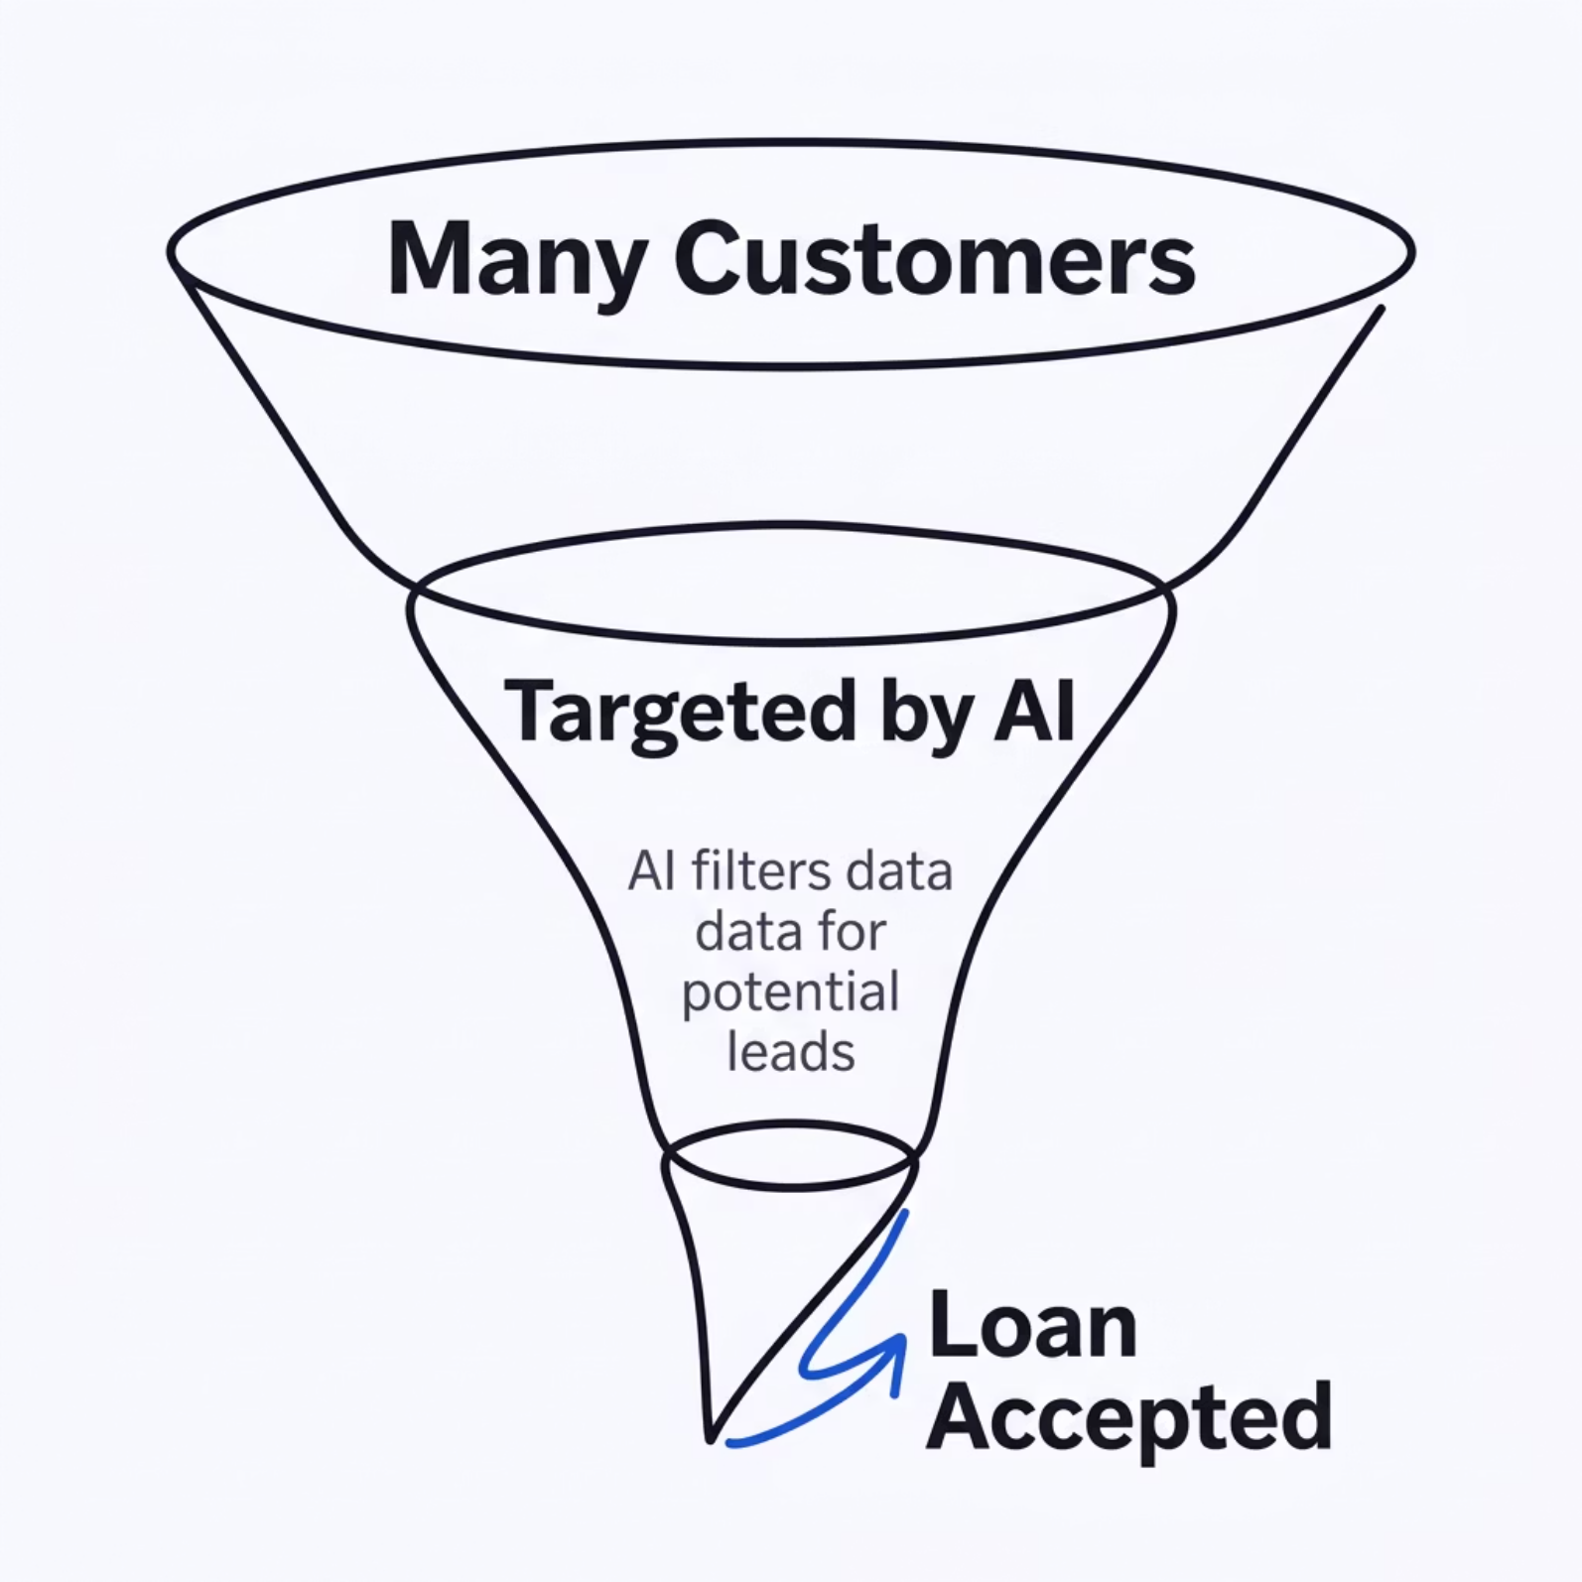

The Business Problem
Banks invest heavily in campaigns to convert liability customers (depositors) into asset customers (borrowers). Broad outreach is expensive — and most of it misses.
The goal: build an AI model that identifies exactly which customers are most likely to accept a personal loan offer, cutting waste and maximizing conversion.

Slide 3
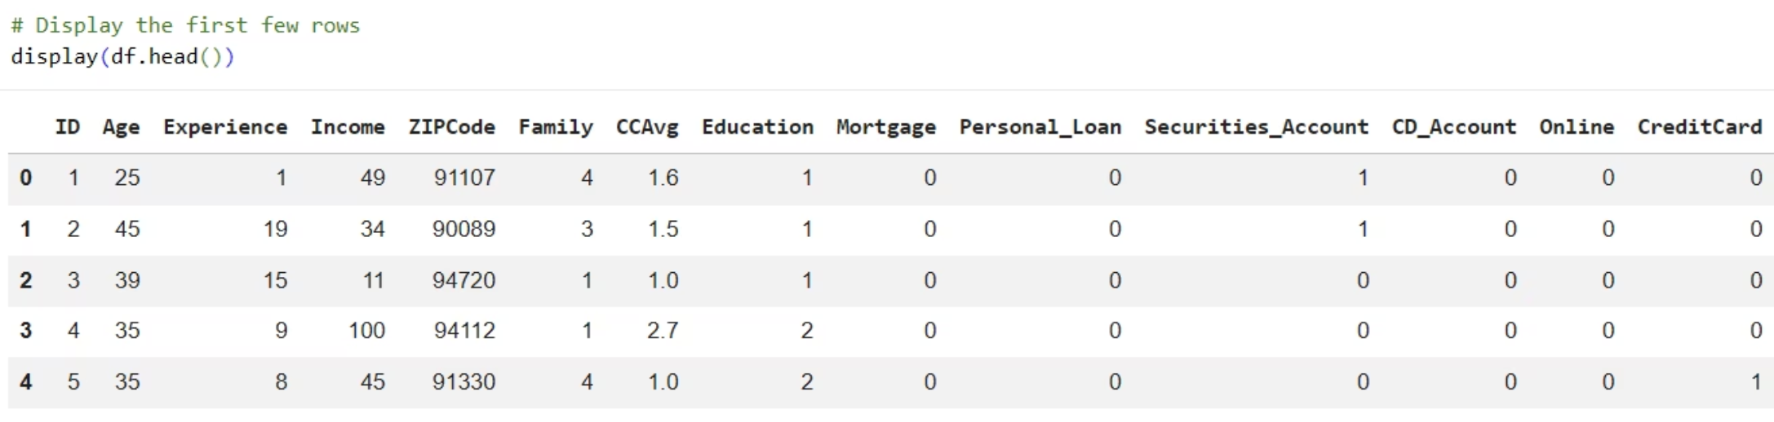
Exploring the Data
EDA
Dataset Snapshot
We analyzed 5,000 bank customers across 14 features — including Age, Income, Education, Family size, Credit Card spending, and more.
Key cleaning step: Detected and corrected real-world anomalies, such as negative values for years of professional experience — an impossible result indicating data entry errors.

Slide 4
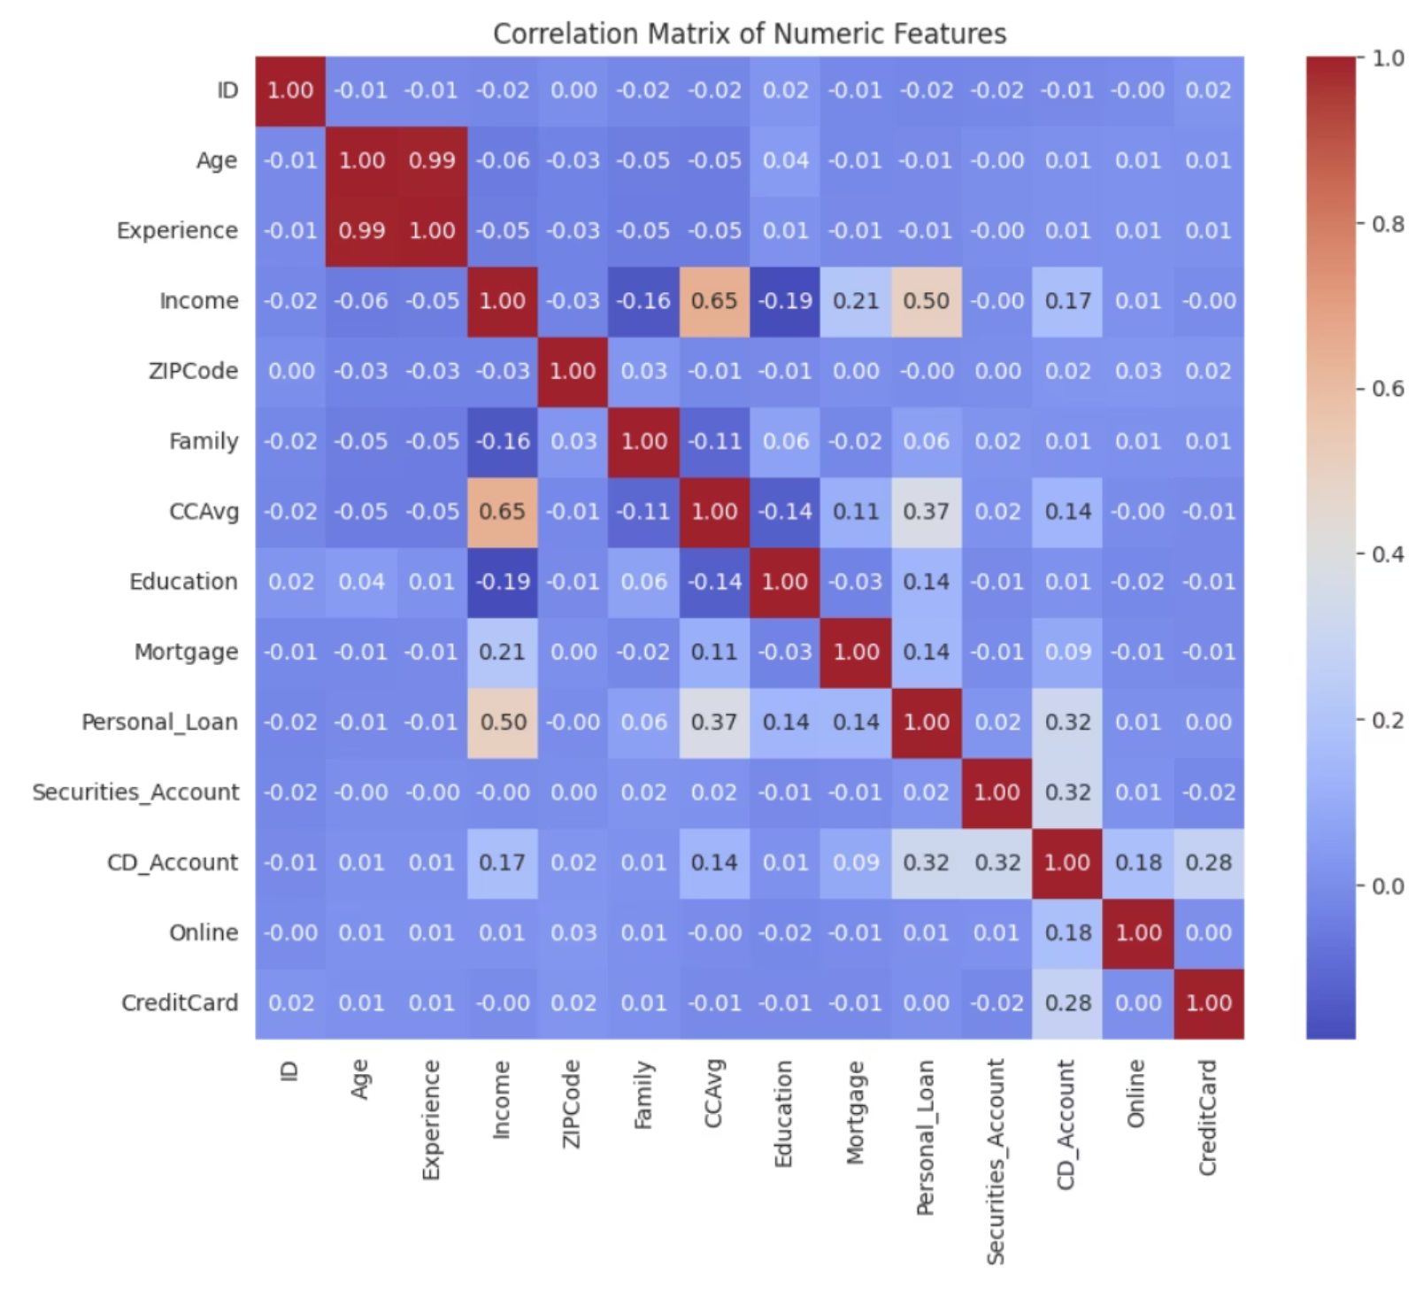
Finding Patterns & Relationships
CORRELATION ANALYSIS
What the Correlation Matrix Revealed
Before modeling, we mapped relationships across all features. Key findings:
Age & Experience are nearly perfectly correlated (r = 0.99) — one can be dropped without losing information
Income & CCAvg show a meaningful positive correlation (r = 0.65)
Personal Loan has the strongest positive link with Income (r = 0.50)
These insights guided our feature selection and model design.

Slide 5

Preprocessing: Getting AI-Ready
FEATURE ENGINEERING
Standardize Features
Normalize income, family size
Validate Pipeline
Clean & Split
Check for data leakage
80% train / 20% test
Large-scale values like a $150,000 income could overwhelm small values like a family size of 2. StandardScaler normalizes every feature to the same range — ensuring the model weighs each signal fairly and learns without bias from raw magnitude.

Slide 6
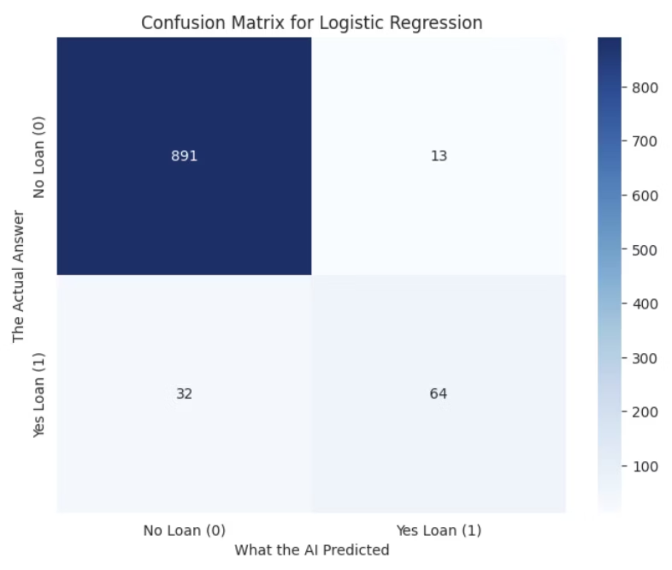
Baseline Model: Logistic Regression
MODEL V1
Results Summary
A strong starting point — but missing 1 in 3 true loan prospects is a meaningful gap for a targeted marketing strategy. We needed a more powerful approach.
95.5%
67% Recall
Overall accuracy on the test set
Of actual loan acceptors correctly identified

Slide 7

Upgrading the Brain: Random Forest
MODEL V2
99.2% Accuracy
94% Recall
Up from 95.5% with Logistic Regression — a dramatic improvement in overall prediction quality
Correctly identified 94% of customers who actually wanted a loan — capturing nearly all high-value targets
100 Decision Trees
An ensemble of trees voting together eliminates noise and dramatically reduces overfitting

Slide 8
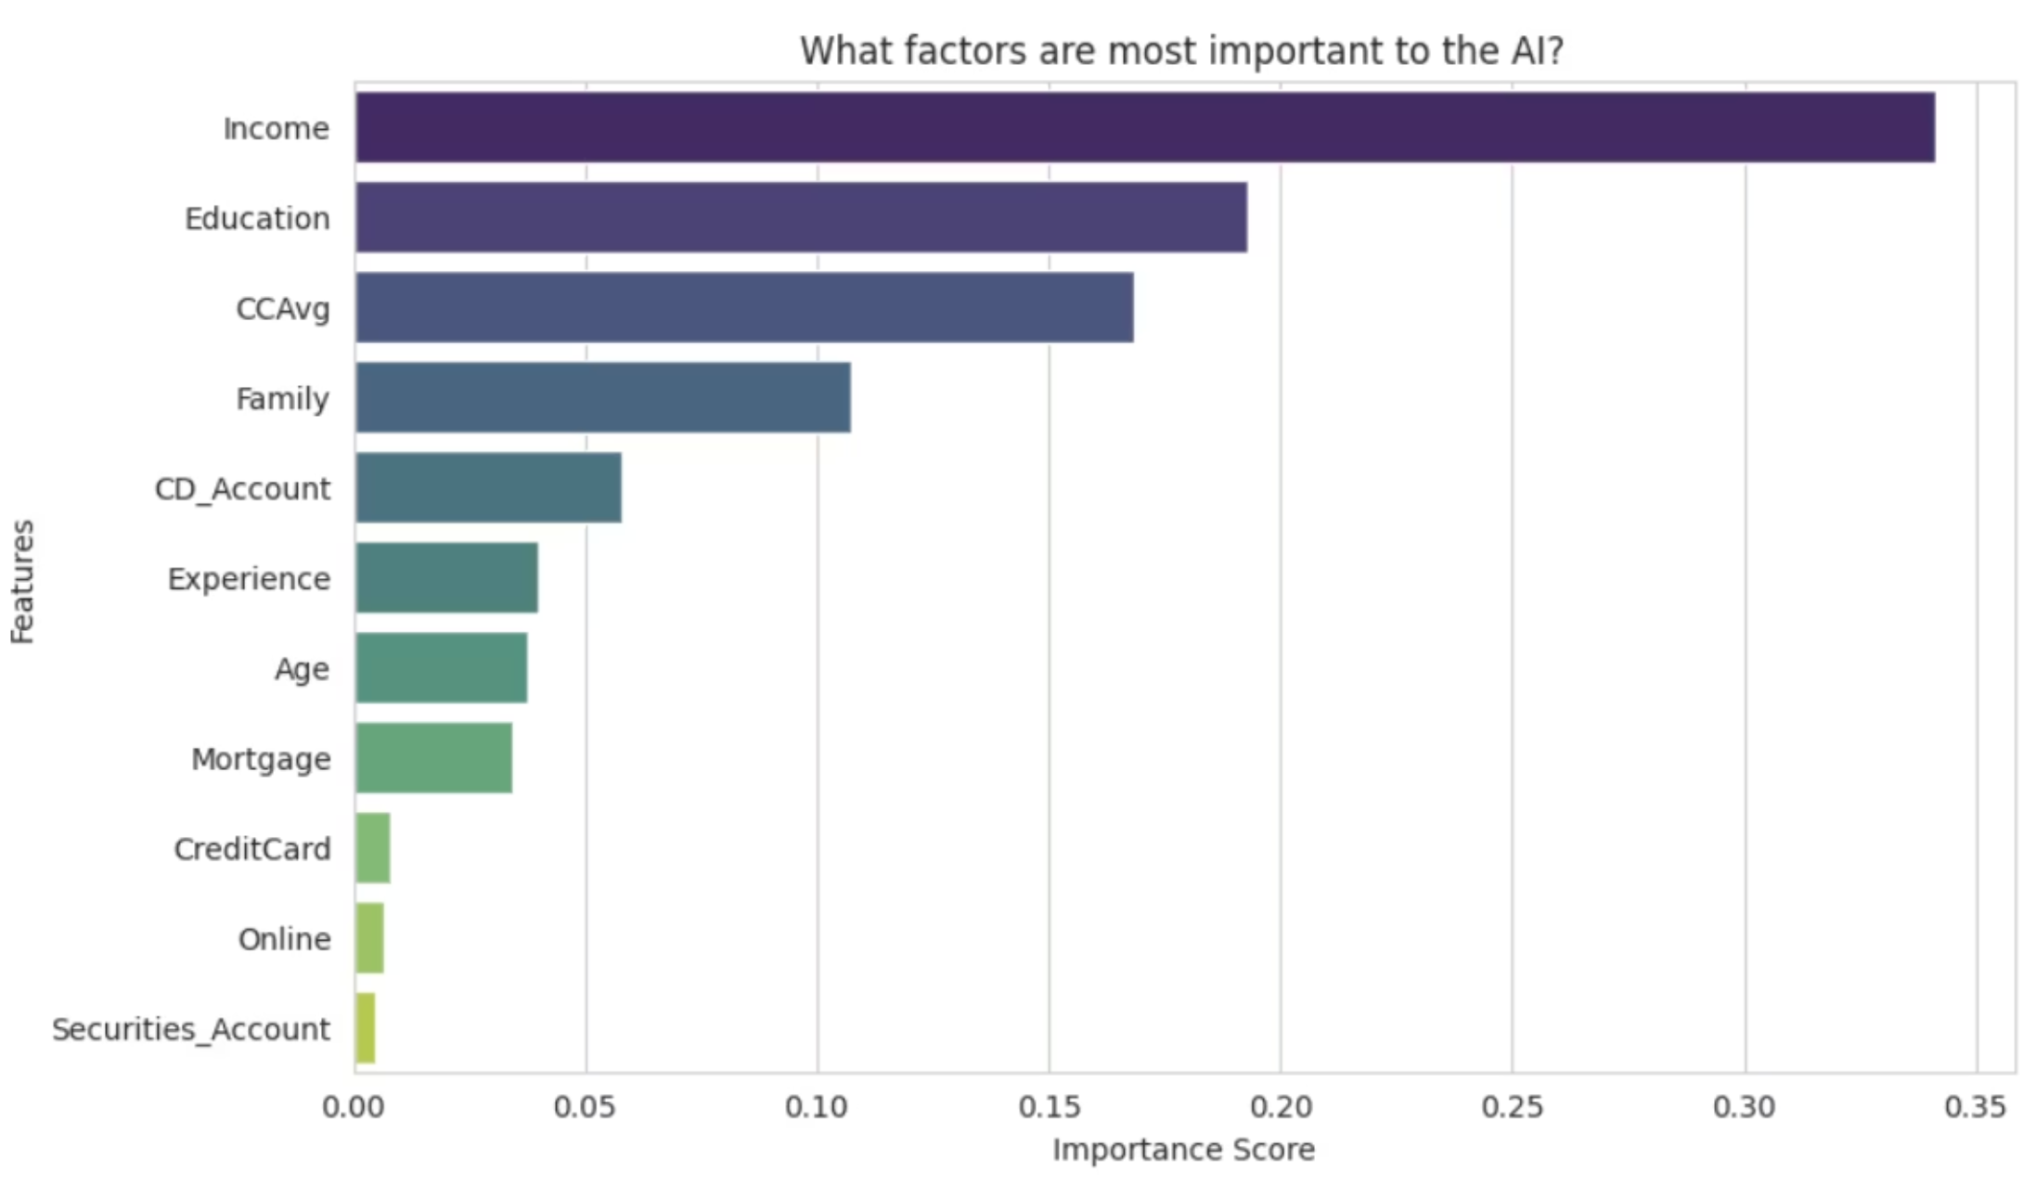
Inside the AI: Feature Importance
EXPLAINABILITY
The Model Explains Itself
This isn't a black box. The Random Forest surfaces which signals drive each prediction, enabling marketers to act on the insights:
Income — by far the strongest predictor (score: ~0.34)
Education — graduate-level customers convert at higher rates
CCAvg — credit card spending reflects financial behavior
Family size — influences loan appetite and need

Slide 9
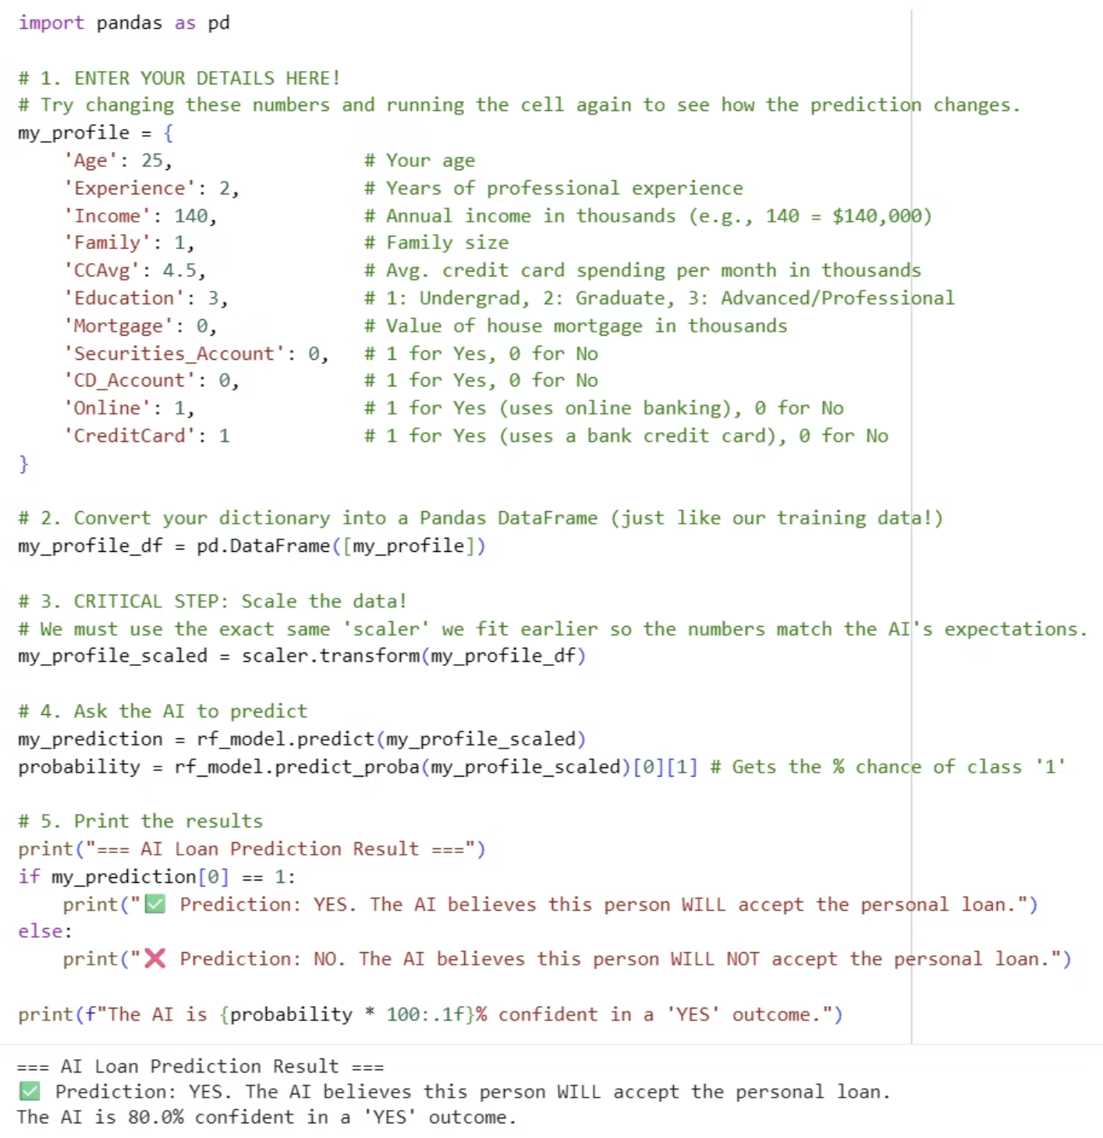
Real-World Application: Live Predictor
INTERACTIVE TOOL
From Model to Decision Tool
We built an interactive prediction interface that goes beyond historical testing. A bank representative can input any customer's profile and instantly receive:
A Yes / No loan acceptance prediction
A confidence percentage (e.g., "80% confident in a YES outcome")
The example shown: Age 25, Income $140K, CCAvg $4.5K/mo — model outputs YES at 80% confidence.

Slide 10

Conclusion & Next Steps
End-to-End Success
From messy raw data to a 99.2%-accurate, explainable AI model — the full pipeline is validated and ready for deployment.
Expand the Dataset
Test the model on data from new bank branches or regions to validate generalizability and reduce geographic bias.
Integrate & Automate
Embed the predictor into CRM workflows so marketing teams receive real-time loan propensity scores on every customer interaction.

