Slide 1
IEMS5723 Social Media Analysis and Development
Tutorial 3

Slide 2
Outline
Data Classification
Network Analysis
NodeXL

Slide 3
Data Classification
Supervised Learning with Naïve Bayes Classifier
#Prepare training data lst = [(“news”, “apple”), (“tech”, “apple”), (“news”, “gun”), (“tech”, “acer”)]
#Defining feature extraction criteria (can be just one) def extFeature(item): return {“head”: item[0]} #{<name of feature>, value}
#Extract feature and mark for each set extracted = [(extFeature(val), key) for key,val in lst]
#Train the classifier classifier = nltk.NaiveBayesClassifier.train(extracted)
#Query the classifier with the extracted feature of target classifier.classifier(extFeature(“apple”)) #-> “tech” classifier.classifier(extFeature(“google”)) #->”new”

Slide 4
NetworkX
Package for studying networks
Official site: https://networkx.lanl.gov/
Download: http://pypi.python.org/pypi/networkx/

Slide 5
NetworkX (Installation)
Download and extract the file
Use the Console prompt and change directory to the extracted directory cd <path to NetworkX directory>
Setup the package python setup.py install

Slide 6
NetworkX (Demo)
Assume equal weight assignment
1
A
B
3
2

Slide 7
NetworkX (Demo cont.)
#Create the graph import networkx graph = networkx.Graph()
#Define the structure graph.add_edge(1, ‘A’) graph.add_edge(2, ‘A’) graph.add_edge(‘A’, ’B’) graph.add_edge(‘B’, 3)
#Compute betweenness centrality result = nx.edge_betweenness_centrality(graph)

Slide 8
NetworkX (Demo cont.)
#Locate the critical edge maxKey, maxVal = None, -1
for key, val in result.iteritems():
if maxVal <= val:
maxVal = val
maxKey = key
if maxKey != None:
print “The edge {0} has highest betweenness: {1:2}” \
.format(maxKey, maxVal)
else:
print “Problem in computing betweenness.”

Slide 9
NodeXL
Network Overview Discovery and Exploration for Excel
Official site: http://www.smrfoundation.org/nodexl/
Download: http://nodexl.codeplex.com/

Slide 10

Start
Open “NodeXL Excel Template”

Slide 11

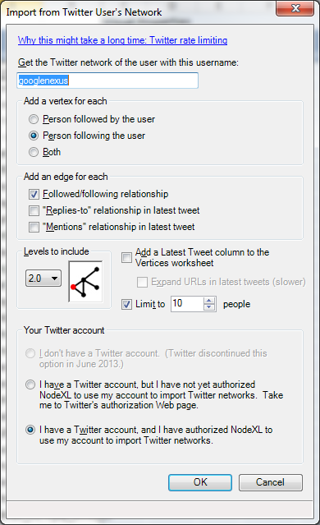
Fetching Twitter Network

Slide 12

Fetched Data
After waiting long period…

Slide 13

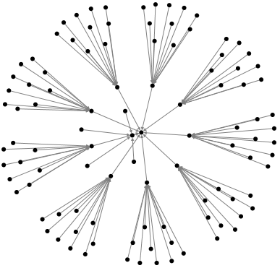
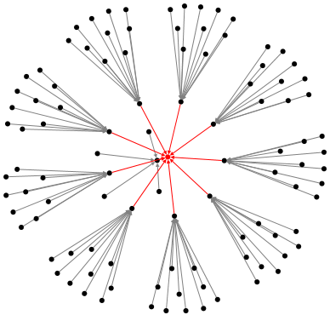
Graphing
Focus on googlenexus

Slide 14
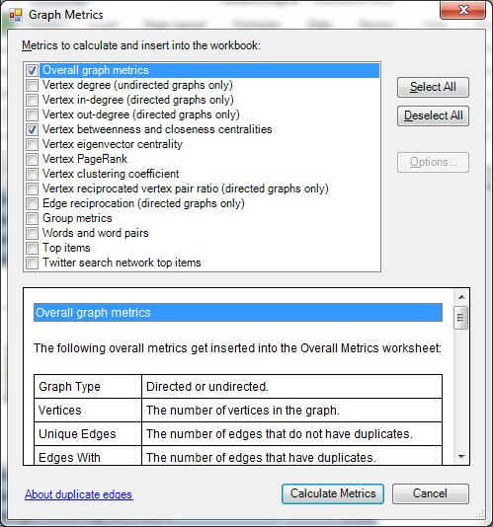

Graph Metrics
Graph Metric | Value
Graph Type | Directed
Vertices | 104
Unique Edges | 103
Edges With Duplicates | 0
Total Edges | 103
Self-Loops | 0
Reciprocated Vertex Pair Ratio | 0
Reciprocated Edge Ratio | 0
Connected Components | 1
Single-Vertex Connected Components | 0
Maximum Vertices in a Connected Component | 104
Maximum Edges in a Connected Component | 103
Maximum Geodesic Distance (Diameter) | 4
Average Geodesic Distance | 3.549926
Graph Density | 0.009615385
Modularity | Not Applicable
NodeXL Version | 1.0.1.251
Minimum Betweenness Centrality | 0
Maximum Betweenness Centrality | 9516.000
Average Betweenness Centrality | 266.192
Median Betweenness Centrality | 0

