Slide 1
IEMS5723 Social Media Analytics
Tutorial 4

Slide 2
Outline
pydot

Slide 3
pydot
Package for “interfacing Graphviz's Dot language. pydot allows to easily create both directed and non directed graphs from Python.”
Official site: http://code.google.com/p/pydot/
Install with pip

Slide 4
pydot (Installation)
Download and install Graphviz http://graphviz.org/Download..php
Further setup with pip
Download https://bootstrap.pypa.io/get-pip.py
Use command python get-pip.py
python -m pip install -Iv \ https://pypi.python.org/packages/source/p/pyparsing/pyparsing-1.5.7.tar.gz
python -m pip install pydot

Slide 5
pydot (Sample)
Assume equal weight assignment
1
A
B
3
2

Slide 6
pydot(Sample cont.)
import pydot
#Create the graph
graph = pydot.Dot(graph_type='graph')
#Input the structure
graph.add_edge(pydot.Edge('1', 'A')) #must use string in dot-language
graph.add_edge(pydot.Edge('2', 'A'))
graph.add_edge(pydot.Edge('A', 'B', label='Main bridge'))
graph.add_edge(pydot.Edge('B', '3'))
#Output the graph in png-format
graph.write('neato.png', prog='neato', format='png')
graph.write('dot.png', prog='dot', format='png')

Slide 7
pydot(Sample cont.)
#Perform Network Analysis with NetworkX
import networkx as nx
#Convert graph from dot type to networkx type
nxGraph = nx.from_pydot(graph)
#similar to before
result = nx.edge_betweenness_centrality(nxGraph)
for key, val in result.iteritems():
print "The edge {0}'s betweenness is {1:2}“\ .format(key, val)

Slide 8
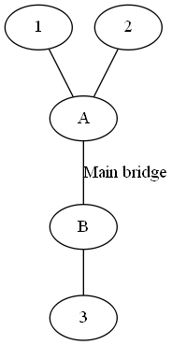
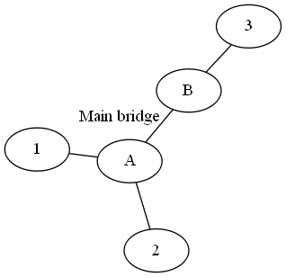
pydot(Sample Result)
The edge ('A', '2')'s betweenness is 0.4
The edge ('B', '3')'s betweenness is 0.4
The edge ('A', '1')'s betweenness is 0.4
The edge ('A', 'B')'s betweenness is 0.6
Dot model
Neato model

