Slide 1
Ad Exposure at NYC Subways

Slide 2
BACKSTORY
PROBLEM
Some ads with high price are ineffective
Edelman is a PR agency in charge of NYC subway billboards
Some customers want to pay a lower price

Slide 3
3 months of the MTA dataset
Easily cleaned
New columns added
DATASET

Slide 4
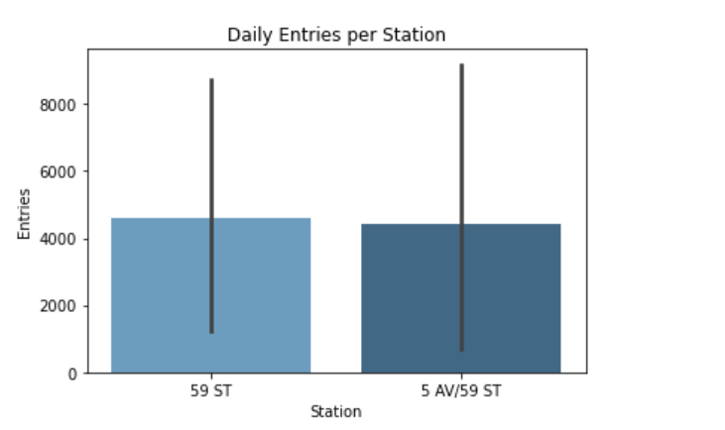
Daily entries per station
Daily entries per station over the span of 3 months

Slide 5
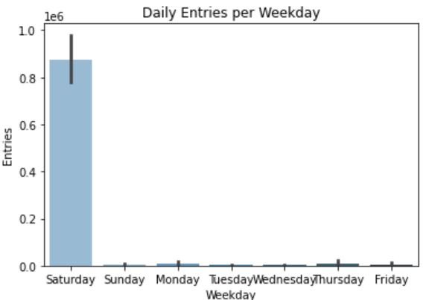
Daily entries per weekday
Mean of daily entries per weekday over the span of 3 months

Slide 6
Which stations are the busiest?
Which weekdays are the busiest?
QUESTIONS
TO ANSWER

Slide 7
59 ST
5 AV/59 ST
TOP STATIONS

Slide 8
The graph illustrates that Saturdays are the busiest
BUSIEST WEEKDAYS

Slide 9
The price of ad billboards in the top stations should be higher than the other ones
CONCLUSION
The price of ad billboards on Saturdays should be higher than other weekdays
If future collaborations happen, there’s other data that could be helpful in assessing ad exposure, such as income status and gender of people at the subway

Slide 10
THANK YOU!

