Slide 1


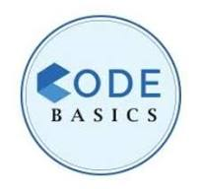
AtliQ Mart
Promotion & Tangible Insights

Slide 2
Introduction
Insights
Agenda
Table Structure
Task’s 1-5
Recommended Insights
Store Performance Analysis
Promotion Type Analysis
Product and Category Analysis

Slide 3

AtliQ Mart
Retail giant
With over 50 supermarkets in the southern region of India
All their stores ran a massive promotion during the Diwali’23 and Sankranti’24

Slide 4

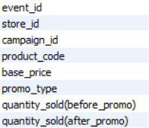


Table Structure
Dim_campaign
Dim_products
Dim_stores
Fact_events

Slide 5
Understanding promotions….
(did well and not)
to make informed decisions
Business requests, query results
Recommended Insights, visualizations
Insights

Slide 6

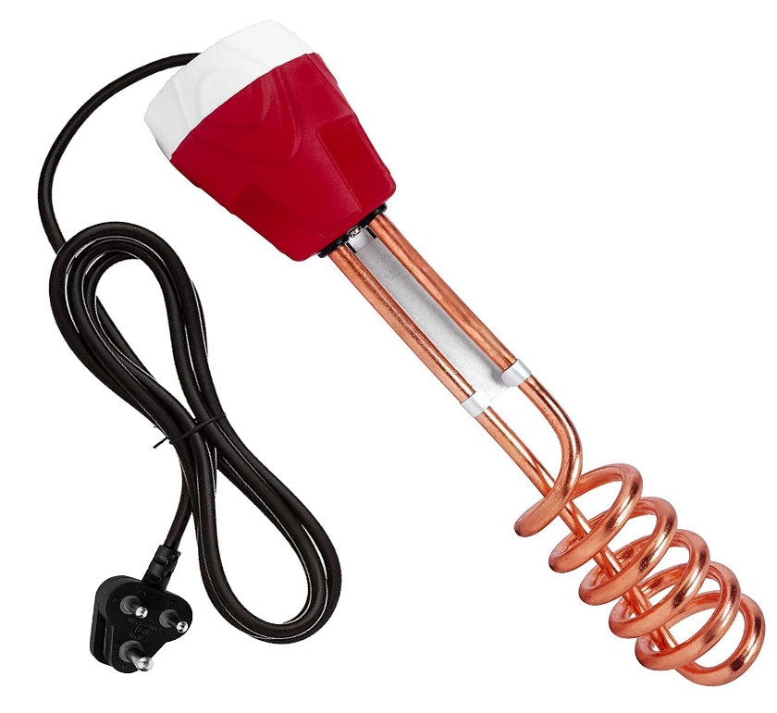
Task -1
List of products with base price greater than 500 and featured in promo-type BOGOF(Buy One Get One Free)
Waterproof Immersion Rod : 1020
Double Bedsheet : 1190

Slide 7
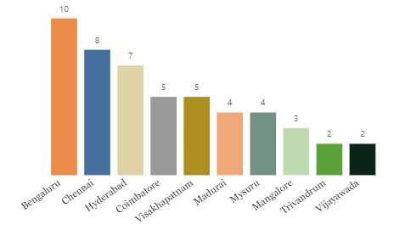
Task - 2
Count of number of stores in each city

Slide 8


Task - 3
Total revenue before and after for each campaign
Total Revenue Before Promo : 82.58M Total Revenue After Promo : 171.46M
Total Revenue Before Promo : 58.13M Total Revenue After Promo : 124.15M

Slide 9
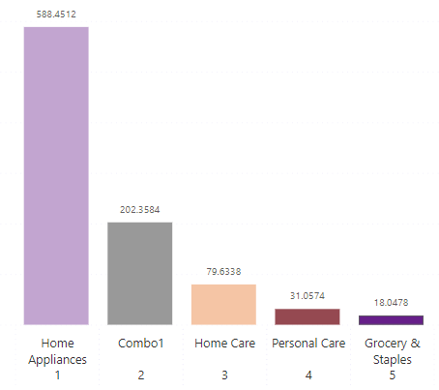
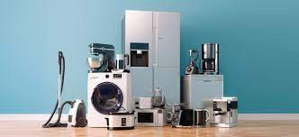



Task - 4
Incremental Sold Quantity(ISU%) for each category during Diwali campaign

Slide 10
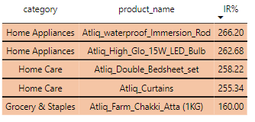
Task - 5
Top 5 products ranked by Incremental Revenue(IR%) across all campaigns

Slide 11
Store Performance Analysis
Promotion Type Analysis
Product & Category Analysis

Slide 12
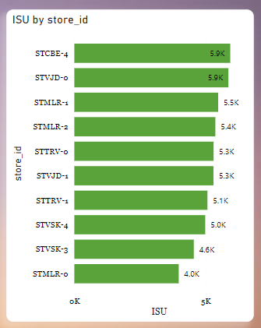
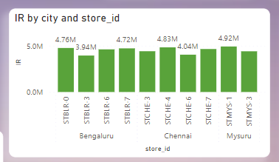
Store Performance Analysis

Slide 13
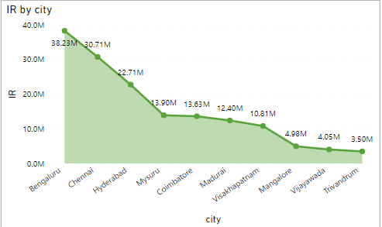
Performance of stores by city
Location
Common Characteristics among top-performing stores
Product MIX
Customer Demographics

Slide 14
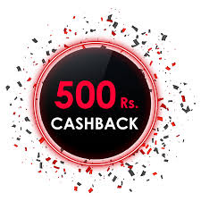


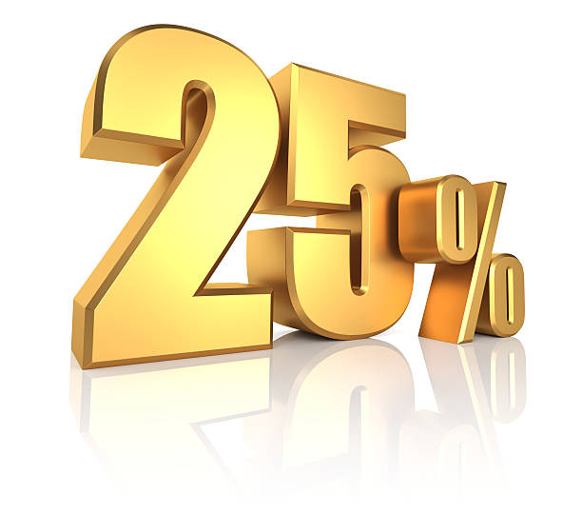
Promotion Type Analysis
Highest Incremental Revenue
6.9 K
91.05 M
5.7 K
69.32 M
Lowest Incremental SOLD UNITS

Slide 15
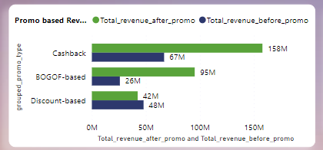
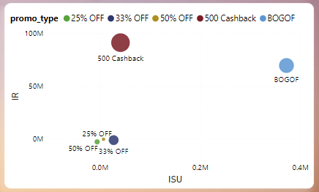
Significant difference
Strike healthy balance between ISU & healthy margins

Slide 16
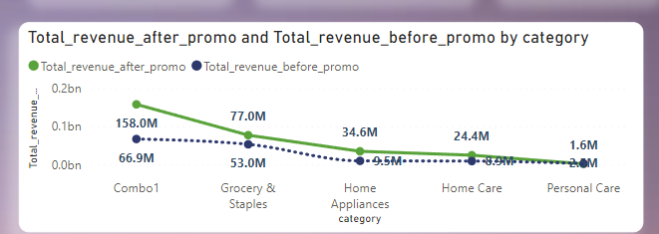
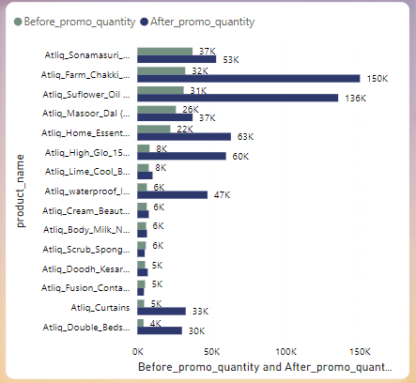
Product & Category Analysis
Categories that saw most significant lift
Products that respond exceptionally well/poorly

Slide 17
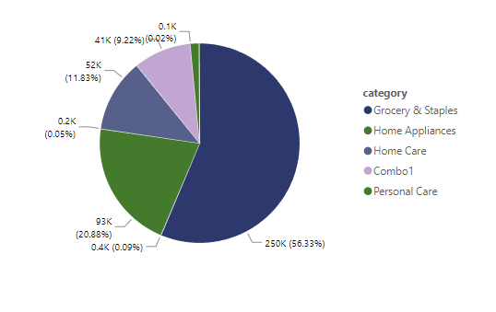
Correlation between product category and promotion type effectiveness

Slide 18
Thank You

