Slide 1



Project_Challenge_9
View in Power BI
Last data refresh:
3/5/2024 6:53:30 PM UTC
Downloaded at:
3/5/2024 6:58:52 PM UTC

Slide 2
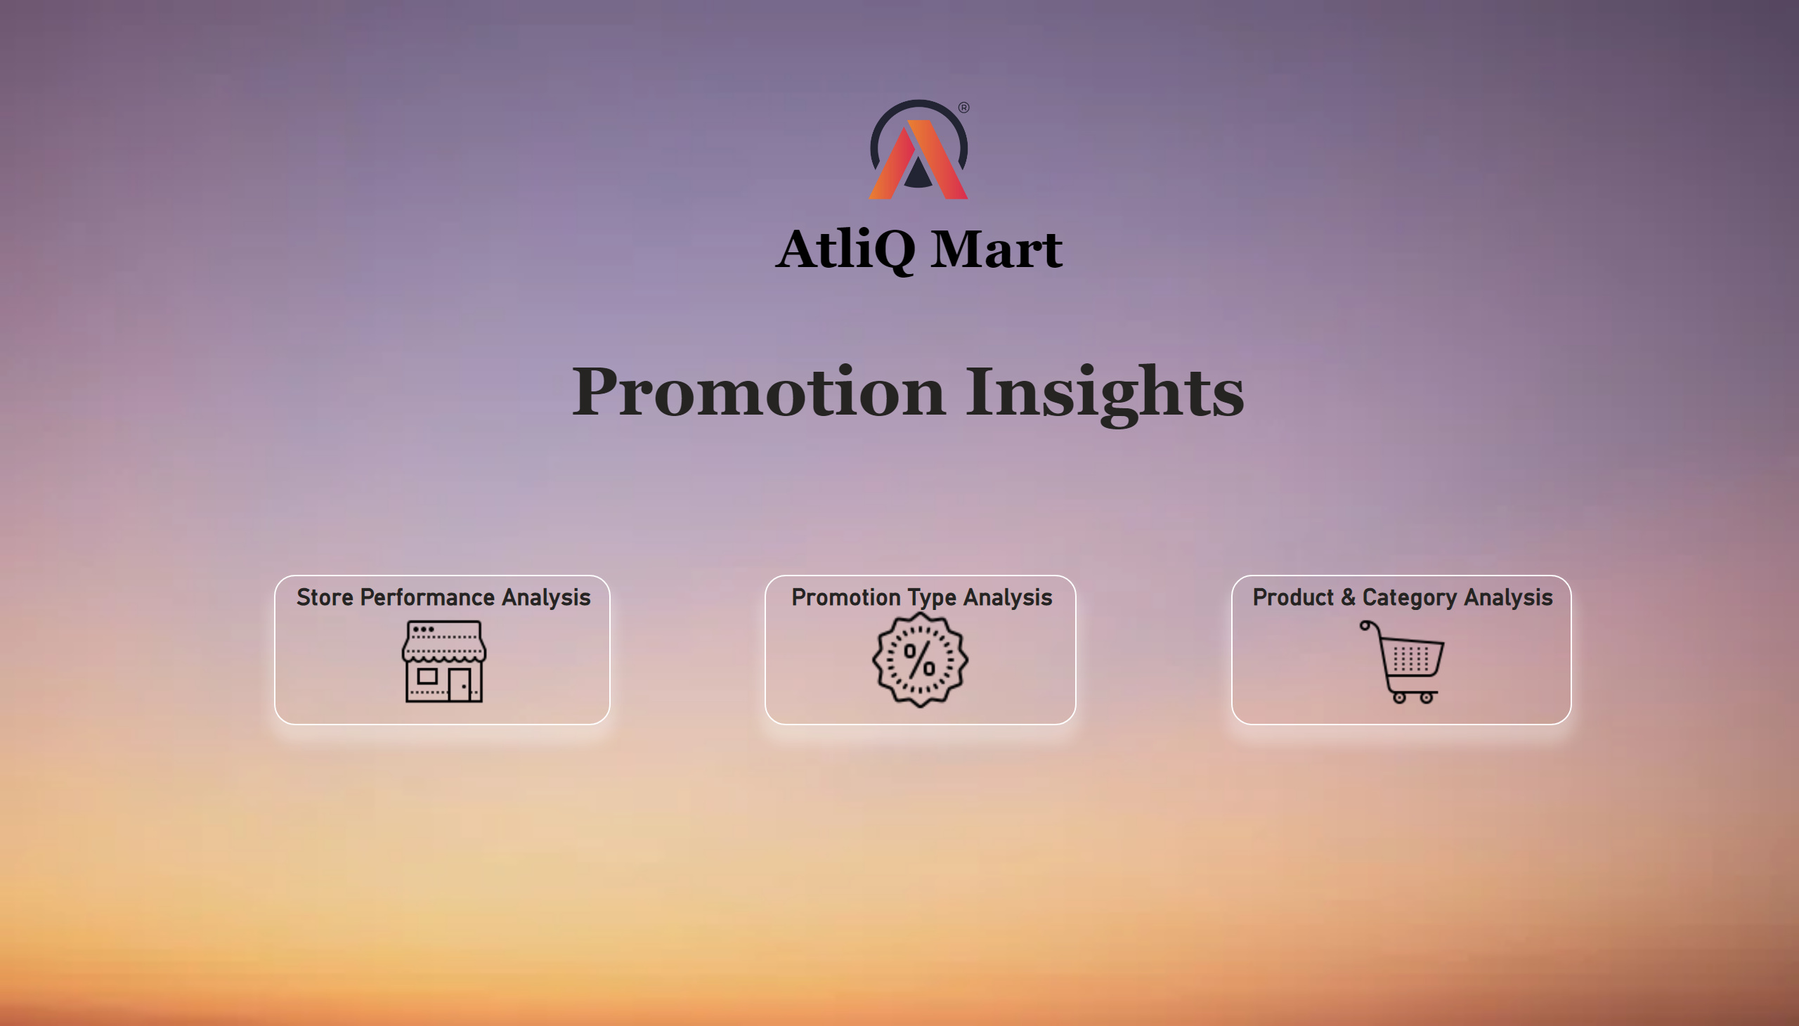
HomePage
Notes:
Store Performance Analysis
No alt text provided
Product & Category Analysis
No alt text provided
Promotion Type Analysis
No alt text provided
image
No alt text provided
textbox
No alt text provided
textbox
No alt text provided

Slide 3
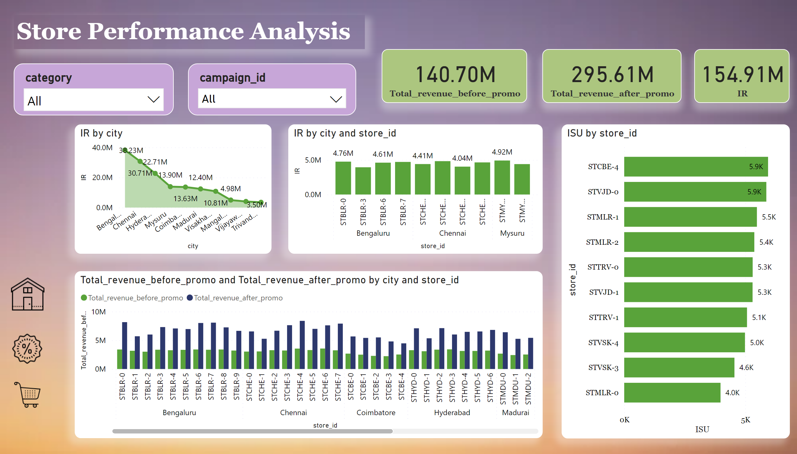
Store Performance Analysis
Notes:
clusteredColumnChart
No alt text provided
clusteredBarChart
No alt text provided
slicer
No alt text provided
areaChart
No alt text provided
card
No alt text provided
card
No alt text provided
card
No alt text provided
Promotion Type Analysis
No alt text provided
Product & Category Analysis
No alt text provided
image
No alt text provided
textbox
No alt text provided
slicer
No alt text provided
clusteredColumnChart
No alt text provided

Slide 4
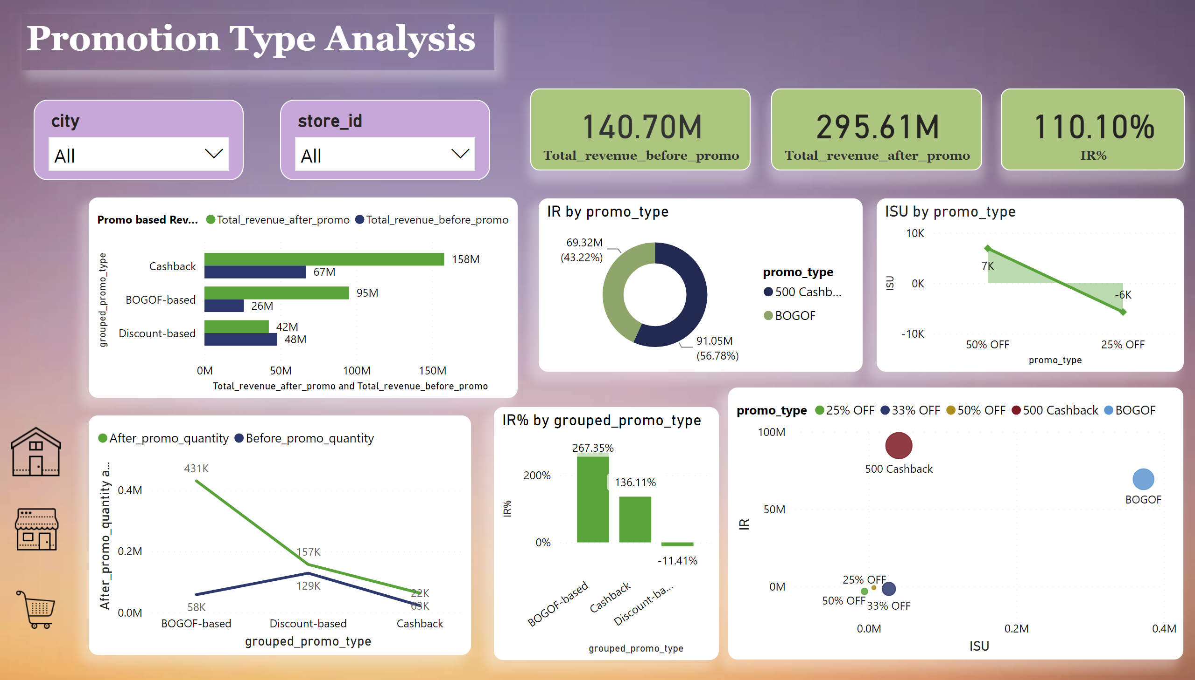
Promotion Type Analysis
Notes:
donutChart
No alt text provided
areaChart
No alt text provided
clusteredBarChart
No alt text provided
lineChart
No alt text provided
lineStackedColumnComboChart
No alt text provided
scatterChart
No alt text provided
card
No alt text provided
card
No alt text provided
card
No alt text provided
Store Performance Analysis
No alt text provided
Product & Category Analysis
No alt text provided
image
No alt text provided
textbox
No alt text provided
slicer
No alt text provided
slicer
No alt text provided

Slide 5
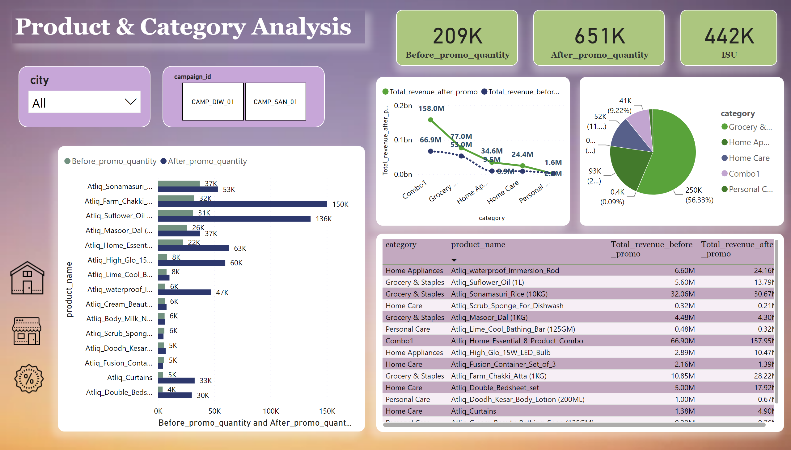
Product and Category Analysis
Notes:
tableEx
No alt text provided
lineChart
No alt text provided
clusteredBarChart
No alt text provided
card
No alt text provided
card
No alt text provided
card
No alt text provided
Store Performance Analysis
No alt text provided
Promotion Type Analysis
No alt text provided
image
No alt text provided
textbox
No alt text provided
slicer
No alt text provided
slicer
No alt text provided
pieChart
No alt text provided

