Slide 1
Appendix B carries the full peer benchmark and the comparator profiles.
Appendix B · Peers and named comparators · pro bono funding analysis for Calvary Women's Services. Core peers are provisional; DWC and the CBWC Empowerment Institute (SheWorks) are Los Angeles reference rows. Method notes B1–B3 and D2 are in Appendix D.

Slide 2
The 18 provisional core peers were chosen for model similarity in four tiers and can be swapped by editing one file.
Organization | Tier | Status | Rationale
N Street Village | 1a · DC women's homelessness | provisional | Closest model match: housing, health and recovery services for homeless and low-income women in DC; about 2x Calvary's revenue
House of Ruth (DC) | 1a · DC women's homelessness | provisional | Housing and services for women, children and families in DC, including DV survivors; large comparator ($20M)
Open Arms Housing | 1a · DC women's homelessness | provisional | Permanent supportive housing for women experiencing homelessness, with a mental-health focus; small ($2.5M), 77% government
New Endeavors by Women | 1a · DC women's homelessness | provisional | Transitional housing for homeless women in DC; similar size ($3.1M); 82% government
District Alliance for Safe Housing (DASH) | 1b · DC DV survivors | provisional | Safe housing for DV and sexual-violence survivors in DC; Calvary's New Foundations site is also DV-designated; 90% government
My Sister's Place | 1b · DC DV survivors | provisional | DC DV shelter and housing for survivors and children; similar size ($8.3M)
DC SAFE | 1b · DC DV survivors | provisional | DV crisis response and emergency shelter in DC; OVSJG-funded like Calvary; 94% government
Samaritan Inns | 2 · DC homelessness and recovery | provisional | Recovery-oriented housing for homeless adults in DC; similar size ($6.2M) but only 11% government (contrast case)
Christ House | 2 · DC homelessness and recovery | provisional | Medical respite for people experiencing homelessness in DC; nearly identical revenue to Calvary ($4.9M)
Source: IRS EO BMF and e-file index; calvary_funding_data/config/core_peers.csv; calvary_funding_data/reports/core_peers_proposal.md
Method: score (women focus, DV, homelessness, recovery, Ward 7/8, DC, size) plus a relevance gate and judgment; swap = edit core_peers.csv and rerun
data as of 2026-10-10 · method note D2

Slide 3
The 18 provisional core peers were chosen for model similarity in four tiers and can be swapped by editing one file. (continued, 2 of 2)
Organization | Tier | Status | Rationale
Everyone Home DC | 2 · DC homelessness and recovery | provisional | DC homelessness prevention and housing; nearly identical revenue ($4.9M); 85% government
Coalition for the Homeless | 2 · DC homelessness and recovery | provisional | DC shelter and housing provider with women's programs; similar size ($7.5M); 92% government
Thrive DC | 2 · DC homelessness and recovery | provisional | DC homelessness services, including a women's program; small ($2.6M) and almost entirely private (contrast case)
Miriam's Kitchen | 2 · DC homelessness and recovery | provisional | Chronic homelessness and PSH case management in DC; philanthropy-led (10% government) with a large donor base
Community of Hope | 2 · Ward 7/8 presence | provisional | Ward 8-based homelessness and health provider in Calvary's service area; large ($57.6M)
Covenant House Washington DC | 2 · Ward 7/8 presence | provisional | Ward 8 shelter and crisis services (youth); similar size ($7.3M); same ward-level funders
Doorways for Women and Families | 3 · DMV women/DV outside DC | provisional | Arlington VA: women, families and DV survivors experiencing homelessness; closest suburban analog ($6.1M)
House of Ruth Maryland | 3 · DMV women/DV outside DC | provisional | Baltimore MD: DV services and housing for women and children; regional DV funder overlap ($11.6M)
Heartly House | 3 · DMV women/DV outside DC | provisional | Frederick MD: DV and sexual-assault shelter and services; similar size ($5.1M)
Source: IRS EO BMF and e-file index; calvary_funding_data/config/core_peers.csv; calvary_funding_data/reports/core_peers_proposal.md
Method: score (women focus, DV, homelessness, recovery, Ward 7/8, DC, size) plus a relevance gate and judgment; swap = edit core_peers.csv and rerun
data as of 2026-10-10 · method note D2

Slide 4
The benchmark table gives every metric for all 21 organizations: size, government share, growth and liquidity.
Organization | Tier | Revenue FY2024 | Gov. share FY22–24 | Gov. share latest | Real CAGR FY19–24 | Months of cash FY24 | Months of cash FY22–24 | Program service share | Fundraising cost per private $ | Resilience type
Calvary | subject | $5.8M | 53% | 45% | 13.8% | 5.2 | 5.5 | 0% | $0.24 | mixed
DC SAFE | 1b | $7.0M | 89% | 94% | 17.7% | 0.9 | 1.4 | 0% | $0.03 | gov.-anchored
Open Arms Housing | 1a | $2.2M | 84% | 84% | 12.5% | 1.2 | 0.9 | 12% | $0.27 | gov.-anchored
My Sister's Place | 1b | $7.2M | 83% | 83% | 19.4% | 2.9 | 2.8 | 0% | $0.15 | gov.-anchored
Everyone Home DC | 2 | $4.9M | 76% | 85% | 10.6% | 9.9 | 8.3 | 0% | $0.14 | gov.-anchored
Heartly House (MD) | 3 | $4.1M | 74% | 78% | 6.2% | 1.0 | 1.2 | 0% | $0.22 | gov.-anchored
DASH | 1b | $7.0M | 70% | 84% | -2.7% | 4.0 | 3.0 | 1% | $0.14 | gov.-anchored
Coalition for the Homeless | 2 | $7.5M | 62% | 92% | -2.6% | 4.1 | 4.8 | 2% | $0.09 | mixed
House of Ruth MD | 3 | $12.1M | 60% | 61% | 2.6% | 2.7 | 2.8 | 2% | $0.26 | mixed
New Endeavors by Women | 1a | $2.6M | 54% | 38% | -2.5% | 0.5 | 0.9 | 1% | $0.14 | mixed
House of Ruth DC | 1a | $14.6M | 53% | 56% | 5.0% | 3.8 | 4.2 | 1% | $0.14 | mixed
Source: IRS Form 990 e-file returns (GivingTuesday, NCCS, IRS SOI, ProPublica); Calvary audits FY13–FY23; fact_org_financials; Funders' 990-PF grants paid and Schedule I rows (IRS e-file via GivingTuesday); fact_grants, dim_funder
Method: government share = line 1e ÷ revenue (Calvary audit basis FY≤2023); FY2022–24 means; real CAGR in 2024 dollars; core peers provisional
Chart m3_00 · data as of 2026-10-10 · method note B1, B2

Slide 5
The benchmark table gives every metric for all 21 organizations: size, government share, growth and liquidity. (continued, 2 of 2)
Organization | Tier | Revenue FY2024 | Gov. share FY22–24 | Gov. share latest | Real CAGR FY19–24 | Months of cash FY24 | Months of cash FY22–24 | Program service share | Fundraising cost per private $ | Resilience type
Covenant House DC | 2 | $7.2M | 53% | 53% | 2.9% | 1.1 | 1.4 | 0% | $0.13 | mixed
Doorways (VA) | 3 | $6.2M | 44% | 43% | 2.5% | 12.1 | 13.4 | 0% | $0.15 | mixed
Samaritan Inns | 2 | $7.1M | 44% | 3% | 10.1% | 4.5 | 2.4 | 18% | $0.15 | mixed
N Street Village | 1a | $10.0M | 42% | 48% | -1.7% | 8.0 | 9.8 | 7% | $0.20 | mixed
Community of Hope | 2 | $57.6M | 40% | 38% | 4.2% | 4.5 | 6.5 | 42% | $0.07 | mixed
Christ House | 2 | $4.9M | 27% | 35% | -0.7% | 6.3 | 9.7 | 9% | $0.07 | philanthropy-led
Thrive DC | 2 | $2.6M | 13% | 1% | -4.9% | 4.2 | 4.4 | 0% | $0.05 | philanthropy-led
Miriam's Kitchen | 2 | $11.3M | 0% | — | 12.0% | 4.0 | 4.7 | 40% | $0.11 | philanthropy-led
CBWC Inst. / SheWorks (LA, reference) | named comparator (LA) | $1.5M | 86% | 85% | — | 4.8 | 16.7 | 0% | $0.09 | gov.-anchored
DWC (LA, reference) | named comparator (LA) | $34.4M | 57% | 57% | 19.0% | 2.4 | 2.1 | 6% | $0.12 | mixed
Source: IRS Form 990 e-file returns (GivingTuesday, NCCS, IRS SOI, ProPublica); Calvary audits FY13–FY23; fact_org_financials; Funders' 990-PF grants paid and Schedule I rows (IRS e-file via GivingTuesday); fact_grants, dim_funder
Method: government share = line 1e ÷ revenue (Calvary audit basis FY≤2023); FY2022–24 means; real CAGR in 2024 dollars; core peers provisional
Chart m3_00 · data as of 2026-10-10 · method note B1, B2

Slide 6
The benchmark table gives every metric for all 21 organizations: the institutional funder base and DAF share.
Organization | Filed grants TY2020–24 | Funders | Institutional funders | Institutional $ | DAF $ | DAF share of filed | Institutional $ ÷ revenue | Note
Calvary | $4.43M | 50 | 42 | $3.34M | $1.09M | 25% | 12.4%
DC SAFE | $720K | 9 | 7 | $674K | $46K | 6% | 2.9%
Open Arms Housing | $255K | 2 | 2 | $255K | $0 | 0% | 2.5%
My Sister's Place | $2.88M | 31 | 25 | $2.40M | $487K | 17% | 7.6%
Everyone Home DC | $526K | 15 | 10 | $388K | $138K | 26% | 1.8%
Heartly House (MD) | $1.87M | 21 | 18 | $1.82M | $49K | 3% | 10.3%
DASH | $1.94M | 28 | 23 | $1.73M | $210K | 11% | 4.7%
Coalition for the Homeless | $472K | 9 | 4 | $219K | $252K | 54% | 0.6%
House of Ruth MD | $5.81M | 95 | 86 | $4.72M | $1.10M | 19% | 8.4%
New Endeavors by Women | $1.14M | 25 | 20 | $951K | $188K | 17% | 6.1%
House of Ruth DC | $8.54M | 93 | 83 | $5.36M | $3.18M | 37% | 7.7%
Source: Funders' 990-PF grants paid and Schedule I rows (IRS e-file via GivingTuesday); fact_grants, dim_funder
Method: TY2020–24, non-cumulative; institutional vs DAF via dim_funder.funder_type; depth = institutional $ ÷ FY2020–24 revenue; DMV funders' filings only
Chart m3_00 · data as of 2026-10-10 · method note B2

Slide 7
The benchmark table gives every metric for all 21 organizations: the institutional funder base and DAF share. (continued, 2 of 2)
Organization | Filed grants TY2020–24 | Funders | Institutional funders | Institutional $ | DAF $ | DAF share of filed | Institutional $ ÷ revenue | Note
Covenant House DC | $1.74M | 29 | 23 | $987K | $749K | 43% | 2.7%
Doorways (VA) | $4.01M | 45 | 36 | $2.33M | $1.69M | 42% | 7.2%
Samaritan Inns | $7.67M | 18 | 14 | $7.55M | $120K | 2% | 26.6%
N Street Village | $7.35M | 64 | 54 | $3.60M | $3.75M | 51% | 6.4%
Community of Hope | $6.74M | 50 | 43 | $3.24M | $3.50M | 52% | 1.4%
Christ House | $2.05M | 28 | 22 | $1.19M | $859K | 42% | 5.1%
Thrive DC | $2.44M | 14 | 8 | $1.14M | $1.31M | 54% | 5.1%
Miriam's Kitchen | $9.52M | 76 | 66 | $5.61M | $3.90M | 41% | 11.3%
CBWC Inst. / SheWorks (LA, reference) | — | — | — | — | — | — | — | Founded 2022; SheWorks program starts after TY2024; LA reference
DWC (LA, reference) | $207K | 7 | 7 | $207K | $0 | 0% | 0.2% | LA reference; DAF grants not captured (Schedule I kept for DC/MD/VA…
Source: Funders' 990-PF grants paid and Schedule I rows (IRS e-file via GivingTuesday); fact_grants, dim_funder
Method: TY2020–24, non-cumulative; institutional vs DAF via dim_funder.funder_type; depth = institutional $ ÷ FY2020–24 revenue; DMV funders' filings only
Chart m3_00 · data as of 2026-10-10 · method note B2

Slide 8
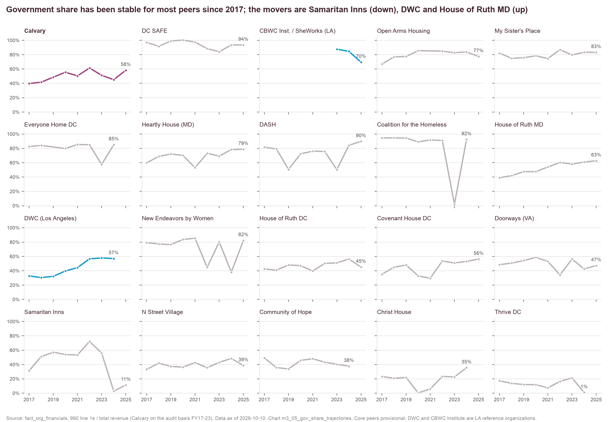
Most organizations' government share has been stable since FY2017, except Samaritan Inns (down) and DWC and House of Ruth MD (up).
Source: IRS Form 990 e-file returns (GivingTuesday, NCCS, IRS SOI, ProPublica); Calvary audits FY13–FY23; fact_org_financials
Method: line 1e ÷ total revenue, Calvary on the audit basis FY17–FY23; one organization per panel
Chart m3_05 · data as of 2026-10-10 · method note B1

Slide 9
Government-share trajectories for all 21 organizations, FY2017–FY2025, show Calvary between 40% and 61% every year.
Organization | FY17 | FY18 | FY19 | FY20 | FY21 | FY22 | FY23 | FY24 | FY25
Calvary | 40% | 42% | 49% | 55% | 50% | 61% | 51% | 45% | 58%
Christ House | 23% | 21% | 22% | 0% | 6% | 23% | 23% | 35% | —
Coalition for the Homeless | 95% | 95% | 94% | 89% | 92% | 91% | 2% | 92% | —
Community of Hope | 49% | 36% | 34% | 46% | 48% | 43% | 40% | 38% | —
Covenant House DC | 35% | 45% | 48% | 33% | 30% | 54% | 51% | 53% | 56%
DASH | 82% | 79% | 51% | 72% | 76% | 76% | 50% | 84% | 90%
DC SAFE | 97% | 92% | 99% | 100% | 97% | 88% | 84% | 94% | 94%
Doorways (VA) | 48% | 51% | 54% | 59% | 53% | 34% | 56% | 43% | 47%
DWC (LA, reference) | 33% | 31% | 32% | 40% | 44% | 57% | 58% | 57% | —
Everyone Home DC | 83% | 84% | — | 80% | 85% | 85% | 58% | 85% | —
Heartly House (MD) | 60% | 69% | 72% | 70% | 53% | 73% | 69% | 78% | 79%
Source: IRS Form 990 e-file returns (GivingTuesday, NCCS, IRS SOI, ProPublica); Calvary audits FY13–FY23; fact_org_financials
Method: line 1e ÷ total revenue on preferred rows; Calvary FY17–FY23 audit basis; '—' = no filing in the data
Chart m3_05 · data as of 2026-10-10 · method note B1

Slide 10
Government-share trajectories for all 21 organizations, FY2017–FY2025, show Calvary between 40% and 61% every year. (continued, 2 of 2)
Organization | FY17 | FY18 | FY19 | FY20 | FY21 | FY22 | FY23 | FY24 | FY25
House of Ruth DC | 43% | 41% | 48% | 47% | 40% | 50% | 51% | 56% | 45%
House of Ruth MD | 39% | 42% | 48% | 48% | 54% | 60% | 58% | 61% | 63%
Miriam's Kitchen | 2% | 1% | 2% | 1% | 10% | 0% | — | — | 10%
My Sister's Place | 82% | 75% | 76% | 78% | 75% | 87% | 80% | 83% | 83%
N Street Village | 33% | 42% | 37% | 36% | 43% | 35% | 43% | 48% | 39%
New Endeavors by Women | 79% | 77% | 76% | 84% | 85% | 45% | 80% | 38% | 82%
Open Arms Housing | 67% | 77% | 77% | 86% | — | 85% | 83% | 84% | 77%
Samaritan Inns | 31% | 51% | 57% | 54% | 53% | 72% | 56% | 3% | 11%
Thrive DC | 17% | 14% | 12% | 12% | 7% | 16% | 21% | 1% | —
CBWC Inst. / SheWorks (LA, reference) | — | — | — | — | — | — | 88% | 85% | 70%
Source: IRS Form 990 e-file returns (GivingTuesday, NCCS, IRS SOI, ProPublica); Calvary audits FY13–FY23; fact_org_financials
Method: line 1e ÷ total revenue on preferred rows; Calvary FY17–FY23 audit basis; '—' = no filing in the data
Chart m3_05 · data as of 2026-10-10 · method note B1

Slide 11
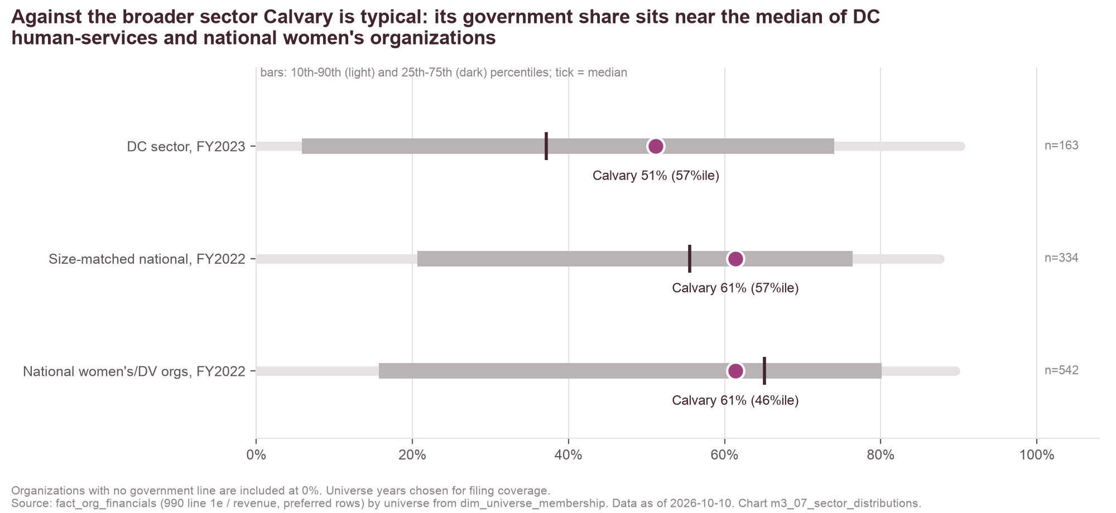
Sector distributions place Calvary at the 57th percentile in the DC sector and the 46th among national women's and DV organizations.
Reading the distributions
Organizations with no government line count at 0%, so p10 is 0% in every universe.
Benchmark years chosen for filing coverage: national universes fall below 15 filers after FY2022.
Calvary's FY2023 share here is line-1e based (51%).
Universe | Year | n | p10 | p25 | Median | p75 | p90 | Calvary | Calvary percentile | Median revenue
DC sector | FY2023 | 163 | 0% | 6% | 37% | 74% | 90% | 51% | 57th | $1.48M
Size-matched national | FY2022 | 334 | 0% | 21% | 56% | 76% | 88% | 61% | 57th | $3.43M
National women's/DV orgs | FY2022 | 542 | 0% | 16% | 65% | 80% | 90% | 61% | 46th | $1.29M
Source: IRS Form 990 e-file returns (GivingTuesday, NCCS, IRS SOI, ProPublica); Calvary audits FY13–FY23; fact_org_financials; dim_universe_membership
Method: 990 line 1e basis; universe rules in config/universes.yaml (dc_sector FY2023, size_matched and national_women FY2022)
Chart m3_07 · data as of 2026-10-10 · method note B1

Slide 12
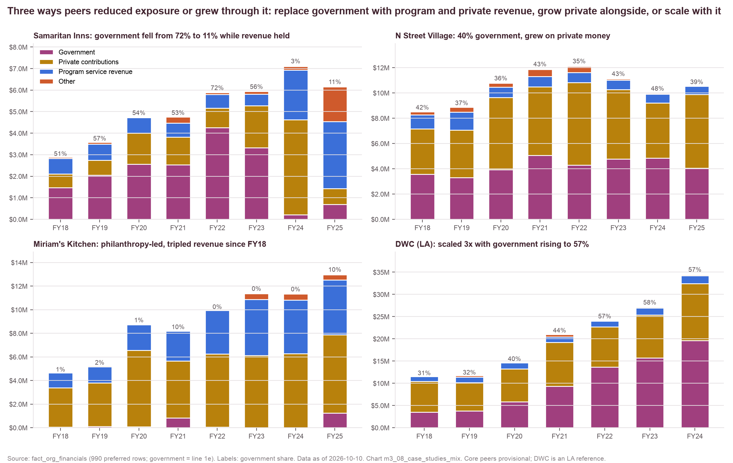
The case studies show three paths: Samaritan Inns replaced government, N Street Village grew private giving alongside it, and DWC scaled with it.
Source: IRS Form 990 e-file returns (GivingTuesday, NCCS, IRS SOI, ProPublica); Calvary audits FY13–FY23; fact_org_financials
Method: revenue mix by year from preferred 990 rows; government = line 1e
Chart m3_08 · data as of 2026-10-10 · method note B1

Slide 13
The four case studies' revenue mix by year: Miriam's Kitchen grew on almost no government money and Samaritan Inns shifted to program revenue.
Organization | Fiscal year | Total revenue | Government | Private contributions | Program service | Other | Government share
DWC (LA, reference) | FY2018 | $11,589,269 | $3,535,362 | $6,873,264 | $1,110,047 | $70,596 | 31%
DWC (LA, reference) | FY2019 | $11,728,685 | $3,783,833 | $6,379,373 | $1,243,185 | $322,294 | 32%
DWC (LA, reference) | FY2020 | $14,724,778 | $5,841,251 | $7,380,276 | $1,356,408 | $146,843 | 40%
DWC (LA, reference) | FY2021 | $20,994,562 | $9,310,478 | $9,914,051 | $1,173,738 | $596,295 | 44%
DWC (LA, reference) | FY2022 | $24,112,515 | $13,657,270 | $9,017,048 | $1,297,220 | $140,977 | 57%
DWC (LA, reference) | FY2023 | $27,162,816 | $15,727,674 | $9,608,643 | $1,638,283 | $188,216 | 58%
DWC (LA, reference) | FY2024 | $34,403,997 | $19,624,976 | $12,804,317 | $1,799,024 | $175,680 | 57%
N Street Village | FY2018 | $8,511,151 | $3,561,742 | $3,590,992 | $1,104,551 | $253,866 | 42%
N Street Village | FY2019 | $8,856,653 | $3,306,791 | $3,761,960 | $1,414,558 | $373,344 | 37%
N Street Village | FY2020 | $10,773,442 | $3,916,582 | $5,726,065 | $804,110 | $326,685 | 36%
N Street Village | FY2021 | $11,867,277 | $5,058,571 | $5,427,536 | $825,527 | $555,643 | 43%
N Street Village | FY2022 | $12,098,781 | $4,292,298 | $6,533,630 | $778,043 | $494,810 | 35%
N Street Village | FY2023 | $11,119,076 | $4,779,705 | $5,497,290 | $732,987 | $109,094 | 43%
N Street Village | FY2024 | $9,977,639 | $4,831,412 | $4,383,806 | $700,063 | $62,358 | 48%
N Street Village | FY2025 | $10,490,546 | $4,045,371 | $5,826,160 | $661,687 | $0 | 39%
Miriam's Kitchen | FY2018 | $4,661,278 | $42,018 | $3,334,195 | $1,263,369 | $21,696 | 1%
Source: IRS Form 990 e-file returns (GivingTuesday, NCCS, IRS SOI, ProPublica); Calvary audits FY13–FY23; fact_org_financials
Method: government = line 1e (may understate where contracts are booked as program revenue, e.g. Samaritan Inns FY24–25)
Chart m3_08 · data as of 2026-10-10 · method note B1

Slide 14
The four case studies' revenue mix by year: Miriam's Kitchen grew on almost no government money and Samaritan Inns shifted to program revenue. (continued, 2 of 2)
Organization | Fiscal year | Total revenue | Government | Private contributions | Program service | Other | Government share
Miriam's Kitchen | FY2019 | $5,233,256 | $106,003 | $3,684,589 | $1,385,647 | $57,017 | 2%
Miriam's Kitchen | FY2020 | $8,757,534 | $75,727 | $6,484,084 | $2,168,577 | $29,146 | 1%
Miriam's Kitchen | FY2021 | $8,193,619 | $821,061 | $4,838,270 | $2,519,725 | $14,563 | 10%
Miriam's Kitchen | FY2022 | $9,864,370 | $47,980 | $6,191,755 | $3,707,105 | $0 | 0%
Miriam's Kitchen | FY2023 | $11,369,396 | $0 | $6,118,225 | $4,750,810 | $500,361 | 0%
Miriam's Kitchen | FY2024 | $11,326,819 | $0 | $6,279,951 | $4,529,311 | $517,557 | 0%
Miriam's Kitchen | FY2025 | $12,956,122 | $1,244,251 | $6,629,725 | $4,651,672 | $430,474 | 10%
Samaritan Inns | FY2018 | $2,888,629 | $1,475,482 | $625,832 | $721,381 | $65,934 | 51%
Samaritan Inns | FY2019 | $3,583,188 | $2,044,022 | $704,059 | $742,518 | $92,589 | 57%
Samaritan Inns | FY2020 | $4,748,291 | $2,562,749 | $1,436,742 | $724,788 | $24,012 | 54%
Samaritan Inns | FY2021 | $4,753,931 | $2,530,159 | $1,281,200 | $663,385 | $279,187 | 53%
Samaritan Inns | FY2022 | $5,887,390 | $4,250,158 | $910,278 | $632,966 | $93,988 | 72%
Samaritan Inns | FY2023 | $5,937,792 | $3,317,281 | $1,964,009 | $537,518 | $118,984 | 56%
Samaritan Inns | FY2024 | $7,100,604 | $205,000 | $4,419,402 | $2,304,336 | $171,866 | 3%
Samaritan Inns | FY2025 | $6,157,060 | $694,982 | $729,422 | $3,114,416 | $1,618,240 | 11%
Source: IRS Form 990 e-file returns (GivingTuesday, NCCS, IRS SOI, ProPublica); Calvary audits FY13–FY23; fact_org_financials
Method: government = line 1e (may understate where contracts are booked as program revenue, e.g. Samaritan Inns FY24–25)
Chart m3_08 · data as of 2026-10-10 · method note B1

Slide 15
OVSJG and CoC awards to peers show the DV peers drawing $3.2–5.3M each from OVSJG while Calvary is one of the larger CoC sub-recipients.
Organization | OVSJG DC FY2026 | HUD CoC FY2025 | Revenue FY2024 | OVSJG ÷ revenue | CoC ÷ revenue
DASH | $5,277,675 | $1,380,480 | $7.0M | 76% | 20%
DC SAFE | $4,610,998 | $0 | $7.0M | 66% | 0%
My Sister's Place | $3,805,746 | $2,062,174 | $7.2M | 53% | 28%
House of Ruth DC | $3,173,814 | $1,380,385 | $14.6M | 22% | 9%
Calvary | $1,050,651 | $1,766,814 | $5.8M | 18% | 30%
New Endeavors by Women | $136,878 | $1,143,319 | $2.6M | 5% | 43%
Christ House | $0 | $2,978,155 | $4.9M | 0% | 61%
Community of Hope | $0 | $866,902 | $57.6M | 0% | 2%
N Street Village | $0 | $157,690 | $10.0M | 0% | 2%
DC pools only: peers with no OVSJG or CoC award are omitted, and the LA comparators have no rows by construction.
Source: DC OVSJG FY2026 award list; HUD CoC FY2025 awards (DC-500); fact_gov_awards, fact_org_financials
Method: award amounts as listed; shares = award ÷ FY2024 revenue (award and revenue years differ)
Chart m3_09 · data as of 2026-10-10 · method note A2

Slide 16
Co-funding overlap between Calvary and each peer is highest with Miriam's Kitchen (17 shared institutional funders), DASH and House of Ruth DC (14 each).
Peer | Shared funders | Shared institutional | Peer's funders | Peer's institutional | Jaccard (all) | Jaccard (institutional) | Calvary funders also funding peer | Peer institutional funders not funding Calvary
Miriam's Kitchen | 25 | 17 | 75 | 65 | 0.25 | 0.19 | 50% | 48
DASH | 19 | 14 | 28 | 23 | 0.32 | 0.27 | 38% | 9
House of Ruth DC | 22 | 14 | 93 | 83 | 0.18 | 0.13 | 44% | 69
New Endeavors by Women | 17 | 12 | 25 | 20 | 0.29 | 0.24 | 34% | 8
My Sister's Place | 17 | 12 | 31 | 25 | 0.27 | 0.22 | 34% | 13
Community of Hope | 15 | 10 | 50 | 43 | 0.18 | 0.13 | 30% | 33
N Street Village | 17 | 9 | 64 | 54 | 0.18 | 0.10 | 34% | 45
Covenant House DC | 15 | 9 | 29 | 23 | 0.23 | 0.16 | 30% | 14
Christ House | 12 | 7 | 28 | 22 | 0.18 | 0.12 | 24% | 15
Doorways (VA) | 15 | 7 | 45 | 36 | 0.19 | 0.10 | 30% | 29
House of Ruth MD | 13 | 5 | 95 | 86 | 0.10 | 0.04 | 26% | 81
Samaritan Inns | 9 | 5 | 18 | 14 | 0.15 | 0.10 | 18% | 9
Everyone Home DC | 9 | 4 | 15 | 10 | 0.16 | 0.08 | 18% | 6
Coalition for the Homeless | 7 | 2 | 9 | 4 | 0.13 | 0.05 | 14% | 2
DC SAFE | 4 | 2 | 9 | 7 | 0.07 | 0.04 | 8% | 5
Thrive DC | 8 | 2 | 14 | 8 | 0.14 | 0.04 | 16% | 6
Open Arms Housing | 2 | 2 | 2 | 2 | 0.04 | 0.05 | 4% | 0
Heartly House (MD) | 3 | 0 | 21 | 18 | 0.04 | 0.00 | 6% | 18
Source: Funders' 990-PF grants paid and Schedule I rows (IRS e-file via GivingTuesday); fact_grants, dim_funder
Method: funder sets from filed grants TY2020–24; institutional excludes DAF sponsors; LA comparators omitted (DMV funders' filings only)
Chart m6_02 · data as of 2026-10-10 · method note C2

Slide 17
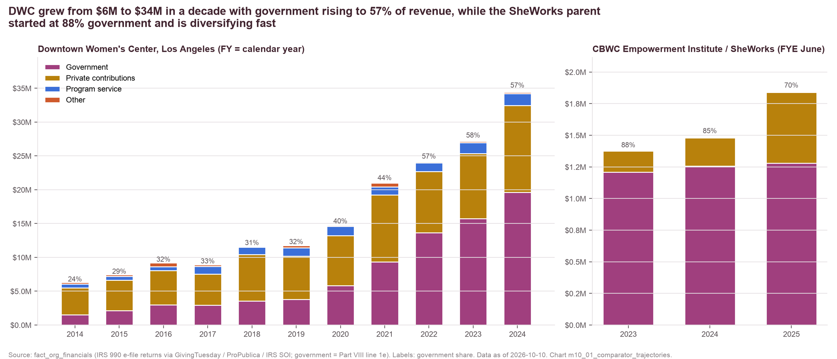
DWC's revenue rose from $6.3M to $34.4M between FY2014 and FY2024 as its government share rose from 24% to 57%.
DWC (LA, reference)
Private contributions tripled ($4.0M → $12.8M) but fell from 64% to 37% of revenue.
Program service revenue (social enterprise, rental) about 5%.
Months of cash 1.8–4.4 throughout (2.4 in FY2024).
Fiscal year = calendar year; government = 990 line 1e.
Source: IRS 990 e-file returns (GivingTuesday, ProPublica, IRS SOI); fact_org_financials
Method: government = Part VIII line 1e; labels show government share; DWC FY = calendar year, CBWC FYE June
Chart m10_01 · data as of 2026-10-10 · method note B3

Slide 18
DWC's filings show revenue up 5.5 times in a decade on 1.8–4.4 months of cash, which is the scale-with-government path.
Fiscal year | Total revenue | Government | Private contributions | Program service | Other | Government share | Total expenses | Net assets | Months of cash
FY2014 | $6,307,637 | $1,505,778 | $4,008,514 | $528,770 | $264,575 | 24% | $7,252,887 | $17,792,658 | 2.1
FY2015 | $7,435,079 | $2,125,014 | $4,528,111 | $556,917 | $225,037 | 29% | $7,371,626 | $17,685,957 | 2.6
FY2016 | $9,176,562 | $2,978,075 | $5,079,605 | $553,562 | $565,320 | 32% | $9,046,705 | $17,489,376 | 2.1
FY2017 | $8,927,525 | $2,928,189 | $4,598,083 | $1,120,103 | $281,150 | 33% | $10,092,147 | $16,546,477 | 2.1
FY2018 | $11,589,269 | $3,535,362 | $6,873,264 | $1,110,047 | $70,596 | 31% | $10,935,298 | $16,891,322 | 3.0
FY2019 | $11,728,685 | $3,783,833 | $6,379,373 | $1,243,185 | $322,294 | 32% | $11,962,655 | $17,097,947 | 2.9
FY2020 | $14,724,778 | $5,841,251 | $7,380,276 | $1,356,408 | $146,843 | 40% | $13,433,897 | $18,411,155 | 4.4
FY2021 | $20,994,562 | $9,310,478 | $9,914,051 | $1,173,738 | $596,295 | 44% | $16,941,771 | $22,403,467 | 3.1
FY2022 | $24,112,515 | $13,657,270 | $9,017,048 | $1,297,220 | $140,977 | 57% | $23,762,411 | $21,955,706 | 2.1
FY2023 | $27,162,816 | $15,727,674 | $9,608,643 | $1,638,283 | $188,216 | 58% | $27,127,703 | $22,321,663 | 1.8
FY2024 | $34,403,997 | $19,624,976 | $12,804,317 | $1,799,024 | $175,680 | 57% | $28,943,860 | $28,330,491 | 2.4
Source: IRS 990 e-file returns (GivingTuesday, ProPublica, IRS SOI); fact_org_financials
Method: preferred 990 rows; government = line 1e; fiscal year ends December
Chart m10_01 · data as of 2026-10-10 · method note B3

Slide 19
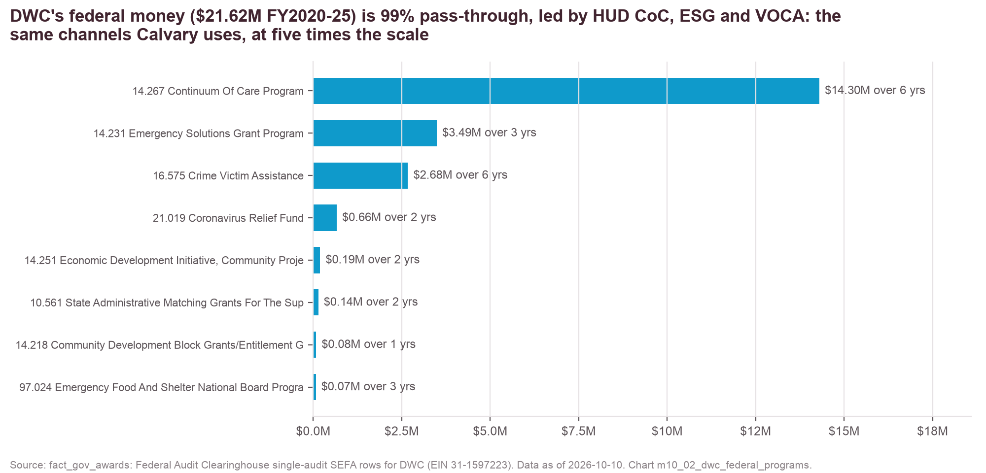
DWC's federal programs by assistance listing, FY2020–25, total $21.6M, 99% passed through, led by HUD CoC at $14.3M.
Listing | Program | Expenditures FY2020–25 | Years | Pass-through
14.267 | Continuum of Care Program | $14,300,743 | 6 | yes
14.231 | Emergency Solutions Grant Program | $3,491,358 | 3 | yes
16.575 | Crime Victim Assistance | $2,675,190 | 6 | yes
21.019 | Coronavirus Relief Fund | $662,128 | 2 | yes
14.251 | Economic Development Initiative, Community… | $194,254 | 2 | no
10.561 | State Administrative Matching Grants for the… | $142,557 | 2 | yes
14.218 | Community Development Block Grants/Entitlement… | $80,945 | 1 | yes
97.024 | Emergency Food and Shelter National Board… | $71,353 | 3 | yes
 | Total | $21,618,528
These are the federal channels Calvary uses (CoC, ESG, VOCA, SNAP E&T, EFSP, Community Project Funding), at about five times the scale, routed through LA County and LAHSA rather than TCP.
Source: Federal Audit Clearinghouse single-audit SEFA for DWC, FY2020–25; fact_gov_awards (source_type fac)
Method: expenditures summed by assistance listing across audit years; pass-through flag as reported
Chart m10_02 · data as of 2026-10-10 · method note B3

Slide 20
DWC's donor lists carry 280 names, but DMV funders' filings show only $308K of grants to it.
Recipient | Source type | Rows | Funders | Amount known
DWC | annual report | 350 | 280 | bands only
DWC | pf grants paid | 51 | 5 | $264,678
DWC | schedule i | 5 | 3 | $42,918
DWC | support page | 33 | 30 | bands only
DWC | web | 8 | 6 | $5,874,200
CBWC Inst. / SheWorks | web | 5 | 5 | bands only
Announced grant (web source) | Year | Amount
Los Angeles County Board of Supervisors, First District | 2025 | $3,000,000
Conrad N. Hilton Foundation | 2026 | $1,525,000
Blue Shield of California Foundation | 2024 | $450,000
The Ahmanson Foundation | 2023 | $324,700
Anthem Blue Cross Foundation | 2026 | $300,000
Anthem Blue Cross Foundation | 2023 | $200,000
Foxwynd Foundation | 2025 | $50,000
The Ahmanson Foundation | 2024 | $24,500
DMV funder (filed grants TY2020–25) | Amount | Years
The Bank of America Charitable Foundation Inc | $154,328 | 4
Wells Fargo Foundation | $100,000 | 1
Give Lively Foundation Inc | $21,678 | 3
For the Girls Inc | $10,990 | 1
ImpactAssets Inc | $10,250 | 1
Bainum Family Foundation | $8,000 | 1
JPMorgan Chase Foundation | $2,150 | 4
RCLCO Foundation Inc | $200 | 1
Annual-report and gala lists carry giving bands, not amounts. DAF grants to LA organizations are not captured, because Schedule I rows were kept for DC/MD/VA recipients only.
Source: DWC annual reports and donor lists, gala pages, funder announcements; DMV funders' 990-PF / Schedule I; fact_grants
Method: web rows carry amounts only where a funder announced one; DMV filings aggregated by funder name as filed
Chart m10_03, m10_04, m10_05 · data as of 2026-10-10 · method note B3

Slide 21
The CBWC Empowerment Institute's three filings show government falling from 88% to 70% of revenue, and SheWorks itself starts after the last one.
Fiscal year (FYE June) | Total revenue | Government | Private contributions | Program service | Government share | Total expenses | Net assets | Months of cash
FY2023 | $1,377,300 | $1,207,810 | $169,349 | $0 | 88% | $404,768 | $972,532 | 28.5
FY2024 | $1,486,733 | $1,257,177 | $223,274 | $1,800 | 85% | $1,747,039 | $712,222 | 4.8
FY2025 | $1,840,152 | $1,280,310 | $558,331 | $1,511 | 70% | $1,506,943 | $1,043,635 | 8.2
What is known about SheWorks
What transfers to Calvary
A workforce program of the institute (Carson, CA; founded 2022), not a separate entity.
Announced October 2025; first cohort of about 30 women, January–May 2026, at the L.A. Care / Blue Shield Promise Community Resource Center in Long Beach.
Stipends, childcare and ride credits; the LA County Federation of Labor is a partial funder and the health plans host in kind.
No FAC or USAspending awards; its funding appears only in TY2025+ filings.
Program design: cohort model, stipends, childcare and transport, employer and health-plan partners, system-impacted women as a named population (an upgrade path for Step Up DC).
Partner structure: labor federation plus health plans as a corporate-partnership pattern.
Not a funding model to copy: the parent is more government-reliant than Calvary.
Source: IRS 990 e-file returns (fact_org_financials); institute, partner and press web pages (fact_grants web rows); modules/m10_comparator_profiles.md
Method: government = line 1e; months of cash as filed; program facts as published by the institute and partners
Chart m10_01 · data as of 2026-10-10 · method note B3

