Slide 1
Calvary funding analysis: consulting team deck
This analysis answers two questions for Calvary: how much pressure its government reliance creates, and which other funding fits. Full methods, evidence and the complete pipeline.

Slide 2
The analysis rests on 25 public-record tables, with every row carrying a source and a retrieval date.
Table | Grain | Rows | Main sources
fact_org_financials | org × fiscal year × source | 150,461 | IRS 990 e-file XML (GivingTuesday), NCCS, IRS SOI, ProPublica, Calvary audits and 990 PDFs
fact_grants | grant record | 928,658 | 990-PF grants paid, Schedule I (DMV funders, DAF sponsors filtered to DC/MD/VA), CRM export, annual reports, web lists
fact_gov_awards | award / subaward / expenditure | 40,300 | USAspending, FAC single audits, Calvary SEFA, Treasury SLFRF, DC OVSJG, DC Council oversight, DC PASS, HUD CoC
fact_policy_events | dated budget or policy change | 297 | DC budget books FY2024–FY2027, Council committee reports, Budget Support Act
fact_opportunities | open or forecast opportunity | 286 | Grants.gov
fact_roles / dim_person | person × org × year | 163,473 / 48,563 | 990 Part VII, 990-EZ, 990-PF officers, Calvary annual reports (roles only)
fact_org_relationships | org pair × type × year | 544,041 | grants, DAF grants, pass-through, Schedule R, shared board members (confidence-rated)
dim_org / dim_funder / dim_universe_membership | organization / funder / universe rule | 105,189 / 8,928 / 17,210 | IRS BMF, e-file index, config rules
dim_geo / dim_period | ward, tract, county / year | 246 / 28 | ACS 2020–24, DC MAR, CPI-U
supp_* (7 tables) | various | — | HUD PIT/HIC, DC budget lines, Calvary program metrics, strategic targets, donor bands, CRM verification
Source: calvary_funding_data/README.md, reports/data_inventory.md, reports/data_quality.md
Method: Prompt 1 data build, QC'd and rebuild-tested; see appendix D
Chart input_map · data as of 2026-10-10 · method note D2

Slide 3
Calvary is compared with 18 provisional DC-area peers, two Los Angeles comparators, and three universes of 163 to 542 organizations.
Universe | Size | Definition | Used for
calvary | 1 | The subject organization | All modules
core_peers (provisional) | 18 | DC-area organizations serving homeless women, DV survivors, recovery; four tiers (DC women/homeless; DC DV; DC homeless/recovery and Ward 7/8; DMV women/DV) | M3, M5, M6, M7
named_comparators | 2 | Downtown Women's Center (LA) and the CBWC Empowerment Institute / SheWorks (LA), at the CEO's request | Reference rows everywhere; M10
dc_sector | 1,027 | DC public charities in homelessness, housing, DV, human services and adjacent NTEE codes | M3 distributions; M4 landscape lens A
size_matched | 566 | National shelter / DV / women's-center organizations with revenue 0.5–2× Calvary's | M3 distributions
national_women | 2,878 | National DV shelters, women's centers, women-named homeless/housing organizations | M3 distributions
dmv_funders | 7,705 | DC/MD/VA private foundations and grantmaking public charities | M4–M7
daf_sponsors | 15 | National DAF sponsors, Schedule I kept for DC/MD/VA recipients | M4 (channel), excluded from the pipeline
Source: dim_universe_membership; config/universes.yaml; config/core_peers.csv
Method: rules in reports/universe_summary.md; peers swapped by editing core_peers.csv and rerunning
Chart universe_summary · data as of 2026-10-10 · method note D2

Slide 4
Government share uses the audit basis where audits exist, because the 990 line understated Calvary's contracts by $1.5M in FY21.
Measure choice
Audits FY13–FY23 report government contracts and grants together; the 990 line 1e reports government grants only.
FY21: audit $1.98M vs line 1e $503K (contracts booked in line 1f).
FY22 and FY23: identical on both measures, so FY24–25 line 1e is treated as audit-equivalent.
Peers are compared on line 1e, the only measure available for them.
Source: Calvary audited financial statements FY13–FY23 and IRS 990 returns, fact_org_financials
Method: share = government revenue ÷ total revenue on each basis
Chart m1_03 · data as of 2026-10-10 · method note A1

Slide 5
The limitations are known and bounded, from missing FY24–25 audits and one-year DHS values to partial filings and provisional peers.
Limitation | Effect | Mitigation
No public FY24/FY25 audits | Government share for the two latest years rests on 990 line 1e | Line 1e matched audits in FY22–23; ceilings-vs-recognized cross-check (A5); audits requested
DHS/TCP contract values public for FY2024 only | Award base understated in other years; scenario baseline carries FY2024 forward | Flagged in every chart; TCP agreements requested
TY2024 foundation filings partial, TY2025 mostly unfiled | Recent private trends understated | TY2020–23 as the trend window; TY2024 labeled 'arriving'
'See attached' grant lists (667 rows, ~$3.5B DMV-wide) | Some funders' grants have no recipient names | Flagged per funder; accessibility penalty in scoring
Provisional core peers | Ranks move if the set changes | Sector percentiles reported alongside; swap via config
Interlock name matching | Medium-confidence links may be different people | Leadership materials use high confidence only; medium labeled unconfirmed
Corporate giving without a foundation | Invisible in filings | CRM reconciliation; corporate track scored by analyst
Source: reports/data_quality.md; module readouts (Caveats)
Method: each limitation maps to a mitigation used in the analysis
Chart — · data as of 2026-10-10 · method note D3

Slide 6
2. Calvary's trajectory
Calvary grew on public partners, private giving held steady, and FY25 ended in deficit with 4.4 months of cash.

Slide 7
Calvary's revenue grew 59% in real terms from FY19 to FY25, and the FY22 spike was a one-time building award.
Trajectory
$1.45M (FY11) → $4.97M (FY25) nominal; $2.49M (FY19) → $4.97M nominal is +59% after inflation ($3.05M → $4.84M in 2024 dollars).
FY22: $8.87M including the $3.68M SLFRF award that bought the New Foundations building.
Expenses passed revenue in FY23 and FY25.
Source: IRS 990 returns FY2011–FY2025 (fact_org_financials), CPI-U (dim_period)
Method: 2024 dollars via CPI-U annual average by fiscal-year-end year
Chart m1_01 · data as of 2026-10-10 · method note A1

Slide 8
Government supplied 40–61% of revenue every year since FY15 and most of the growth.
Mix
Government share by year: FY15 41%, FY16 44%, FY17 40%, FY18 42%, FY19 49%, FY20 55%, FY21 50%, FY22 61%, FY23 51%, FY24 45%, FY25 58%.
Private contributions ex events = contributions total − government − line 1c events (the 990 does not split foundations from individuals).
The FY25 return reported the gala on line 8a, so it sits in other revenue net of direct costs (see the events slide).
Source: Calvary audits FY15–FY23 (government revenue) and IRS 990 returns, fact_org_financials
Method: government on the audit basis to FY23, line 1e FY24–25
Chart m1_02 · data as of 2026-10-10 · method note A1

Slide 9
The audit basis and the 990 line agree except in FY21, so the FY24–25 figures can be read as audit-equivalent.
Reconciliation
FY21 audit government revenue $1,981,161; line 1e $503,222; line 1f $3,063,099.
FY22: both $5,685,504. FY23: both $2,460,897.
FY24 line 1e $2,621,203 (45%); FY25 $2,892,598 (58%).
Source: fact_org_financials (audit rows and preferred 990 rows)
Method: see method note A1
Chart m1_03 · data as of 2026-10-10 · method note A1

Slide 10
Calvary ran deficits in two of the last three years, and its cash cushion fell from 7.5 to 4.4 months.
Margin and cash
FY23 −$674K; FY24 +$507K; FY25 −$607K.
Months of cash: FY20 6.3, FY21 7.5, FY22 6.3, FY23 5.0, FY24 5.2, FY25 4.4.
Net assets $8.1M at FY25, mostly the building.
Source: IRS 990 returns, fact_org_financials
Method: surplus = total revenue − total expenses; months of cash = cash and savings ÷ monthly expenses
Chart m1_04, m1_05 · data as of 2026-10-10 · method note A1

Slide 11
Event receipts held near $0.5–0.6M in FY23–FY25, because the FY25 return reported the gala on a different line.
Flag D3, closed
Lines 1c + 8a: $519K (FY23), $596K (FY24), $533K (FY25).
FY25: line 1c $55K and line 8a $478K, with $259K of direct costs netted on line 8c (+$219K).
The 2025 gala was held on 23 April 2025, inside FY25, and the 2026 gala raised over $620K.
Source: IRS 990 Part VIII lines 1c, 8a and 8c, fact_org_financials; Calvary gala announcements
Method: event receipts = line 1c event contributions + line 8a gross fundraising-event income
Chart m1_06 · data as of 2026-10-10 · method note A1

Slide 12
Filed institutional grants stayed near $1M a year from 26–29 funders, and GWCF supplied 27% of five years' total.
Concentration
$4.43M from 50 funders TY2020–24; institutional $3.34M, DAF sponsors $1.09M.
GWCF 27%, top five 63%; HHI 1,168.
By year: TY2020 $637K (27 funders) … TY2024 $1.17M (26), partial.
Source: Funders' 990-PF / Schedule I rows naming Calvary, fact_grants; dim_funder
Method: non-cumulative rows, aggregated by funder EIN
Chart m1_07, m1_08 · data as of 2026-10-10 · method note A3

Slide 13
3. Government funding
Three streams, one hub, stable pools with annual threats, and a draw-down question.

Slide 14
Calvary's recurring government awards grew from $0.6M (2020) to $4.1M (2024) across OVSJG, HUD CoC and DHS via TCP.
Streams
OVSJG recurring: $369K (FY20) → $1.05M (FY26).
HUD CoC: $240K (2019) → $1.77M (FY2025).
DHS/TCP: $1.42M (FY2024 only).
One-time: SLFRF $3.68M, PPP $327K, HUD CPF $200K.
2019 includes two Reach Up records ($292K and $369K) that may be one award recorded twice, so the series is quoted from 2020.
Source: fact_gov_awards: dc_ovsjg, hud_coc, dc_oversight, audit_sefa rows for Calvary
Method: one source per stream; DC FY for OVSJG/DHS, HUD competition year for CoC; TCP carries 78% of the 2024 base
Chart m2_01, m2_01b · data as of 2026-10-10 · method note A2

Slide 15
Seven streams carry different renewal risks, and the DHS contract and Sisters Rise are the least documented and the riskiest.
Stream | First → latest | Funding source | Renewal mechanism | Durability risk
DHS/TCP: Sisters Rise EHV | $593K (2024) → $593K (2024) | DC local funds via TCP, paired with Emergency Housing Vouchers | Annual provider contract (25 units); the project left the HIC in 2025 | High: HUD's 29 September 2026 notice ends the EHV program (vouchers convert by 31 December 2026 and cannot be reissued); the 2025 HIC no longer lists Sisters Rise PSH
DHS/TCP: Transitional Housing | $830K (2024) → $830K (2024) | DC local funds via TCP (DHS Homeless Services Continuum) | Annual provider contract via TCP (45 beds) | Medium-high: single public data point; TCP's DHS POs fell sharply in FY2025 after DC's financial-system change
CoC: New Foundations 2 | $470K (2023) → $546K (2025) | Federal HUD CoC 14.267 via TCP | Annual renewal; new in 2023 | Medium: a young project is the first to go in a tight competition
CoC: Reach Up | $1,222K (2021) → $924K (2025) | Federal HUD CoC 14.267 via TCP | Annual renewal; expanded in 2024 | Medium: TCP reallocation cut it from $1.22M to $0.42M in 2022, then it grew to $0.92M
CoC: Sister Circle PSH | $240K (2019) → $297K (2025) | Federal HUD CoC 14.267 via TCP | Annual renewal in the DC CoC competition | Medium-low: PSH renewals are usually protected; FY2025 renewals were paid in full after the NOFO was enjoined, and the FY2026 competition (awards about December 2026) is the live question
OVSJG: New Foundations TH | $439K (2023) → $543K (2026) | DC local funds | Annual OVSJG grant; started FY23 after the FY22 building award | Medium: as above; tied to a DV-designated site
OVSJG: Reach Up TH | $661K (2019) → $508K (2026) | DC local funds (FY24-26 lists); SLFRF-funded in FY22-23 | Annual OVSJG grant; continuation funding | Medium: annual, Mayor proposed cuts to Victim Services grants in FY26 and FY27, Council restored both
Source: fact_gov_awards, fact_policy_events, supp_hic_projects
Method: risk ratings are analyst judgment (basis = inferred)
Chart m2_03 · data as of 2026-10-10 · method note A2

Slide 16
Calvary recognized 73% (FY24) and 67% (FY25) of its known award ceilings as revenue, a gap the audits would explain.
Ceilings vs recognized
FY24 ceilings $3.60M vs recognized $2.62M (73%).
FY25 ceilings $4.29M vs $2.89M (67%).
Flag D1: the audited FY22–23 single audits show CoC spending at 28% and 58% of the prior year's CoC awards, so reconcile CoC first, then DHS.
The 2021 Reach Up expansion ($1.22M, reallocated to $0.42M in 2022) explains part of the CoC gap.
Source: fact_gov_awards aligned to Calvary FY; fact_org_financials
Method: CoC competition year t → Calvary FY t+1; DHS FY2024 carried forward; EFSP/SNAP at audited FY23 level; CoC draw rate = SEFA expenditure ÷ prior-year awards
Chart m2_02 · data as of 2026-10-10 · method note A5

Slide 17
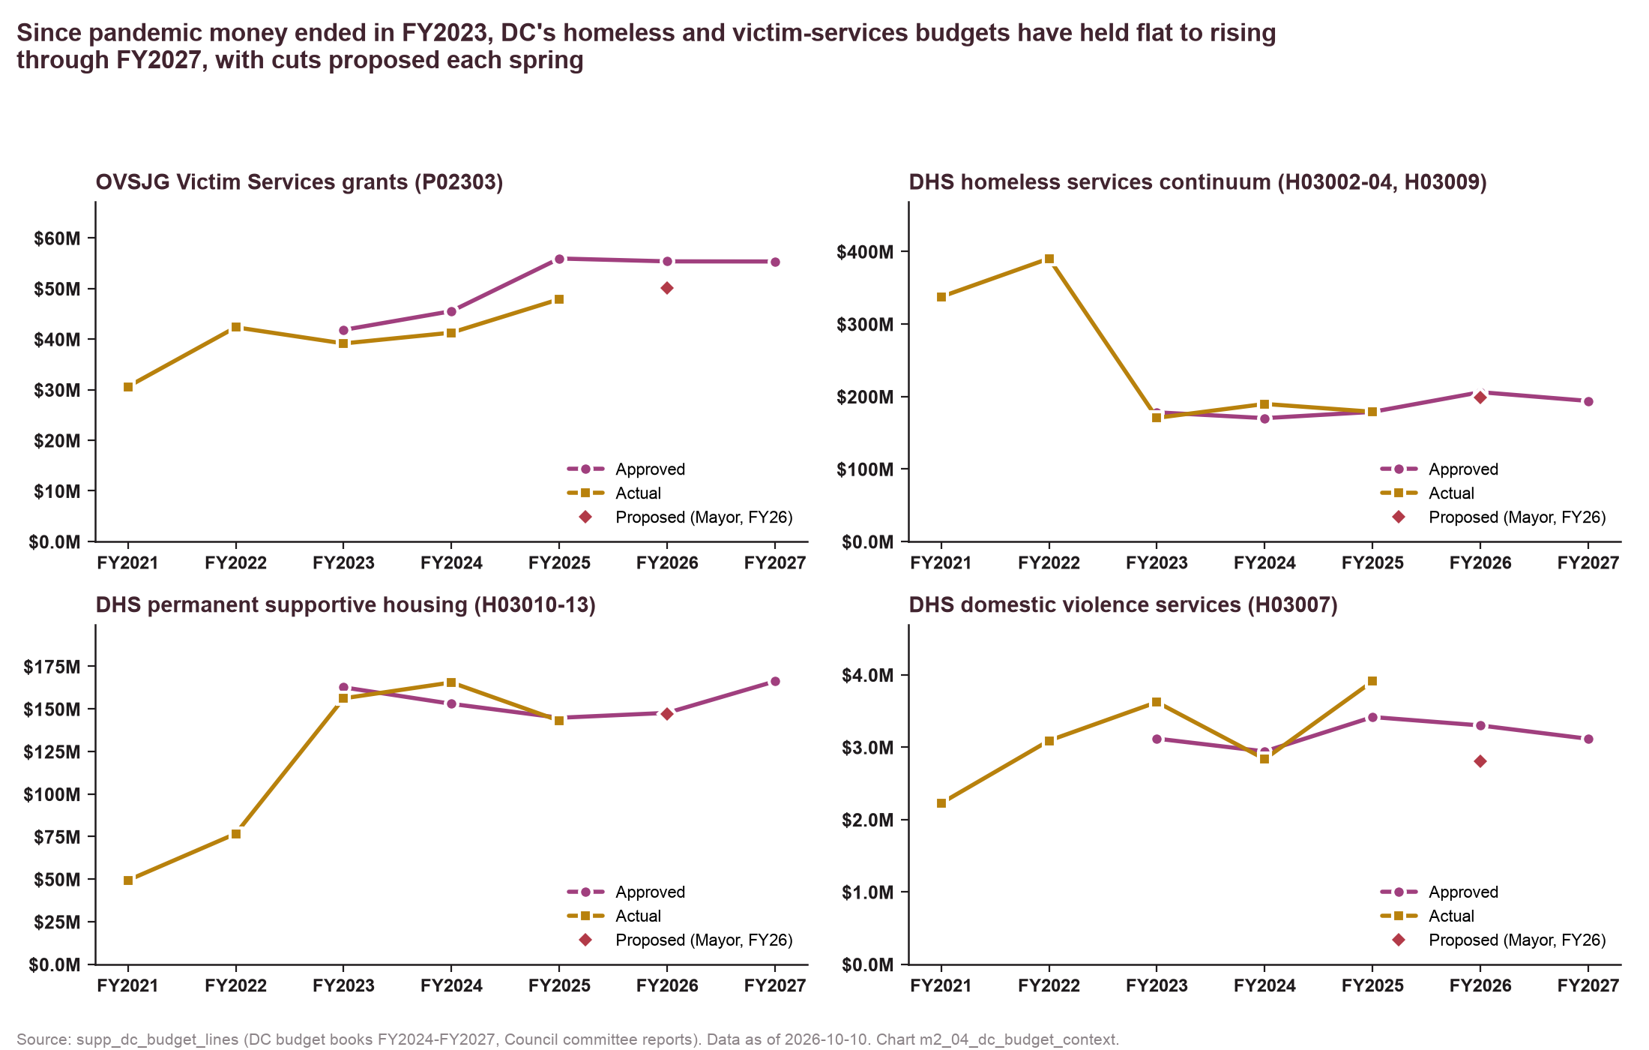
Since pandemic money ended, DC's homeless, PSH and victim-services budgets have held flat to rising through FY2027.
Budget lines
OVSJG P02303 approved: $45.5M FY24, $55.9M FY25, $55.4M FY26, $55.3M FY27; actual $41.3M FY24, $47.9M FY25.
DHS continuum $170M → $206M → $194M; PSH $153M → $145M → $148M → $166M.
DV services $2.9–3.4M, cut proposed and restored twice.
Source: supp_dc_budget_lines (DC budget books FY2024–FY2027, Council committee reports)
Method: activity-level totals by program code
Chart m2_04 · data as of 2026-10-10 · method note A6

Slide 18
The Mayor proposed victim-services and DV cuts in each of the last two springs, and the Council restored them.
Pattern
FY26: Mayor −$5.8M to Victim Services grants; Council +$3.5M committee and +$6.0M one-time enhancement.
FY27: Mayor −$5.6M; Council restored $5.1M one-time and $0.5M recurring, so FY2028 is the next test.
DHS DV services −$500K proposed in both years; restored.
OVSJG under-spend vs approved is the quieter risk.
Source: fact_policy_events (DC budget books, Council committee reports)
Method: events of $2M or more touching the homeless continuum, PSH, DV and victim-services lines
Chart m2_06 · data as of 2026-10-10 · method note A6

Slide 19
Calvary holds about 1% of OVSJG awards and 5% of DC's CoC awards, so growth comes from winning projects.
Pools
OVSJG total awards $47M (FY20) → $97M (FY26); Calvary 0.7–1.5% (4.6% in FY22 with the building award).
DC CoC awards $22M (2019) → $33.5M (FY2025); Calvary 1.1% → 5.3%.
Source: fact_gov_awards: OVSJG award lists (all recipients) and HUD CoC awards (DC-500)
Method: Calvary ÷ pool total by year
Chart m2_05 · data as of 2026-10-10 · method note A2

Slide 20
OVSJG cuts cost $67–250K, a lost CoC project $0.2–0.4M, a lost DHS/TCP contract $0.65–1.13M, and the combined case $1.05–1.47M.
Scenario | Revenue loss (range) | % revenue | Floor case D | Months of cash after 12m (net) | Months to zero cash (net, point)
Baseline FY25 (actual) | – | – | – | 3.1 | 41
OVSJG grants cut 10% | −$67K to −$100K | 1–2% | −$100K | 3.0–3.1 | 39
OVSJG grants cut 25% | −$168K to −$250K | 3–5% | −$250K | 2.9–3.0 | 36
HUD CoC renewals cut 15% | −$99K to −$207K | 2–4% | −$264K | 2.9–3.0 | 36
One CoC project lost (New Foundations 2) | −$204K to −$424K | 4–9% | −$542K | 2.7–2.9 | 31
DHS/TCP contract not renewed | −$650K to −$1,125K | 13–23% | −$26K | 1.9–2.4 | 23
Combined (OVSJG -25%, CoC -15%, DHS lost) | −$1,052K to −$1,474K | 21–30% | −$540K | 1.5–2.0 | 20
Source: fact_gov_awards, fact_org_financials; config/scenarios.yaml
Method: baseline FY25: revenue $4.97M, expenses $5.58M, cash $2.06M, government $2.89M; splits A ceiling share, B CoC at its FY22–23 draw rate (DHS residual), C without Sisters Rise; floor D draws OVSJG and CoC in full
Chart m2_07 · data as of 2026-10-10 · method note A4

Slide 21
4. Peer benchmarking
Calvary is mid-pack on government share, fast on growth, average on cash, and above most peers on institutional depth.

Slide 22
Calvary's 53% government share ranks 11th of 19 DC-area organizations, below every DC DV provider and above the philanthropy-led models.
Typology
Government-anchored (≥65%): DC SAFE, Open Arms, My Sister's Place, Everyone Home DC, Heartly House, DASH, CBWC Institute.
Mixed (35–65%): Coalition, House of Ruth MD, DWC, New Endeavors, House of Ruth DC, Calvary, Covenant House, Doorways, Samaritan Inns, N Street Village, Community of Hope.
Philanthropy-led (<35%): Christ House, Thrive DC, Miriam's Kitchen.
Source: fact_org_financials (990 line 1e; Calvary audit basis FY22–23)
Method: FY2022–24 mean; provisional peers; LA comparators as reference
Chart m3_01 · data as of 2026-10-10 · method note B1

Slide 23
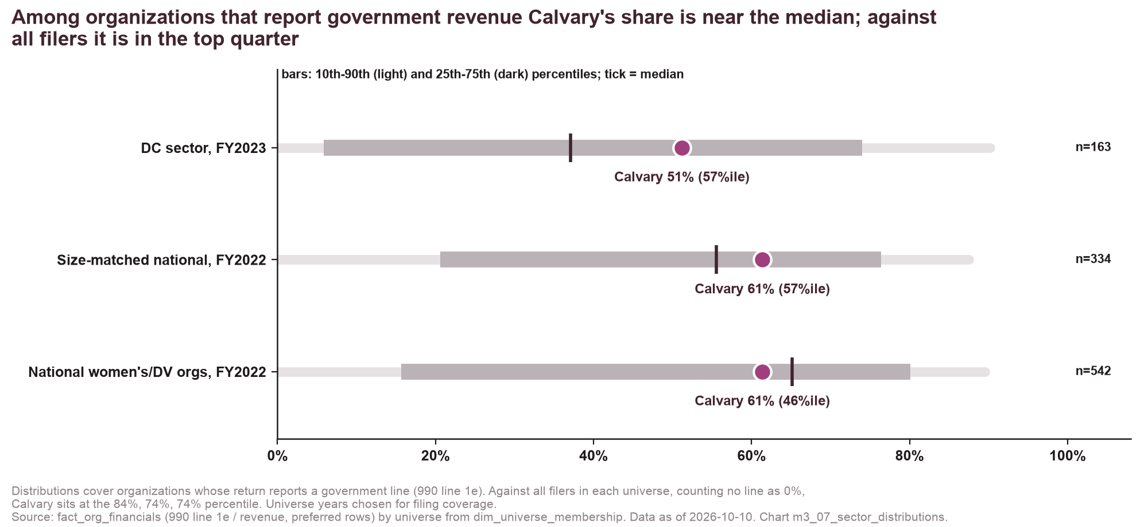
Among organizations that report government revenue Calvary is typical, and against all filers it sits in the top quarter.
Distributions
Among reporters of government revenue:
DC sector FY2023 (n=163): median 37%, Calvary 51% (57th percentile).
Size-matched national FY2022 (n=334): median 56%, Calvary 61% (57th).
National women's/DV FY2022 (n=542): median 65%, Calvary 61% (46th).
Against all filers (no line = 0%):
84th in DC (n=426), 74th size-matched (n=556), 74th women's/DV (n=1,124).
Source: fact_org_financials by universe (dim_universe_membership)
Method: percentile among organizations reporting government revenue; the all-filers percentile counts a missing government line as 0%
Chart m3_07 · data as of 2026-10-10 · method note B1

Slide 24
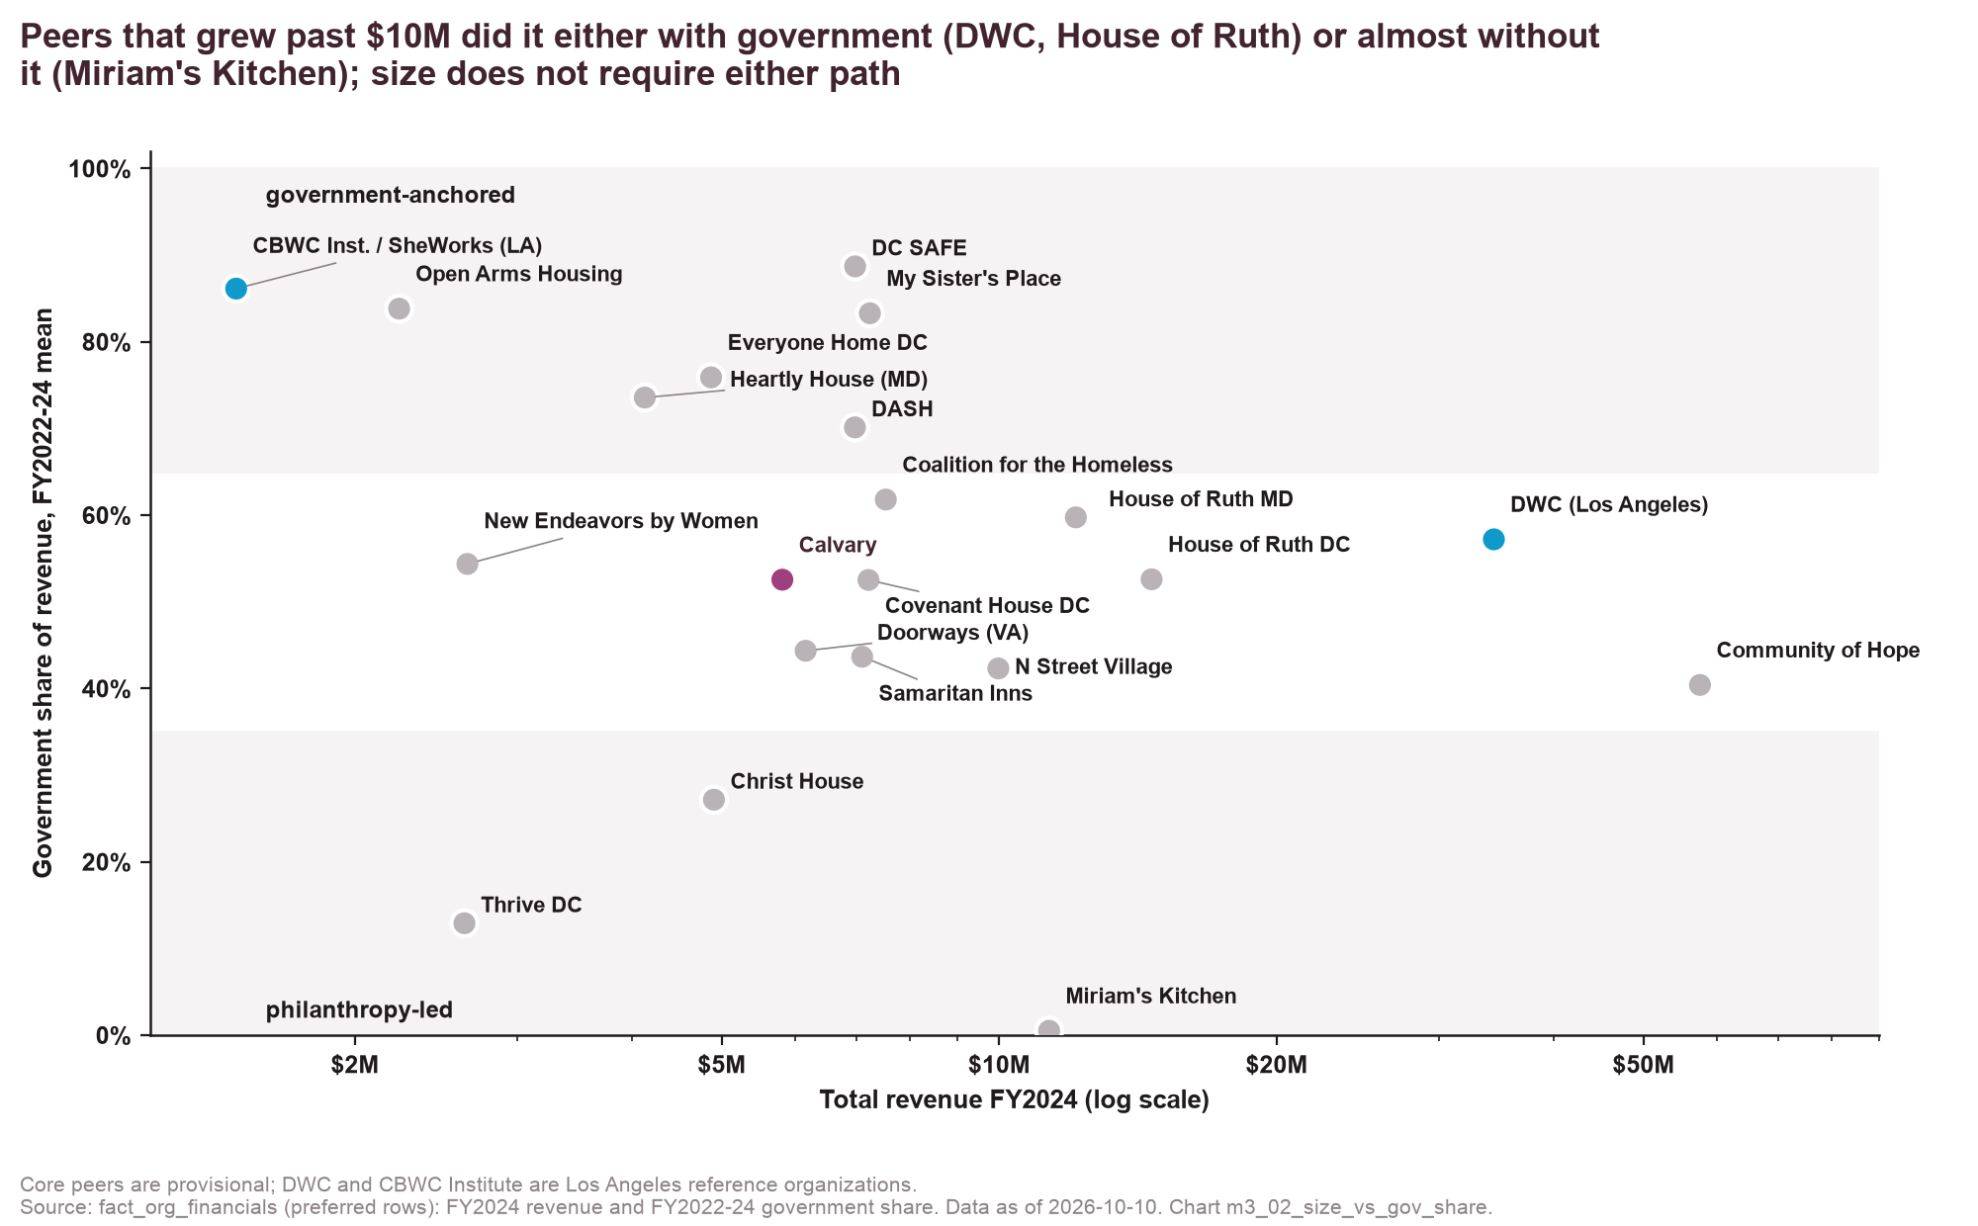
Peers grew past $10M with government (DWC, House of Ruth) or almost without it (Miriam's Kitchen), so size requires neither.
Source: fact_org_financials: FY2024 revenue and FY2022–24 government share
Method: log revenue axis; typology bands shaded
Chart m3_02 · data as of 2026-10-10 · method note B1

Slide 25
Calvary's real growth of 13.8% a year since FY19 trails only My Sister's Place, DWC and DC SAFE among peers.
Growth
Endpoints FY2019 and FY2024 avoid Calvary's one-time FY22 award.
CBWC Institute omitted (founded 2022).
Source: fact_org_financials, dim_period CPI-U
Method: compound annual growth of 2024-dollar revenue
Chart m3_03 · data as of 2026-10-10 · method note B1

Slide 26
Calvary's 5.2 months of cash in FY24 is mid-pack, between DV providers at one month and Doorways at twelve.
Liquidity
Calvary 5.2 (FY24), 4.4 (FY25).
DC SAFE 0.9, Heartly House 1.0, New Endeavors 0.5, Covenant House 1.1.
Doorways 12.1, Everyone Home DC 9.9, N Street Village 8.0.
Source: fact_org_financials: cash_savings_eoy, total_expenses
Method: cash and savings ÷ monthly expenses
Chart m3_04 · data as of 2026-10-10 · method note B1

Slide 27
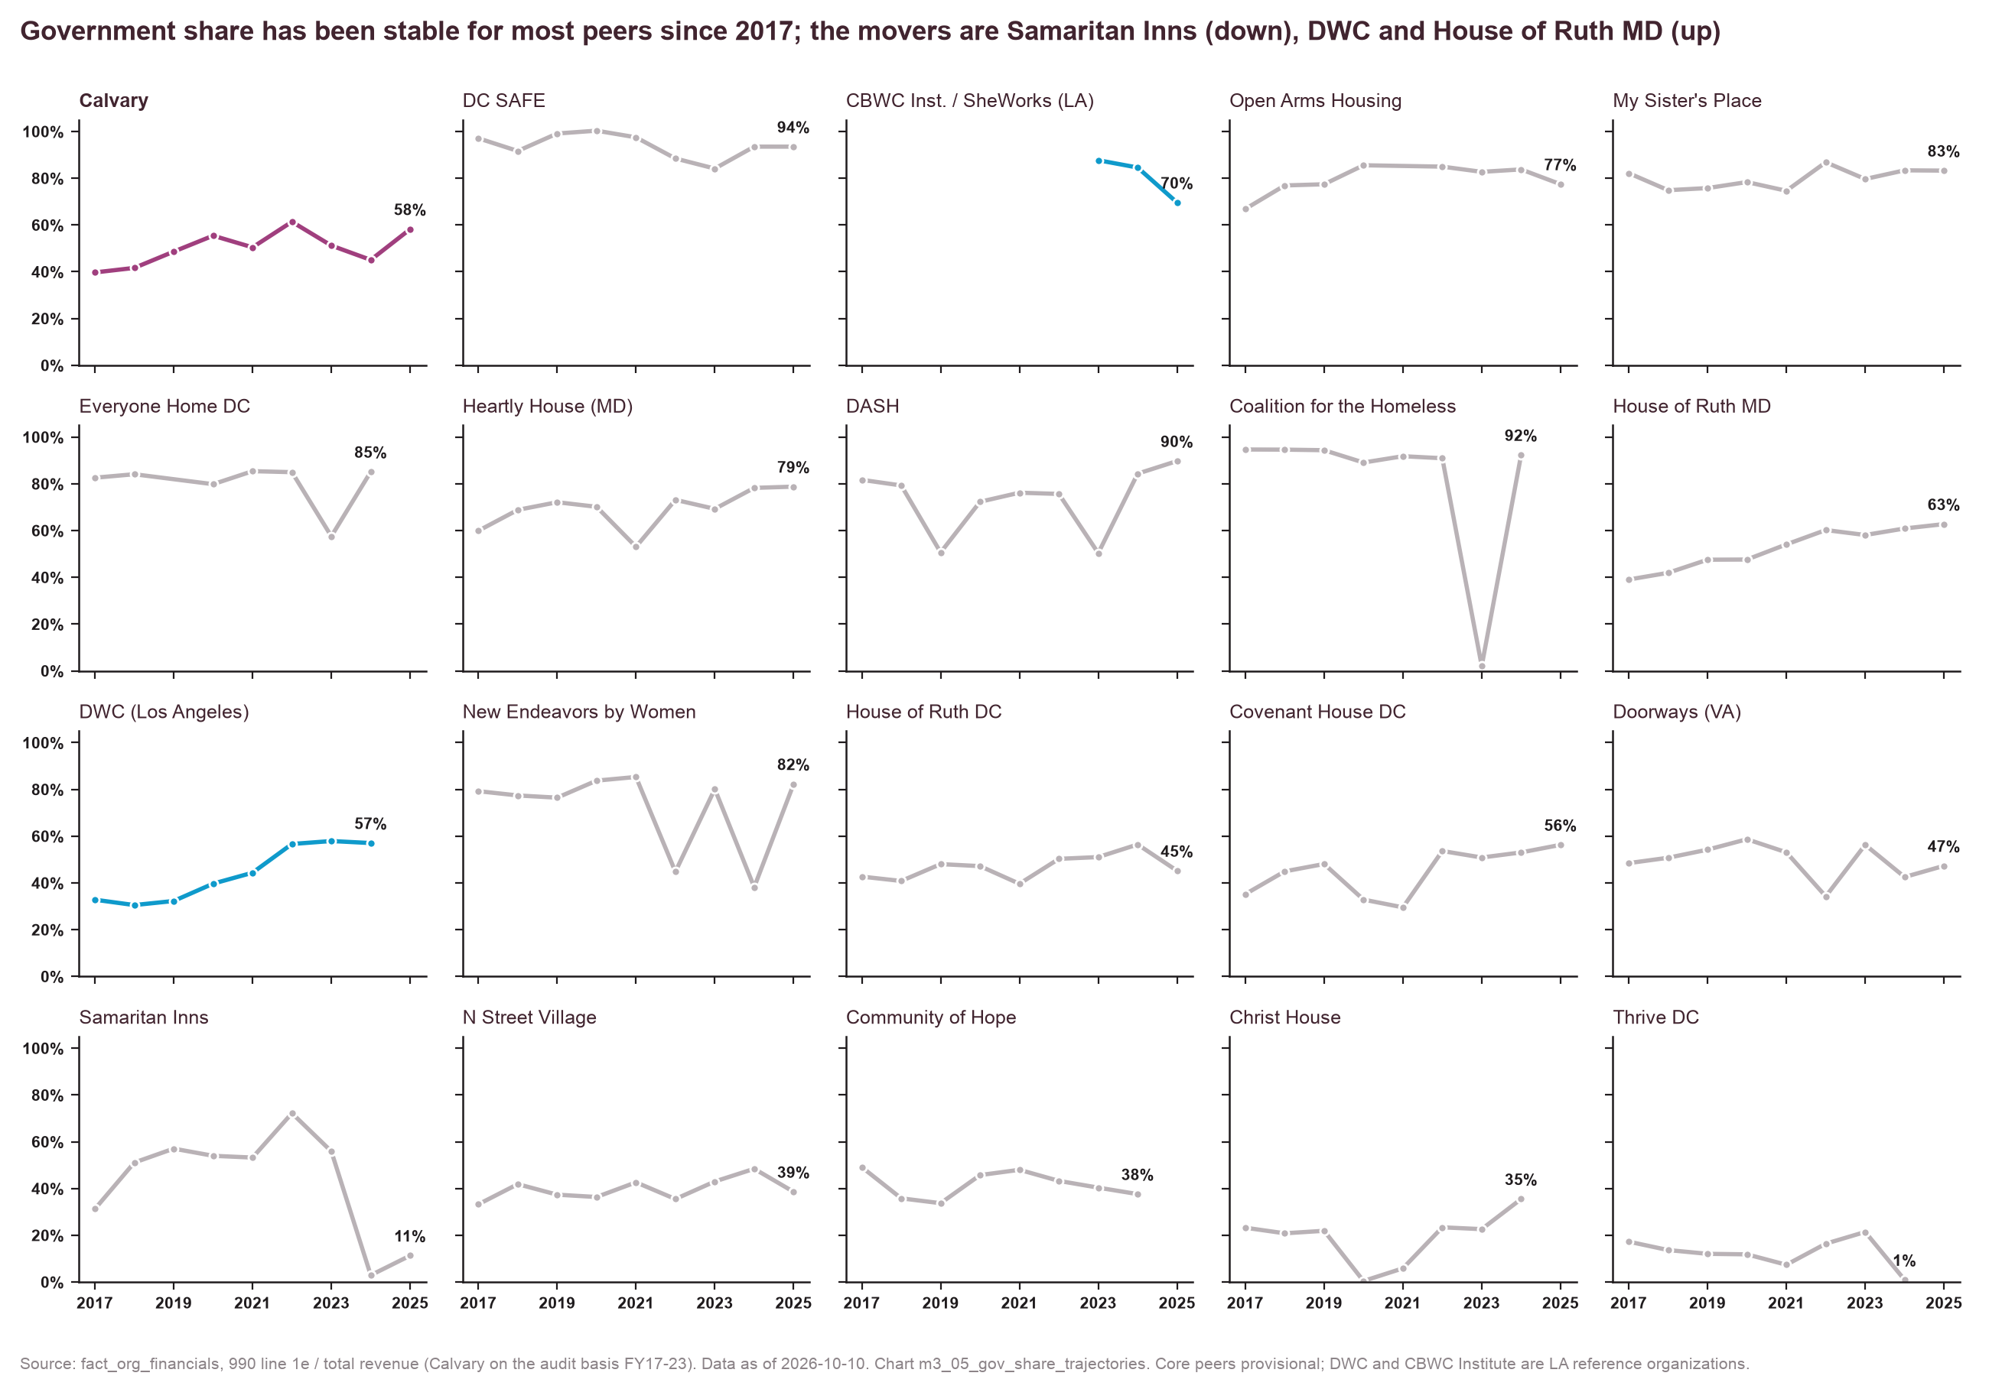
Most peers' government share has held since 2017, except Samaritan Inns (down) and DWC and House of Ruth MD (up).
Source: fact_org_financials (990 line 1e; Calvary audit basis FY17–23)
Method: small multiples, one organization per panel
Chart m3_05 · data as of 2026-10-10 · method note B1

Slide 28
Calvary's institutional grants equal 12% of revenue, above all peers except Samaritan Inns, so the headroom is depth per funder.
Depth and DAF share
Calvary 12% with 42 funders; Samaritan Inns 27% with 14.
DAF share of filed grants: Calvary 25%; N Street Village 51%; Miriam's Kitchen 41%; House of Ruth DC 37%; Doorways 42%.
DMV funders' filings only; LA comparators not comparable.
Source: fact_grants, dim_funder, fact_org_financials
Method: institutional = non-DAF funders; dollars ÷ FY2020–24 revenue
Chart m3_06 · data as of 2026-10-10 · method note B2

Slide 29
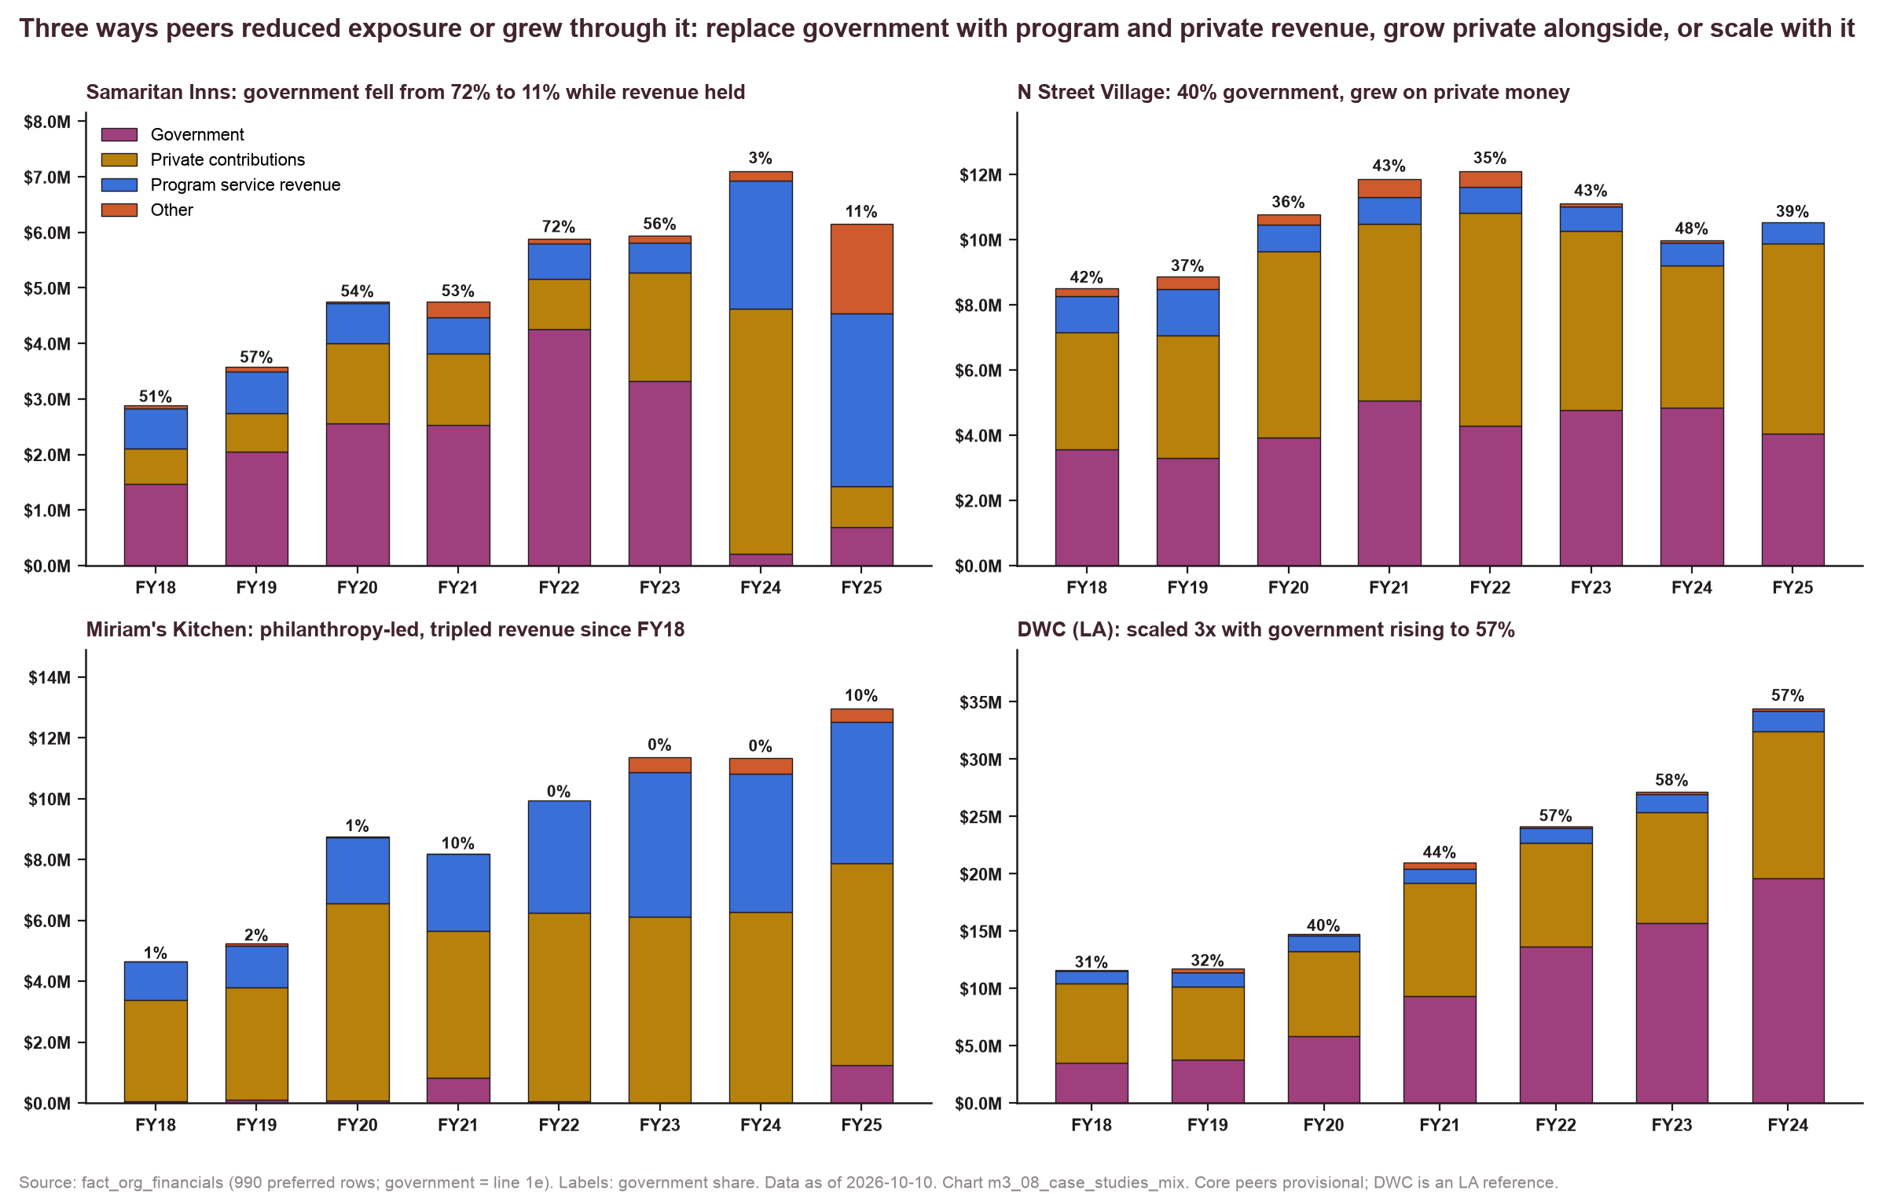
Peers show three replicable paths: replacing government with program revenue, growing private alongside it, or scaling with it.
Source: fact_org_financials (990 preferred rows; government = line 1e)
Method: revenue mix by year for four organizations
Chart m3_08 · data as of 2026-10-10 · method note B1

Slide 30
The DV peers draw $3–5M a year each from OVSJG, while Calvary's $1.05M makes it a mid-sized grantee.
Shared pools
OVSJG FY2026: DASH $5.28M, DC SAFE $4.61M, My Sister's Place $3.81M, House of Ruth DC $3.17M, Calvary $1.05M.
CoC FY2025: Christ House $2.98M, My Sister's Place $2.06M, Calvary $1.77M, House of Ruth DC $1.38M, DASH $1.38M.
Source: fact_gov_awards: OVSJG FY2026 list; HUD CoC FY2025 awards
Method: DC pools only
Chart m3_09 · data as of 2026-10-10 · method note A2

Slide 31
5. Funder landscape and gaps
The pool is large and concentrated, most majors already fund Calvary, and the gaps are specific and named.

Slide 32
DMV funders put about $132M a year into DC's homelessness and human-services organizations, 58% of it through donor-advised funds.
Lens A
$660M TY2020–24 to 1,027 dc_sector organizations; 555 institutional funders.
Institutional dollars $50–52M/yr TY2020–23, $72M in TY2024 (partial filings).
Includes Clark's $32.8M spend-down (closed end of 2025).
Excludes Gates (global/research recipients) and TCP (a pass-through intermediary with no itemized Schedule I): config/landscape_exclusions.csv.
Source: fact_grants (990-PF / Schedule I TY2020–24) to dc_sector recipients; dim_funder
Method: funder tax years; TY2024 partial
Chart m4_01, m4_02 · data as of 2026-10-10 · method note C1

Slide 33
Ten institutional funders supply 55% of foundation dollars to DC's sector, and six of the 25 largest already fund Calvary.
Majors
Fund Calvary: GWCF, Cafritz, Bank of America, United Way NCA, Jane Bancroft Robinson, Abell.
Do not: Clark ($32.8M, a spend-down, closed end of 2025), JPMorgan Chase (matching-gift channel), Wal-Mart, Casey, Weinberg, Morningstar, Diana Davis Spencer, Rast, Meyer, Capital Area Food Bank, Wells Fargo, Bernstein, PepsiCo, Washington Home.
Top 10 = about half of institutional dollars (concentration curve in appendix C).
Source: fact_grants, dim_funder (landscape table m4_00)
Method: institutional = non-DAF; exclusions applied
Chart m4_03, m4_04 · data as of 2026-10-10 · method note C1

Slide 34
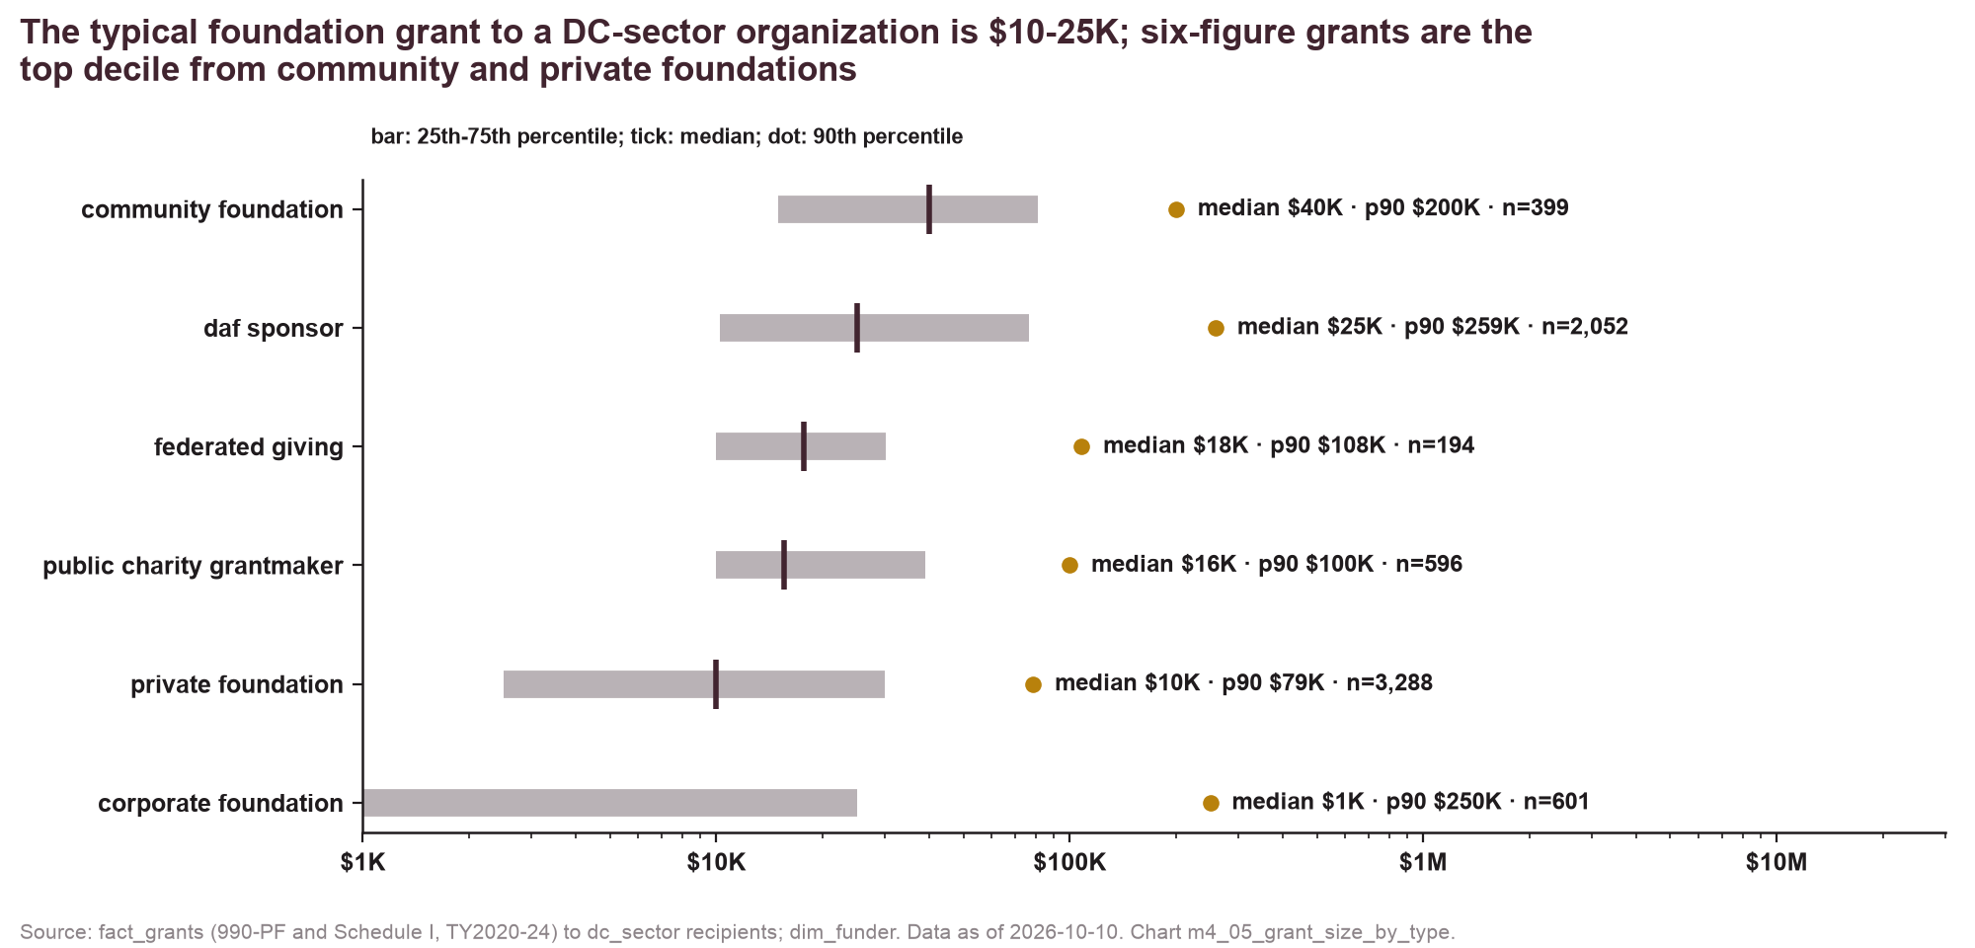
The typical foundation grant to a DC-sector organization is $10–25K, and six-figure grants are the top decile.
Grant size
Private foundations: median $10K, p90 $79K (n=3,288).
Community foundations: median $40K, p90 $200K.
DAF sponsors: median $25K, p90 $259K.
Corporate foundations: median under $1K ($570; matching gifts), p90 $250K.
Source: fact_grants to dc_sector recipients TY2020–24; dim_funder
Method: percentiles of grant size by funder type
Chart m4_05 · data as of 2026-10-10 · method note C1

Slide 35
Fidelity Charitable alone moved $179M of donor-advised money into DC-sector organizations in five years.
DAF channel
DAF sponsors are intermediaries: the decisions sit with individual donors.
Calvary's DAF receipts: $1.1M over five years (Benevity $512K, Fidelity $314K, Schwab $128K).
Peers with Calvary's profile raise 40–50% of filed grants via DAFs.
Source: fact_grants (DAF sponsors' Schedule I, DC/MD/VA recipients)
Method: by sponsor, TY2020–24
Chart m4_06 · data as of 2026-10-10 · method note C1

Slide 36
Most institutional money is general operating or untagged, and the largest mission-tagged funders are Maryland and Virginia foundations.
Purpose
'Other' (untagged) 47% of tagged dollars; general operating 20%; women 9%; housing 4%; DV smaller.
Mission-tagged DMV funders: Weinberg, The Community Foundation (VA), Clark (closed), Wells Fargo, Abell — most give little in DC (m4_08).
Implication: target the DC general-support givers who already fund peers.
Source: fact_grants purpose text tagged with dim_program_area keywords
Method: a grant can carry several tags
Chart m4_07, m4_08 · data as of 2026-10-10 · method note C1

Slide 37
Twenty-three funders give to three or more of Calvary's peers but not Calvary, and fifteen choose their own grantees.
Gap list
22 of 23 filed itemized lists in TY2023+, so the absence is current.
Not shown (8): Venable (closed to new), T Rowe Price Program For Charitable Giving (channel), Gifts For The Homeless (channel), Capital Area Food Bank (channel), America's Charities (channel), JPMorgan Chase (channel), Clark Charitable (closed), Give Lively (channel).
Calvary is enrolled with America's Charities; Venable takes DC applications only from recent grantees or by invitation.
* Funds exactly three peers: depends on the provisional peer set. Appendix C lists all 75 funders of 2+ peers.
Source: fact_grants (peers' and Calvary's filed grants TY2020–24), dim_funder; open status from funders' own pages, Oct 2026
Method: no Calvary row in TY2020–24 filings; DAF sponsors excluded; giving channels and closed funders listed, not charted
Chart m5_01, m7_04 · data as of 2026-10-10 · method note C1

Slide 38
Eleven former funders that once gave $156K have filed grant lists since TY2023 with nothing for Calvary.
Lapsed
Many Hands $55.5K (TY2020), Jane Bancroft Robinson $25K, Robert M. Fisher $25K, Junior League $15K …
Many Hands funds budgets of $0.5–5M, so Calvary ($5.58M in FY25) is not eligible for its January 2027 cycle.
World Bank CCF's $100K (TY2022) was a one-time capital-campaign grant and staff giving continues: not lapsed.
Max & Victoria Dreyfus unclear (no itemized TY2023+ return in the data). Check the CRM for gifts routed through DAFs before outreach.
Source: fact_grants (all years naming Calvary; funders' TY2023+ returns); Many Hands eligibility page
Method: lapsed = last grant ≤TY2022 and funder itemized since; one-time capital-campaign grants excluded
Chart m5_02 · data as of 2026-10-10 · method note C1

Slide 39
Fifteen of Calvary's current funders have written larger single grants to a peer than to Calvary.
Headroom
Among current funders that also fund two or more peers (20 counting all current institutional funders, 27 with DAF sponsors).
Cafritz $170K vs $250K; GWCF $458K vs $526K; Bank of America $15K vs $50K; United Way NCA $23K vs $56K; Fowler $40K vs $50K; Ludwig $25K vs $50K.
A peer's larger grant may be capital or program-specific.
'Current' means a filed grant in TY2020–24: 11 of the 15 gave in TY2023–24, and 4 last gave in TY2020–22 (lapsed or unclear).
Source: fact_grants TY2020–24
Method: largest single grants, not totals
Chart m5_03 · data as of 2026-10-10 · method note C1

Slide 40
Only 44% of the CRM's $10.6M in 2023–26 institutional giving is verifiable in funders' filings.
CRM vs filings
Confirmed in TY2023+ filings: $4.63M, 25 funders.
Corporate / no public filing: $2.55M, 92 funders (MGAC, IMF, Latham, Frontier Co-op, Reservoir).
'See attached' filers: $1.28M (Philip L. Graham, Clark-Winchcole, Kay, Herb Block).
Exempt filers with no Calvary row: $1.61M; earlier-only: $0.48M.
Source: supp_crm_cash_verification (Calvary CRM export 2023–26 vs funders' filings)
Method: CRM totals cumulative over an unconfirmed window (assumptions A1–A2 of the data build)
Chart m5_06 · data as of 2026-10-10 · method note C1

Slide 41
6. Network
Calvary is in the core of the funder web, and paths run through shared funders and peers, not boards.

Slide 42
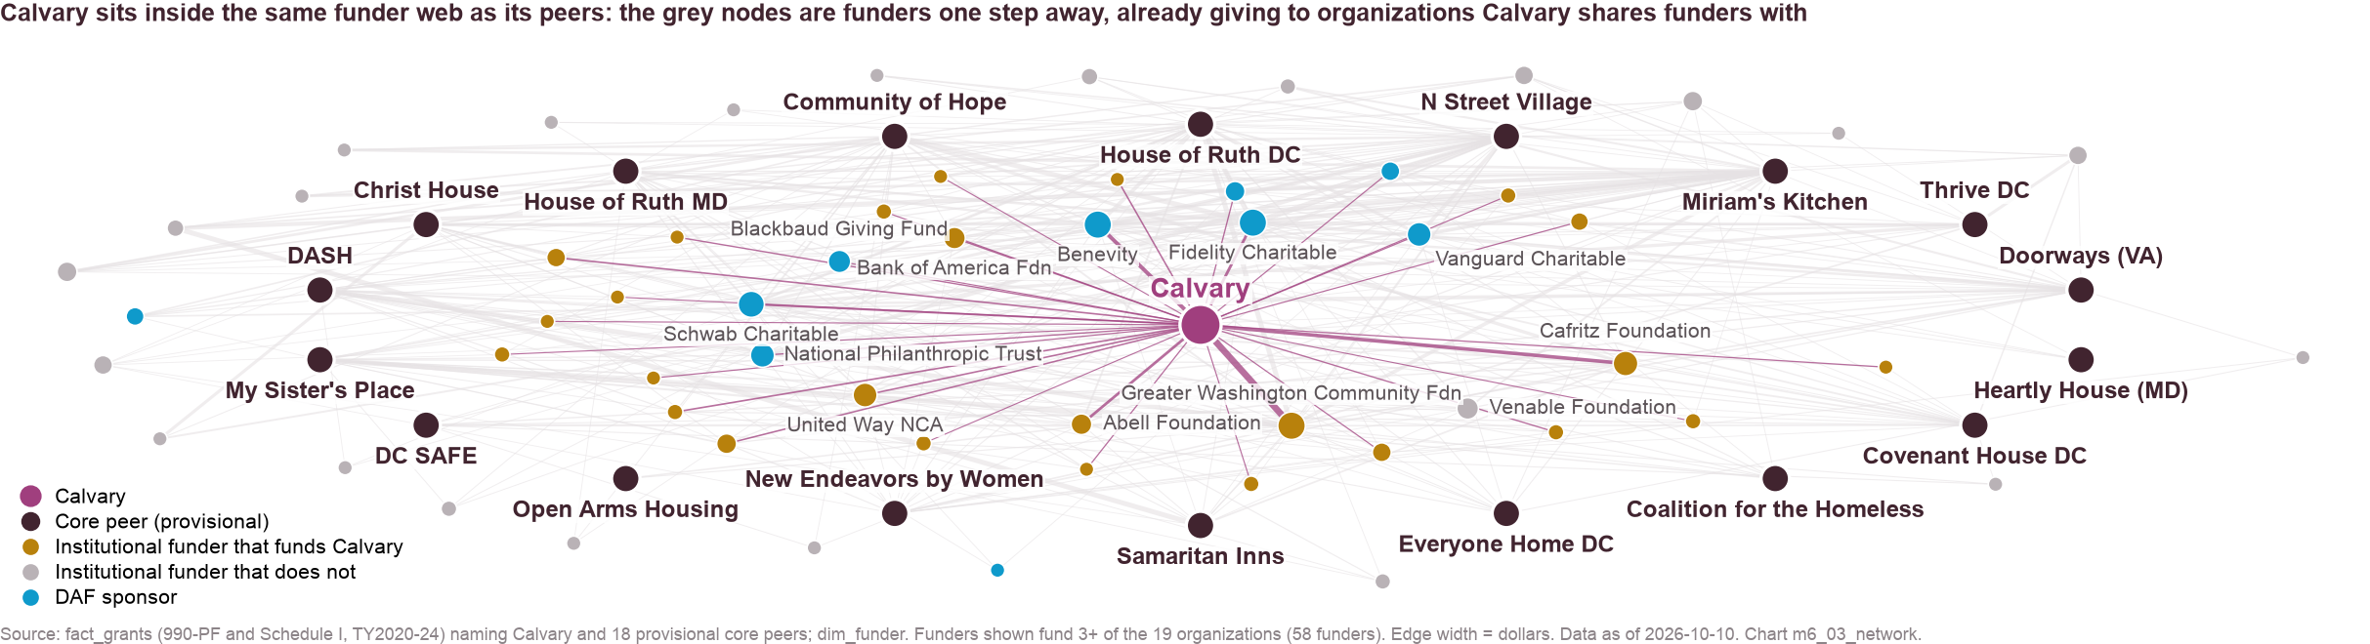
Calvary sits inside the same funder web as its peers, and most of the best-connected funders already fund it.
Central funders
By organizations funded: Fidelity 18, GWCF 18, Benevity 18, Schwab 16, Cafritz 14, Vanguard 13, NPT 13, United Way NCA 13, Blackbaud 11, Venable 10, Bank of America 10, Abell 9.
328 funders connect the 19 organizations ($69.9M); 58 fund three or more.
Source: fact_grants (Calvary + 18 peers, TY2020–24), dim_funder
Method: bipartite graph; concentric layout; edge width = dollars
Chart m6_03, m6_01 · data as of 2026-10-10 · method note C2

Slide 43
Calvary shares the most institutional funders with Miriam's Kitchen, DASH and House of Ruth DC.
Overlap
Shared: Miriam's Kitchen 17, DASH 14, House of Ruth DC 14, New Endeavors 12, My Sister's Place 12.
Not shared: House of Ruth MD 81, House of Ruth DC 69, Miriam's Kitchen 48, N Street Village 45.
Source: fact_grants, dim_funder
Method: institutional funders only (DAF sponsors excluded)
Chart m6_02 · data as of 2026-10-10 · method note C2

Slide 44
Board interlocks are a thin channel, with no high-confidence Calvary links and eight medium-confidence leads to confirm.
Subject | Linked organization | Funder? | Confidence (use) | Years / evidence
Calvary | Charter School Incubator Initiative | yes | unconfirmed (medium confidence) | years 2020-2020 vs 2019-2021
Calvary | Clean Power Institute | no | unconfirmed (medium confidence) | years 2019-2021 vs 2023-2024 (no overlap)
Calvary | Davis Construction Foundation | yes | unconfirmed (medium confidence) | years 2017-2019 vs 2021-2025 (no overlap)
Calvary | Dress For Success Washington Dc | no | unconfirmed (medium confidence) | years 2015-2018 vs 2021-2022 (no overlap)
Calvary | Miriam's Kitchen | no | unconfirmed (medium confidence) | years 2019-2024 vs 2020-2020
Calvary | The United Way Of Central Maryland | yes | unconfirmed (medium confidence) | years 2022-2024 vs 2022-2024
Calvary | United Way Of The National Capital Area | yes | unconfirmed (medium confidence) | years 2020-2024 vs 2020-2021
Calvary | Washington Area Women's Foundation | yes | unconfirmed (medium confidence) | years 2020-2024 vs 2022-2024
Covenant House DC | Rockson Community Development Corporation | yes | unconfirmed (medium confidence) | years 2020-2022 vs 2023-2024
DASH | All For Recovery | yes | unconfirmed (medium confidence) | years 2020-2020 vs 2024-2024 (no overlap)
DC SAFE | Bread For The City | yes | unconfirmed (medium confidence) | years 2020-2021 vs 2020-2024
Doorways (VA) | Arlington Community Foundation | yes | unconfirmed (medium confidence) | years 2020-2021 vs 2023-2024 (no overlap)
Source: fact_org_relationships (shared_board_member), dim_person (person_id only; no names stored)
Method: exact normalized name plus a corroborating signal; high confidence also needs overlapping board terms; leadership materials use high confidence only
Chart m6_04 · data as of 2026-10-10 · method note C2

Slide 45
Board interlocks are a thin channel, with no high-confidence Calvary links and eight medium-confidence leads to confirm. (continued, 2 of 2)
Subject | Linked organization | Funder? | Confidence (use) | Years / evidence
Doorways (VA) | Delta Housing Corporation of the District of Columbia | yes | unconfirmed (medium confidence) | years 2020-2024 vs 2020-2024
Doorways (VA) | Fidelity Investments Charitable Gift Fund | yes | unconfirmed (medium confidence) | years 2022-2024 vs 2021-2024
Everyone Home DC | Baltimore Community Foundation | yes | unconfirmed (medium confidence) | years 2020-2023 vs 2020-2024
Heartly House (MD) | Farvue Foundation | yes | unconfirmed (medium confidence) | years 2020-2025 vs 2020-2020
Heartly House (MD) | The Community Foundation Of Frederick County Maryland | yes | unconfirmed (medium confidence) | years 2024-2024 vs 2020-2024
House of Ruth DC | Women's Business Enterprise National Council | yes | unconfirmed (medium confidence) | years 2020-2023 vs 2021-2024
House of Ruth MD | The Dipietro Family Foundation | yes | unconfirmed (medium confidence) | years 2020-2022 vs 2020-2024
Miriam's Kitchen | America's Charities | yes | unconfirmed (medium confidence) | years 2020-2024 vs 2020-2025
My Sister's Place | Bread For The City | yes | unconfirmed (medium confidence) | years 2024-2024 vs 2020-2022 (no overlap)
My Sister's Place | District of Columbia Coalition Against Domestic | yes | unconfirmed (medium confidence) | years 2020-2024 vs 2020-2023
My Sister's Place | Washington Lawyers' Committee For Civil Rights And Urban Affairs | yes | unconfirmed (medium confidence) | years 2021-2023 vs 2024-2024
N Street Village | Inspire Access | yes | unconfirmed (medium confidence) | years 2020-2024 vs 2023-2024
Source: fact_org_relationships (shared_board_member), dim_person (person_id only; no names stored)
Method: exact normalized name plus a corroborating signal; high confidence also needs overlapping board terms; leadership materials use high confidence only
Chart m6_04 · data as of 2026-10-10 · method note C2

Slide 46
7. Pipeline and scoring
Seven weighted dimensions in one editable file produce nine Tier 1 rows with next steps.

Slide 47
The pipeline scores 182 candidates on seven weighted dimensions that can be changed in one config file and rerun.
Dimension | Weight | Evidence (0–1 score)
Mission fit | 0.20 | Funder issue tags (housing/DV/women 1.0; behavioral health/workforce/health 0.7; general operating 0.6) + share of DC-sector dollars tagged housing/DV/women
Peer giving | 0.20 | Core peers funded TY2020–24, capped at 8
Regional giving | 0.10 | Dollars to DC-sector organizations, log scale $50K → $10M
Award size | 0.15 | Median grant to peers (else DC-sector median), log scale $5K → $250K
Accessibility | 0.10 | Funder type and breadth (community foundation 0.85 … narrow family foundation 0.30); −0.15 'see attached'; −0.30 in-kind channels; DAF-like 0.15
Durability | 0.10 | Years funding peers and years active in the sector
Relationship | 0.15 | M6 path strength + 0.35 current funder + 0.20 lapsed + 0.15 on CRM/lists
Tiers | — | Tier 1: score ≥ 0.62 and typical grant ≥ $25K (max 20). Tier 2: ≥ 0.48. Tier 3: rest. Government and corporate rows: analyst scores.
Status rules | — | Channels and DAF-like programs capped at Tier 2; closed funders kept but excluded; not eligible → Tier 3; closed to new applicants → at most Tier 2; current funders under $10K dropped; typical grant falls back to DC-sector median, then Calvary's largest grant
Source: config/scoring_weights.yaml; config/guideline_notes.csv (open status); chart_data/m5_00_candidate_funders.csv; m6_05_relationship_paths.csv
Method: weighted sum; rerun scripts/07, 12 and 13 after editing weights
Chart m7_00 · data as of 2026-10-10 · method note C3

Slide 48
Nine rows reach Tier 1: four current foundation partners, one new foundation, one corporate relationship and three public streams.
# | Target | Track | Score | Typical grant | Why | Relationship path
1 | William S Abell Foundation | institutional: steward / upgrade | 0.86 | $25K | 8 peers; typical grant $25K; DC-sector $2.7M; current funder | current funder (largest grant $270K); funds 8 peers that share 5+ funders with Calvary; 20 of Calvary's…
2 | Greater Washington Community Foundation | institutional: steward / upgrade | 0.85 | $33K | 17 peers; typical grant $33K; DC-sector $43.2M; current funder | current funder (largest grant $458K); funds 12 peers that share 5+ funders with Calvary; 24 of Calvary's…
3 | DC OVSJG Victim Services grants (Reach Up, New Foundations) | government_dc | 0.80 | — | retain and grow: annual continuation; Council restored proposed cuts FY26 and FY27 | existing grantee / sub-recipient
4 | Morris And Gwendolyn Cafritz Foundation | institutional: steward / upgrade | 0.78 | $36K | 13 peers; typical grant $36K; DC-sector $12.6M; current funder | current funder (largest grant $170K); funds 10 peers that share 5+ funders with Calvary; 22 of Calvary's…
5 | HUD Continuum of Care via TCP (Sister Circle, Reach Up, New Foundations 2) | government_federal | 0.78 | — | annual renewal; 5% of DC CoC; protect renewals, consider a PSH expansion project in the next competition | existing grantee / sub-recipient
6 | DHS homeless services via TCP (TH contract, Sisters Rise) | government_dc | 0.72 | — | largest single stream; confirm FY25-26 contract values and draw-down against ceilings | existing grantee / sub-recipient
7 | John Edward Fowler Memorial Foundation | institutional: steward / upgrade | 0.72 | $33K | 7 peers; typical grant $32K; DC-sector $1.6M; current funder | current funder (largest grant $40K); funds 7 peers that share 5+ funders with Calvary; 17 of Calvary's…
8 | MGAC | corporate: steward / upgrade (CRM) | 0.69 | $238K | CRM total $713K 2023-26; cash vs in-kind unclear | existing corporate relationship (CRM); verify cash share
9 | Robert I Schattner Foundation | institutional: new | 0.67 | $60K | 4 peers; typical grant $60K; DC-sector $2.1M; no Calvary grant | funds 4 peers that share 5+ funders with Calvary; 12 of Calvary's funders co-fund its grantees
Source: recommendations/funder_pipeline.csv
Method: see scoring table
Chart m7_00 · data as of 2026-10-10 · method note C3

Slide 49
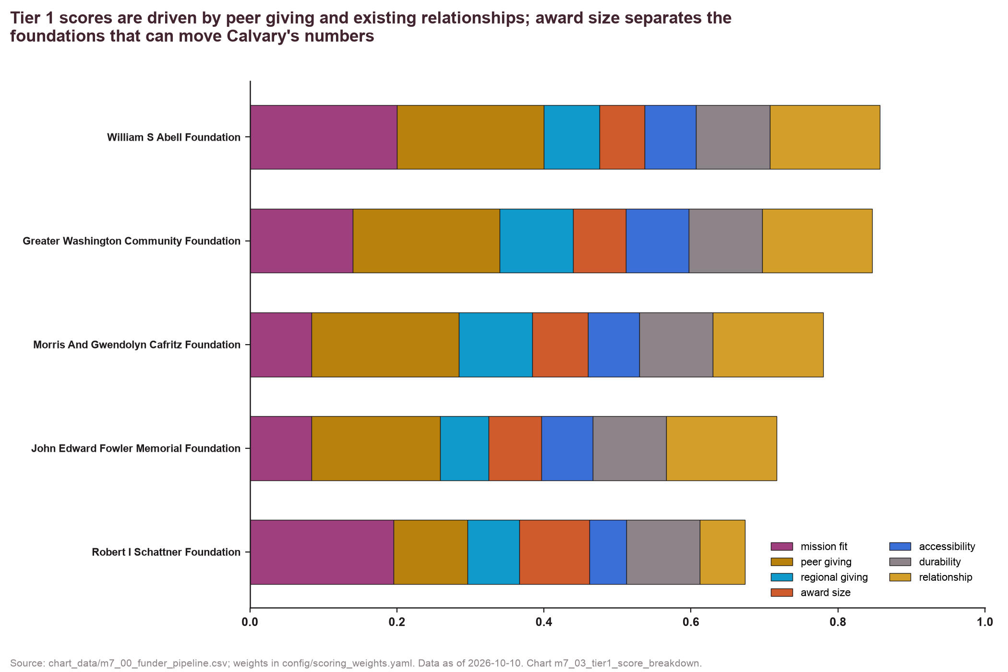
Peer giving and existing relationships drive Tier 1 scores, while award size separates the foundations that can move the numbers.
Source: chart_data/m7_00_funder_pipeline.csv
Method: weighted contribution of each dimension
Chart m7_03 · data as of 2026-10-10 · method note C3

Slide 50
The 90-day plan gives each Tier 1 target a next step, an owner, a deadline and its open status.
Target | Next step | Owner | By | Open to new requests
William S Abell Foundation | Steward and renew: Abell gave $270K (TY2021) and $25K (TY2023), with a further $25K in March 2025; it is invitation-only with no consecutive-year requests, so ask its staff when the next request is welcome and what it would fund | Development director | Day 45 | Invitation only
Greater Washington Community Foundation | Two conversations with GWCF: a successor to the Health Equity Fund support, and a core general-operating request | Development director | Day 45 | Open: Cycle-specific; check Grant Opportunities page
DC OVSJG Victim Services grants (Reach Up, New Foundations) | Confirm FY26 award letters and draw-down status; schedule program-officer check-in; map FY27 renewal calendar | CEO + board chair | Day 30 | Existing award
Morris And Gwendolyn Cafritz Foundation | Upgrade ask: request a multi-year general-operating grant at the funder's peer-level amount, citing the FY25 deficit and the concentration in three public streams | Development director | Day 60 | Open: March 1, July 1, November 1 (5:00 pm ET)
HUD Continuum of Care via TCP (Sister Circle, Reach Up, New Foundations 2) | Confirm FY26 award letters and draw-down status; schedule program-officer check-in; map FY27 renewal calendar | CEO + board chair | Day 30 | Existing award
DHS homeless services via TCP (TH contract, Sisters Rise) | Confirm FY26 award letters and draw-down status; schedule program-officer check-in; map FY27 renewal calendar | CEO + board chair | Day 30 | Existing award
John Edward Fowler Memorial Foundation | Upgrade ask: request a multi-year general-operating grant at the funder's peer-level amount, citing the FY25 deficit and the concentration in three public streams | Development director | Day 60 | Open: Rolling (no deadline)
MGAC | Quantify cash vs in-kind in the CRM; propose a multi-year sponsorship or program partnership | CEO + board chair | Day 60 | Existing partner
Robert I Schattner Foundation | Secure an invitation through a named peer or co-funder (Schattner does not consider unsolicited requests); no LOI | Development director | Day 90 (introduction, then invitation) | Invitation only
Source: recommendations/action_plan_90day.csv; config/guideline_notes.csv (sources/web_tier1_guidelines.csv)
Method: deadlines relative to plan start, sequenced for a six-person development team; open status checked on funders' own pages, Oct 2026
Chart m7_01, m7_04 · data as of 2026-10-10 · method note C3

Slide 51
Moving any weight by 0.05 keeps at least nine of the top ten and moves top-30 ranks under two places.
Change | Mean rank shift (top 30) | Top-10 overlap | Tier 1–2 added | Tier 1–2 dropped
mission_fit -0.05 (renormalized) | 1.20 | 10 | 0 | 2
mission_fit +0.05 (renormalized) | 1.40 | 9 | 6 | 0
peer_giving -0.05 (renormalized) | 1.17 | 9 | 6 | 0
peer_giving +0.05 (renormalized) | 0.63 | 10 | 0 | 3
regional_giving -0.05 (renormalized) | 1.20 | 10 | 1 | 1
regional_giving +0.05 (renormalized) | 1.03 | 9 | 5 | 1
award_size -0.05 (renormalized) | 1.67 | 10 | 2 | 0
award_size +0.05 (renormalized) | 1.70 | 9 | 4 | 2
accessibility -0.05 (renormalized) | 0.77 | 9 | 0 | 1
accessibility +0.05 (renormalized) | 1.00 | 10 | 1 | 0
durability -0.05 (renormalized) | 0.90 | 10 | 2 | 4
durability +0.05 (renormalized) | 0.77 | 10 | 5 | 0
relationship -0.05 (renormalized) | 0.87 | 9 | 7 | 1
relationship +0.05 (renormalized) | 1.27 | 10 | 0 | 1
tier2 cutoff -0.05 | 0.00 | 10 | 20 | 0
tier2 cutoff +0.05 | 0.00 | 10 | 0 | 12
Source: chart_data/m7_05_sensitivity.csv
Method: each weight ±0.05 with renormalization; tier-2 cutoff ±0.05
Chart m7_05 · data as of 2026-10-10 · method note C3

Slide 52
8. Mission expansion
Near options come first, health is a partnership, and families are not suggested.

Slide 53
Health and workforce funding pools are large and one step from Calvary's programs, while aging, veterans and reentry are small.
Scan
Near: education $94M (schools dominate), workforce $30M, behavioral health $21M, DV $4.5M.
Medium: health $84M (206 funders at $100K+), aging $9.7M, veterans $7.7M, reentry $1.0M.
Far: maternal/family $4.2M.
Source: fact_grants purpose tags (DMV institutional, TY2020–24); fact_opportunities; config/expansion_areas.yaml
Method: general operating excluded; distance ratings are analyst judgment
Chart m8_01 · data as of 2026-10-10 · method note D1

Slide 54
Each option carries a trade-off, from workforce and behavioral health at modest cost to DV formalization that raises government share.
Option | Distance | Pool evidence | Upside | Cost / risk
Formalize workforce (SheWorks-style cohort in Step Up DC) | near | $30M/yr tagged; DOES/WIOA; SNAP E&T held | New funders and public contracts; outcomes story | First cost: the second workforce position, unfunded in FY2026; partner management
Behavioral-health credential or billing partner | near | $21M/yr tagged; Medicaid | Therapy becomes program revenue (Samaritan Inns path) | Compliance, staffing, 12–18 months
DV program formalization (VOCA eligibility) | near | OVSJG $55M pool; DV peers 70–89% government | Deeper OVSJG relationship; DV funders | Reporting; raises government share
FQHC clinic hours on site (Community of Hope; DWC/JWCH model) | medium | $84M/yr tagged; 206 funders at $100K+ | Health funders at low capital cost | Partner dependence
Older-women track in PSH | medium | $9.7M/yr; The Washington Home | Narrative fit | Small pool
Women veterans / reentry | medium | small private pools; HVRP, BJA | Program-specific federal money | New compliance regimes
Families / maternal | far | $4.2M/yr | — | Mission change; not suggested
Source: modules/m8_expansion_scan.md; config/expansion_areas.yaml
Method: options and trade-offs are analyst judgment on the scan evidence
Chart m8_01 · data as of 2026-10-10 · method note D1

Slide 55
Direct federal competition is thin, with 36 relevant notices, so the realistic channels remain HUD CoC and HUD CPF.
Agency | Notices | Examples
Department of Housing and Urban Development | 7 | Resident Opportunity and Self-Sufficiency Service…; Preservation and Reinvestment Initiative for Community…
Bureau of Justice Assistance | 7 | BJA FY 2026 Invited to Apply- Medicaid and Corrections…; BJA FY 2026 Veterans Treatment Court Program
Office of Juvenile Justice Delinquency Prevention | 7 | OJJDP FY 2026 Juvenile Drug Treatment Court Program; OJJDP FY 2026 Community and Schools Youth Drug Prevention…
Substance Abuse and Mental Health Services Adminis | 4 | Residential Treatment for Pregnant and Postpartum Women; State Pilot Program for Treatment for Pregnant and…
Employment and Training Administration | 2 | Unemployment Insurance Integrity Center of Excellence…; Fiscal Year 2027 State Workforce Agency Unemployment…
U.S. Dept. of Treasury RESTORE Act Program | 2 | RESTORE Act Direct Component - Non-Construction Activities; RESTORE Act Direct Component – Construction and Real…
Administration for Children and Families - OHS | 1 | Early Head Start Expansion and Early Head Start - Child…
Veterans Employment and Training Service | 1 | Homeless Veterans’ Reintegration Program (HVRP)…
Veterans Legacy Grants Program | 1 | Veterans Legacy Grants Program
Administration for Community Living | 1 | Alzheimer's Disease Programs Initiative (ADPI)…
Bureau of Justice Statistics | 1 | BJS FY 2026 State Justice Statistics Program for…
National Institute of Justice | 1 | NIJ FY 2026 Evaluation of the Effectiveness of the Bureau…
Administration for Children and Families - ORR | 1 | Home Study and Post-Release Services for Unaccompanied…
Source: fact_opportunities (Grants.gov posted and forecasted)
Method: research, tribal, rural and overseas notices removed; relevant agencies kept
Chart m8_02 · data as of 2026-10-10 · method note D1

Slide 56
9. Need and capacity
The city's deepest need meets a shrinking system and a growing share for Calvary.

Slide 57
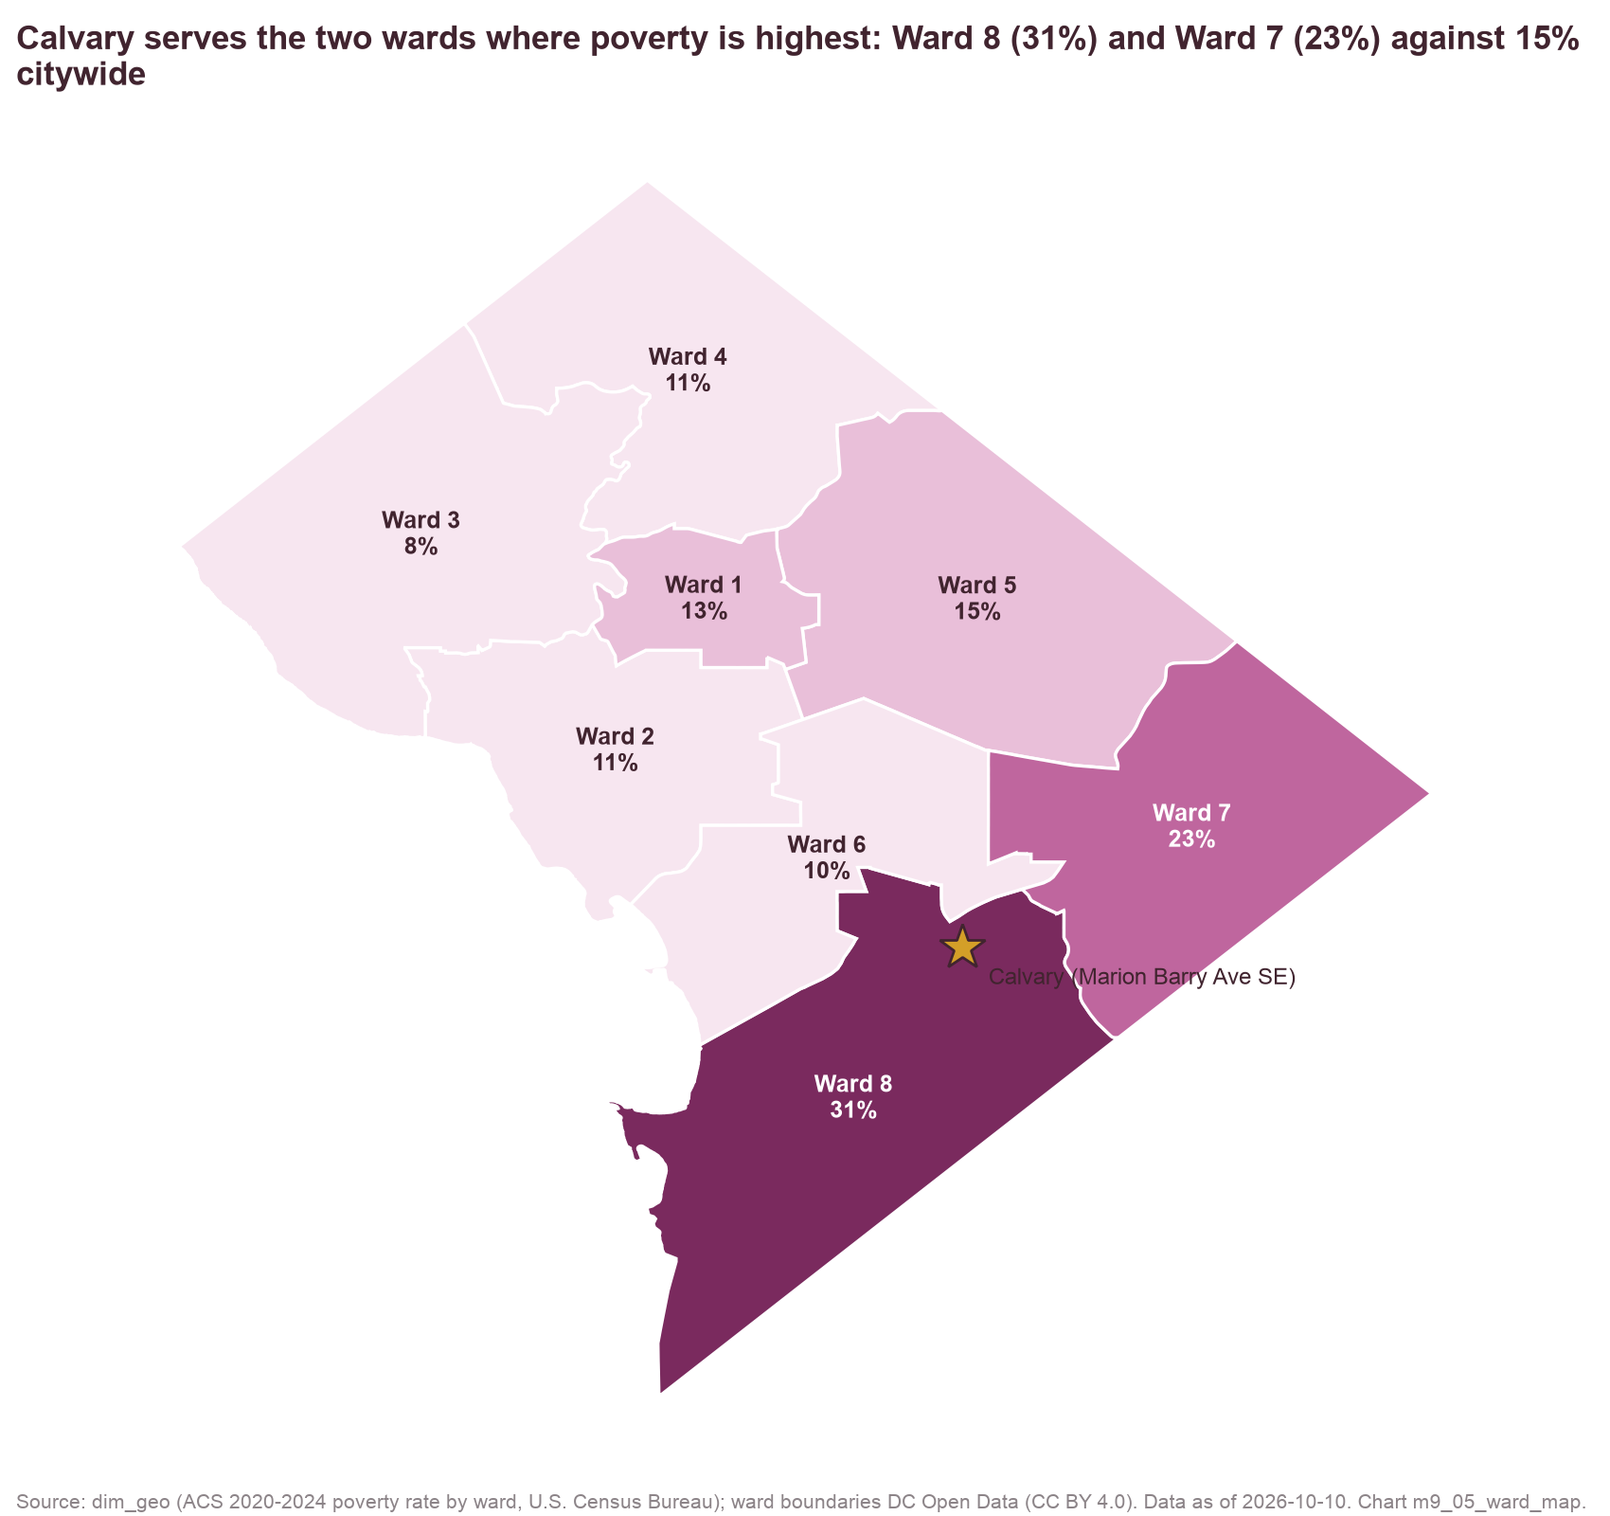
Calvary's home ward has twice the city's poverty rate and the highest female poverty in DC.
Ward indicators
Poverty: Ward 8 31%, Ward 7 23%, DC 15%. Female poverty: 32% / 25% / 16%.
Renters paying 50%+: 33% / 32% / 24%. Unemployment: 13% / 13% / 6%.
Female householder, no spouse: 30% / 29% / 13%.
Source: dim_geo (ACS 2020–24, DC wards as state legislative districts; DC Open Data ward boundaries)
Method: five-year estimates; 90% MOE in the table
Chart m9_01, m9_05 · data as of 2026-10-10 · method note —

Slide 58
DC's homeless count fell from 8,350 (2016) to 5,138 (2025) while Calvary's inventory grew to 124 beds.
Capacity
2022: 68 beds in all programs; 45 transitional = 2.5% of DC's
2023: 98 beds in all programs; 73 transitional = 4.9% of DC's
2024: 107 beds in all programs; 60 transitional = 3.5% of DC's
2025: 124 beds in all programs; 94 transitional = 6.8% of DC's
Women-focused providers 2025: N Street Village 457, Open Arms 412, House of Ruth 388, New Endeavors 135, Calvary 124.
Source: supp_homeless_counts (HUD PIT, DC-500); supp_hic_projects (HUD HIC 2022–2025)
Method: beds = HIC total_beds by project type
Chart m9_02, m9_03 · data as of 2026-10-10 · method note —

Slide 59
10. Named comparators
DWC shows scale with government, and SheWorks shows a program design.

Slide 60
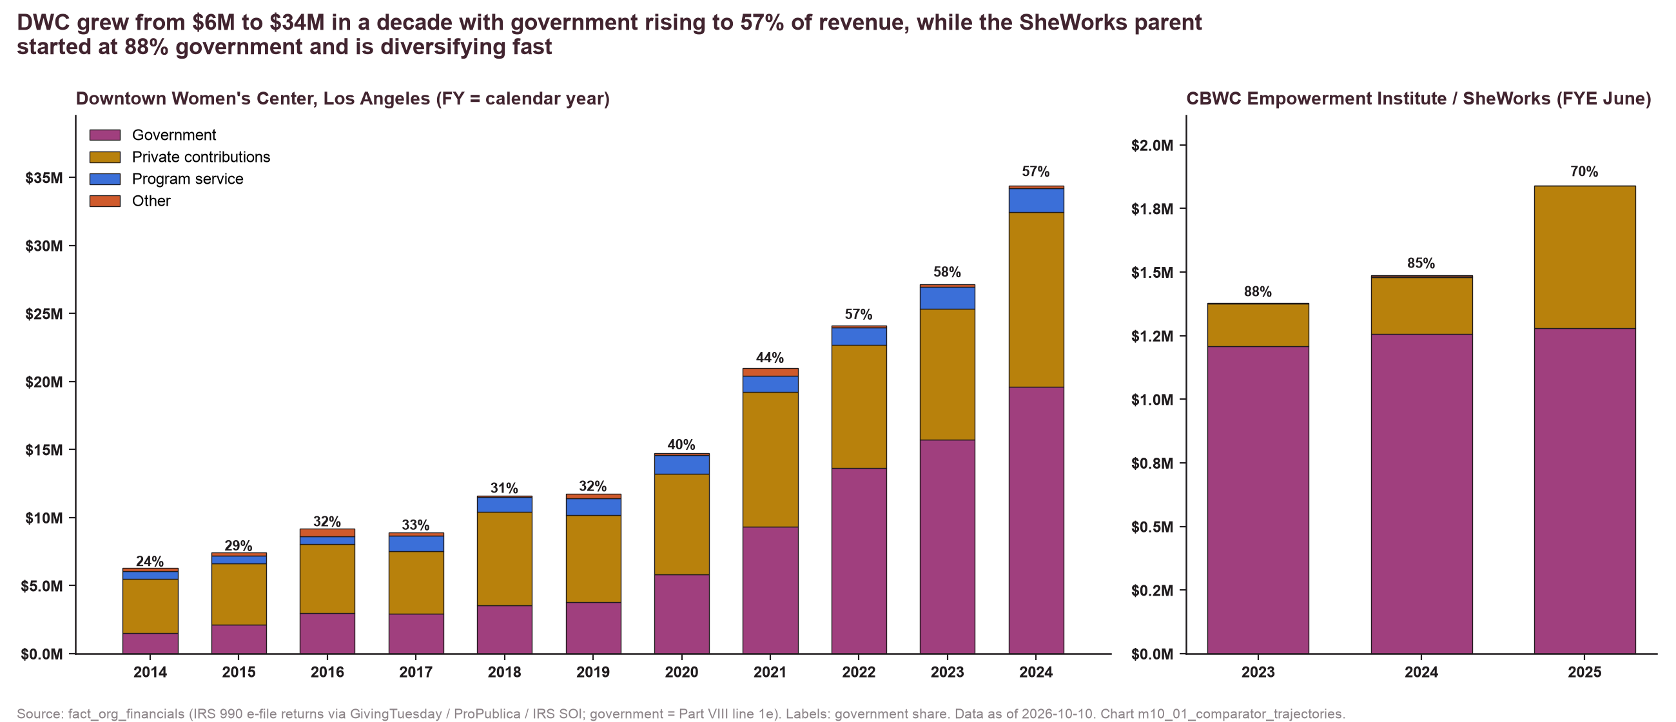
DWC grew from $6M to $34M in a decade as government rose to 57% of revenue, on thin cash.
DWC
FY2014 $6.3M, 24% government → FY2024 $34.4M, 57%: 5.5x since FY2014 and 3x since FY2018 ($11.6M).
Federal FY2020–25 $21.6M: CoC $14.3M, ESG $3.5M, VOCA $2.7M; 99% pass-through.
159 PSH units; clinic with JWCH; MADE enterprise; Rosa's Place (97 units) under construction.
Source: fact_org_financials (IRS 990), fact_gov_awards (FAC single audits)
Method: government = line 1e; DWC fiscal year = calendar year
Chart m10_01, m10_02 · data as of 2026-10-10 · method note B3

Slide 61
The SheWorks parent started at 88% government and is diversifying fast, and SheWorks is a program design to borrow.
Item | DWC (Los Angeles) | CBWC Empowerment Institute / SheWorks (Carson, CA)
Revenue, latest | $34.4M (FY2024) | $1.84M (FY2025, FYE June)
Government share | 57% | 70% (88% in FY2023)
Months of cash | 2.4 | 8.2
Programs | PSH (159 units), community housing, women's health clinic (JWCH), MADE paid transitional work | Black Women's Think Tank, Conversations, Protecting Black Women and Girls; SheWorks cohort (Jan–May 2026, ~30 women; stipends, childcare, ride credits)
Funders in the data | 280 names across its two 2023 lists; Hilton $1.53M, Blue Shield of CA Fdn $450K, Ahmanson $325K, Anthem $300K, LA County First District $3M; DMV funders: Bank of America $154K, Wells Fargo $100K | LA County Federation of Labor (partial funding); L.A. Care and Blue Shield Promise (host sites, in kind); no FAC or USAspending awards
What transfers | Housing-development pipeline; clinic partnership; social enterprise; donor-base scale | Cohort design and partner structure for Step Up DC
What does not | The mix (scaled with government on thin cash) | The funding model (more government-dependent than Calvary)
Source: fact_org_financials, fact_gov_awards, fact_grants web rows (annual reports, funder announcements)
Method: see M10 readout; DAF grants to LA organizations not captured
Chart m10_01, m10_03, m10_05 · data as of 2026-10-10 · method note B3

Slide 62
11. Verdict, recommendations and open items
Moderate-to-high pressure comes from concentration and liquidity, with five recommendation areas and two documents requested.

Slide 63
The verdict is moderate-to-high pressure, driven by channel concentration and liquidity rather than by the government share.
53%
78%
27%
4.4 mo
Government share FY22–24 mean (58% FY25); 11th of 19 peers; 57th percentile among DC reporters
Share of the $4.1M 2024 award base that passes through TCP (CoC + DHS)
Share of five years of filed grants from one funder (GWCF incl. Health Equity Fund); top five 63%
Cash at FY25 year-end after a $607K deficit; 7.5 months in FY21
Public funding at about half of revenue is typical for this work. The things to plan around are the shape of that funding (three streams, two through one intermediary), a private base that has held steady from the same funders, and a $607K FY25 deficit that left 4.4 months of cash. DC's pools have held, with cuts proposed and restored each spring; the federal side (the FY2026 CoC competition, the EHV end on 31 December 2026) and the TCP channel are the larger uncertainties.
Source: recommendations/funding_pressure_verdict.md (evidence table with chart IDs)
Method: verdict synthesizes M1–M3 and M9
Chart m1_02, m2_01, m1_07, m1_05 · data as of 2026-10-10

Slide 64
Five recommendation areas follow: protect and draw the public base, rebuild private revenue, hold a reserve, expand near, mitigate risk.
1. Public base
2. Private revenue
3. Reserve
4. Expansion
5. Risk mitigation
Reconcile CoC draw-down first, then DHS
Confirm DHS / Sisters Rise with TCP
Defend CoC renewals; scope PSH expansion
OVSJG budget calendar
Deepen Cafritz and Fowler; GWCF successor and core asks; steward Abell
An invitation to Schattner through a peer it funds
Re-engage lapsed; major-gifts/DAF program
Six months of expenses (~$2.8M)
Close the FY25 gap in the FY26 budget
Treat HEF as one-time
Workforce cohort (SheWorks model)
Behavioral-health credential decision
FQHC partnership
DV formalization only with eyes open
Direct DHS line alongside TCP; HUD CPF; DHS PSH
Contract terms; monthly draw tracking
Advocacy calendar; early-warning indicators
Target arithmetic: private revenue ~$2.1M (FY25) → ~$3.0M in three years (institutional +$0.5M, major donors/DAF +$0.3M, earned +$0.1–0.3M; events held near $0.5M) takes the public share to about 50% at flat public funding.
Source: recommendations/strategic_recommendations.md
Method: recommendations are options for Calvary's leadership to weigh
Chart — · data as of 2026-10-10

Slide 65
Two documents from Calvary would resolve the two open flags, and the FY25 990 itself closed the third.
Flag | Finding | Why it matters | Handling (approved CP2) | Document that resolves it
D1 | Recognized 67–73% of known award ceilings in FY24–25 | ~$1M/yr may be undrawn or the DHS carry-forward overstates FY25 | Medium confidence; labeled 'ceilings vs recognized' | FY24/FY25 audits; TCP subgrant agreements
D2 | Sisters Rise PSH (24 EHV units, $593K) absent from the 2025 HIC | Part of FY25's drop may be a lost stream; baseline may be high | DHS stream 'at risk'; FY2024 value kept in baseline | TCP agreements; Calvary confirmation
D3 (closed) | Event contributions (line 1c) $538K → $55K | The FY25 return reported the gala on line 8a; receipts held at $533K | Reclassified: no event drop | None needed (990 lines 1c + 8a)
Source: discoveries_log.md; open_questions.md part B (data build)
Method: each flag logged with evidence, proposed action and response
Chart m2_02, m2_03, m1_06 · data as of 2026-10-10

Slide 66
The appendix decks carry every chart, table and method note, and the insight register tracks verification for all 36 findings.
Appendix A: Calvary and government funding (22 slides). Appendix B: peers and named comparators (21). Appendix C: funders, gaps, network and pipeline (70). Appendix D: data and methods (33, method notes A1–D3).
Reports: executive summary, full findings, methodology, recommendations; board readout talking points; consulting team briefing.
Scoring weights and status rules: config/scoring_weights.yaml; funder open status: config/guideline_notes.csv; scenarios: config/scenarios.yaml; peers: calvary_funding_data/config/core_peers.csv; exclusions: config/landscape_exclusions.csv and config/grant_exclusions.csv.
Traceability: chart ID → chart_data/<id>.csv → clean table → source registry; scripts/lib/trace.py checks the chain.
Insight register: 36 findings, confidence high/medium/low, verified after the October 2026 independent review and fix cycle (reports/review/). Data as of 2026-10-10.
Source: calvary_analysis/README.md; insight_register.csv
Method: —
Chart all · data as of 2026-10-10

