Slide 1
Appendix A: Calvary and Government Funding
Appendix A · Calvary and government funding · pro bono funding analysis for Calvary Women's Services. Method notes A1–A6 are in Appendix D.

Slide 2
Calvary's revenue series agrees across five sources within 1% in every year, so the trajectory rests on firm ground.
Fiscal year | Total revenue (990) | 990 sources with revenue | Largest 990-source difference | Audit total revenue | Audit difference | Audit net assets = 990
FY11 | $1,445,107 | 2 | 0.0% | no audit | — | —
FY12 | $2,021,027 | 2 | 0.0% | no audit | — | —
FY13 | $1,886,681 | 2 | 0.0% | $2,056,534 | 9.0% | yes
FY14 | $2,072,635 | 2 | 0.0% | $2,217,472 | 7.0% | yes
FY15 | $2,008,601 | 4 | 0.0% | $2,173,996 | 8.2% | yes
FY16 | $1,990,443 | 4 | 0.0% | $2,130,506 | 7.0% | yes
FY17 | $2,259,177 | 4 | 0.0% | $2,432,385 | 7.7% | yes
FY18 | $2,153,899 | 5 | 0.0% | $2,352,225 | 9.2% | yes
FY19 | $2,486,678 | 4 | 0.0% | $2,584,467 | 3.9% | yes
FY20 | $3,896,046 | 5 | 0.0% | $3,908,836 | 0.3% | yes
FY21 | $3,851,984 | 4 | 0.0% | $3,928,601 | 2.0% | yes
FY22 | $8,867,250 | 3 | 0.0% | $9,264,137 | 4.5% | yes
FY23 | $4,456,814 | 3 | 0.0% | $4,807,645 | 7.9% | yes
FY24 | $5,817,167 | 1 | 0.0% | no audit | — | —
FY25 | $4,967,995 | 2 | 0.0% | no audit | — | —
Source: IRS 990 XML (GivingTuesday), IRS SOI, ProPublica, NCCS e-file tables, Calvary 990 PDFs and audits; calvary_funding_data/reports/calvary_financials_reconciliation.csv
Method: difference = source revenue vs e-filed XML; audits differ 0–9% by design (GAAP in-kind and special-event presentation)
data as of 2026-10-10 · method note A1

Slide 3
Government revenue on the audit basis exceeded 990 line 1e by $1.48M in FY21 and matched it in FY22 and FY23.
Fiscal year | Government (audit) | Audit total revenue | Share (audit) | Government (990 line 1e) | 990 total revenue | Share (line 1e) | Audit − line 1e
FY13 | $813,088 | $2,056,534 | 40% | — | $1,886,681 | — | —
FY14 | $829,432 | $2,217,472 | 37% | — | $2,072,635 | — | —
FY15 | $888,295 | $2,173,996 | 41% | $888,295 | $2,008,601 | 44% | $0
FY16 | $932,814 | $2,130,506 | 44% | $932,814 | $1,990,443 | 47% | $0
FY17 | $965,548 | $2,432,385 | 40% | $965,548 | $2,259,177 | 43% | $0
FY18 | $979,272 | $2,352,225 | 42% | $979,272 | $2,153,899 | 45% | $0
FY19 | $1,256,102 | $2,584,467 | 49% | $1,256,102 | $2,486,678 | 51% | $0
FY20 | $2,166,119 | $3,908,836 | 55% | $2,166,119 | $3,896,046 | 56% | $0
FY21 | $1,981,161 | $3,928,601 | 50% | $503,222 | $3,851,984 | 13% | $1,477,939
FY22 | $5,685,504 | $9,264,137 | 61% | $5,685,504 | $8,867,250 | 64% | $0
FY23 | $2,460,897 | $4,807,645 | 51% | $2,460,897 | $4,456,814 | 55% | $0
FY24 | — | — | — | $2,621,203 | $5,817,167 | 45% | —
FY25 | — | — | — | $2,892,598 | $4,967,995 | 58% | —
Source: Calvary audited financial statements FY13–FY23 and IRS 990 Part VIII line 1e; fact_org_financials
Method: share = government revenue ÷ total revenue on each basis; FY24–25 have no public audit
Chart m1_03 · data as of 2026-10-10 · method note A1

Slide 4
Revenue, expenses, net assets, cash and months of cash by year show the FY22 capital event and the FY23 and FY25 deficits.
Fiscal year | Total revenue | Total expenses | Surplus / deficit | Revenue (2024 $) | Net assets (year end) | Cash and savings | Months of cash
FY11 | $1,445,107 | $1,065,764 | $379,343 | $2,015,275 | $1,117,933 | — | —
FY12 | $2,021,027 | $1,144,102 | $876,925 | $2,761,283 | $2,171,801 | — | —
FY13 | $1,886,681 | $1,464,641 | $422,040 | $2,540,516 | $2,593,841 | — | —
FY14 | $2,072,635 | $1,705,571 | $367,064 | $2,746,362 | $2,960,905 | — | —
FY15 | $2,008,601 | $1,879,006 | $129,595 | $2,658,357 | $3,090,500 | $1,067,632 | 6.8
FY16 | $1,990,443 | $1,989,199 | $1,244 | $2,601,507 | $3,091,744 | $1,058,436 | 6.4
FY17 | $2,259,177 | $2,076,427 | $182,750 | $2,891,150 | $3,274,494 | $1,119,092 | 6.5
FY18 | $2,153,899 | $2,152,260 | $1,639 | $2,690,702 | $3,276,133 | $1,343,966 | 7.5
FY19 | $2,486,678 | $2,403,977 | $82,701 | $3,051,134 | $3,358,790 | $1,163,003 | 5.8
FY20 | $3,896,046 | $3,215,728 | $680,318 | $4,722,160 | $4,039,108 | $1,697,108 | 6.3
FY21 | $3,851,984 | $3,334,967 | $517,017 | $4,459,257 | $4,555,754 | $2,076,828 | 7.5
FY22 | $8,867,250 | $4,550,205 | $4,317,045 | $9,504,566 | $8,872,799 | $2,398,667 | 6.3
FY23 | $4,456,814 | $5,130,964 | −$674,150 | $4,588,263 | $8,198,649 | $2,149,562 | 5.0
FY24 | $5,817,167 | $5,310,627 | $506,540 | $5,817,167 | $8,705,189 | $2,315,867 | 5.2
FY25 | $4,967,995 | $5,575,321 | −$607,326 | $4,840,626 | $8,098,765 | $2,063,796 | 4.4
Source: IRS Form 990 e-file returns (GivingTuesday, NCCS, IRS SOI, ProPublica), Calvary 990 PDFs and audits FY13–FY23; fact_org_financials; dim_period (CPI-U)
Method: preferred 990 row per year; 2024 dollars via CPI-U; months of cash = cash and savings ÷ (expenses ÷ 12); FY22 includes the $3.68M SLFRF award
Chart m1_01, m1_04, m1_05 · data as of 2026-10-10 · method note A1

Slide 5
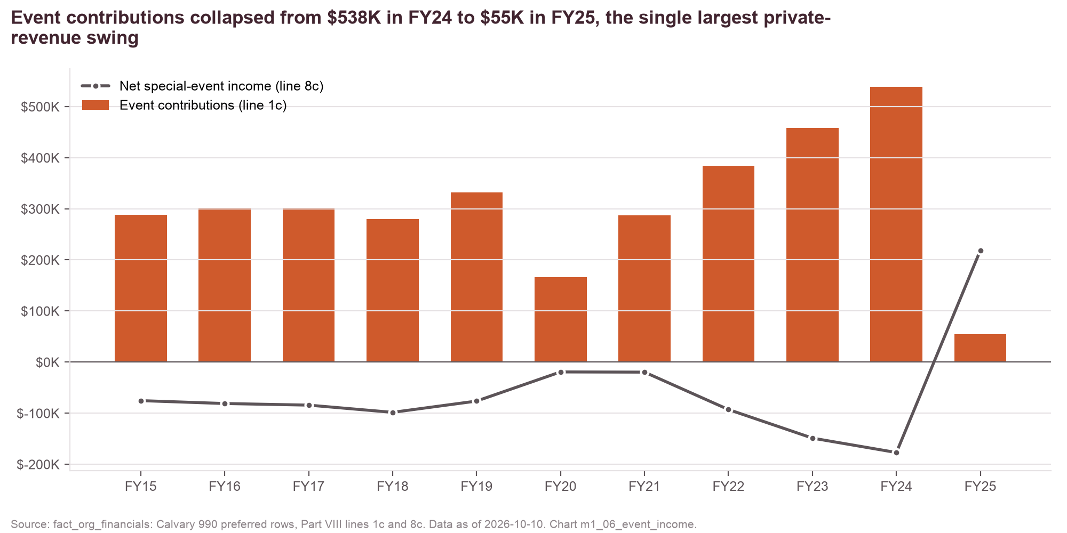
Event contributions and net event income by year show the FY25 collapse against positive net income.
Fiscal year | Event contributions (line 1c) | Net special-event income (line 8c)
FY15 | $287,580 | −$75,685
FY16 | $301,790 | −$81,352
FY17 | $301,899 | −$84,479
FY18 | $279,265 | −$98,619
FY19 | $331,837 | −$76,550
FY20 | $165,497 | −$19,511
FY21 | $287,145 | −$19,919
FY22 | $383,731 | −$93,154
FY23 | $457,758 | −$149,059
FY24 | $538,070 | −$177,248
FY25 | $54,730 | $218,588
Source: IRS 990 Part VIII lines 1c and 8c; fact_org_financials
Method: as reported; line 8c = gross event income less direct event expenses (discovery flag D3: confirm FY25 gala timing)
Chart m1_06 · data as of 2026-10-10 · method note A1

Slide 6
Fifty funders filed grants to Calvary in TY2020–24 and the top ten supplied 79% of the dollars.
Rank | Funder | Funder type | Filed grants TY2020–24 | Tax years | Grants | Share | Cumulative share
1 | Greater Washington Community Foundation | community foundation | $1,206,500 | 5 | 6 | 27.2% | 27.2%
2 | American Online Giving Foundation Inc | daf sponsor | $511,616 | 5 | 5 | 11.5% | 38.8%
3 | Morris and Gwendolyn Cafritz Foundation | private foundation | $450,000 | 5 | 5 | 10.1% | 48.9%
4 | Leafglen Foundation | private foundation | $330,000 | 5 | 5 | 7.4% | 56.3%
5 | Fidelity Investments Charitable Gift Fund | daf sponsor | $314,317 | 5 | 5 | 7.1% | 63.4%
6 | William S Abell Foundation Inc | private foundation | $295,000 | 2 | 2 | 6.7% | 70.1%
7 | Donor Advised Charitable Giving | daf sponsor | $128,155 | 5 | 5 | 2.9% | 73.0%
8 | World Bank Community Connections Fund | public charity grantmaker | $100,000 | 1 | 1 | 2.3% | 75.2%
9 | Association of American Medical Colleges | public charity grantmaker | $91,500 | 5 | 5 | 2.1% | 77.3%
10 | United Way of the National Capital Area | federated giving | $89,549 | 5 | 5 | 2.0% | 79.3%
11 | Carol and Gene Ludwig Family Foundation | private foundation | $82,500 | 5 | 5 | 1.9% | 81.2%
12 | John Edward Fowler Memorial Foundation | private foundation | $80,000 | 2 | 2 | 1.8% | 83.0%
13 | Bank of America Charitable Foundation Inc | corporate foundation | $60,000 | 4 | 4 | 1.4% | 84.3%
14 | Many Hands Inc | public charity grantmaker | $55,500 | 1 | 1 | 1.3% | 85.6%
Source: Funders' 990-PF grants paid and Schedule I rows naming Calvary (IRS e-file via GivingTuesday); fact_grants, dim_funder
Method: TY2020–24, cumulative rows excluded, aggregated by funder EIN; DAF sponsors included and typed; HHI 1,168
Chart m1_07 · data as of 2026-10-10 · method note A3

Slide 7
Fifty funders filed grants to Calvary in TY2020–24 and the top ten supplied 79% of the dollars. (continued, 2 of 4)
Rank | Funder | Funder type | Filed grants TY2020–24 | Tax years | Grants | Share | Cumulative share
15 | Rapoport Family Foundation | private foundation | $50,000 | 3 | 3 | 1.1% | 86.7%
16 | National Philanthropic Tr | daf sponsor | $45,750 | 4 | 4 | 1.0% | 87.7%
17 | Corina Higginson Trust | private foundation | $45,000 | 5 | 5 | 1.0% | 88.8%
18 | PayPal Charitable Giving Fund | daf sponsor | $41,636 | 1 | 1 | 0.9% | 89.7%
19 | Vanguard Charitable Endowment Program | daf sponsor | $31,000 | 4 | 4 | 0.7% | 90.4%
20 | MGM Resorts Foundation | public charity grantmaker | $30,000 | 3 | 3 | 0.7% | 91.1%
21 | Alice Shaver Foundation | private foundation | $30,000 | 3 | 3 | 0.7% | 91.8%
22 | Robert M Fisher Memorial Foundation Inc | private foundation | $25,000 | 1 | 1 | 0.6% | 92.3%
23 | Walter a Bloedorn Foundation | private foundation | $25,000 | 4 | 4 | 0.6% | 92.9%
24 | Owen Family Foundation | private foundation | $25,000 | 5 | 5 | 0.6% | 93.4%
25 | Jane Bancroft Robinson Foundation Inc | public charity grantmaker | $25,000 | 1 | 1 | 0.6% | 94.0%
26 | Dimick Foundation | private foundation | $23,000 | 4 | 4 | 0.5% | 94.5%
27 | Congressional Sports for Charity | public charity grantmaker | $22,500 | 3 | 3 | 0.5% | 95.0%
28 | Ada Harris Maley Memorial Fund | private foundation | $20,000 | 5 | 5 | 0.5% | 95.5%
Source: Funders' 990-PF grants paid and Schedule I rows naming Calvary (IRS e-file via GivingTuesday); fact_grants, dim_funder
Method: TY2020–24, cumulative rows excluded, aggregated by funder EIN; DAF sponsors included and typed; HHI 1,168
Chart m1_07 · data as of 2026-10-10 · method note A3

Slide 8
Fifty funders filed grants to Calvary in TY2020–24 and the top ten supplied 79% of the dollars. (continued, 3 of 4)
Rank | Funder | Funder type | Filed grants TY2020–24 | Tax years | Grants | Share | Cumulative share
29 | Lavin Family Foundation Inc | private foundation | $20,000 | 4 | 4 | 0.5% | 95.9%
30 | Qlarant Foundation Inc | public charity grantmaker | $20,000 | 1 | 1 | 0.5% | 96.4%
31 | Leslie Joanne Foundation | private foundation | $20,000 | 1 | 1 | 0.5% | 96.8%
32 | Miller & Chevalier Charitable Foundation | private foundation | $17,200 | 5 | 5 | 0.4% | 97.2%
33 | The Junior League of the City of Washington Inc | public charity grantmaker | $15,000 | 1 | 1 | 0.3% | 97.6%
34 | Charities Aid Foundation America | daf sponsor | $13,936 | 1 | 1 | 0.3% | 97.9%
35 | Monumental Sports & Entertainment Foundation | public charity grantmaker | $11,546 | 1 | 1 | 0.3% | 98.1%
36 | Levatus Charitable Trust | private foundation | $10,000 | 1 | 1 | 0.2% | 98.4%
37 | Max & Victoria Dreyfus Foundation | private foundation | $10,000 | 2 | 2 | 0.2% | 98.6%
38 | Baxt Family Foundation Inc | private foundation | $10,000 | 4 | 4 | 0.2% | 98.8%
39 | The Nancy Peery Marriott Foundation Inc | private foundation | $10,000 | 1 | 1 | 0.2% | 99.0%
40 | The Phase Foundation | private foundation | $9,000 | 1 | 1 | 0.2% | 99.2%
41 | The Blackbaud Giving Fund | daf sponsor | $7,232 | 1 | 1 | 0.2% | 99.4%
42 | Spur Local Inc | public charity grantmaker | $5,000 | 1 | 1 | 0.1% | 99.5%
Source: Funders' 990-PF grants paid and Schedule I rows naming Calvary (IRS e-file via GivingTuesday); fact_grants, dim_funder
Method: TY2020–24, cumulative rows excluded, aggregated by funder EIN; DAF sponsors included and typed; HHI 1,168
Chart m1_07 · data as of 2026-10-10 · method note A3

Slide 9
Fifty funders filed grants to Calvary in TY2020–24 and the top ten supplied 79% of the dollars. (continued, 4 of 4)
Rank | Funder | Funder type | Filed grants TY2020–24 | Tax years | Grants | Share | Cumulative share
43 | Harry and Zoe Poole Foundation | private foundation | $5,000 | 2 | 2 | 0.1% | 99.6%
44 | Jacquemin Family Foundation Inc | private foundation | $5,000 | 1 | 1 | 0.1% | 99.7%
45 | Omidyar Network Fund Inc | corporate foundation | $3,000 | 1 | 1 | 0.1% | 99.8%
46 | CPMG Foundation | private foundation | $2,500 | 1 | 1 | 0.1% | 99.9%
47 | RCLCO Foundation Inc | private foundation | $2,072 | 3 | 3 | 0.0% | 99.9%
48 | Sidgmore Family Foundation | private foundation | $2,000 | 1 | 1 | 0.0% | 100.0%
49 | Grossman Family Charitable Funds Inc | private foundation | $1,250 | 1 | 1 | 0.0% | 100.0%
50 | Whispering Bells Foundation Charitable Tr UA 122690 | private foundation | $400 | 1 | 1 | 0.0% | 100.0%
Source: Funders' 990-PF grants paid and Schedule I rows naming Calvary (IRS e-file via GivingTuesday); fact_grants, dim_funder
Method: TY2020–24, cumulative rows excluded, aggregated by funder EIN; DAF sponsors included and typed; HHI 1,168
Chart m1_07 · data as of 2026-10-10 · method note A3

Slide 10
OVSJG awards to Calvary rose from $369K to $1.05M between DC FY2020 and FY2026, with the one-time $3.68M building award in FY2022.
DC FY | Reach Up TH | New Foundations TH | Recurring total | One-time
2019 | $660,935 | — | $660,935 | —
2020 | $368,935 | — | $368,935 | —
2021 | $368,935 | — | $368,935 | —
2022 | $468,435 | — | $468,435 | $3,680,675 SLFRF
2023 | $402,540 | $438,500 | $841,040 | —
2024 | $430,873 | $482,528 | $913,401 | —
2025 | $478,622 | $519,656 | $998,278 | —
2026 | $507,595 | $543,056 | $1,050,651 | —
FY2019 and FY2022 Reach Up totals combine two awards each ($292,000 + $368,935; $368,935 + $99,500). FY2024–26 lists label all Calvary grants Local; the FY23 SEFA shows SLFRF pass-through.
Source: DC OVSJG award lists FY2019–2026 (DC Open Data, OVSJG recipient lists); fact_gov_awards (source_type dc_ovsjg)
Method: one source per stream; DC fiscal year = Calvary fiscal year; the SLFRF building award is excluded from the recurring base
Chart m2_01, m2_01b · data as of 2026-10-10 · method note A2

Slide 11
HUD CoC awards to Calvary's three projects rose from $240K (2019) to $1.77M (FY2025) through TCP.
Competition year | Sister Circle PSH | Reach Up | New Foundations 2 | Total | Calvary FY
2019 | $239,659 | — | — | $239,659 | FY20
2020 | $248,131 | — | — | $248,131 | FY21
2021 | $250,135 | $1,222,263 | — | $1,472,398 | FY22
2022 | $250,135 | $421,930 | — | $672,065 | FY23
2023 | $254,491 | $427,330 | $469,719 | $1,151,540 | FY24
2024 | $296,926 | $921,970 | $542,456 | $1,761,352 | FY25
2025 | $296,930 | $923,637 | $546,247 | $1,766,814 | FY26
TCP is the applicant; each project is stored once as a subaward with TCP as pass-through. Reach Up fell from $1.22M (2021) to $0.42M (2022) under TCP reallocation and expanded in 2024.
Source: HUD Continuum of Care award lists, DC-500, competition years 2019–FY2025; fact_gov_awards (source_type hud_coc)
Method: HUD competition year t aligned to Calvary operating year t+1 (coc_award_lag_years: 1 in config/scenarios.yaml)
Chart m2_01 · data as of 2026-10-10 · method note A2

Slide 12
DC's FY2024 oversight responses are the only public record of Calvary's DHS contracts: $830K for transitional housing and $593K for Sisters Rise.
Contract (via TCP) | DC FY | Amount | Capacity | Renewal mechanism | Durability rating (analyst judgment)
Transitional Housing | 2024 | $830,384 | 45 beds | Annual provider contract via TCP (45 beds) | Medium-high: single public data point; TCP's DHS POs fell sharply in FY2025 after DC's financial-system change
Sisters Rise EHV | 2024 | $593,280 | 25 units | Annual provider contract (25 units); the project left the HIC in 2025 | High: EHV is a sunsetting federal voucher program; the 2025 HIC no longer lists Sisters Rise PSH
Total | 2024 | $1,423,664
Why this stream rests on one public data point
Provider amounts appear only in the Council's FY2024 oversight responses (pp 111–112); DHS provider lists for 2025–2026 were not posted.
TCP's own 990s do not itemize provider payments on Schedule I, so they cannot fill the other years.
Every other year of this stream is unknown, not zero; the scenario baseline carries the FY2024 value forward (dhs_assumed_flat_from_fy2024).
Sisters Rise is absent from the 2025 Housing Inventory Count (discovery flag D2); TCP subgrant agreements FY2023–FY2026 would close it.
Source: DC Council FY2024 performance oversight responses (DHS); fact_gov_awards (source_type dc_oversight); supp_hic_projects
Method: contract ceilings as reported; durability ratings are analyst judgment (basis = inferred)
Chart m2_01, m2_03 · data as of 2026-10-10 · method note A2

Slide 13
Calvary's single audits for FY22 and FY23 show $4.07M and $0.94M of federal expenditures, almost all passed through DC agencies and TCP.
Program | Assistance listing | Passed through | FY22 | Share | FY23 | Share
State and Local Fiscal Recovery Funds (SLFRF) | 21.027 | DC OVSJG | $3,583,885 | 88.1% | $440,677 | 47.0%
HUD Continuum of Care | 14.235 | TCP | $415,830 | 10.2% | $390,649 | 41.6%
Emergency Food and Shelter Program (EFSP) | — | FEMA | $48,889 | 1.2% | $67,684 | 7.2%
SNAP Employment and Training | — | DC DHS | $19,114 | 0.5% | $38,989 | 4.2%
Total federal expenditures |  |  | $4,067,718 | 100% | $937,999 | 100%
Reading the SEFA
SEFA lines are expenditures in the audited fiscal year, not awards; they are never added to OVSJG or CoC award amounts.
FAC's 'audit year 2023' record repeats the FY22 lines; the FY23 audit PDF ($937,999) is used and both are kept, flagged.
FY17–FY20 audits state Calvary was not subject to a single audit; the FY21 audit is silent; FY24–FY25 audits are not public.
Source: Calvary audited financial statements FY22 (via Candid) and FY23, Federal Audit Clearinghouse; fact_gov_awards (source_type audit_sefa); notes_for_analysis.md §2
Method: expenditures as audited; shares of each year's total
data as of 2026-10-10 · method note A2

Slide 14
One-time awards (SLFRF, PPP, HUD CPF, LISC) total $4.23M and are excluded from the recurring base.
Award | Year | Year basis | Source | Amount
SLFRF via OVSJG: New Foundations building | 2022 | DC FY | dc_ovsjg | $3,680,675
Paycheck Protection Loan Program (PPP) | 2020 | federal FY | usaspending | $327,200
HUD Economic Development Initiative, Community Project Funding | 2023 | federal FY | usaspending | $200,000
HUD Section 4 Capacity Building (LISC subaward) | 2017 | federal FY | usaspending | $25,000
Total one-time |  |  |  | $4,232,875
What each award was
SLFRF via OVSJG: the New Foundations building (FY2022); it drives the FY22 revenue spike.
HUD Community Project Funding (14.251): $200,000 awarded 2023 for a capital project, $76,866 outlaid in the data.
SBA Paycheck Protection Program loan (2020) and a $25,000 LISC capacity-building subaward (2017).
No DHCD award appears in the government-award data, so none is listed.
Source: DC OVSJG award lists; USAspending (SBA, HUD); fact_gov_awards
Method: one-time = capital, pandemic or single-year awards; excluded from recurring stream totals and scenarios
Chart m2_01b · data as of 2026-10-10 · method note A2

Slide 15
The award-ceiling alignment uses DC fiscal years directly, HUD competition years lagged one year, and the FY2024 DHS value carried forward.
Calvary FY | OVSJG | HUD CoC (lagged) | DHS / TCP | Other federal | SLFRF spent | Known ceilings | Recognized government | Basis | Recognized ex SLFRF ÷ ceilings
FY19 | $660,935 | $0 | unknown | $68,003 | $0 | $728,938 | $1,256,102 | audit | 172%
FY20 | $368,935 | $239,659 | unknown | $68,003 | $0 | $676,597 | $2,166,119 | audit | 320%
FY21 | $368,935 | $248,131 | unknown | $68,003 | $0 | $685,069 | $1,981,161 | audit | 289%
FY22 | $468,435 | $1,472,398 | unknown | $68,003 | $3,583,885 | $2,008,836 | $5,685,504 | audit | 105%
FY23 | $841,040 | $672,065 | unknown | $106,673 | $440,677 | $1,619,778 | $2,460,897 | audit | 125%
FY24 | $913,401 | $1,151,540 | $1,423,664 | $106,673 | $0 | $3,595,278 | $2,621,203 | 990 line 1e | 73%
FY25 | $998,278 | $1,761,352 | $1,423,664 | $106,673 | $0 | $4,289,967 | $2,892,598 | 990 line 1e | 67%
Source: fact_gov_awards (OVSJG, HUD CoC, DC oversight, audit SEFA) and fact_org_financials (audits to FY23, 990 line 1e FY24–25)
Method: CoC year t → Calvary FY t+1; DHS FY2024 carried forward; EFSP/SNAP at audited FY23 level; DHS unknown before FY2024 (flag D1)
Chart m2_02 · data as of 2026-10-10 · method note A5

Slide 16
Seven streams carry distinct renewal mechanisms and risks.
Stream | First → latest | Funding source | Renewal mechanism | Durability risk (judgment)
DHS/TCP: Sisters Rise EHV | $593K (2024) → $593K (2024) | DC local funds via TCP, paired with Emergency Housing Vouchers | Annual provider contract (25 units); the project left the HIC in 2025 | High: EHV is a sunsetting federal voucher program; the 2025 HIC no longer lists Sisters Rise PSH
DHS/TCP: Transitional Housing | $830K (2024) → $830K (2024) | DC local funds via TCP (DHS Homeless Services Continuum) | Annual provider contract via TCP (45 beds) | Medium-high: single public data point; TCP's DHS POs fell sharply in FY2025 after DC's financial-system change
CoC: New Foundations 2 | $470K (2023) → $546K (2025) | Federal HUD CoC 14.267 via TCP | Annual renewal; new in 2023 | Medium: a young project is the first to go in a tight competition
CoC: Reach Up | $1.22M (2021) → $924K (2025) | Federal HUD CoC 14.267 via TCP | Annual renewal; expanded in 2024 | Medium: TCP reallocation cut it from $1.22M to $0.42M in 2022, then it grew to $0.92M
CoC: Sister Circle PSH | $240K (2019) → $297K (2025) | Federal HUD CoC 14.267 via TCP | Annual renewal in the DC CoC competition | Medium-low: PSH renewals are usually protected, but HUD's 2025 CoC NOFO shifted priorities
OVSJG: New Foundations TH | $439K (2023) → $543K (2026) | DC local funds | Annual OVSJG grant; started FY23 after the FY22 building award | Medium: as above; tied to a DV-designated site
OVSJG: Reach Up TH | $661K (2019) → $508K (2026) | DC local funds (FY24-26 lists); SLFRF-funded in FY22-23 | Annual OVSJG grant; continuation funding | Medium: annual, Mayor proposed cuts to Victim Services grants in FY26 and FY27, Council restored both
Source: fact_gov_awards, fact_policy_events, supp_hic_projects (HUD HIC 2024–2025)
Method: first and latest observed award per stream; risk ratings are analyst judgment (basis = inferred)
Chart m2_03 · data as of 2026-10-10 · method note A2

Slide 17
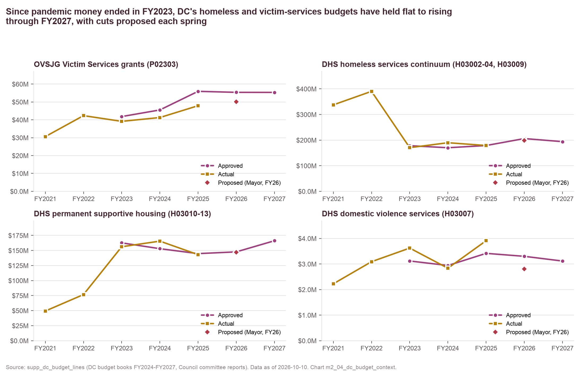
Since pandemic money ended, DC's four budget lines behind Calvary's local streams have held flat to rising, with OVSJG under-spending 9–14%.
Approved vs actual
OVSJG P02303 approved $45.5M (FY24), $55.9M (FY25), $55.4M (FY26), $55.3M (FY27); actual $41.3M and $47.9M in FY24–FY25.
DHS continuum approved $170M (FY24) → $206M (FY26) → $194M (FY27).
PSH approved $145M–$166M FY25–FY27.
DV services $2.9M–$3.4M approved; the Mayor's FY26 proposal ($2.8M) was not enacted.
Source: DC Approved Budget and Financial Plan books FY2024–FY2027, Council committee budget reports, Budget Support Acts; supp_dc_budget_lines
Method: sums of activity-level total rows per program code; proposed = Mayor's FY2026 proposal as reported by Council committees
Chart m2_04 · data as of 2026-10-10 · method note A6

Slide 18
DC budget lines for OVSJG, the DHS continuum, PSH and DV services by stage and year show approved budgets flat to rising through FY2027.
Budget line | Stage | FY2021 | FY2022 | FY2023 | FY2024 | FY2025 | FY2026 | FY2027
DHS domestic violence services (H03007) | approved | — | — | $3.1M | $2.9M | $3.4M | $3.3M | $3.1M
DHS domestic violence services (H03007) | actual | $2.2M | $3.1M | $3.6M | $2.8M | $3.9M | — | —
DHS domestic violence services (H03007) | proposed | — | — | — | — | — | $2.8M | —
DHS homeless services continuum (H03002-04, H03009) | approved | — | — | $178.0M | $170.0M | $178.7M | $205.9M | $193.7M
DHS homeless services continuum (H03002-04, H03009) | actual | $337.4M | $390.2M | $170.4M | $189.6M | $178.8M | — | —
DHS homeless services continuum (H03002-04, H03009) | proposed | — | — | — | — | — | $198.1M | —
DHS permanent supportive housing (H03010-13) | approved | — | — | $162.6M | $152.9M | $144.8M | $147.6M | $166.2M
DHS permanent supportive housing (H03010-13) | actual | $49.3M | $76.7M | $156.2M | $165.5M | $143.0M | — | —
DHS permanent supportive housing (H03010-13) | proposed | — | — | — | — | — | $146.9M | —
OVSJG Victim Services grants (P02303) | approved | — | — | $41.8M | $45.5M | $55.9M | $55.4M | $55.3M
OVSJG Victim Services grants (P02303) | actual | $30.6M | $42.3M | $39.1M | $41.3M | $47.9M | — | —
OVSJG Victim Services grants (P02303) | proposed | — | — | — | — | — | $50.1M | —
Source: DC Approved Budget and Financial Plan books FY2024–FY2027, Council committee budget reports, Budget Support Acts; supp_dc_budget_lines
Method: activity-level totals; each book carries two years of actuals and two approved years; proposed = Mayor's FY2026 proposal
Chart m2_04 · data as of 2026-10-10 · method note A6

Slide 19
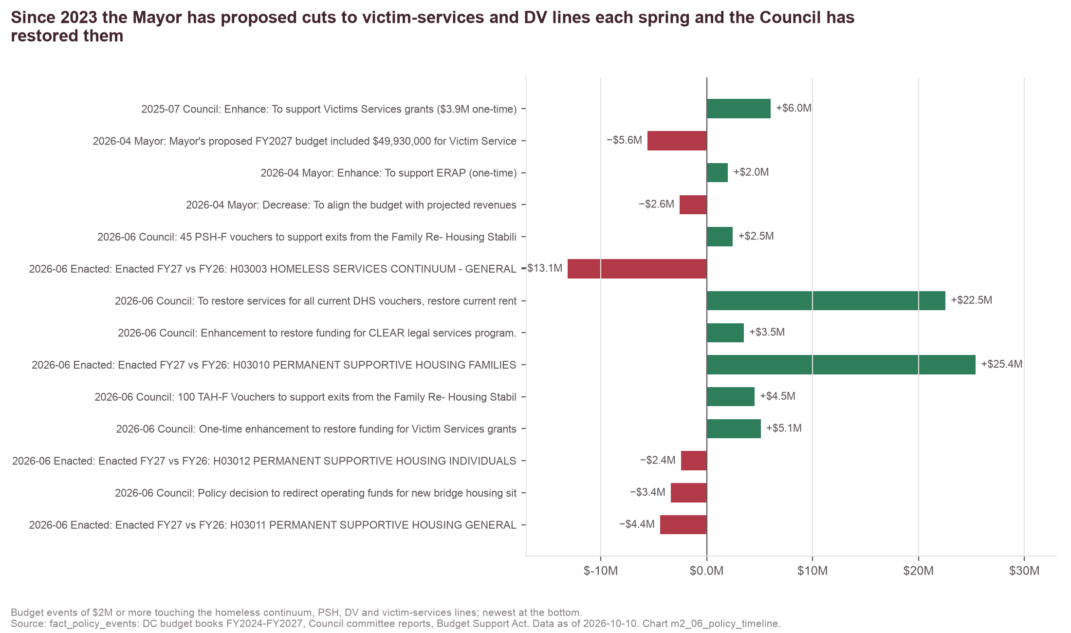
In each of the last two budget seasons the Mayor proposed cuts to OVSJG Victim Services grants and the Council restored them.
Pattern
FY26: Mayor −$5.84M to $50.1M; Council committee +$3.5M and a +$6.03M enhancement ($3.9M one-time).
FY27: Mayor −$5.60M to $49.9M; Council +$5.1M one-time restoration.
DHS lines move by larger amounts in both directions, driven by family rehousing (FRSP), ERAP and PSH vouchers.
Source: DC Approved Budget and Financial Plan books FY2024–FY2027, Council committee budget reports, Budget Support Acts; fact_policy_events
Method: events of $1M or more touching homeless, PSH, DV and victim-services lines, FY2024–FY2027
Chart m2_06 · data as of 2026-10-10 · method note A6

Slide 20
Fourteen budget events of $2M or more touched Calvary's OVSJG Victim Services line since 2023.
Date | Budget FY | Stage | Event | Change
2023-05-30 | FY2024 | revised | Enhance: To support Victim Services - Domestic Violence ($4.6M one-time) [division: Victim… | $10,490,000
2023-05-30 | FY2024 | enacted | FY2024 approved budget vs FY2023 approved (all funds): PS0023 SUBTOTAL: VICTIM SERVICES (as… | $3,717,000
2023-05-30 | FY2024 | enacted | FY2024 approved budget vs FY2023 approved (all funds): P02303 VICTIM SERVICES (as printed in… | $3,710,000
2024-04-03 | FY2025 | proposed | OVSJG FY2025 proposal erroneously included $6.538 million of already-spent federal VOCA… | −$2,700,000
2024-06-12 | FY2025 | enacted | FY2025 approved budget vs FY2024 approved (all funds): P02303 VICTIM SERVICES GRANTS (as… | $10,407,000
2024-06-12 | FY2025 | enacted | FY2025 approved budget vs FY2024 approved (all funds): PS0023 SUBTOTAL: VICTIM SERVICES (as… | $10,395,000
2025-06-02 | FY2026 | proposed | Mayor's proposed FY2026 budget decreased OVSJG Victim Services grants by $5,842,000 to a… | −$5,842,000
2025-06-02 | FY2026 | proposed | Increase: To align the budget with projected revenues [division: Victim Services; Mayor… | $2,598,000
2025-06-02 | FY2026 | proposed | Enhance: To support the Sexual Assault Victims’ Right Act Amendment (one-time) [division… | $3,046,000
2025-07-28 | FY2026 | revised | Committee on the Judiciary and Public Safety recommended change to the Mayor's proposed… | $3,500,000
2025-07-28 | FY2026 | revised | Enhance: To support Victims Services grants ($3.9M one-time) [division: Victim Services… | $6,028,000
2026-04-14 | FY2027 | proposed | Decrease: To align the budget with projected revenues [division: Victim Services; Mayor… | −$2,557,000
2026-04-14 | FY2027 | proposed | Mayor's proposed FY2027 budget included $49,930,000 for Victim Services grants, a $5,596,000… | −$5,596,000
2026-06-23 | FY2027 | revised | One-time enhancement to restore funding for Victim Services grants [P02303 VICTIM SERVICES… | $5,100,000
Source: DC Approved Budget and Financial Plan books FY2024–FY2027, Council committee budget reports, Budget Support Acts; fact_policy_events
Method: OVSJG events with a dated budget stage and |change| ≥ $2M; P02303 and its PS0023 subtotal are separate printed rows; DHS events are in chart_data/m2_06
Chart m2_06 · data as of 2026-10-10 · method note A6

Slide 21
Calvary held 0.7–1.5% of the OVSJG pool outside FY22's building award and moved from 1.1% (2019) to 5.3% (2025) of the DC CoC pool.
Year | All OVSJG awards | Calvary OVSJG | of which recurring | Calvary share of OVSJG | DC CoC awards (DC-500) | Calvary CoC | Calvary share of CoC
2019 | $96,738,945 | $660,935 | $660,935 | 0.7% | $22,075,117 | $239,659 | 1.1%
2020 | $47,478,438 | $368,935 | $368,935 | 0.8% | $23,608,105 | $248,131 | 1.1%
2021 | $54,624,805 | $368,935 | $368,935 | 0.7% | $25,062,775 | $1,472,398 | 5.9%
2022 | $90,888,468 | $4,149,110 | $468,435 | 4.6% | $27,933,554 | $672,065 | 2.4%
2023 | $71,617,828 | $841,040 | $841,040 | 1.2% | $29,711,325 | $1,151,540 | 3.9%
2024 | $62,935,024 | $913,401 | $913,401 | 1.5% | $33,659,924 | $1,761,352 | 5.2%
2025 | $92,682,681 | $998,278 | $998,278 | 1.1% | $33,538,014 | $1,766,814 | 5.3%
2026 | $96,653,604 | $1,050,651 | $1,050,651 | 1.1% | — | — | —
Source: DC OVSJG award lists (all recipients) and HUD CoC award lists (all DC-500 projects); fact_gov_awards
Method: Calvary ÷ pool total by year; OVSJG by DC FY, CoC by competition year as listed (Calvary CoC column follows the m2_05 alignment)
Chart m2_05 · data as of 2026-10-10 · method note A2

Slide 22
The six scenarios and their parameters are reproducible from config/scenarios.yaml.
Baseline parameter (FY25) | Value
Baseline year | FY25
Total revenue | $4,967,995
Total expenses | $5,575,321
Surplus / deficit | −$607,326
Cash at year end | $2,063,796
Recognized government revenue | $2,892,598
Government share | 58.2%
Apportioned: OVSJG | $673,109
Apportioned: HUD CoC | $1,187,628
Apportioned: DHS / TCP | $959,935
Apportioned: other federal | $71,926
New Foundations 2 share of CoC | 30.8%
Cost-avoidance share (net view) | 50.0%
Scenario | Revenue loss | % of revenue | Deficit (gross) | Deficit (net) | Cash after 12m (net, months) | Months to zero (net)
Baseline FY25 (actual) | $0 | 0.0% | −$607,326 | −$607,326 | 3.1 | 41
OVSJG grants cut 10% | $67,311 | 1.4% | −$674,637 | −$640,981 | 3.1 | 39
OVSJG grants cut 25% | $168,277 | 3.4% | −$775,603 | −$691,465 | 3.0 | 36
HUD CoC renewals cut 15% | $178,144 | 3.6% | −$785,470 | −$696,398 | 2.9 | 36
One CoC project lost (New Foundations 2) | $365,762 | 7.4% | −$973,088 | −$790,207 | 2.7 | 31
DHS/TCP contract not renewed | $959,935 | 19.3% | −$1,567,261 | −$1,087,293 | 2.1 | 23
Combined (OVSJG -25%, CoC -15%, DHS lost) | $1,306,356 | 26.3% | −$1,913,682 | −$1,260,504 | 1.7 | 20
Cuts: S1 OVSJG 10%; S2 OVSJG 25%; S3 CoC 15%; S4 New Foundations 2 lost (30.8% of CoC); S5 DHS/TCP 100%; S6 S2 + S3 + S5. Net view: 50% of a lost stream's revenue is avoidable cost (cost_avoidance_share). Stream amounts are recognized FY25 government revenue apportioned by FY-aligned award ceilings.
Source: fact_gov_awards, fact_org_financials (FY25 990); config/scenarios.yaml
Method: apportioned stream amounts × configured cuts; cash after 12 months and months to zero as computed in scripts/02_m2_exposure.py
Chart m2_07 · data as of 2026-10-10 · method note A4

