Slide 1
Calvary's funding today, and the opportunities ahead
A pro bono look at Calvary Women's Services' public and private funding, built from public records, for discussion with leadership and the board.

Slide 2
Calvary has become a system-level provider whose funding needs a better shape and a deeper cushion, not a smaller share.
Situation: Calvary has built a stronger organization, funded mostly by public partners.
Revenue up 59% in real terms FY19→FY25; inventory 68 → 124 beds, 6.8% of DC's transitional-housing beds
Public funding is about half of revenue (53% FY22–24), typical for DC peers (11th of 19)
Complication: the money arrives in a concentrated shape, private support has held flat, and FY25 thinned the cushion.
Three public streams, two through TCP, carry 74% of a $4.1M award base; the DHS contract is the largest and least documented
Foundation grants steady at ~$1M a year, one partner 27%; FY25: −$607K, event income −$483K, 4.4 months of cash
Calvary recognized only about two-thirds of its known award ceilings as revenue in FY24–25
Resolution: draw every awarded dollar, grow private support alongside the public base, and hold a reserve.
A 90-day plan on four fronts with eleven Tier 1 targets: upgrade GWCF, Cafritz, Abell, Fowler; open Clark, Schattner; confirm the TCP contracts
Target: private revenue from ~$2.1M to ~$3M in three years, a six-month reserve, and workforce / behavioral-health formalization
What we need from you: reactions, the FY24–25 audits, the TCP agreements, and the FY25 gala calendar
Source: all modules M1–M10; figures carry chart IDs on the slides that follow
Method: Situation–Complication–Resolution; bold lines are the argument, bullets the evidence
Chart m1_01, m2_01, m2_07, m7_00 · data as of 2026-10-10

Slide 3
In five years Calvary has grown revenue 59% in real terms and its housing inventory to 124 beds.
+59%
124 beds
3 streams
50 funders
Real revenue growth FY19 → FY25 ($2.49M → $4.97M, 2024 dollars)
Housing inventory 2025, up from 68 in 2022; 6.8% of DC's transitional-housing beds (2.5% in 2022)
Public partners: DC OVSJG, HUD Continuum of Care via TCP, DC DHS via TCP
Foundations and donor-advised sponsors with filed grants to Calvary, TY2020–24
Calvary did this while serving the two wards with the deepest need in the city: Ward 8's poverty rate is 31% against 15% citywide, and a third of renters in Wards 7 and 8 pay more than half their income in rent.
Implication: the case for Calvary to funders is strong and quantified, and the question is how to fund the next five years as well as the last five.
Source: IRS Form 990 returns FY2011–FY2025 (GivingTuesday / ProPublica / IRS SOI) in fact_org_financials; HUD Housing Inventory Count 2022–2025 in supp_hic_projects; ACS 2020–24 by ward in dim_geo
Method: revenue deflated with CPI-U to 2024 dollars; beds = HIC total_beds for Calvary projects
Chart m1_01, m9_03, m9_01 · data as of 2026-10-10 · method note A1

Slide 4
Public partners funded most of that growth and now provide about half of revenue, typical for DC peers.
What the chart says
The share is typical.
Government ran 40–61% every year since FY15; 53% on average for FY22–24.
11th of 19 DC-area organizations; 57th percentile of DC's human-services sector.
Growth came with it.
The FY22 spike was a one-time $3.68M award to buy the New Foundations building.
Implication: the share itself is not the problem to solve, and the shape of the public money and the private base are.
Source: Calvary audited financial statements FY15–FY23 (government revenue) and IRS 990 returns, fact_org_financials
Method: government share = audited government contracts and grants ÷ audited revenue; 990 line 1e ÷ 990 revenue for FY24–25
Chart m1_02 · data as of 2026-10-10 · method note A1

Slide 5
The question is the shape of the public money, since three streams, two through one intermediary, carry $4.1M a year.
Three channels, one hub
TCP carries 74% of the base.
HUD CoC via TCP: $0.24M (2019) → $1.77M (FY2025), three projects.
DHS via TCP: $1.42M in FY2024 (transitional housing $830K, Sisters Rise $593K); other years not public.
OVSJG is direct and growing.
$0.37M (FY20) → $1.05M (FY26), two transitional-housing grants.
Implication: the relationship with TCP matters as much as any single program, and the DHS contract is the stream to document first.
Source: DC OVSJG award lists FY2019–2026; HUD CoC award lists (TCP as applicant); DC Council oversight responses FY2024; Calvary single audits — fact_gov_awards
Method: one source per stream, never summed across sources; OVSJG and DHS by DC fiscal year, CoC by competition year; one-time awards excluded
Chart m2_01 · data as of 2026-10-10 · method note A2

Slide 6
Private support has held steady near $1M a year in grants, with one partner providing more than a quarter.
Steady, and concentrated
$0.64–1.17M a year from 26–29 funders.
Grants named in funders' own filings, TY2020–24.
One partner is 27%; the top five are 63%.
GWCF, including the time-limited Health Equity Fund.
Donor-advised sponsors (Benevity, Fidelity, Schwab) add $1.1M over five years: individual donors' money.
Implication: the Health Equity Fund's finite life makes a successor conversation with GWCF timely, and the base needs more names and deeper grants.
Source: Funders' IRS 990-PF and Schedule I filings TY2020–24 naming Calvary (GivingTuesday / IRS e-file), fact_grants and dim_funder
Method: non-cumulative rows, aggregated by funder EIN; TY2024 filings partly released
Chart m1_07, m1_08 · data as of 2026-10-10 · method note A3

Slide 7
After a strong FY24, FY25 brought a $607K deficit, a $483K event-income drop, and 4.4 months of cash.
−$607K
$538K → $55K
4.4 months
FY25 operating result (revenue $4.97M, expenses $5.58M); FY24 was +$507K
Event contributions FY24 → FY25 (990 line 1c); net event income turned positive, so timing may explain part of it
Cash and savings ÷ monthly expenses at FY25 year-end, down from 7.5 months in FY21
These are clouds on the horizon rather than a verdict on the year: FY24 was unusually strong and the event line may be a calendar change. They do mean there is little room to absorb a public-funding shock.
Implication: the plan that follows starts with cash and draw-down, because a thin cushion turns a survivable cut into a crisis.
Source: IRS 990 returns FY2021–FY2025, fact_org_financials
Method: months of cash = cash_savings_eoy ÷ (total_expenses ÷ 12)
Chart m1_04, m1_05, m1_06 · data as of 2026-10-10 · method note A1

Slide 8
The clouds on the horizon
DC's budgets have held, the Council has restored every proposed cut, and the real risk sits in one channel.

Slide 9
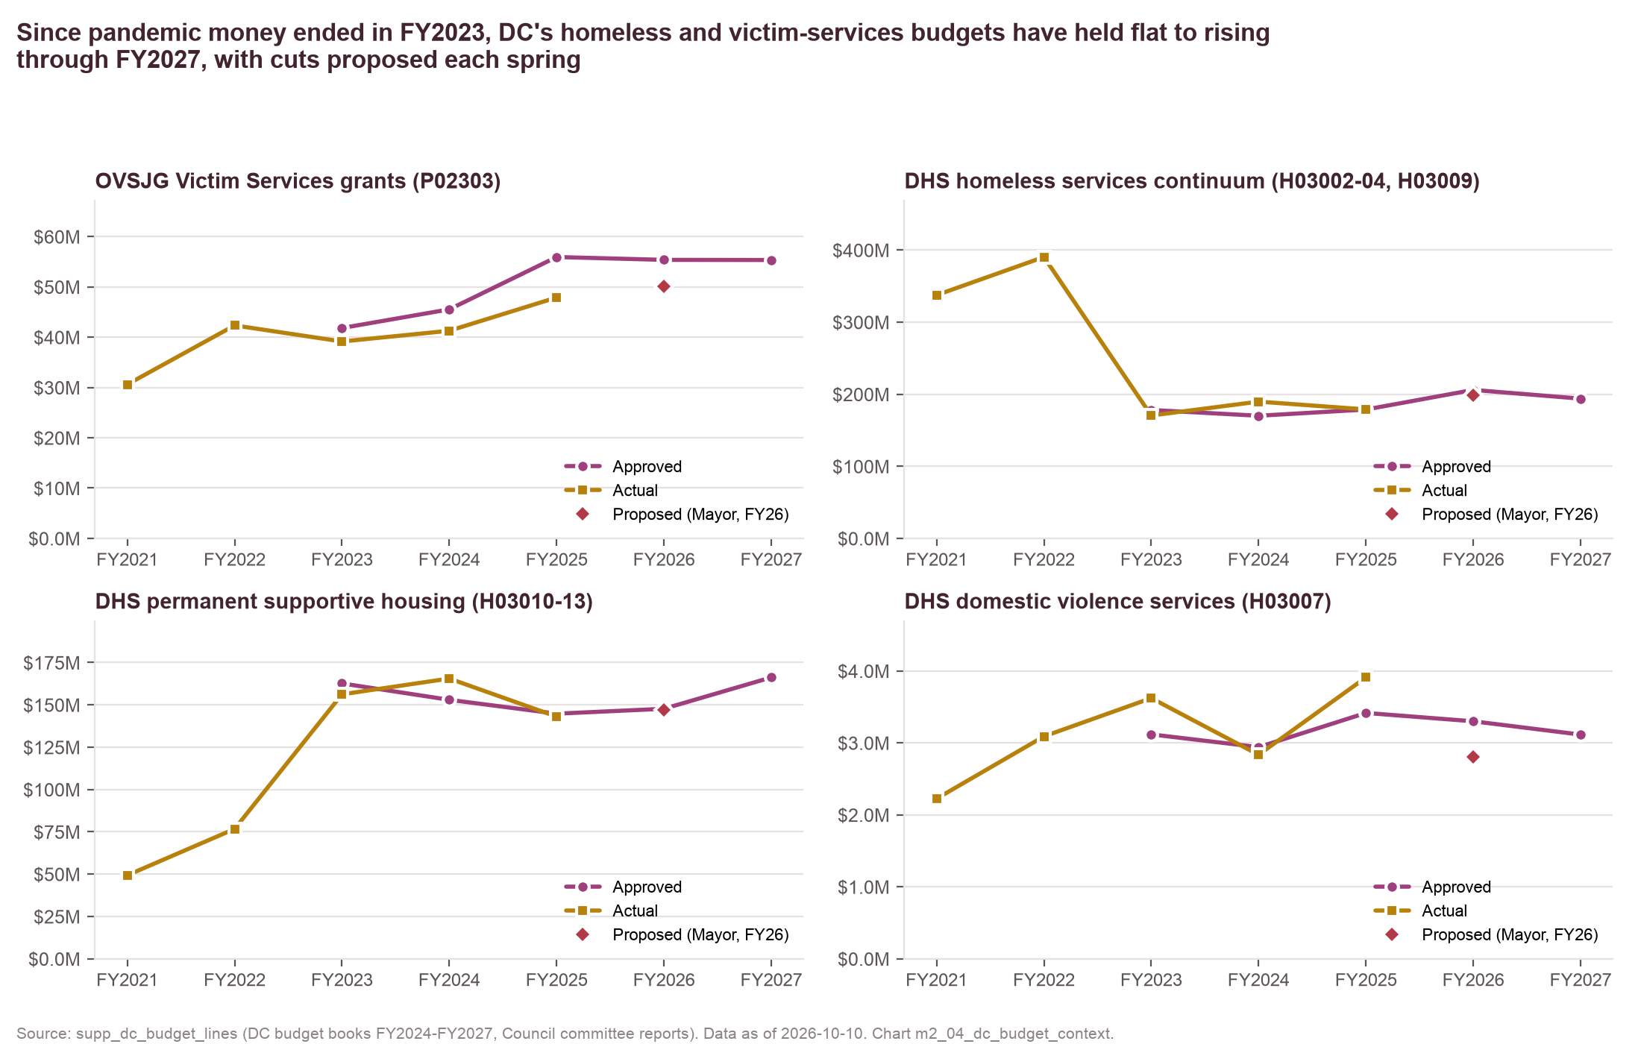
DC's budgets behind Calvary's local funding have held through FY2027, but a cut is proposed every spring.
Stable pools, annual threat
OVSJG Victim Services grants are flat at $55M.
$45.5M (FY24) → $55.9M (FY25) → $55.4M (FY26) → $55.3M (FY27) approved.
Mayor proposed −$5.8M (FY26) and −$5.6M (FY27); the Council restored both.
DHS homeless services rose.
$170M (FY24) → $206M (FY26) → $194M (FY27); actual OVSJG spending runs 9–14% under approved.
Implication: the local risk is annual and political, which an advocacy calendar can manage, and it is not a structural decline.
Source: DC budget books FY2024–FY2027 (OCFO Schedule 30-PBB, agency chapters) and Council committee reports — supp_dc_budget_lines, fact_policy_events
Method: activity-level totals by program code; approved vs actual vs Mayor's proposal
Chart m2_04, m2_06 · data as of 2026-10-10 · method note A6

Slide 10
Calvary can absorb the headline cuts, but losing the DHS contract through TCP is the cloud to plan for.
Scenario (FY25 baseline) | Revenue loss | % of revenue | Deficit (gross) | Months of cash after a year (net)
Baseline FY25 (actual) | – | – | −$607K | 3.1
OVSJG grants cut 10% | −$67K | 1% | −$675K | 3.1
OVSJG grants cut 25% | −$168K | 3% | −$776K | 3.0
HUD CoC renewals cut 15% | −$178K | 4% | −$785K | 2.9
One CoC project lost (New Foundations 2) | −$366K | 7% | −$973K | 2.7
DHS/TCP contract not renewed | −$960K | 19% | −$1,567K | 2.1
Combined (OVSJG -25%, CoC -15%, DHS lost) | −$1,306K | 26% | −$1,914K | 1.7
Reading: an OVSJG cut of the size proposed in FY26 costs about $67K; a lost DHS/TCP contract costs about $960K. The net column assumes half of a lost stream's revenue is avoidable cost. Even the baseline burns cash at about $50K a month.
Implication: protect the TCP-channel contract first, and the OVSJG budget season is survivable with a reserve and a voice in the coalition.
Source: fact_gov_awards (award ceilings by stream) and fact_org_financials (FY25 990); parameters in config/scenarios.yaml
Method: FY25 recognized government revenue apportioned to streams by FY-aligned award ceilings; cuts applied to the apportioned amounts
Chart m2_07 · data as of 2026-10-10 · method note A4

Slide 11
Calvary recognized about two-thirds of its known award ceilings in FY24–25, the first place to look.
A question, not a finding
FY24: $2.62M of $3.6M (73%). FY25: $2.89M of $4.3M (67%).
Ceilings are awards, not revenue: timing, draw rates and cost-reimbursement limits all lower the figure.
The DHS value is public for FY2024 only and is carried into FY25.
The audits would settle it.
Calvary's FY24 and FY25 audits and its TCP subgrant agreements answer this in an afternoon.
Implication: undrawn awards are the cheapest revenue there is, and a draw-down reconciliation is the first task in the 90-day plan.
Source: fact_gov_awards aligned to Calvary's fiscal year (DC FY direct; HUD competition year lagged one year; DHS FY2024 carried forward); fact_org_financials
Method: ratio = recognized government revenue ÷ sum of known award ceilings
Chart m2_02 · data as of 2026-10-10 · method note A5

Slide 12
What peers show
Organizations with Calvary's profile have grown on more than one model; the closest fit is to grow private support alongside a stable public base.

Slide 13
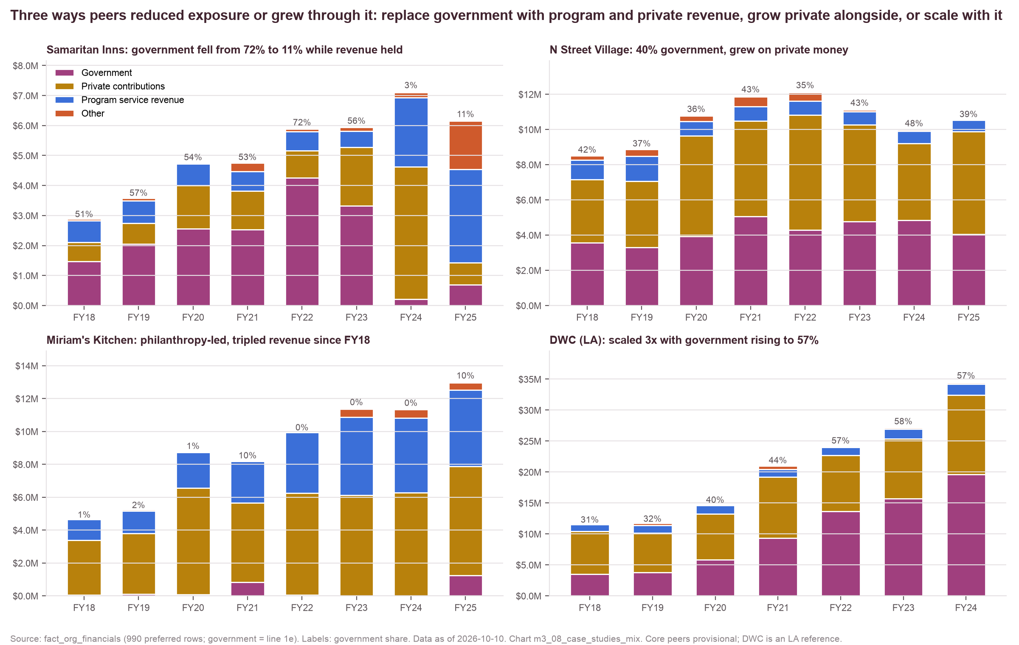
Peers show three workable paths, and N Street Village's, growing private support beside a stable public base, fits Calvary best.
Three paths
Samaritan Inns
Government 72% → 11% while revenue held, replaced by program revenue.
N Street Village
~40% government, grew on private money; 8 months of cash.
Miriam's Kitchen
Philanthropy-led, tripled since FY18.
DWC (LA)
Scaled 3× since 2018 with government rising to 57%, on 2–3 months of cash.
Implication: the N Street Village path fits Calvary's model and size, and Samaritan Inns shows the earned-revenue option.
Source: IRS 990 returns of 18 provisional DC-area peers and 2 Los Angeles comparators, fact_org_financials
Method: government = 990 line 1e; peers chosen for model similarity (config/core_peers.csv, provisional)
Chart m3_08, m3_01 · data as of 2026-10-10 · method note B1

Slide 14
Calvary already works its foundation funders harder than most peers, so the headroom is deeper grants, donors and earned revenue.
Depth, not count
Calvary: 42 funders; grants equal to 12% of revenue.
Typical peer 6–8% (N Street Village, House of Ruth DC); only Samaritan Inns (27%) is far ahead.
Donor-advised funds are the gap.
25% of Calvary's filed grants vs 51% at N Street Village and 41% at Miriam's Kitchen.
Implication: more applications have limited headroom, and bigger multi-year grants, a major-gifts program and billable program revenue are the levers.
Source: Funders' 990-PF and Schedule I filings TY2020–24 naming each organization (fact_grants, dim_funder); 990 revenue FY2020–24 (fact_org_financials)
Method: institutional = all funder types except DAF sponsors; DMV funders' filings only
Chart m3_06 · data as of 2026-10-10 · method note B2

Slide 15
Where the opportunities are
The money exists in DC's funder community, and most of it already flows to organizations that share Calvary's funders.

Slide 16
DMV funders give DC's sector $132M a year, and 23 of them already fund three or more of Calvary's peers.
Warm cold prospects
$660M flowed to DC's sector in TY2020–24, 58% via donor-advised funds.
Clark Charitable: $7.8M to five peers, median grant $250K, no Calvary grant yet.
Schattner, Cohen, Bernstein and The Washington Home each fund 3–4 peers at $25–75K.
Venable and America's Charities are already in Calvary's records; the filing gap is lag.
Implication: these funders already fund Calvary's model, and the ask is an introduction, not a case for the cause.
Source: Funders' 990-PF and Schedule I filings TY2020–24 (fact_grants, dim_funder, dim_universe_membership); landscape exclusions in config/landscape_exclusions.csv
Method: gap = funder names 2+ core peers and no Calvary row in TY2020–24 filings; DAF sponsors excluded
Chart m5_01, m4_01 · data as of 2026-10-10 · method note C1

Slide 17
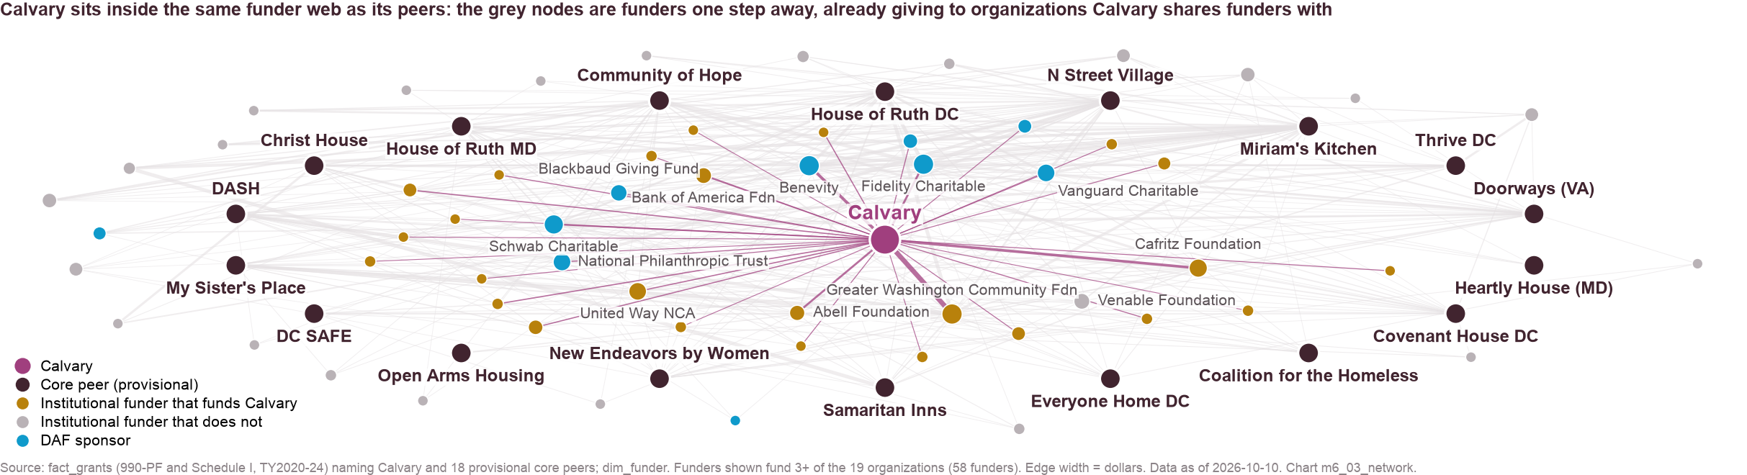
Calvary sits inside the funder web, so the next funders are one introduction away through peers that share its funders.
Closest neighbors
17 shared funders with Miriam's Kitchen; 14 each with DASH and House of Ruth DC.
House of Ruth DC (69) and House of Ruth MD (81) have the longest lists of funders Calvary lacks.
Board overlaps are thin in public filings.
One high-confidence link, not a funder; introductions run through shared funders and peers.
Implication: ask the closest peers for introductions to the funders they share with each other but not yet with Calvary.
Source: fact_grants (funders of Calvary and 18 peers, TY2020–24), fact_org_relationships (board links by person match confidence)
Method: bipartite funder–recipient graph; funders of 3+ organizations shown; high-confidence board links only in this deck
Chart m6_03, m6_02 · data as of 2026-10-10 · method note C2

Slide 18
A plan to consider
Four fronts over 90 days, eleven named targets, and two policy choices for the board.

Slide 19
We suggest a 90-day plan that draws every awarded dollar, upgrades partners, opens new foundations and restores the event line.
1. Draw every awarded dollar
2. Upgrade current partners
3. Open new foundations
4. Restore the event line
Day 30
Reconcile award ceilings to revenue for FY24–26
Confirm the DHS contract and Sisters Rise status with TCP
Defend the three CoC renewals; scope a PSH expansion project
Day 45
Multi-year general-operating asks to GWCF, Cafritz, Abell, Fowler, United Way NCA, Bank of America
Ask GWCF about a Health Equity Fund successor
Cafritz deadlines: Mar 1, Jul 1, Nov 1
Day 60–90
Clark Charitable first, via the peers it funds
Schattner, Cohen, Bernstein, The Washington Home
Re-engage Many Hands (January window), World Bank CCF, Jane Bancroft Robinson
Day 45
Confirm whether the FY25 gala moved across the fiscal year
Set the FY26 event at the FY24 level ($538K)
Start a named major-gifts and DAF program
Implication: front 1 costs nothing and may be worth the most, and fronts 2–4 are the private-revenue plan that moves the share toward half.
Source: recommendations/strategic_recommendations.md, built from modules M1–M7
Method: recommendations are options for Calvary's leadership to weigh, drawn from the evidence in this deck
Chart m7_01 · data as of 2026-10-10

Slide 20
Eleven Tier 1 targets come with a next step, an owner and a deadline.
Target | Track | Next step | Owner | By | Application cycle
William S Abell Foundation | foundation | Upgrade ask: request a multi-year general-operating grant at the funder's peer-level amount, citing the FY25 deficit and the three-stream exposure | Development director | Day 45
Greater Washington Community Foundation | foundation | Upgrade ask: request a multi-year general-operating grant at the funder's peer-level amount, citing the FY25 deficit and the three-stream exposure | Development director | Day 45 | Cycle-specific; check Grant Opportunities page
Clark Charitable Foundation | foundation | Warm introduction through a shared peer or co-funder; request guidelines / invitation; submit an LOI in the next cycle | CEO + board chair | Day 60 (LOI by day 90)
DC OVSJG Victim Services grants (Reach Up, New Foundations) | DC public | Confirm FY26 award letters and draw-down status; schedule program-officer check-in; map FY27 renewal calendar | CEO + board chair | Day 30
Morris And Gwendolyn Cafritz Foundation | foundation | Upgrade ask: request a multi-year general-operating grant at the funder's peer-level amount, citing the FY25 deficit and the three-stream exposure | Development director | Day 45 | March 1, July 1, November 1
HUD Continuum of Care via TCP (Sister Circle, Reach Up, New Foundations 2) | federal public | Confirm FY26 award letters and draw-down status; schedule program-officer check-in; map FY27 renewal calendar | CEO + board chair | Day 30
DHS homeless services via TCP (TH contract, Sisters Rise) | DC public | Confirm FY26 award letters and draw-down status; schedule program-officer check-in; map FY27 renewal calendar | CEO + board chair | Day 30
John Edward Fowler Memorial Foundation | foundation | Upgrade ask: request a multi-year general-operating grant at the funder's peer-level amount, citing the FY25 deficit and the three-stream exposure | Development director | Day 45 | Rolling
MGAC | corporate | Quantify cash vs in-kind in the CRM; propose a multi-year sponsorship or program partnership | CEO + board chair | Day 45
Robert I Schattner Foundation | foundation | Warm introduction through a shared peer or co-funder; request guidelines / invitation; submit an LOI in the next cycle | Development director | Day 60 (LOI by day 90)
Americas Charities | foundation | Warm introduction through a shared peer or co-funder; request guidelines / invitation; submit an LOI in the next cycle | Development director | Day 60 (LOI by day 90) | Annual campaign enrollment
Implication: owners and dates are proposals for the working session, and the scoring weights behind the tiers are editable in one file.
Source: recommendations/funder_pipeline.csv and action_plan_90day.csv (from fact_grants, dim_funder, fact_org_relationships, the CRM reconciliation and a reviewed web pull of funder guidelines)
Method: seven weighted dimensions in config/scoring_weights.yaml; Tier 1 = score ≥ 0.62 and typical grant ≥ $25K; public rows carry analyst scores
Chart m7_01, m7_04 · data as of 2026-10-10 · method note C3

Slide 21
Formalizing workforce and behavioral health opens the largest nearby pools without changing the mission.
Options and trade-offs
Workforce (near): a SheWorks-style cohort inside Step Up DC; opens DOES and workforce funders.
Behavioral health (near): a credential or billing partner turns therapy into program revenue.
Health (medium): clinic hours with an FQHC partner (Community of Hope is a Ward 8 peer).
DV formalization raises the public share; families would be a mission change and is not suggested.
Implication: pick two near options to scope this year, and health is a partnership conversation, not a build.
Source: fact_grants purpose text tagged with dim_program_area keywords (DMV institutional funders, TY2020–24); fact_opportunities; config/expansion_areas.yaml
Method: dollars whose purpose names the area (general operating excluded, so pools are understated); distance ratings are analyst judgment; education shown in the appendix
Chart m8_01 · data as of 2026-10-10 · method note D1

Slide 22
A six-month reserve and an annual advocacy calendar would make the spring budget season routine.
Reserve policy
Advocacy and monitoring calendar
Target six months of expenses, about $2.8M; Calvary holds 4.4 today.
Peers with Calvary's mix hold more: Doorways 12, Everyone Home DC 10, N Street Village 8; government-anchored DV providers hold about one.
Treat the Health Equity Fund and other time-limited sources as one-time in the budget.
Close the FY25 gap in the FY26 budget with the private tracks plus a cost plan.
March–July is the season: proposal, markups, vote.
Mayor's budget March–April (cuts proposed in FY26 and FY27); committee markups May–June; Council vote June–July (restorations).
Join the coalition testimony that restored the victim-services line twice.
Track draw-down against ceilings monthly; watch OVSJG under-spend, TCP's DHS purchase orders, the CoC NOFO and the EHV sunset.
Implication: two board decisions: adopt a reserve target, and put the advocacy calendar on the board's own calendar.
Source: fact_org_financials (months of cash, 20 organizations), fact_policy_events (DC budget calendar FY2024–FY2027)
Method: months of cash = cash and savings ÷ monthly expenses, FY2024
Chart m3_04, m2_06 · data as of 2026-10-10 · method note A6, B1

Slide 23
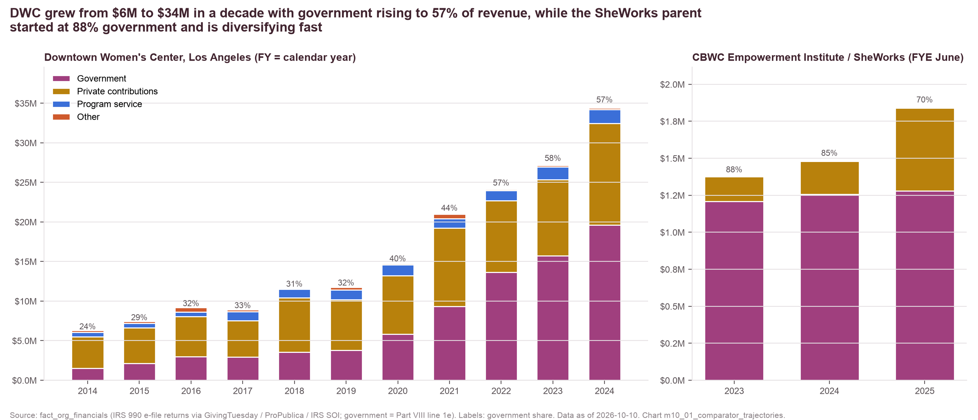
The Los Angeles comparators show scale with government (DWC) and a program design to borrow (SheWorks).
What transfers
DWC
$6M (2014) → $34M (2024), government 24% → 57%, 99% pass-through federal money, 2.4 months of cash.
Transferable: the PSH pipeline, the clinic partnership, the MADE enterprise.
SheWorks
Cohort model with stipends, childcare, transport and labor and health-plan partners; a design for Step Up DC, not a funding model.
Implication: borrow DWC's housing-development and partnership playbook and SheWorks' program design, and do not copy either funding mix.
Source: IRS 990 returns (fact_org_financials); Federal Audit Clearinghouse single audits (fact_gov_awards); organization web pages and funder announcements (fact_grants web rows)
Method: government = 990 line 1e; DWC fiscal year is the calendar year; CBWC fiscal year ends June
Chart m10_01, m10_02 · data as of 2026-10-10 · method note B3

Slide 24
The FY24–25 audits, the TCP agreements and the FY25 gala calendar would sharpen every number in this deck.
FY24 and FY25 audited statements
TCP subgrant agreements FY2023–FY2026
FY25 event calendar and CRM notes
Resolves the ceilings-vs-recognized question (~$1M a year).
Government revenue on the audit basis for the two latest years
Whether single audits were filed
Resolves the DHS contract values and the Sisters Rise / EHV status.
Renewal terms for the largest single stream
Draw-down terms and schedules
Resolves whether the gala moved across the fiscal year.
Cash vs in-kind in the corporate relationships (MGAC, Capital One, IMF)
Lapsed funders' gifts routed through DAFs
Implication: with these three documents the government picture rests on Calvary's own numbers rather than on public reconstruction.
Source: discoveries_log.md (flags D1–D3) and open_questions.md part B from the data build
Method: each document maps to a flag raised during the analysis
Chart m2_02, m2_03, m1_06 · data as of 2026-10-10

Slide 25
The next steps are your reactions, the three documents, and a working session that turns Tier 1 into assignments.
What has been done
What comes next
Decisions needed from you
Ten analysis modules on 25 public-record tables
Verdict, scored pipeline (182 rows), 90-day plan, expansion options
Every figure traced to a chart-data file and a public source
Week 1: leadership reactions to the framing, targets and options
Week 2: the three documents
Week 3: working session to assign Tier 1 owners and dates
Day 30 / 45 / 60–90 milestones from the action plan
Adopt (or adjust) the verdict framing and the $3M / 50% target
Confirm the Tier 1 list and owners
Pick two expansion options to scope
Adopt a reserve target and the advocacy calendar
Implication: nothing here is final until Calvary's team has weighed it, and the consulting team keeps the pipeline and charts current as decisions land.
Source: recommendations/action_plan_90day.csv
Method: deadlines are relative to the start of the plan
Chart m7_01 · data as of 2026-10-10

Slide 26
Every figure traces to a chart-data file and a public source, and the consulting and appendix decks carry the methods.
Consulting deck: 55 slides with every module, method and the complete scored pipeline.
Appendix A: Calvary and government funding. Appendix B: peers and named comparators. Appendix C: funders, gaps, network and pipeline. Appendix D: data and methods (method notes A1–D3).
Reports: executive summary, full findings, methodology, recommendations; board talking points and consulting briefing.
Every chart ID (e.g., m2_02) is a CSV in chart_data/ whose source IDs point to the public documents in the source registry; scoring weights live in config/scoring_weights.yaml.
Data as of 2026-10-10. Core peers are provisional; FY24–25 government figures rest on the 990 until the audits are shared.
Source: calvary_analysis/README.md
Method: traceability checked by scripts/lib/trace.py
Chart all · data as of 2026-10-10

