Slide 1
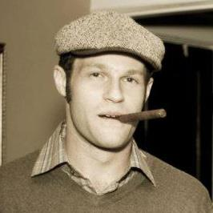

Datt
Decentralized Content Sharing App with Integrated Bitcoin Payments
Ryan X. Charles
San Francisco Bitcoin Meetup
Oct. 27, 2015
Ryan X. Charles
Founder of Datt (datt.co)
twitter.com/ryanxcharles
github.com/ryanxcharles
Datt GitHub, Twitter, and blog:
github.com/dattnetwork
twitter.com/dattnetwork
blog.datt.co
Datt

Slide 2
Outline
Origins
Technology
Product
Business
Community
Prototype Status
Ryan X. Charles
Founder of Datt (datt.co)
twitter.com/ryanxcharles
github.com/ryanxcharles
Datt GitHub, Twitter, and blog:
github.com/dattnetwork
twitter.com/dattnetwork
blog.datt.co
Datt

Slide 3

reddit
Sep. 2014 – Jan. 2015
World's first official “cryptocurrency engineer”
Hired by then-CEO Yishan; Yishan quit after 1.5 months; New leadership not interested in cryptocurrency
Full story in Let's Talk Bitcoin: https://letstalkbitcoin.com/blog/post/lets-talk-bitcoin-189-the-story-of-reddit-notes
Ryan X. Charles
Founder of Datt (datt.co)
twitter.com/ryanxcharles
github.com/ryanxcharles
Datt GitHub, Twitter, and blog:
github.com/dattnetwork
twitter.com/dattnetwork
blog.datt.co
Datt

Slide 4

reddit Drama Summer 2015
reddit had much drama for about a year from ~summer 2014 - ~summer 2015
Turning point when they laid off Victoria – community liaison
Community outrage - /r/iama shutdown, many other subreddits shutdown
Ultimately lead to CEO Ellen Pao resigning, replaced by co-founder Steve Huffman
Ryan X. Charles
Founder of Datt (datt.co)
twitter.com/ryanxcharles
github.com/ryanxcharles
Datt GitHub, Twitter, and blog:
github.com/dattnetwork
twitter.com/dattnetwork
blog.datt.co
Datt

Slide 5
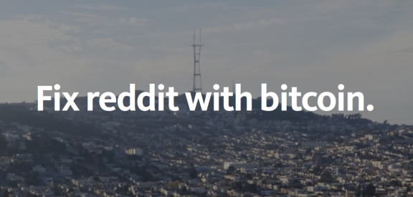
“Fix reddit with bitcoin.”
I wrote an article about making reddit decentralized and adding bitcoin payments
Help fix incentives problems between company and users:
  Company doesn't “own” the user's data – the users do
  Users get paid for their work
Revealed for first time that even reddit wanted to be decentralized
https://medium.com/@ryanxcharles/fix-reddit-with-bitcoin-7da3f85fb9ba
Ryan X. Charles
Founder of Datt (datt.co)
twitter.com/ryanxcharles
github.com/ryanxcharles
Datt GitHub, Twitter, and blog:
github.com/dattnetwork
twitter.com/dattnetwork
blog.datt.co
Datt

Slide 6
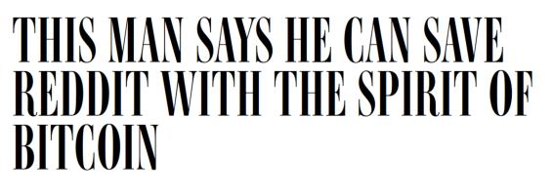
Positive Response
My article was written about in Wired, Business Insider, re/code, and others. ~80 people emailed wanting to help.
Popular response was validation that people want this to exist.
Decided to work on it full-time.
Then went to India for Blockchain University – long story. Then came back, and...
“The Spirit of Bitcoin” - an airplane to cross the Atlantic in 2016
Ryan X. Charles
Founder of Datt (datt.co)
twitter.com/ryanxcharles
github.com/ryanxcharles
Datt GitHub, Twitter, and blog:
github.com/dattnetwork
twitter.com/dattnetwork
blog.datt.co
Datt

Slide 7

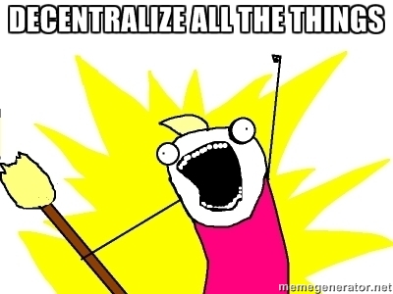
DATT
Brainstormed name: “DATT = Decentralize All The Things” (though it looks better as the word Datt)
Put together international hackathon on weekend of Jul. 31 – Aug. 2. ~15 people in SF, ~100 total on Slack channel
Set up GitHub page:
  https://github.com/dattnetwork
Contributors created logo and landing page:
  http://datt.co
Blog to track progress:
  http://blog.datt.co
Twitter to track progress:
  https://twitter.com/dattnetwork
Became Entrepreneur in Residence at IDEO Futures
Ryan X. Charles
Founder of Datt (datt.co)
twitter.com/ryanxcharles
github.com/ryanxcharles
Datt GitHub, Twitter, and blog:
github.com/dattnetwork
twitter.com/dattnetwork
blog.datt.co
Datt

Slide 8
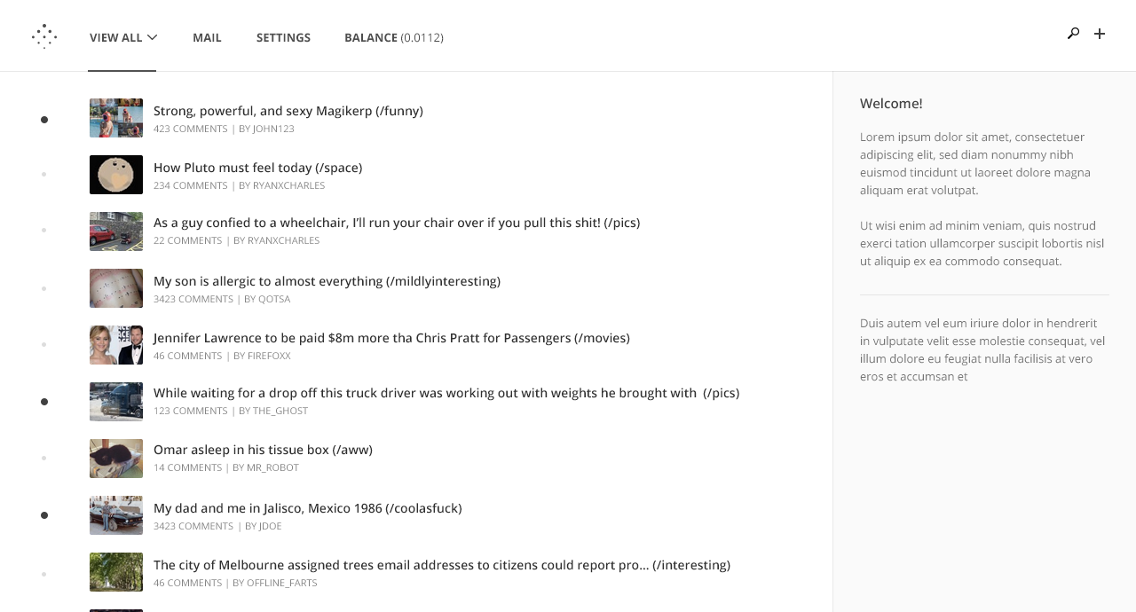
Mockups
Caveat: End product may look and feel different.
Logo and mockups by Chris Robinson (http://chrisrobinson.me/)
Ryan X. Charles
Founder of Datt (datt.co)
twitter.com/ryanxcharles
github.com/ryanxcharles
Datt GitHub, Twitter, and blog:
github.com/dattnetwork
twitter.com/dattnetwork
blog.datt.co
Datt

Slide 9
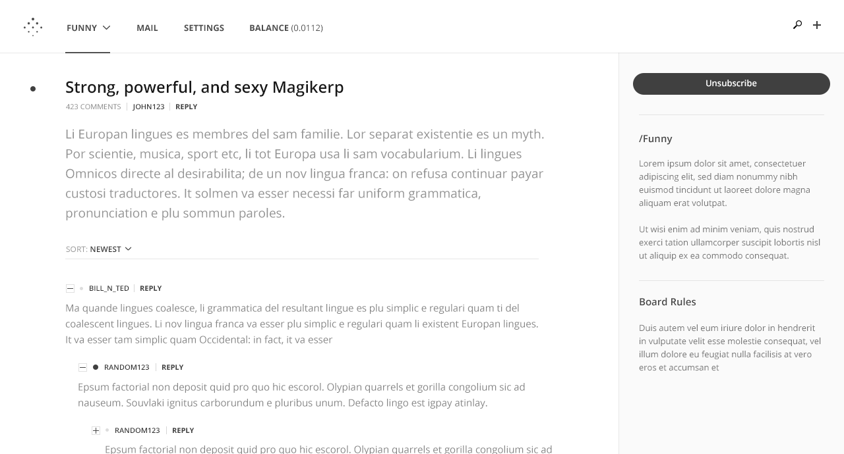
Mockups
Caveat: End product may look and feel different.
Logo and mockups by Chris Robinson (http://chrisrobinson.me/)
Ryan X. Charles
Founder of Datt (datt.co)
twitter.com/ryanxcharles
github.com/ryanxcharles
Datt GitHub, Twitter, and blog:
github.com/dattnetwork
twitter.com/dattnetwork
blog.datt.co
Datt

Slide 10
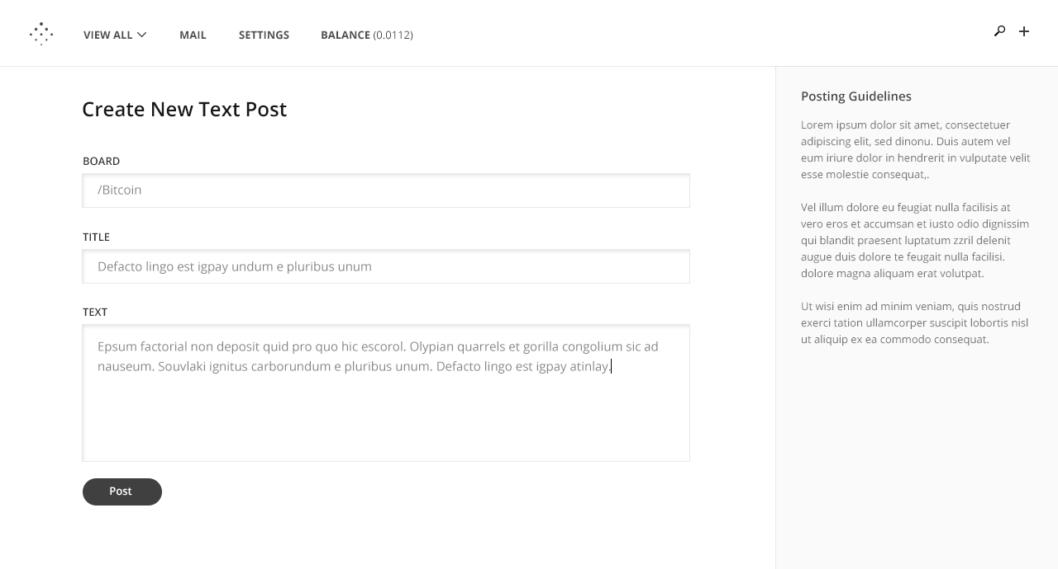
Mockups
Caveat: End product may look and feel different.
Logo and mockups by Chris Robinson (http://chrisrobinson.me/)
Ryan X. Charles
Founder of Datt (datt.co)
twitter.com/ryanxcharles
github.com/ryanxcharles
Datt GitHub, Twitter, and blog:
github.com/dattnetwork
twitter.com/dattnetwork
blog.datt.co
Datt

Slide 11
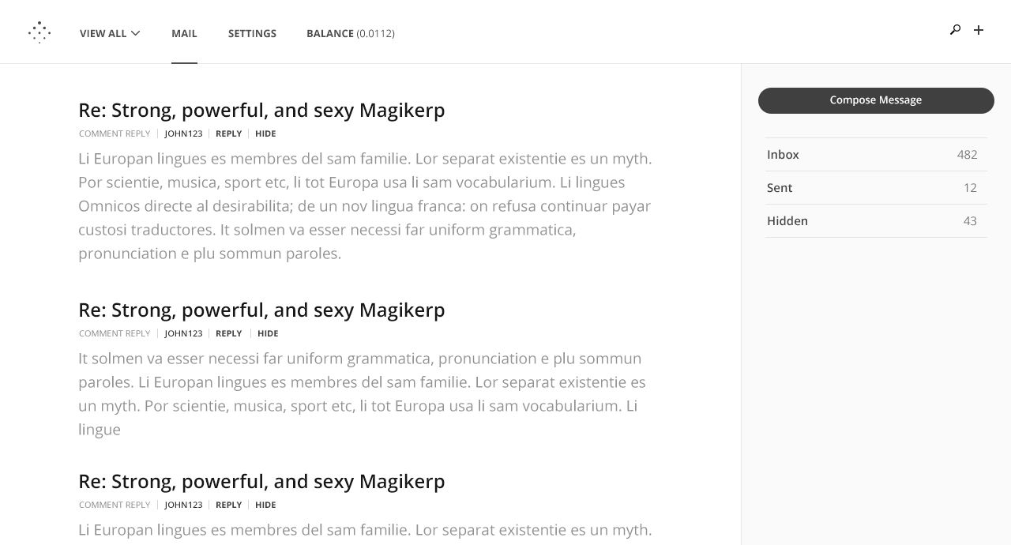
Mockups
Caveat: End product may look and feel different.
Logo and mockups by Chris Robinson (http://chrisrobinson.me/)
Ryan X. Charles
Founder of Datt (datt.co)
twitter.com/ryanxcharles
github.com/ryanxcharles
Datt GitHub, Twitter, and blog:
github.com/dattnetwork
twitter.com/dattnetwork
blog.datt.co
Datt

Slide 12
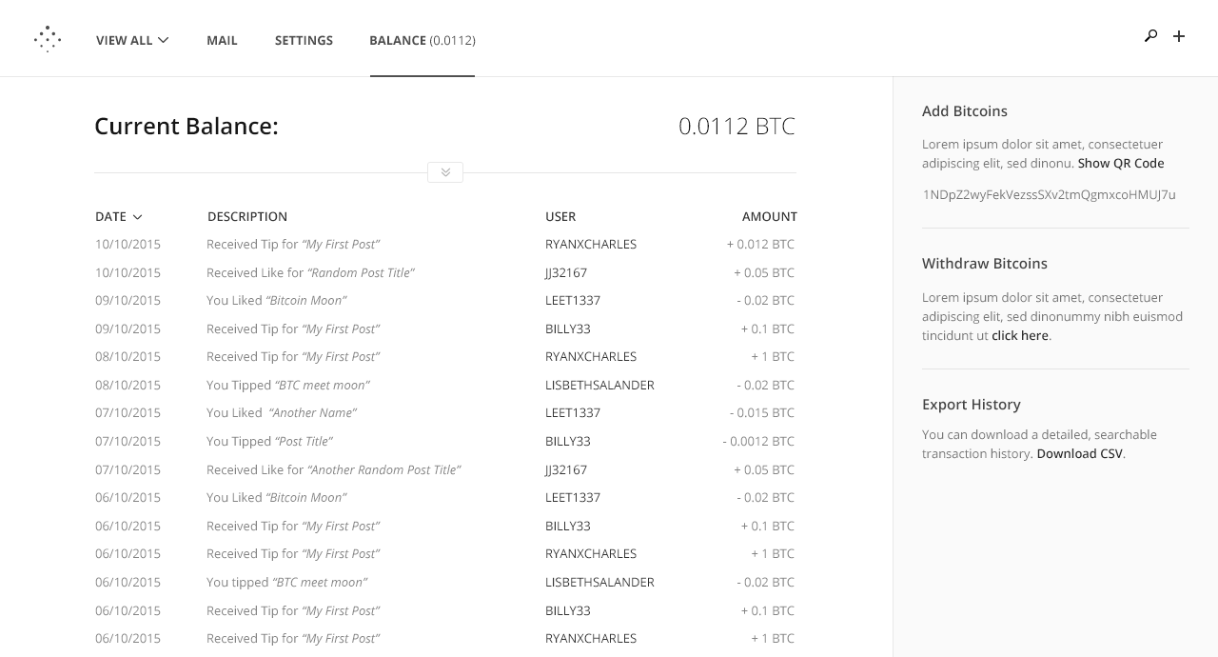
Mockups
Caveat: End product may look and feel different.
Logo and mockups by Chris Robinson (http://chrisrobinson.me/)
Ryan X. Charles
Founder of Datt (datt.co)
twitter.com/ryanxcharles
github.com/ryanxcharles
Datt GitHub, Twitter, and blog:
github.com/dattnetwork
twitter.com/dattnetwork
blog.datt.co
Datt

Slide 13
Open-Source
Everything is being developed in the open on our GitHub page and Slack channel
Not just software, but business plans, product plans, and community plans are open-source
>20 people have made substantial contributions
Ryan X. Charles
Founder of Datt (datt.co)
twitter.com/ryanxcharles
github.com/ryanxcharles
Datt GitHub, Twitter, and blog:
github.com/dattnetwork
twitter.com/dattnetwork
blog.datt.co
Datt

Slide 14
Prototype Status
The minimalist, non-launchable, technology demo prototype is about 75% finished
“Invite-only” prototype launch in November
Need to heavily refine all aspects before real launch – product, community, business, technology
March is realistic goal for “public launch”
Ryan X. Charles
Founder of Datt (datt.co)
twitter.com/ryanxcharles
github.com/ryanxcharles
Datt GitHub, Twitter, and blog:
github.com/dattnetwork
twitter.com/dattnetwork
blog.datt.co
Datt

Slide 15
Product Overview
Inspired by reddit, but is not intended to look or feel the same as reddit or be a full reddit replacement
More emphasis on content producers – probably will let you follow people like Twitter
Trying very hard to get the psychology right – why do people want to pay for content they can get for free?
Do not need to have bitcoin to view or post content
Ryan X. Charles
Founder of Datt (datt.co)
twitter.com/ryanxcharles
github.com/ryanxcharles
Datt GitHub, Twitter, and blog:
github.com/dattnetwork
twitter.com/dattnetwork
blog.datt.co
Datt

Slide 16
Community Overview
Intended to reach a mainstream audience
Bitcoiners, decentralization community, disaffected reddit users form current core users – but aim to focus product on a more broad userbase
We have several conflicting community plans – see dattdocs
Ryan X. Charles
Founder of Datt (datt.co)
twitter.com/ryanxcharles
github.com/ryanxcharles
Datt GitHub, Twitter, and blog:
github.com/dattnetwork
twitter.com/dattnetwork
blog.datt.co
Datt

Slide 17
Business Overview
Business model is to take a portion of payments (though decentralized, client default settings pay a portion to the company)
So long as people like us, most people probably will not change the default settings
Other business models possible such as providing extra services, or of course ads, but not on Day 1
Ryan X. Charles
Founder of Datt (datt.co)
twitter.com/ryanxcharles
github.com/ryanxcharles
Datt GitHub, Twitter, and blog:
github.com/dattnetwork
twitter.com/dattnetwork
blog.datt.co
Datt

Slide 18
Technology Overview
Bitcoin for payments
Blockchain for misc. features such as querying content and identities – though not all things will be included at launch
Custom P2P protocol for now, but probably will switch to IPFS or something similar
Code: Javascript, Node.js 4.2, React, isomorphic, fullnode, and will use C++ crypto in backend
Ryan X. Charles
Founder of Datt (datt.co)
twitter.com/ryanxcharles
github.com/ryanxcharles
Datt GitHub, Twitter, and blog:
github.com/dattnetwork
twitter.com/dattnetwork
blog.datt.co
Datt

Slide 19
Contributing
Code
datt repo & Slack
https://github.com/dattnetwork/datt
http://datt-slackin.herokuapp.com/
Business
dattdocs repo & Slack
https://github.com/dattnetwork/dattdocs
http://datt-slackin.herokuapp.com/
Product
dattdocs, dattmedia, & Slack
https://github.com/dattnetwork/dattmedia
https://github.com/dattnetwork/dattdocs
http://datt-slackin.herokuapp.com/
Community
dattdocs repo & Slack
https://github.com/dattnetwork/dattdocs
http://datt-slackin.herokuapp.com/
Ryan X. Charles
Founder of Datt (datt.co)
twitter.com/ryanxcharles
github.com/ryanxcharles
Datt GitHub, Twitter, and blog:
github.com/dattnetwork
twitter.com/dattnetwork
blog.datt.co
Datt

Slide 20
Following
Mailing List
http://datt.co (at bottom)
Twitter
https://twitter.com/dattnetwork
Blog
http://blog.datt.co
Slack
https://dattnetwork.slack.com/
Register: https://datt-slackin.herokuapp.com
Ryan X. Charles
Founder of Datt (datt.co)
twitter.com/ryanxcharles
github.com/ryanxcharles
Datt GitHub, Twitter, and blog:
github.com/dattnetwork
twitter.com/dattnetwork
blog.datt.co
Datt

Slide 21
Thanks!
Brad Kam
Chris Marie
Chris Robinson
Darren M
Deepak Raous
Eric Martindale
George Vaccaro
go1dfish
Guillaume Dumas
Johan Halseth
Michael Houston
Omar Mashaal
Paul Salisbury
Ramakrishnan A (Ramki)
Willy Bruns
Blockchain University
ChangeTip
IDEO Futures
Ryan X. Charles
Founder of Datt (datt.co)
twitter.com/ryanxcharles
github.com/ryanxcharles
Datt GitHub, Twitter, and blog:
github.com/dattnetwork
twitter.com/dattnetwork
blog.datt.co
Datt

