Slide 1
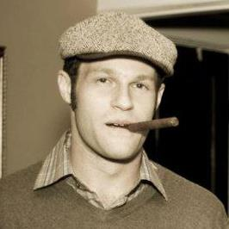

Datt
Decentralized Content Sharing App with Integrated Bitcoin Payments
Ryan X. Charles
LAUNCH
Nov. 2, 2015
Ryan X. Charles
Founder of Datt (datt.co)
twitter.com/ryanxcharles
github.com/ryanxcharles
Datt GitHub, Twitter, and blog:
github.com/dattnetwork
twitter.com/dattnetwork
blog.datt.co
Datt

Slide 2

reddit Drama Summer 2015
reddit had much drama for about a year from ~summer 2014 - ~summer 2015
Turning point when they laid off Victoria – community liaison
Community outrage - /r/iama shutdown, many other subreddits shutdown
Ultimately lead to CEO Ellen Pao resigning, replaced by co-founder Steve Huffman
Ryan X. Charles
Founder of Datt (datt.co)
twitter.com/ryanxcharles
github.com/ryanxcharles
Datt GitHub, Twitter, and blog:
github.com/dattnetwork
twitter.com/dattnetwork
blog.datt.co
Datt

Slide 3
Problem
Users have no power when they disagree with company or mods
Users have no way to pay or be paid for creating content, or moderating or curating content
Users' and company's interest fall out of alignment sometimes
Ryan X. Charles
Founder of Datt (datt.co)
twitter.com/ryanxcharles
github.com/ryanxcharles
Datt GitHub, Twitter, and blog:
github.com/dattnetwork
twitter.com/dattnetwork
blog.datt.co
Datt

Slide 4
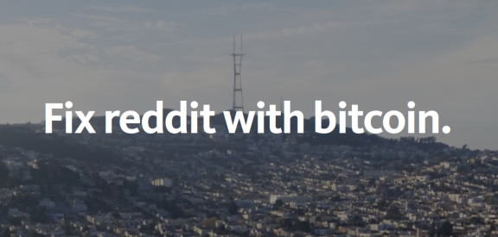
“Fix reddit with bitcoin.”
Datt is based on an article about making reddit decentralized and adding bitcoin payments
Help fix incentives problems between company and users:
  Company doesn't “own” the user's data – the users own their content
  Users get paid for their work
https://medium.com/@ryanxcharles/fix-reddit-with-bitcoin-7da3f85fb9ba
Ryan X. Charles
Founder of Datt (datt.co)
twitter.com/ryanxcharles
github.com/ryanxcharles
Datt GitHub, Twitter, and blog:
github.com/dattnetwork
twitter.com/dattnetwork
blog.datt.co
Datt

Slide 5
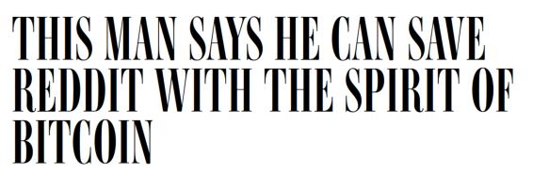
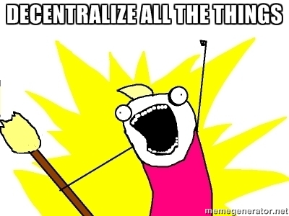
Community
My article was written about in Wired, Business Insider, re/code, and others. ~80 people emailed wanting to help. Brought them together for Datt.
Currently ~170 members on Slack
~300 people on mailing list
~200 followers on Twitter
Core users: disaffected reddit users, decentralization community.
Aiming for mainstream audience.
Ryan X. Charles
Founder of Datt (datt.co)
twitter.com/ryanxcharles
github.com/ryanxcharles
Datt GitHub, Twitter, and blog:
github.com/dattnetwork
twitter.com/dattnetwork
blog.datt.co
Datt

Slide 6
Go-To Market Plan
Build network effect into the app – users get a portion of payments made by users they refer
Contact ~300+ “core users” and tell them it's launching
Contact journalists that wrote about the article previously (~10)
Leverage my Twitter account (~4900 followers, mostly bitcoiners)
Possibly leverage LAUNCH's network
Possibly leverage IDEO's network
Ryan X. Charles
Founder of Datt (datt.co)
twitter.com/ryanxcharles
github.com/ryanxcharles
Datt GitHub, Twitter, and blog:
github.com/dattnetwork
twitter.com/dattnetwork
blog.datt.co
Datt

Slide 7
Technology
Blockchain for payments, misc. features such as querying content and identities – though not all things will be included at launch
Custom P2P protocol for now, but probably will switch to or leverage IPFS or something similar
Code: Javascript, Node.js 4.2, React, isomorphic, fullnode, and will use C++ crypto in backend
Ryan X. Charles
Founder of Datt (datt.co)
twitter.com/ryanxcharles
github.com/ryanxcharles
Datt GitHub, Twitter, and blog:
github.com/dattnetwork
twitter.com/dattnetwork
blog.datt.co
Datt

Slide 8
Business
Business model 1: Take a portion of payments (though decentralized, client default settings pay a portion to the company)
Business model 2: We curate the front-page – can curate front-page and be a user of our own platform
Other business models possible such as providing extra services, or of course ads, but not on Day 1
Ryan X. Charles
Founder of Datt (datt.co)
twitter.com/ryanxcharles
github.com/ryanxcharles
Datt GitHub, Twitter, and blog:
github.com/dattnetwork
twitter.com/dattnetwork
blog.datt.co
Datt

Slide 9
Financials
10 million users, $30 per user per month, company gets 2% of txs: $600,000/mo
10 million users, $5 per user per month, company gets 20% of txs: $1,000,000/mo
Key metrics:
  How many users are making payments?
  How much is average user earning?
Ryan X. Charles
Founder of Datt (datt.co)
twitter.com/ryanxcharles
github.com/ryanxcharles
Datt GitHub, Twitter, and blog:
github.com/dattnetwork
twitter.com/dattnetwork
blog.datt.co
Datt

Slide 10
Competitors
Traditional social media: reddit, Facebook, Twitter
Decentralized platforms: LBRY, aether, DECENT, rupy,
Bitcoin: Zapchain, Changetip
Must outcompete on product+community
  Differentiator: Focus on creators + decentralized + product/design
Ryan X. Charles
Founder of Datt (datt.co)
twitter.com/ryanxcharles
github.com/ryanxcharles
Datt GitHub, Twitter, and blog:
github.com/dattnetwork
twitter.com/dattnetwork
blog.datt.co
Datt

Slide 11

Team
Ryan X. Charles: CEO of Datt
Currently Entrepreneur in Residence at IDEO Futures
Formerly reddit, BitGo, BitPay
After prototype, will look for Head of Business Operations and Lead Engineer
>15 contributors: Brad Kam, Chris Marie, Chris Robinson, Darren M, Deepak Raous, Eric Martindale, George Vaccaro, go1dfish, Guillaume Dumas, Johan Halseth, Michael Houston, Omar Mashaal, Paul Salisbury, Ramakrishnan A (Ramki), Willy Bruns, Blockchain University, ChangeTip, IDEO Futures
Ryan X. Charles
Founder of Datt (datt.co)
twitter.com/ryanxcharles
github.com/ryanxcharles
Datt GitHub, Twitter, and blog:
github.com/dattnetwork
twitter.com/dattnetwork
blog.datt.co
Datt

Slide 12
Product Overview
Inspired by reddit, but is not intended to look or feel the same as reddit or be a full reddit replacement
More emphasis on content producers – probably will let you follow people like Twitter
Trying very hard to get the psychology right – why do people want to pay for content they can get for free?
Do not need to have bitcoin to view or post content
Ryan X. Charles
Founder of Datt (datt.co)
twitter.com/ryanxcharles
github.com/ryanxcharles
Datt GitHub, Twitter, and blog:
github.com/dattnetwork
twitter.com/dattnetwork
blog.datt.co
Datt

Slide 13
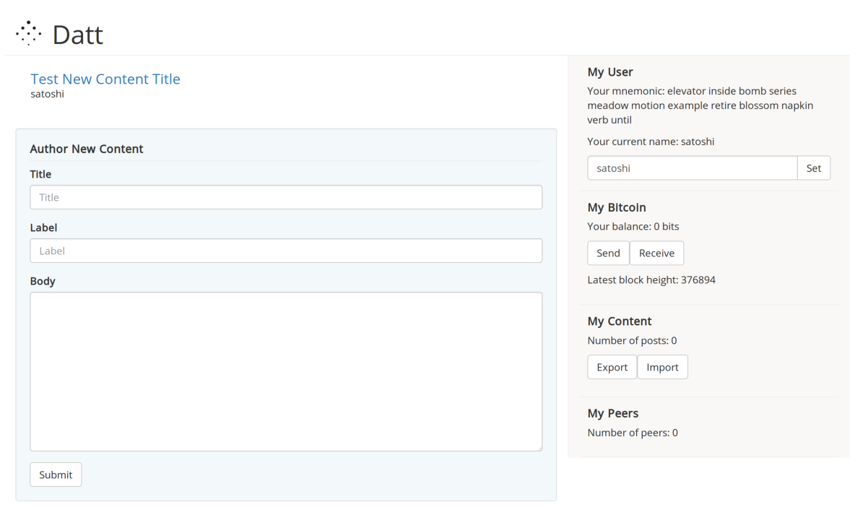
Prototype Status
Working app with users and content
P2P protocol half-finished
Payments not integrated yet
Sprint to prototype launch on Nov. 23
Ryan X. Charles
Founder of Datt (datt.co)
twitter.com/ryanxcharles
github.com/ryanxcharles
Datt GitHub, Twitter, and blog:
github.com/dattnetwork
twitter.com/dattnetwork
blog.datt.co
Datt

Slide 14
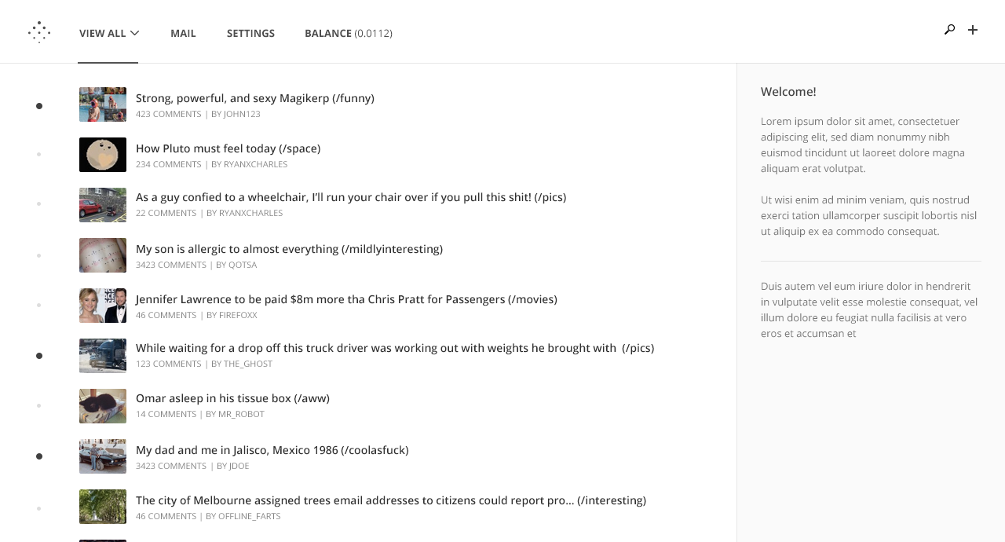
Mockups
Caveat: End product may look and feel different.
Logo and mockups by Chris Robinson (http://chrisrobinson.me/)
Ryan X. Charles
Founder of Datt (datt.co)
twitter.com/ryanxcharles
github.com/ryanxcharles
Datt GitHub, Twitter, and blog:
github.com/dattnetwork
twitter.com/dattnetwork
blog.datt.co
Datt

Slide 15
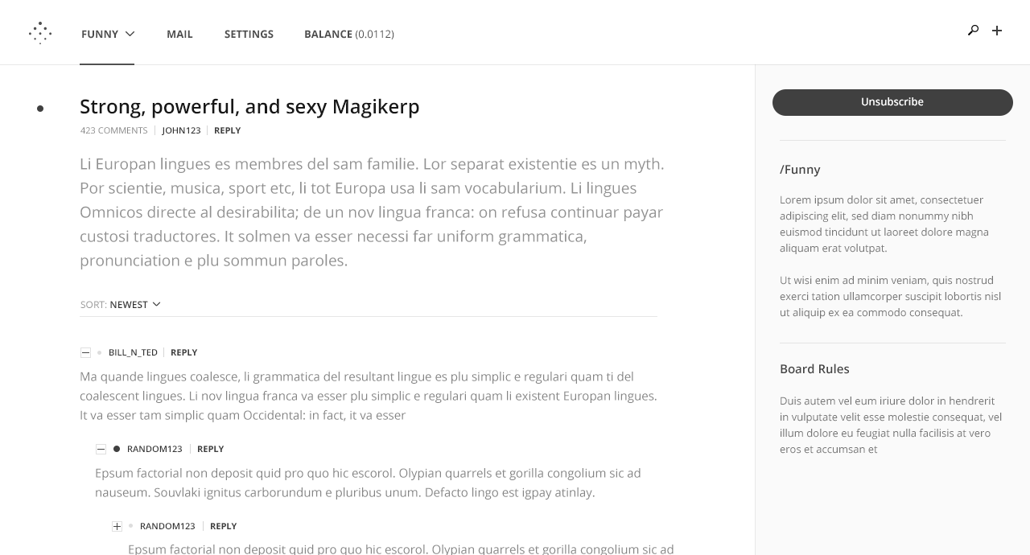
Mockups
Caveat: End product may look and feel different.
Logo and mockups by Chris Robinson (http://chrisrobinson.me/)
Ryan X. Charles
Founder of Datt (datt.co)
twitter.com/ryanxcharles
github.com/ryanxcharles
Datt GitHub, Twitter, and blog:
github.com/dattnetwork
twitter.com/dattnetwork
blog.datt.co
Datt

Slide 16
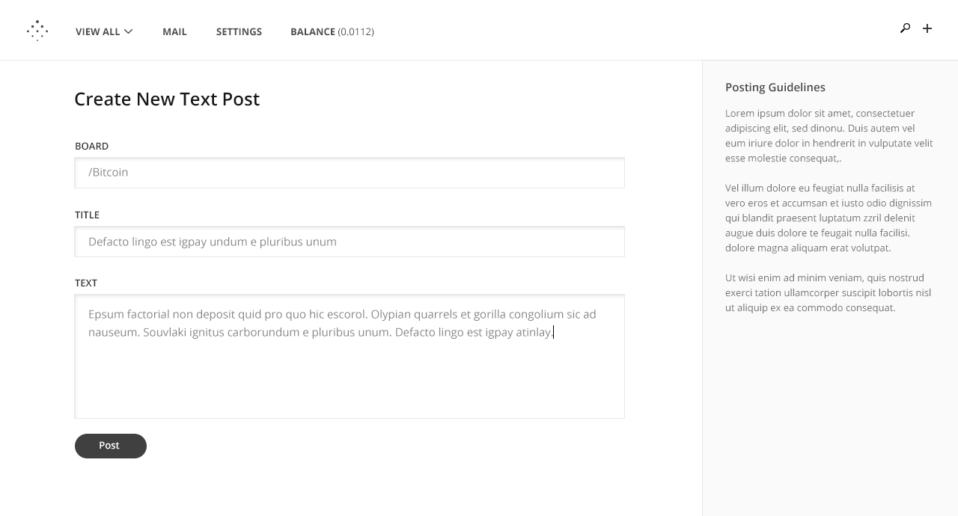
Mockups
Caveat: End product may look and feel different.
Logo and mockups by Chris Robinson (http://chrisrobinson.me/)
Ryan X. Charles
Founder of Datt (datt.co)
twitter.com/ryanxcharles
github.com/ryanxcharles
Datt GitHub, Twitter, and blog:
github.com/dattnetwork
twitter.com/dattnetwork
blog.datt.co
Datt

Slide 17
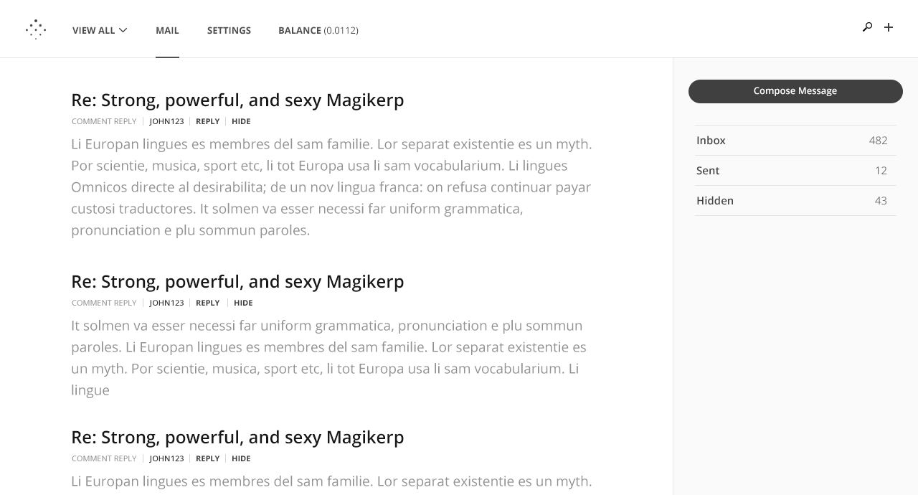
Mockups
Caveat: End product may look and feel different.
Logo and mockups by Chris Robinson (http://chrisrobinson.me/)
Ryan X. Charles
Founder of Datt (datt.co)
twitter.com/ryanxcharles
github.com/ryanxcharles
Datt GitHub, Twitter, and blog:
github.com/dattnetwork
twitter.com/dattnetwork
blog.datt.co
Datt

Slide 18
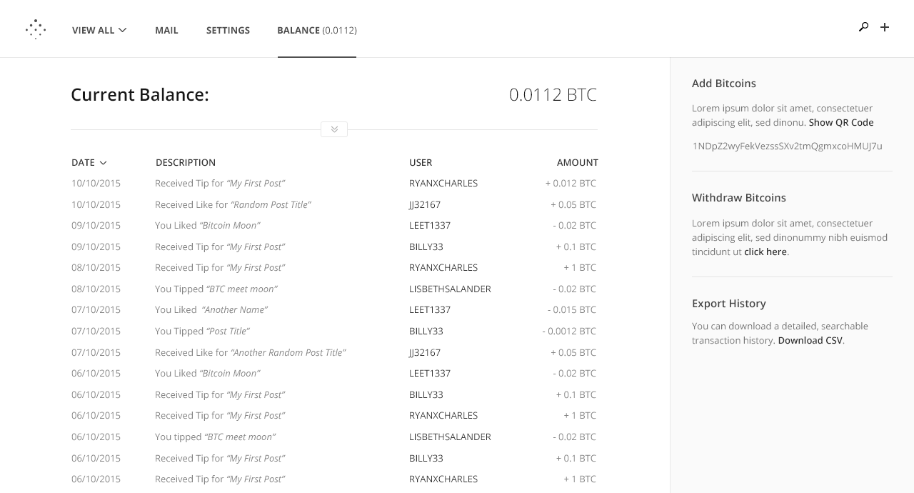
Mockups
Caveat: End product may look and feel different.
Logo and mockups by Chris Robinson (http://chrisrobinson.me/)
Ryan X. Charles
Founder of Datt (datt.co)
twitter.com/ryanxcharles
github.com/ryanxcharles
Datt GitHub, Twitter, and blog:
github.com/dattnetwork
twitter.com/dattnetwork
blog.datt.co
Datt

Slide 19
Contributing
Code
datt repo & Slack
https://github.com/dattnetwork/datt
http://datt-slackin.herokuapp.com/
Business
dattdocs repo & Slack
https://github.com/dattnetwork/dattdocs
http://datt-slackin.herokuapp.com/
Product
dattdocs, dattmedia, & Slack
https://github.com/dattnetwork/dattmedia
https://github.com/dattnetwork/dattdocs
http://datt-slackin.herokuapp.com/
Community
dattdocs repo & Slack
https://github.com/dattnetwork/dattdocs
http://datt-slackin.herokuapp.com/
Ryan X. Charles
Founder of Datt (datt.co)
twitter.com/ryanxcharles
github.com/ryanxcharles
Datt GitHub, Twitter, and blog:
github.com/dattnetwork
twitter.com/dattnetwork
blog.datt.co
Datt

Slide 20
Following
Mailing List
http://datt.co (at bottom)
Twitter
https://twitter.com/dattnetwork
Blog
http://blog.datt.co
Slack
https://dattnetwork.slack.com/
Register: https://datt-slackin.herokuapp.com
Ryan X. Charles
Founder of Datt (datt.co)
twitter.com/ryanxcharles
github.com/ryanxcharles
Datt GitHub, Twitter, and blog:
github.com/dattnetwork
twitter.com/dattnetwork
blog.datt.co
Datt

Slide 21
Thanks!
Brad Kam
Chris Marie
Chris Robinson
Darren M
Deepak Raous
Eric Martindale
George Vaccaro
go1dfish
Guillaume Dumas
Johan Halseth
Michael Houston
Omar Mashaal
Paul Salisbury
Ramakrishnan A (Ramki)
Willy Bruns
Blockchain University
ChangeTip
IDEO Futures
Ryan X. Charles
Founder of Datt (datt.co)
twitter.com/ryanxcharles
github.com/ryanxcharles
Datt GitHub, Twitter, and blog:
github.com/dattnetwork
twitter.com/dattnetwork
blog.datt.co
Datt

