Slide 1
Section 13.1 – Secondary storage management
(Former Student’s Note)

Slide 2
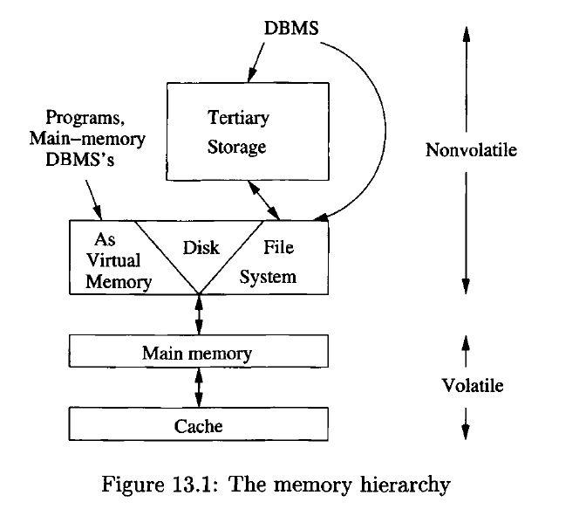
The Memory Hierarchy
Computer systems have several different components in which data may be stored.
Data capacities & access speeds range over at least seven orders of magnitude
Devices with smallest capacity also offer the fastest access speed

Slide 3
Description of Levels
Cache
  Megabyte or more of Cache storage.
  On-board cache : On same chip.
  Level-2 cache : On another chip.
  Cache data accessed in few nanoseconds.
  Data moved from main memory to cache when needed by processor
  Volatile

Slide 4
Description of Levels
2. Main Memory
  1 GB or more of main memory.
  Instruction execution & Data Manipulation - involves information resident in main memory.
  Time to move data from main memory to the processor or cache is in the 10-100 nanosecond range.
  Volatile

Slide 5
Description of Levels
3. Secondary Storage
  Typically a magnetic disk.
  Capacity upto 1 TB.
  One machine can have several disk units.
  Time to transfer a single byte between disk & main memory is around 10 milliseconds.

Slide 6
Description of Levels
4. Tertiary Storage
  Holds data volumes measured in terabytes.
  Significantly higher read/write times.
  Smaller cost per bytes.
  Retrieval takes seconds or minutes, but capacities in the petabyte range are possible.

Slide 7
Transfer of Data Between Levels
  Data moves between adjacent levels of the hierarchy.
  Each level is organized to transfer large amounts of data to or from the level below
  Key technique for speeding up database operations is to arrange data so that when one piece of a disk block is needed, it is likely that other data on the same block will also be needed at about the same time.
  ---- This is called data clustering (this is difference from data mining)

Slide 8
Volatile & Non Volatile Storage
  A volatile device “forgets” what is stored in it when the power goes off.
  Example: Main Memory
  A nonvolatile device, on the other hand, is expected to keep its contents intact even for long periods when the device is turned off or there is a power failure.
  Example: Secondary & Tertiary Storage
Note: No change to the database can be considered final until it
has migrated to nonvolatile, secondary storage.

Slide 9
Virtual Memory
  Managed by Operating System.
  Some memory in main memory & rest on disk.
  Transfer between the two is in units of disk blocks (pages).
  Not a level of the memory hierarchy

