Slide 1

Chapter 18: CONCURRENCY CONTROL
18.3 Enforcing Serializability by Locks
Abhilash Goyal
Fall 2014
For Presentation at
CS 257: Principles of Database System
Reference: “DataBase Systems, The Complete Book”, Second Edition, Hector, Jeffery, Jennifer
Notes:
Abhilash Goyal 25th June 2013

Slide 2
Outline
Enforcing Serializability by Locks
Locks
The Locking Scheduler
Two-Phase Locking
A Risk of Deadlock
Questions and Feedback
Notes:
Abhilash Goyal 25th June 2013

Slide 3
Enforcing Serializability by Locks
A transaction obtains locks on the database elements it accesses to prevent other transactions from accessing these elements at roughly the same time and thereby incurring the risk of unserializability.
In this scheme, there is only one kind of lock, which transactions must obtain on a database element if they want to perform any operation whatsoever on that element.
In Section 18.4, we shall learn more realistic locking schemes, with several kinds of lock, including the common shared/exclusive locks that correspond to the privileges of reading and writing, respectively
Notes:
Abhilash Goyal 25th June 2013

Slide 4
Outline
Enforcing Serializability by Locks
Locks
The Locking Scheduler
Two-Phase Locking
A Risk of Deadlock
Questions and Feedback
Notes:
Abhilash Goyal 25th June 2013

Slide 5
Locks (1)
Scheduler is responsible is to take requests from transactions and either allow them to operate on the database or block the transaction until such time as it is safe to allow it to continue.
A lock table will be used to guide this decision.
Request from
transactions
Lock
Table
Scheduler
Serialized Schedule of Actions
Notes:
Abhilash Goyal 25th June 2013

Slide 6
Locks (2)
Transactions must request and release locks, in addition to reading and writing database elements.
The use of locks must be proper in two senses, one applying to the structure of transactions, and the other to the structure of schedules.
Consistency of Transactions:
1. A transaction can only read or write an element if it previously was granted a lock on that element and hasn’t yet released the lock.
2. If a transaction locks an element, it must later unlock that element.
Legality of Schedules:
No two transactions may have locked the same element without one having first released the lock.

Slide 7
Locks (3)
Actions to include locking and unlocking
l_{i} (X): Transaction T_{i} requests a lock on database element X .
u_{i}(X): Transaction T_{i} releases (“unlocks”) its lock on database element X.
If there are actions l_{i} (X) followed by I_{j}(X) in a schedule then
somewhere between these actions there must be an action
u_{i}(X).
For example:
l(A);r(A ); A := A+100; w(A); u(A); l(B); r( B ); B := B+100; w(B); u(B);
Notes:
Abhilash Goyal 25th June 2013

Slide 8
The Locking Scheduler (1)
Scheduler grants Transaction requests if and only if the request will result in a legal schedule.
The scheduler has a Lock Table that tells, for every database element, the transaction (if any) that currently holds a lock on that element.
Locks (element, transaction), consisting of pairs (X , T ) such that transaction T currently has a lock on database element X .
Request from
transactions
Lock Table
(A , 1 )
(B , 2 )
(C, 3 )
.
.
Scheduler
Serialized Schedule of Actions
Lock Table Entry

Slide 9
Outline
Enforcing Serializability by Locks
Locks
The Locking Scheduler
Two-Phase Locking
A Risk of Deadlock
Questions and Feedback
Notes:
Abhilash Goyal 25th June 2013

Slide 10
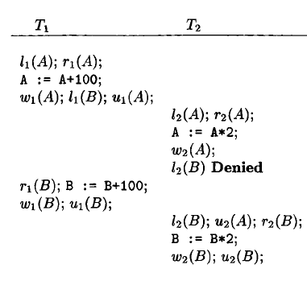
The Locking Scheduler (2)
For Example:
Request from
transactions
Lock
Table
Scheduler
Serialize Schedule
Action
(Book: Section 18.3 Figure 18.13)

Slide 11
Outline
Enforcing Serializability by Locks
Locks
The Locking Scheduler
Two-Phase Locking
A Risk of Deadlock
Questions and Feedback
Notes:
Abhilash Goyal 25th June 2013

Slide 12
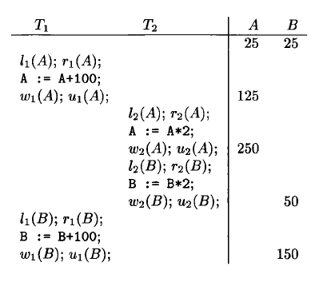
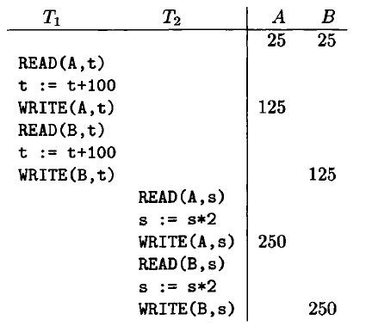
Two-Phase Locking (1)
Motivation
Serial Schedule
Legal Schedule, but NOT Serializable
(Book: Section 18.1 Figure 18.3)
(Book: Section 18.3 Figure 18.12)

Slide 13
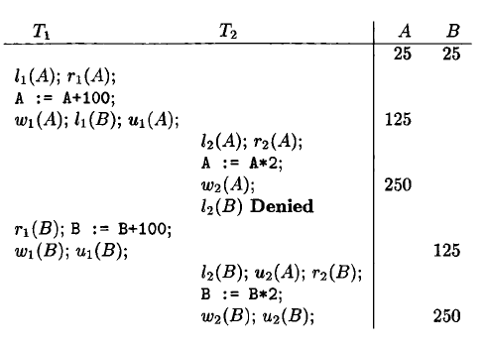
Two-Phase Locking (2)
Two-Phase Locking
In every transaction, all lock actions precede all unlock actions.
Serial Schedule
Schedule with Two-Phase Locking

Slide 14
Outline
Enforcing Serializability by Locks
Locks
The Locking Scheduler
Two-Phase Locking
A Risk of Deadlock
Questions and Feedback
Notes:
Abhilash Goyal 25th June 2013

Slide 15
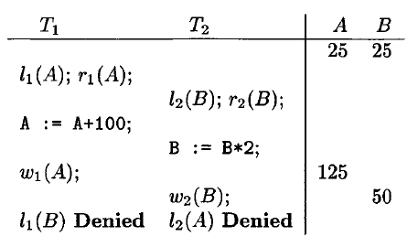
A Risk of Deadlock
Two Phase locking has the potential for deadlock
Deadlock

Slide 16
Outline
Enforcing Serializability by Locks
Locks
The Locking Scheduler
Two-Phase Locking
A Risk of Deadlock
Questions and Feedback
Notes:
Abhilash Goyal 25th June 2013

Slide 17


Questions and Feedback
Thanks !!
Reference: “DataBase Systems, The Complete Book”, Second Edition, Hector, Jeffery, Jennifer

