Slide 1
CS4432: Database Systems II
Data Storage
(Sections 11.2, 11.3, 11.4, 11.5)

Slide 2
Data Storage: Overview
How does a DBMS store and manage large amounts of data?
  (today, tomorrow)
What representations and data structures best support efficient manipulations of this data?
  (next week)

Slide 3
The Memory Hierarchy
Avg. Size: 256kb-1MB
Read/Write Time: 10⁻⁸ seconds.
Random Access
Smallest of all memory, and also the most costly.
Usually on same chip as processor.
Easy to manage in Single Processor Environments, more complicated in Multiprocessor Systems.
Avg. Size: 128 MB – 1 GB
Read/Write Time: 10⁻⁷ to 10⁻⁸ seconds.
Random Access
Becoming more affordable.
Volatile
Avg. Size: 30GB-160GB
Read/Write Time: 10⁻² seconds
NOT Random Access
Extremely Affordable: $0.68/GB!!!
Can be used for File System, Virtual Memory, or for raw data access.
Blocking (need buffering)
Avg. Size: Gigabytes-Terabytes
Read/Write Time: 10¹ - 10² seconds
NOT Random Access, or even remotely close
Extremely Affordable: pennies/GB!!!
Not efficient for any real-time database purposes, could be used in an offline processing environment
Tertiary Storage
Slowest
Secondary Storage
Main Memory
Fastest
Cache (all levels)

Slide 4
Memory Hierarchy Summary
magnetic
optical
disks
nearline
tape &
optical
disks
offline
tape
10¹⁵
10¹³
electronic
secondary
online
tape
10¹¹
10⁹
typical capacity (bytes)
electronic
main
10⁷
10⁵
cache
10³
10⁻⁹
10⁻⁶
10⁻³
10⁻⁰
10³
access time (sec)

Slide 5
Memory Hierarchy Summary
10⁴
cache
electronic
main
online
tape
10²
electronic
secondary
magnetic
optical
disks
dollars/MB
nearline
tape &
optical
disks
10⁰
10⁻²
offline
tape
10⁻⁴
10⁻⁹
10⁻⁶
10⁻³
10⁻⁰
10³
access time (sec)

Slide 6
Motivation
Consider the following algorithm :
For each tuple r in relation R{
Read the tuple r
For each tuple s in relation S{
read the tuple s
append the entire tuple s to r
}
}
What is the time complexity of this algorithm?

Slide 7
Motivation
Complexity:
  This algorithm is O(n²) ! Is it always ?
  Yes, if we assume random access of data.
Hard disks are NOT Random Access !
Unless organized efficiently, this algorithm may be much worse than O(n²).
We need to know how a hard disk operates to understand how to efficiently store information and optimize storage.

Slide 8
Disk Mechanics
Many DB related issues involve hard disk I/O!
Thus we will now study how a hard disk works.

Slide 9
Disk Mechanics
Disk Head
Cylinder
Platter

Slide 10
Disk Mechanics
Track
Sector
Gap

Slide 11
Disk Mechanics
P
...
...
M
DC

Slide 12
Disk Controller
P
...
...
M
DC
Disk Controller is a processor capable of:
  Controlling the motion of disk heads
  Selecting surface from which to read/write
  Transferring data to/from memory

Slide 13
More Disk Terminology
Rotation Speed:
  The speed at which the disk rotates: 5400RPM = one rotation every 11ms.
Number of Tracks:
  Typically 10,000 to 15,000.
Bytes per track:
  ~10⁵ bytes per track

Slide 14
How big is the disk if?
There are 4 platters
There are 8192 tracks per surface
There are 256 sectors per track
There are 512 bytes per sector
Remember 1kb = 1024 bytes, not 1000!
Size = 2 * num of platters * tracks * sectors * bytes per sector
Size = 2 * 4platters * 8192 tracks/platter * 256 sect/trac * 512 bytes/sect
Size = 2³³ bytes / (1024 bytes/kb) /(1024 kb/MB) /(1024 MB/GB)
Size = 2³³ = 2³ * 2³⁰ = 8GB

Slide 15
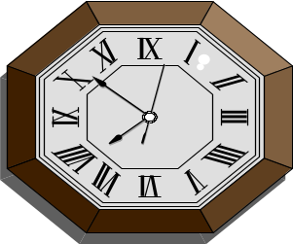
What about access time?
I want
block X
block x
in memory
?
Time = Disk Controller Processing Time +
Disk Latency +
Transfer Time

Slide 16
Access time, Graphically
P
Disk Controller Processing Time
...
...
M
DC
Transfer Time
Disk Latency

Slide 17
Disk Controller Processing Time
Time = Disk Controller Processing Time
+ Disk Latency
+ Transfer Time
CPU Request → Disk Controller
  nanoseconds
Disk Controller Contention
  microseconds
Bus
  microseconds
Typically a few microseconds, so this is negligible for our purposes.

Slide 18
Transfer Time
Time = Disk Controller Processing Time
+ Disk Latency
+ Transfer Time
Typically 10mb/sec
Or 4096 blocks takes ~ .5 ms

Slide 19
Disk Delay
Time = Disk Controller Processing Time
+ Disk Latency + Transfer Time
More complicated
Disk Delay = Seek Time +
Rotational Latency

Slide 20
Seek Time
Seek time is most critical time in Disk Delay.
Average Seek Times:
  Maxtor 40GB (IDE) ~10ms
  Western Digital (IDE) 20GB ~9ms
  Seagate (SCSI) 70 GB ~3.6ms
  Maxtor 60GB (SATA) ~9ms

Slide 21
Rotational Latency
Head Here
Block I Want

Slide 22
Average Rotational Latency
Average latency is about half of the time it takes to make one revolution.
3600 RPM = 8.33 ms
5400 RPM = 5.55 ms
7200 RPM = 4.16 ms
10,000 RPM = 3.0 ms (newer drives)

Slide 23
Example Disk Latency Problem
Calculate the Minimum, Maximum and Average disk latencies for reading a 4096-byte block on the same hard drive as before:
4 platters
8192 tracks
256 sectors/track
512 bytes/sector
Disk rotates at 3840 RPM
Seek time: 1 ms between cylinders, + 1ms for every 500 cylinders traveled.
Gaps consume 10% of each track
A 4096-byte block is 8 sectors
The disk makes one revolution in 1/64 of a second
1 rotation takes: 15.6 ms
Moving one track takes 1.002ms. Moving across all tracks takes 17.4ms

Slide 24
Solution: Minimum Latency
Assume best case:
  head is already on block we want!
In that case, it is just read time of 8 sectors of 4096-byte block. We will pass over 8 sectors and 7 gaps.
Remember : 10% are gaps and 90% are information, . or 36º are gaps, 324º is information.
36 x (7/256) + 324 x (8/256) = 11.109 degrees
11.109 / 360 = .0308 rot (3.08% of the rotation)
.0308 rot / 64 rot/sec = 0.482ms ~ 0.5ms

Slide 25
Solution: Maximum Latency
Now assume worst case:
  The disk head is over innermost cylinder and the block we want is on outermost cylinder,
  block we want has just passed under the head, so we have to wait a full rotation.
Time = Time to move from innermost track to outermost track +
    Time for one full rotation +
    Time to read 8 sectors
    = 17.4 ms (seek time) + 15.6 ms (one rotation) + .5ms . . (from minimum latency calculation)
    = 33.5 ms!!

Slide 26
Solution: Average Latency
Now assume average case:
  It will take an average amount of time to seek, and
  block we want is ½ of a revolution away from heads.
Time = Time to move over tracks +
    Time for one-half of a rotation +
    Time to read 8 sectors
    = 6.5ms (next slide) + 7.8ms (.5 rotation) + .5 ms (from min latency )
    = 14.8 ms

Slide 27
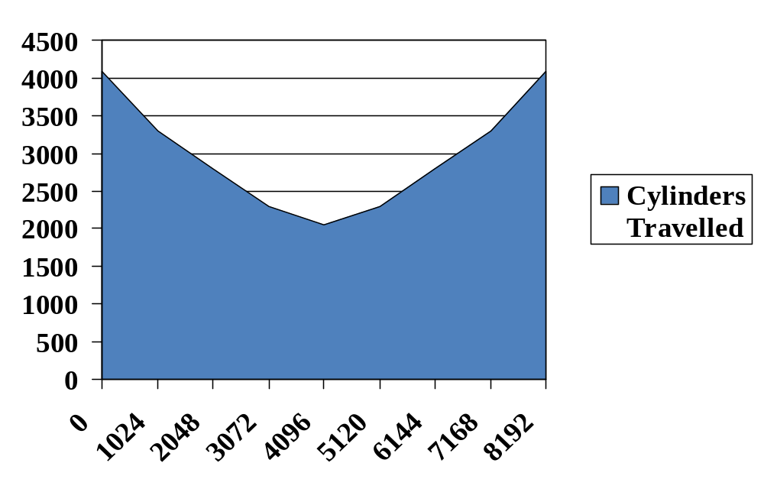
Solution: Calculating Average Seek Time
Graph: indicates avg travel time as fct of initial head position.
That is about 1/3 across the disk on average.
So integrate over this graph : =2730 cylinders = 1 + 2730/500 = 6.5 ms

Slide 28
Writing Blocks
Basically same as reading!
Phew!

Slide 29
Verifying a write
Verify : Same as reading/writing,
  plus one additional revolution to come back to the block and verify.
So for our earlier example to verify each case:
MIN 0.5ms + 15.6ms + 0.5ms = 16.6ms
MAX 33.5ms + 15.6ms + 0.5ms = 49.6ms
AVG 14.8ms + 15.6ms + 0.5ms = 30.9 ms

Slide 30
After seeing all of this …
Which will be faster Sequential I/O or Random I/O?
What are some ways we can improve I/O times without changing the disk features?

Slide 31
Next …
Disk Optimizations

Slide 32
One Simple Idea : Prefetching
Problem: Have a File
        Sequence of Blocks B1, B2
      Have a Program
        Process B1
        Process B2
        Process B3
...
CS 4432

Slide 33
Single Buffer Solution
(1) Read B1 → Buffer
(2) Process Data in Buffer
(3) Read B2 → Buffer
(4) Process Data in Buffer ...
CS 4432

Slide 34
Say P = time to process/block
R = time to read in 1 block
n = # blocks
Single buffer time = n(P+R)
CS 4432

Slide 35
Question:
Could the DBMS know something about behavior of such future block accesses ?
What if:
If we knew more about sequence of future block accesses, what and how could we do better ?
CS 4432

Slide 36
Idea : Double Buffering/Prefetching
process
process
Memory:
Disk:
C
B
A
B
A
A
B
C
D
E
F
G
done
done
CS 4432

Slide 37
Say P ≥ R
P = Processing time/block
R = IO time/block
n = # blocks
What is processing time now?
Double buffering time = ?
CS 4432

Slide 38
Say P ≥ R
P = Processing time/block
R = IO time/block
n = # blocks
Double buffering time = R + nP
Single buffering time = n(R+P)
CS 4432

Slide 39
Block Size Selection?
Question : Do we want Small or Big Block Sizes ?
Pros ?
Cons ?
CS 4432

Slide 40
Block Size Selection?
Big Block → Amortize I/O Cost
  For seek and rotational delays are reduced …
Unfortunately...
Big Block ⇒ Read in more useless stuff!
and takes longer to read
CS 4432

Slide 41
Trend
As memory prices drop,
blocks get bigger ...
CS 4432

Slide 42
Using secondary storage effectively
Example: Sorting data on disk
General Wisdom :
  I/O costs dominate
  Design algorithms to reduce I/O
CS 4432

Slide 43
Disk IO Model Of Computations →
Efficient Use of Disk
Example: Sort Task
Notes:
1

Slide 44
“Good” DBMS Algorithms
Try to make sure if we read a block, we use much of data on that block
Try to put blocks together that are accessed together
Try to buffer commonly used blocks in main memory
CS 4432

Slide 45
Why Sort Example ?
A classic problem in computer science!
Data requested in sorted order
  e.g., find students in increasing gpa order
Sorting is first step in bulk loading B+ tree index.
Sorting useful for eliminating duplicate copies in a collection of records (Why?)
Sort-merge join algorithm involves sorting.
Problem: sort 1Gb of data with 1Mb of RAM.
  why not virtual memory?
Notes:
4

Slide 46
Sorting Algorithms
Any examples algorithms you know ??
Typically they are main-memory oriented
They don’t look too good when you take disk I/Os into account ( why? )
CS 4432

Slide 47
Merge Sort
Merge : Merge two sorted lists and repeatedly choose the smaller of the two “heads” of the lists
Merge Sort: Divide records into two parts; merge-sort those recursively, and then merge the lists.
CS 4432

Slide 48
2-Way Sort: Requires 3 Buffers
Pass 1: Read a page, sort it, write it.
  only one buffer page is used
Pass 2, 3, …, etc.:
  three buffer pages used.
INPUT 1
OUTPUT
INPUT 2
Main memory buffers
Disk
Disk
Notes:
5

Slide 49
Two-Way External Merge Sort
3,4
6,2
9,4
8,7
5,6
3,1
2
Input file
PASS 0
3,4
2,6
4,9
7,8
5,6
1,3
2
1-page runs
PASS 1
2,3
4,7
1,3
2-page runs
4,6
8,9
5,6
2
PASS 2
2,3
4,4
1,2
4-page runs
6,7
3,5
8,9
6
PASS 3
1,2
2,3
3,4
8-page runs
4,5
6,6
7,8
9
Idea: Divide and conquer: sort subfiles and merge
Notes:
6

Slide 50
Two-Way External Merge Sort
3,4
6,2
9,4
8,7
5,6
3,1
2
Input file
PASS 0
3,4
2,6
4,9
7,8
5,6
1,3
2
1-page runs
Costs for each pass?
How many passes do we need ?
What is the total cost for sorting?
PASS 1
2,3
4,7
1,3
2-page runs
4,6
8,9
5,6
2
PASS 2
2,3
4,4
1,2
4-page runs
6,7
3,5
8,9
6
PASS 3
1,2
2,3
3,4
8-page runs
4,5
6,6
7,8
9
Notes:
6

Slide 51
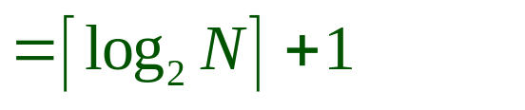
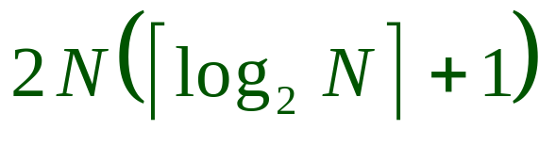
Two-Way External Merge Sort
Each pass we read + write each page in file.
= 2 * N
N pages in file => number of passes:
So total cost is:
3,4
6,2
9,4
8,7
5,6
3,1
2
Input file
PASS 0
3,4
2,6
4,9
7,8
5,6
1,3
2
1-page runs
PASS 1
2,3
4,7
1,3
2-page runs
4,6
8,9
5,6
2
PASS 2
2,3
4,4
1,2
4-page runs
6,7
3,5
8,9
6
PASS 3
1,2
2,3
3,4
8-page runs
4,5
6,6
7,8
9
Notes:
6

Slide 52
General External Merge Sort
What if we had more buffer pages?
How do we utilize them ?
Notes:
7

Slide 53
General External Merge Sort
INPUT ?
. . .
INPUT ?
. . .
. . .
OUTPUT?
INPUT ?
Disk
Disk
B Main memory buffers
To sort file with N pages using B buffer pages?
Notes:
7

Slide 54
General External Merge Sort
To sort file with N pages using B buffer pages
Phase 1 (pass 0):
  Fill memory with records
  Sort using any favorite main-memory sort
  Write sorted records to disk
  Repeat above, until all records have been put into one sorted list
INPUT 1
. . .
INPUT 2
. . .
. . .
INPUT B
Disk
Disk
B Main memory buffers
Notes:
7

Slide 55
General External Merge Sort
Phase 1 (pass 0): using B buffer pages
  Produce what output ???
  Cost (in terms of I/Os) ???
INPUT 1
. . .
INPUT 2
. . .
. . .
INPUT B
Disk
Disk
B Main memory buffers
Notes:
7

Slide 56
General External Merge Sort
To sort file with N pages using B buffer pages:
  Produce output: Sorted runs of B pages each
    Run Sizes: B pages each run.
    How many runs: [ N / B ] runs.
  Cost : ?
INPUT 1
. . .
INPUT 2
. . .
. . .
OUTPUT
INPUT B-1
Disk
Disk
B Main memory buffers
Notes:
7

Slide 57
General External Merge Sort
To sort file with N pages using B buffer pages:
  Pass 0: use B buffer pages.
  Produce output: Sorted runs of B pages each
    Run Sizes: B pages each run.
    How many runs: [ N / B ] runs.
  Cost:
    2 * N I/Os
INPUT 1
. . .
INPUT 2
. . .
. . .
OUTPUT
INPUT B-1
Disk
Disk
B Main memory buffers
Notes:
7

Slide 58
General External Merge Sort
Sort N pages using B buffer pages:
  Phase 1 (which is pass 0 ). Produce sorted runs of B pages each.
  Phase 2 (may involve several passes 2, 3, etc.)
  Each pass merges B – 1 runs.
INPUT 1
. . .
INPUT 2
. . .
. . .
OUTPUT
INPUT B-1
Disk
Disk
B Main memory buffers
Notes:
7

Slide 59
Phase 2
Initially load input buffers with the first blocks of respective sorted run
Repeatedly run a competition among list unchosen records of each of buffered blocks
  Move record with least key to output
Manage buffers as needed:
  If input block exhausted, get next block from file
  If output block is full, write it to disk
CS 4432

Slide 60
General External Merge Sort
Sort N pages using B buffer pages:
  Phase 1 (which is pass 0 ). Produce sorted runs of B pages each.
  Phase 2 (may involve several passes 2, 3, etc.)
  Number of passes ? Cost of each pass?
INPUT 1
. . .
INPUT 2
. . .
. . .
OUTPUT
INPUT B-1
Disk
Disk
B Main memory buffers
Notes:
7

Slide 61
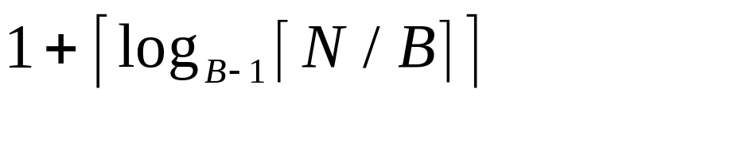
Cost of External Merge Sort
Number of passes:
Cost = 2N * (# of passes)
Total Cost : multiply above
Notes:
8

Slide 62
Example
Buffer : with 5 buffer pages,
File to sort : 108 pages
  Pass 0:
    Size of each run?
    Number of runs?
  Pass 1:
    Size of each run?
    Number of runs?
  Pass 2: ???
Notes:
8

Slide 63
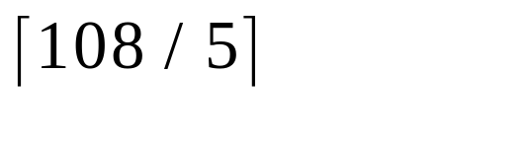
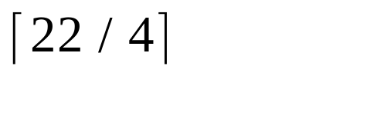
Example
Buffer : with 5 buffer pages
File to sort : 108 pages
  Pass 0: = 22 sorted runs of 5 pages each (last run is only 3 pages)
  Pass 1: = 6 sorted runs of 20 pages each (last run is only 8 pages)
  Pass 2: 2 sorted runs, 80 pages and 28 pages
  Pass 3: Sorted file of 108 pages
Total I/O costs: ?
Notes:
8

Slide 64
Example
Buffer : with 5 buffer pages
File to sort : 108 pages
  Pass 0: = 22 sorted runs of 5 pages each (last run is only 3 pages)
  Pass 1: = 6 sorted runs of 20 pages each (last run is only 8 pages)
  Pass 2: 2 sorted runs, 80 pages and 28 pages
  Pass 3: Sorted file of 108 pages
Total I/O costs: 2*N ( 4 )
Notes:
8

Slide 65
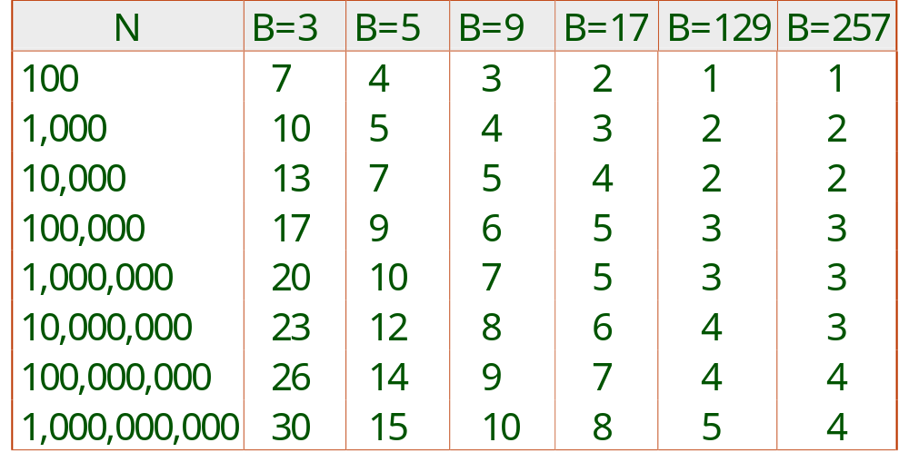
Number of Passes of External Sort
Notes:
9

Slide 66
How large a file can be sorted in 2 passes with a given buffer size M?
???
CS 4432

Slide 67
Double Buffering (Useful here)
To reduce wait time for I/O request to complete, can prefetch into `shadow block’.
  Potentially, more passes; in practice, most files still sorted in 2 or at most 3 passes.
INPUT 1
INPUT 1'
INPUT 2
OUTPUT
INPUT 2'
OUTPUT'
b
Disk
INPUT k
block size
Disk
INPUT k'
B main memory buffers, k-way merge

Slide 68
Sorting Summary
External sorting is important; DBMS may dedicate part of buffer pool for sorting!
External merge sort minimizes disk I/O cost
  Larger block size means less I/O cost per page.
  Larger block size means smaller # runs merged
In practice, # of runs rarely > 2 or 3
Notes:
19

Slide 69
Re-examine
Improving Access Times of Secondary Storage : Five Disk Optimizations
Chapter 11.5
CS 4432

Slide 70
Five Optimizations (in disk controller or OS)
Group blocks accessed together on same cylinder
  (to reduce seek times)
One big disk → several smaller disks
  (to help read several blocks at same time)
Mirror disks → multiple copies of same data
  (redundant disks to reduce rotational delay)
Prefetch blocks into memory → double-buffering.
  (bring data in early)
Disk Scheduling Algorithms → to select order in which several blocks will be read or written
  (streamline reads)
CS 4432

Slide 71
Assessment of Five Optimizations
Effect for “regular predictable tasks”,
  like one long dedicated process with sequential read
  e.g., a database SORT (1st-phase of multi-way-sort)
Effect for many “unpredictable irregular tasks”
  like many short processes in parallel
  e.g., airline reservations or 2nd-phase of multi-way sort
Or, some mixture in workload …
CS 4432

Slide 72
Five Optimizations : Useful or Not ?
Group blocks together on same cylinder
One big disk -> several smaller disks
Mirror disks -> multiple copies of same data
Prefetch blocks -> e.g., double-buffering.
Disk scheduling -> e.g., elevator algorithm
CS 4432

Slide 73
Assessment of Five Optimizations
Book has in-depth answer to this assessment !
So read the book (ch. 11.5).
CS 4432

