Slide 1
MoneyTraders
Trading Bot
Team members: Anastasia Stefanescu
Bianca Popa
Marius Scarlat
Sebastian Popa
Ionut Voicila

Slide 2
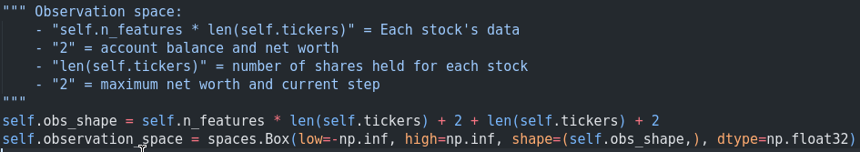
Trading Environments
StockTradingEnv
Observation space
Action space
Reward Structure

Slide 3

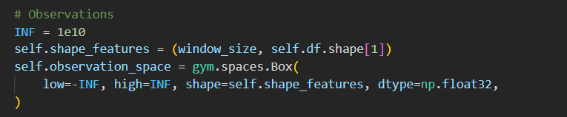
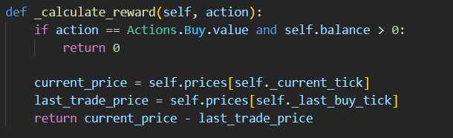
Trading Environments
b. StockTradingEnv- V2 - single stock trading
Action space

Slide 4
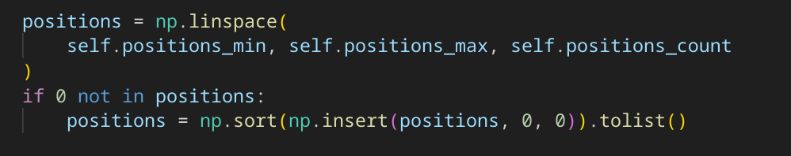
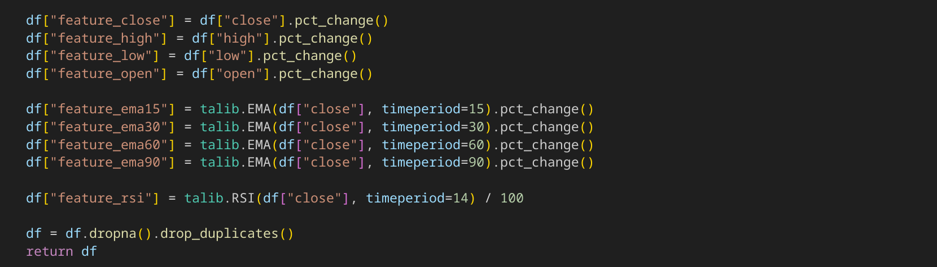
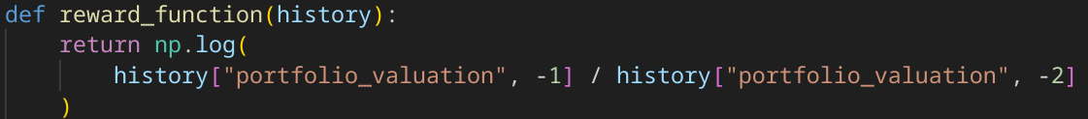
Trading Environments
c. GymTradingEnv
Action space
Observation space
Reward Structure

Slide 5
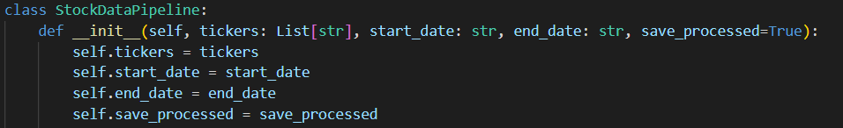

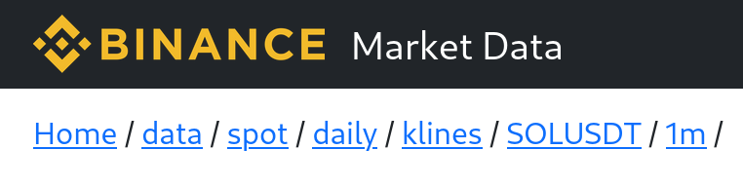

Datasets
Notes:
am creat un pipeline care ia date in timeframe daily folosind api ul de la yahoofinance si le proceseaza
de asemenea am descarcat date in timeframe de un minut de pe binnance pentru cryptomoneda solana

Slide 6
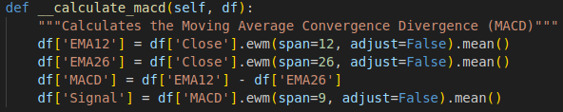
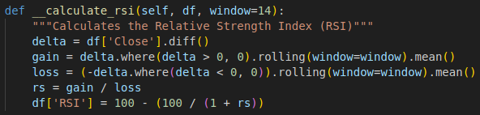
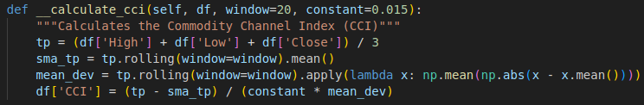
Additional features - financial indicators
Notes:
dupa descarcarea datelor am adaugat cativa indicatori financiari ca feature noi pe langa preturile obtinute (pretul de deschidere, pretul de inchidere, pretul maxim, pretul minim, volumul de trazactionare) precum: RSI, CCI MACD

Slide 7
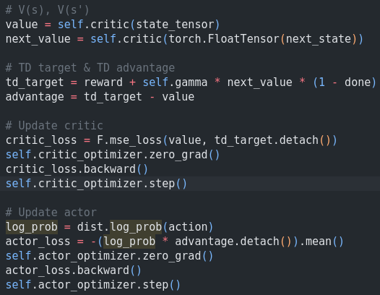
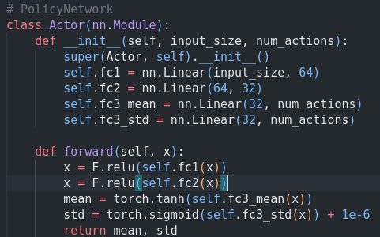
Methods and Algorithms
A2C (Advantage Actor-Critic)

Slide 8
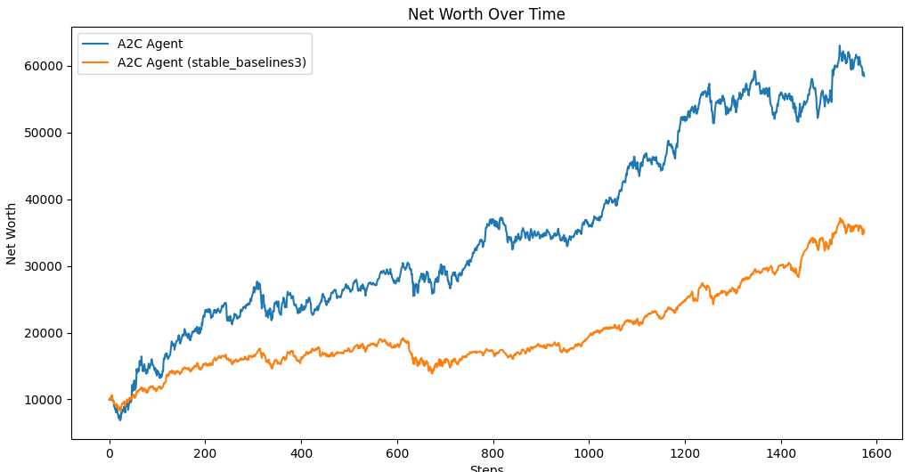
Methods and Algorithms
A2C (Advantage Actor-Critic)

Slide 9
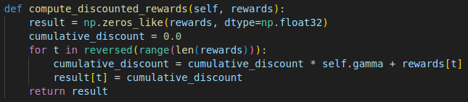
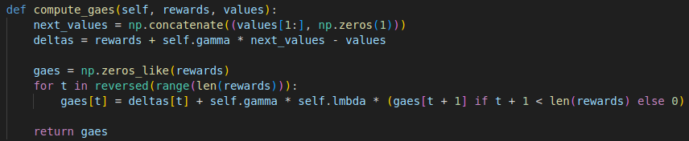
Methods and Algorithms
b. PPO (Proximal policy optimization)

Slide 10
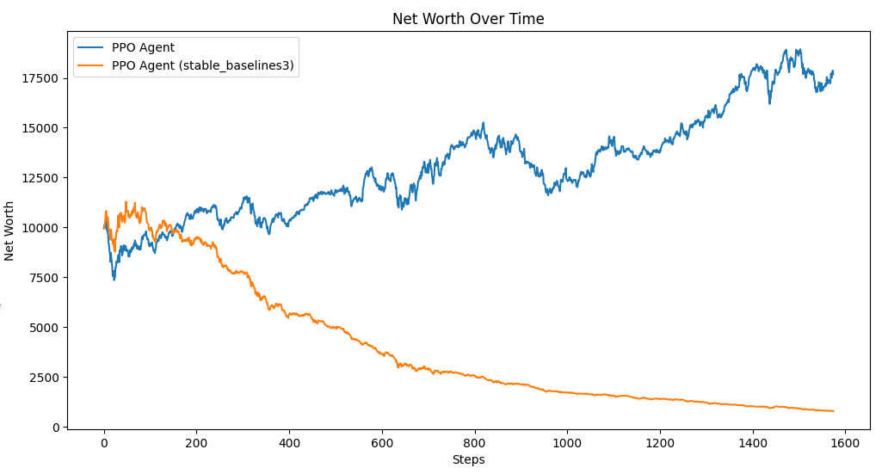
Methods and Algorithms
b. PPO (Proximal policy optimization)

Slide 11
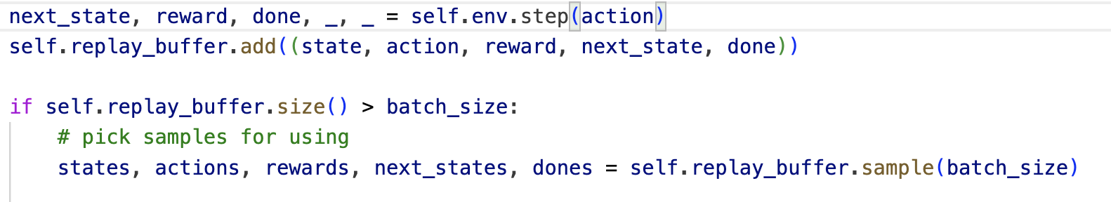
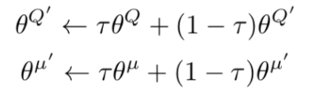
Methods and Algorithms
c. DDPG (Deep Deterministic Policy Gradient)
Replay Buffer
Soft Update
Temporal Difference Targets
Critic loss

Slide 12
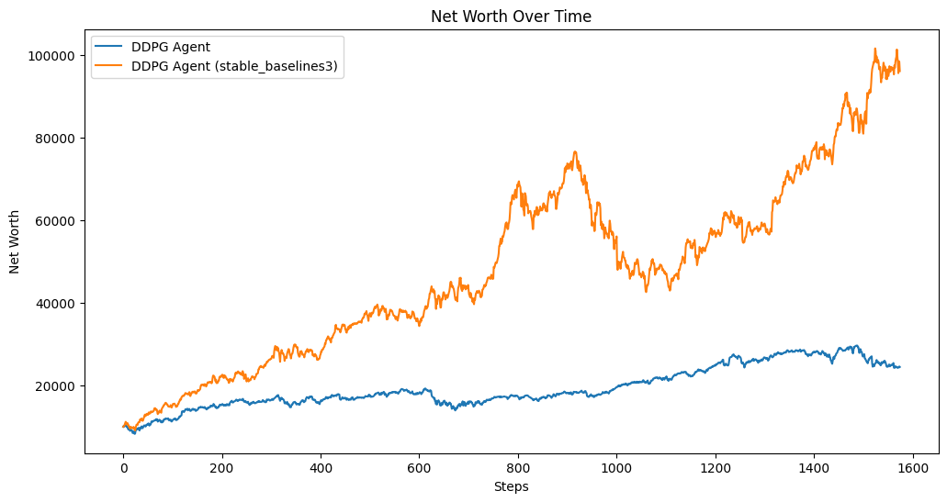
Methods and Algorithms
c. DDPG (Deep Deterministic Policy Gradient)

Slide 13

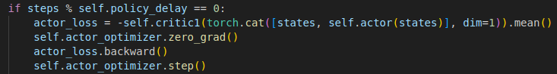
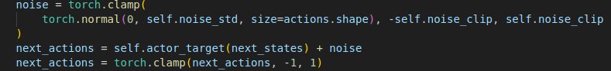
Methods and Algorithms
d. TD3 (Twin Delayed Deep Deterministic Policy Gradient)
Clipped Double Q-Learning
Delayed Policy Updates
Target Policy Smoothing:

Slide 14
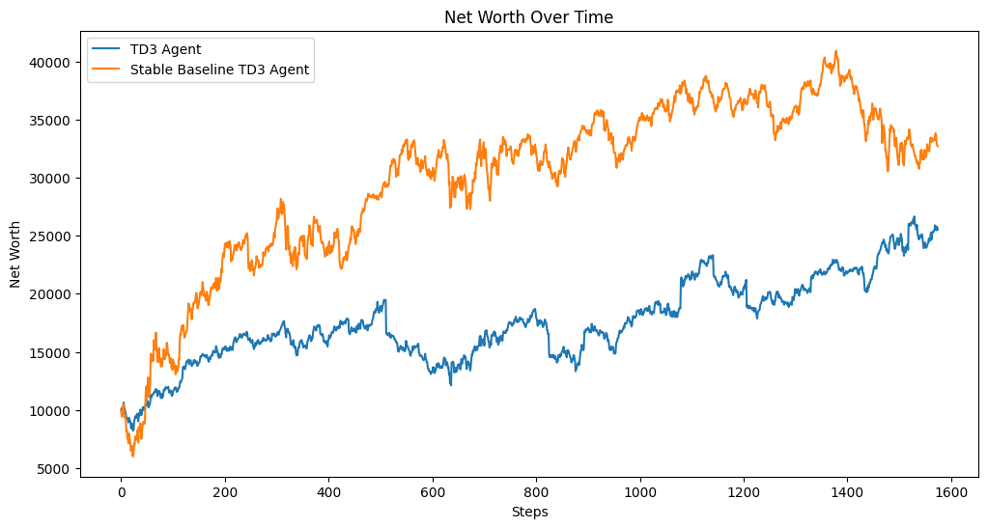
Methods and Algorithms
d. TD3 (Twin Delayed Deep Deterministic Policy Gradient)

Slide 15
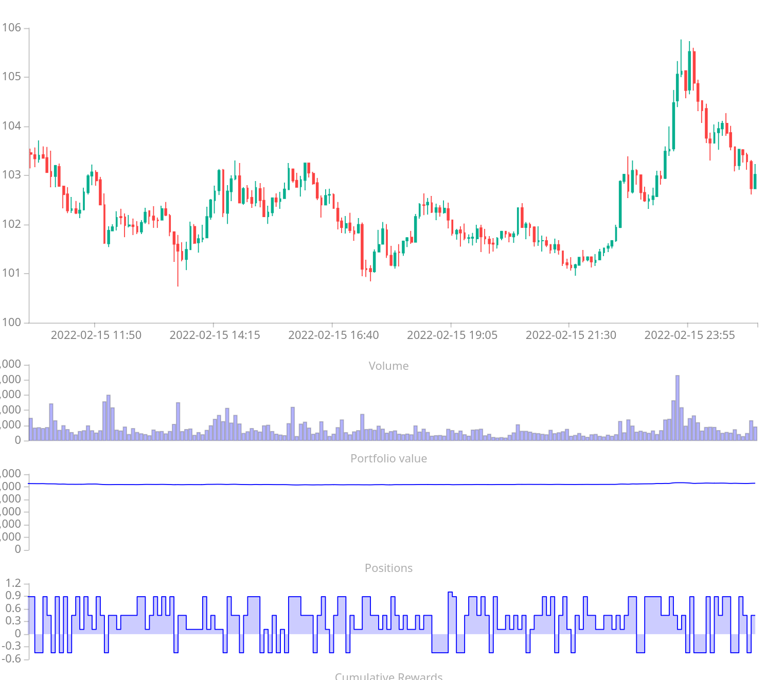
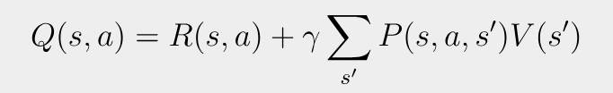
Methods and Algorithms
e. DQN (Deep Q-Network)

Slide 16
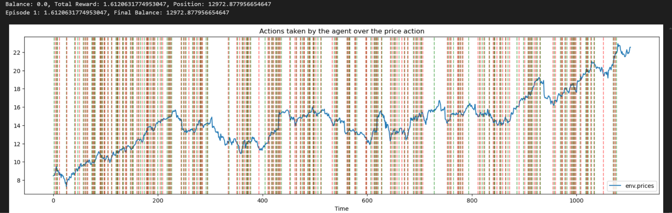
Methods and Algorithms
e.1 DQN (Deep Q-Network) stable_baselines3 - on training - 5 ani de date
Notes:
folsind al doilea environment prezentat si modelul DQN din libraria stable_baseline am reusit sa obtin un model care identifica trendurile si face tranzactii in perioadele de crestere respectiv nu face in perioadele de scadere
in figura prezentata, linia verticala verde reprezinta semnalul de BUY iar cea rosie de SELL pe o rulare pe datele de test

Slide 17
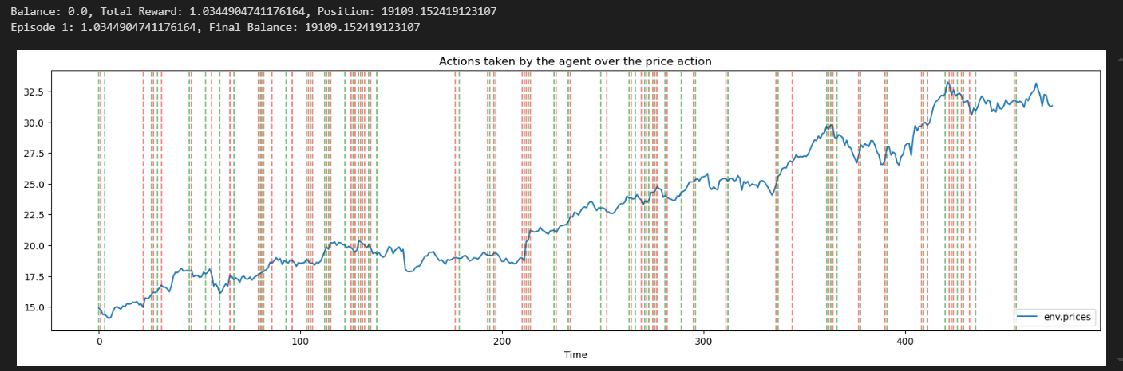
Methods and Algorithms
e.1 DQN (Deep Q-Network) stable_baselines3 - on test - 1 an de date
Notes:
iar in figura aceasta sunt tranzactiile pe datele de test pe care modelul nu le-a mai vazut pana acum
rezultatele pe mai multe rulari de test aduc un profit de 5-20%

Slide 18
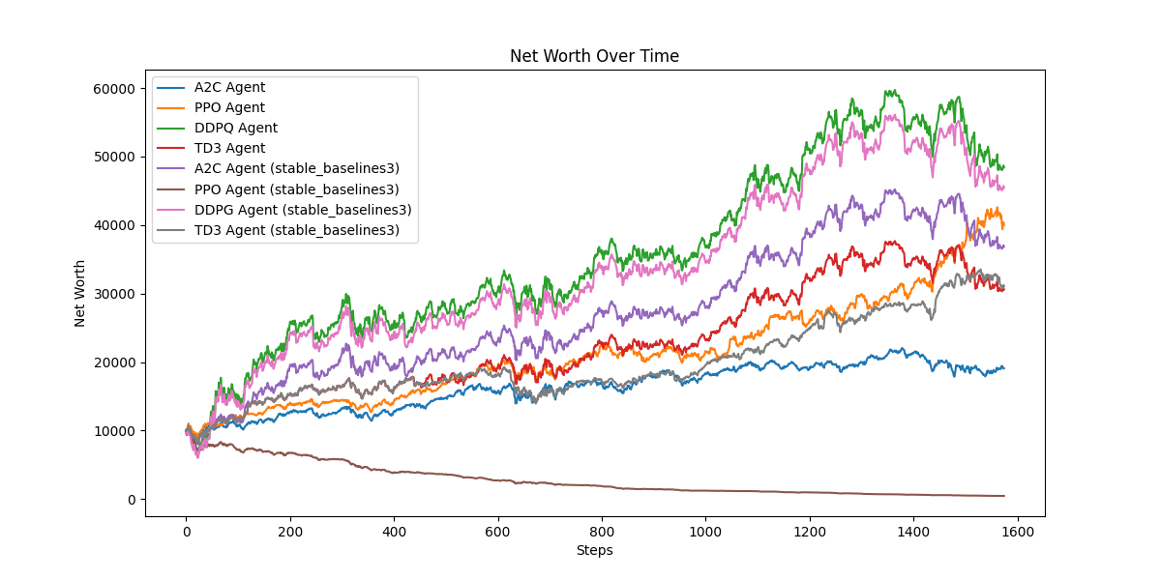
Methods and Algorithms

