Slide 1
Monster Forest
2D Platform
by Team Monsterit, Amiedu

Slide 2
Table of Content
Game Overview
Synopsis
Unique Selling Points
Competence Titles
Platform Minimum Requirements
Game Rules
Game Structure
Core Game → do something here please
Game Controls
HUD
Characters
NPC enemies
Character Line UP
Items
Wish List

Slide 3
Game Overview
Title: Monster Forest
Platform: PC Standalone
Genre: 2D Platform fantasy
Target: Casual gamer (aging from 6 – 30+)
Publisher: Amiedu
Engineers: Graphics Muhannad, Marko, Pyry and Ville
Coding Linda, Vahid and Kim
Release date: May 2018

Slide 4
High Concept / Synopsis
The goal of each level is to find a piece of crystal, which is now owned by the boss. So the player must go through challenges and puzzles to confront the boss and retrieve one of the pieces from him. After the boss is defeated, the player clears the level and can move to the next one.
Two little space monsters, who happily sore the cosmos with their comet, accidentally flew too close to planet name Kauhi, which caused them to crash into it. The comets power source, The Power Crystal, was destroyed by the crash into 12 different fragments. Now the two must recover the pieces if they want to continue their journey through the stars. So they venture into the foreign soil of this planet, which is inhabited by mean and ruthless monsters who want to keep the crystal fragments themselves.

Slide 5
Unique Selling Points
Multiplatform ??
Challenges
Switching Main Character

Slide 6
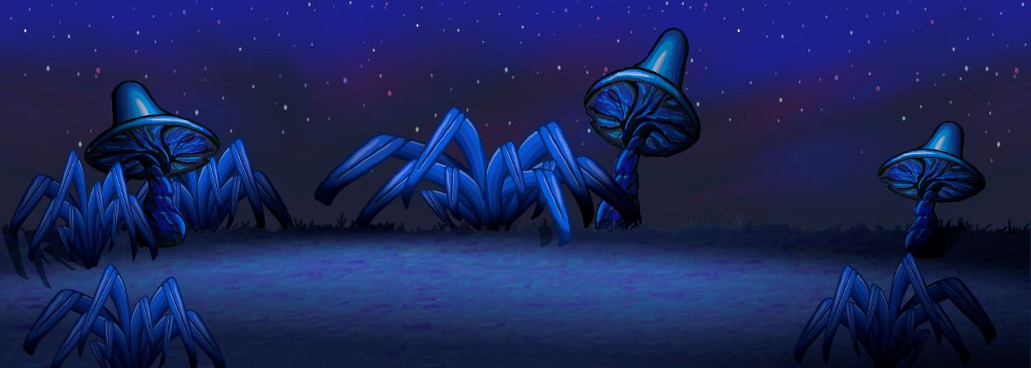
Competence Titles
Monster Forest

Slide 7
Platform Minimum Requirements.
PC, MAC AND LINUX STANDALONE OS:
Graphics card: DX9 (shader model 2.0) capabilities;
generally everything made since 2008 should work
Plan for Mobiles (iOS & Android) in the future:

Slide 8
Game Rules
The main character, Big Hand, can move and jump on platforms to get over the levels. Big Hand can't go into some places without solving a puzzle (this will give players score points). If an enemy is nearby, he can pick up a rock and throw it at the enemy.
In mid-game, the player can switch Big Hand to another character, Little One, whose ability is to fly over platforms and enemies. Little One can solve puzzles as well but doesn't always need it to progress the game. (This choice will leave player fewer score points)
In each level, there are 4-5 different enemies including Boss enemy. Each enemy has a different behaviour and will try to kill the main characters. The Player scores points by killing enemies, the number of points earned depends on the enemy type. The player health will be reduced from enemy attack and die when health point is zero.
After collecting a specific number of gems from the level, (Treasures, see the Props, Allies) the player can reach to the enemy boss to fight with him and finally to win the piece of the power gem.

Slide 9
Game Structure
Splash screen
Main Menu
Option/Setting
Load game
Quit game
Game Play

Slide 10
Flow Diagram
Monster Forests
Enemies: 2
Crystals: 5
You won!
You collected 12 crystals
Start
Win
Lose
Play again
Quit
Quit
Health Bar
Timer??
You died
Restart
Quit

Slide 11
Core Game
What character needs to do to complete the level
Move & jump

Slide 12
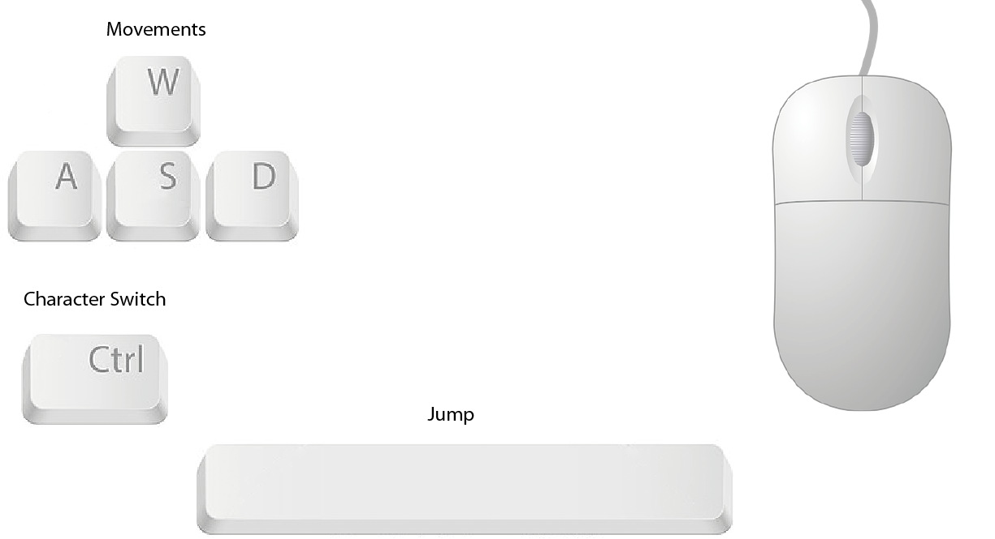
Game Controls

Slide 13
HUD
Number Crystals collected:
Number of Dead Enemy:
As a text
WHAT ELSE?
Image, bar??
Player Health Bar

Slide 14
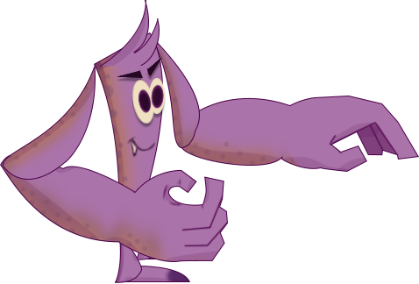
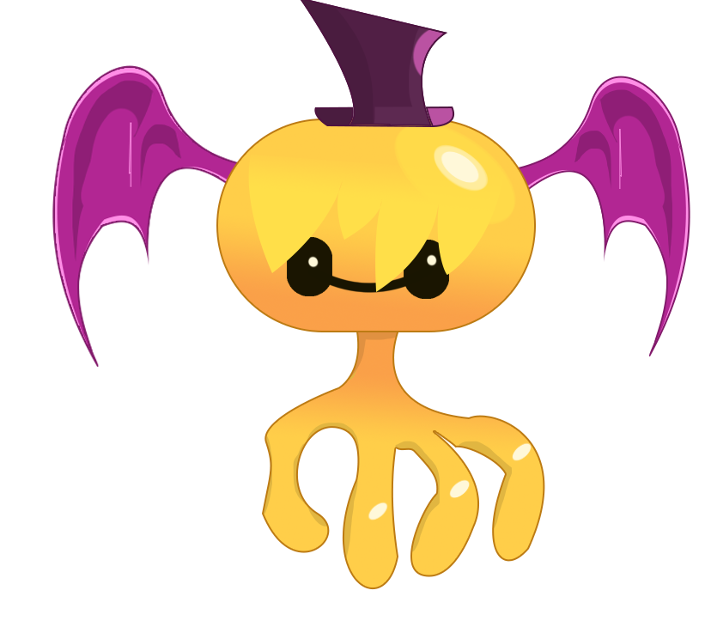
Main Characters
Name | Image | Ability/ weapon | Target | Effect on enemy | Health | Move Speed
Big Hand |  | Jumping Attack/rocks | All enemies Attack: Throw the rocks to the enemy Cooling time: 0.5s | Damage | 100 | 10
Little- Big Hand |  | Flying Collecting items | Crystals |  | 100 | 20?

Slide 15
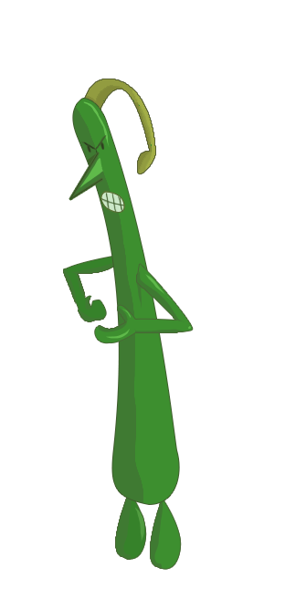
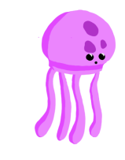

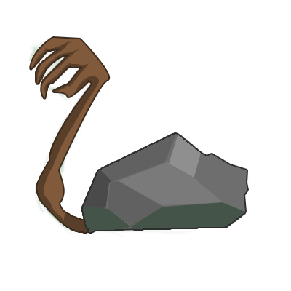
NPC Enemies
Name | Boss | Taller | Jelly | HandRock
Image
Size
Behaviour | ??
Attack/weapon | ?? | Fall down |  | Throw/rocks??
Max Health | 500 | 200 | 100 | 100
Move Speed | 0 | 0 | 10 | 5

Slide 16
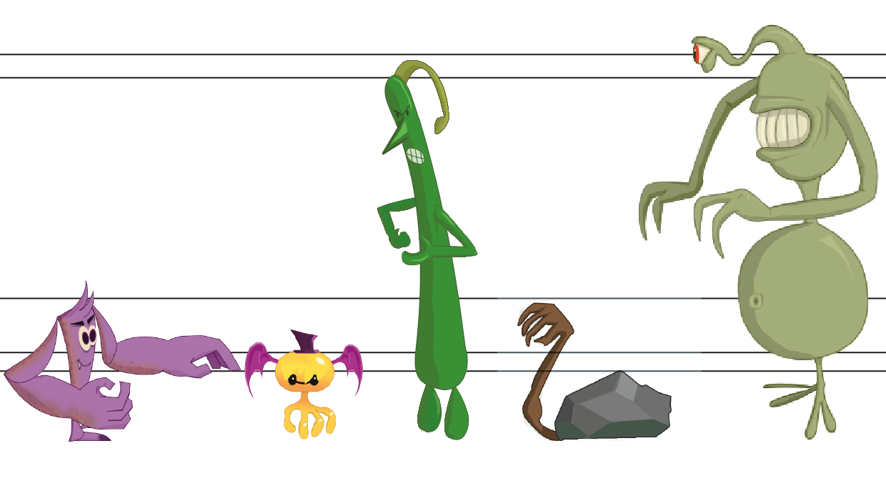
Character LineUP

Slide 17
Items
Rocks: for attack weapon
Crystals: earning and finding??
Flowers: for healing player health
What else?

Slide 18
Wish List: Future feature
ADD MORE ALLIES In a future DLC, add more Allies for the Player to choose from, each with different behaviors.
ADD ADAPTIVE LIGHTING Create a lighting system that will vary depending on the level of Player stress. The light could vary from a warm sun that shines through a window (when the Player has high life levels and few Enemies) to a rainstorm with lightning (when the Player is about to die).
MAKE THIS GAME AS MOBILE APP for iOS & Android

