Slide 2
OCR-AMR System : WiFi-Based
OCR
Sensors
OCR
Sensors
Internet
OCR
Sensors
WiFi
LTE/ethernet Router
Image Server
OCR
System/
Data Extraction
Data
Collection
Server
OCR
Sensors

Slide 3
OCR-AMR System : LoRa-based
WiFi
LTE/ethernet Router
Internet
Image Server
OCR
System/
Data Extraction
Data
Collection
Server
LoRa
Gateway
OCR
Sensors
OCR
Sensors
OCR
Sensors
OCR
Sensors

Slide 4
Proposed OCR-based AMR Hardware System
ESP32
WiFi/BLE
Module
Indicators
(LEDs)
ESP32
Cam
Module
SDCard Reader
Voltage/Power Level
Power Module
(Battery, Voltage Regulators, chargers)

Slide 5
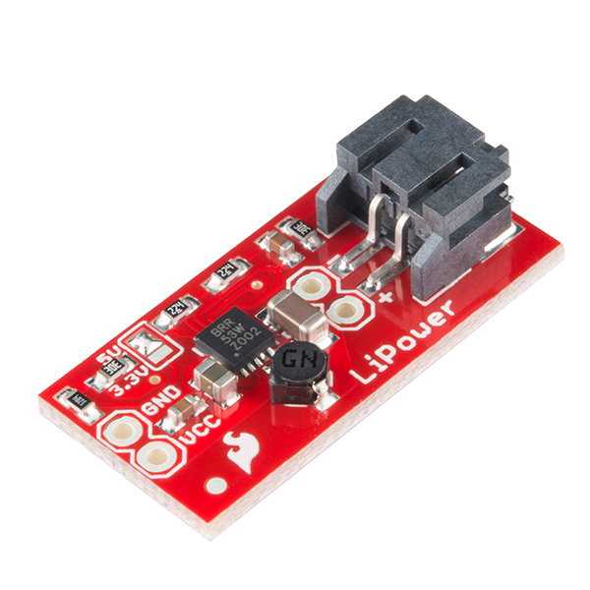
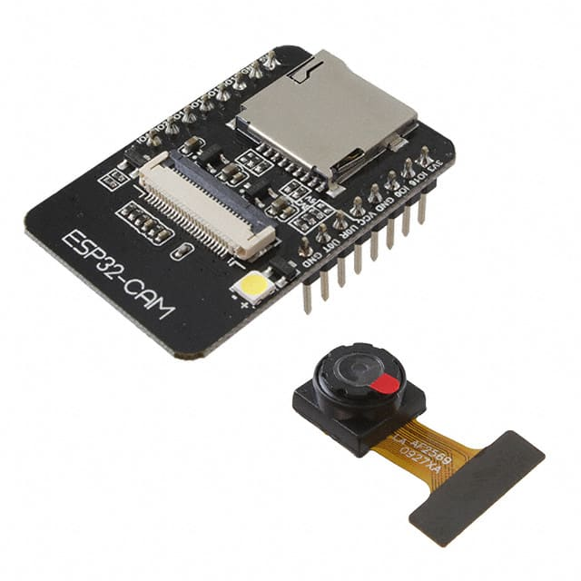
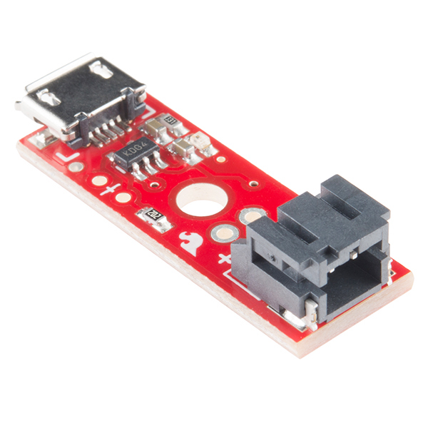
Fast Prototyping for Image Acquisition System (v0.0)
ESP32
WiFi/BLE
Module
Indicators
(LEDs)
ESP32
Cam
Module
Voltage/Power Level
Power Module
(Battery, Voltage Regulators, chargers)

Slide 6
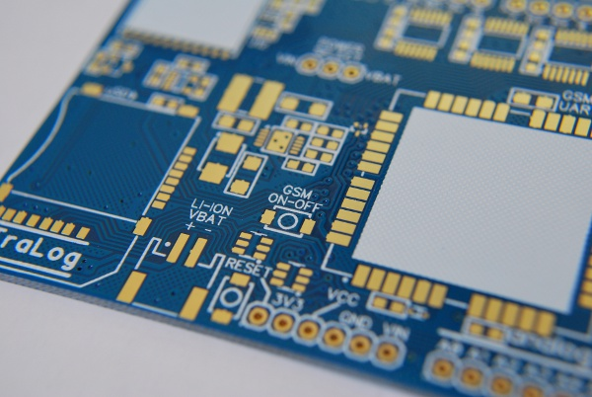
Custom Circuit and Printed Circuit Board Design and Prototyping (v0.1)
ESP32
WiFi/BLE
Module
Indicators
(LEDs)
ESP32
Cam
Module
Voltage/Power Level
Power Module
(Battery, Voltage Regulators, chargers)
Custom PCB

Slide 7
Hardware Phases
Phase 1 : Fast Prototyping
Off-the-shelf components
Phase 2 : Custom Circuit/PCB Prototype
Custom circuit/PCB Design
Initial PCB Fabrication Turn-Around
Phase 3 : Improvements/Modifications
Towards product finalization
Packaging constraints

Slide 8
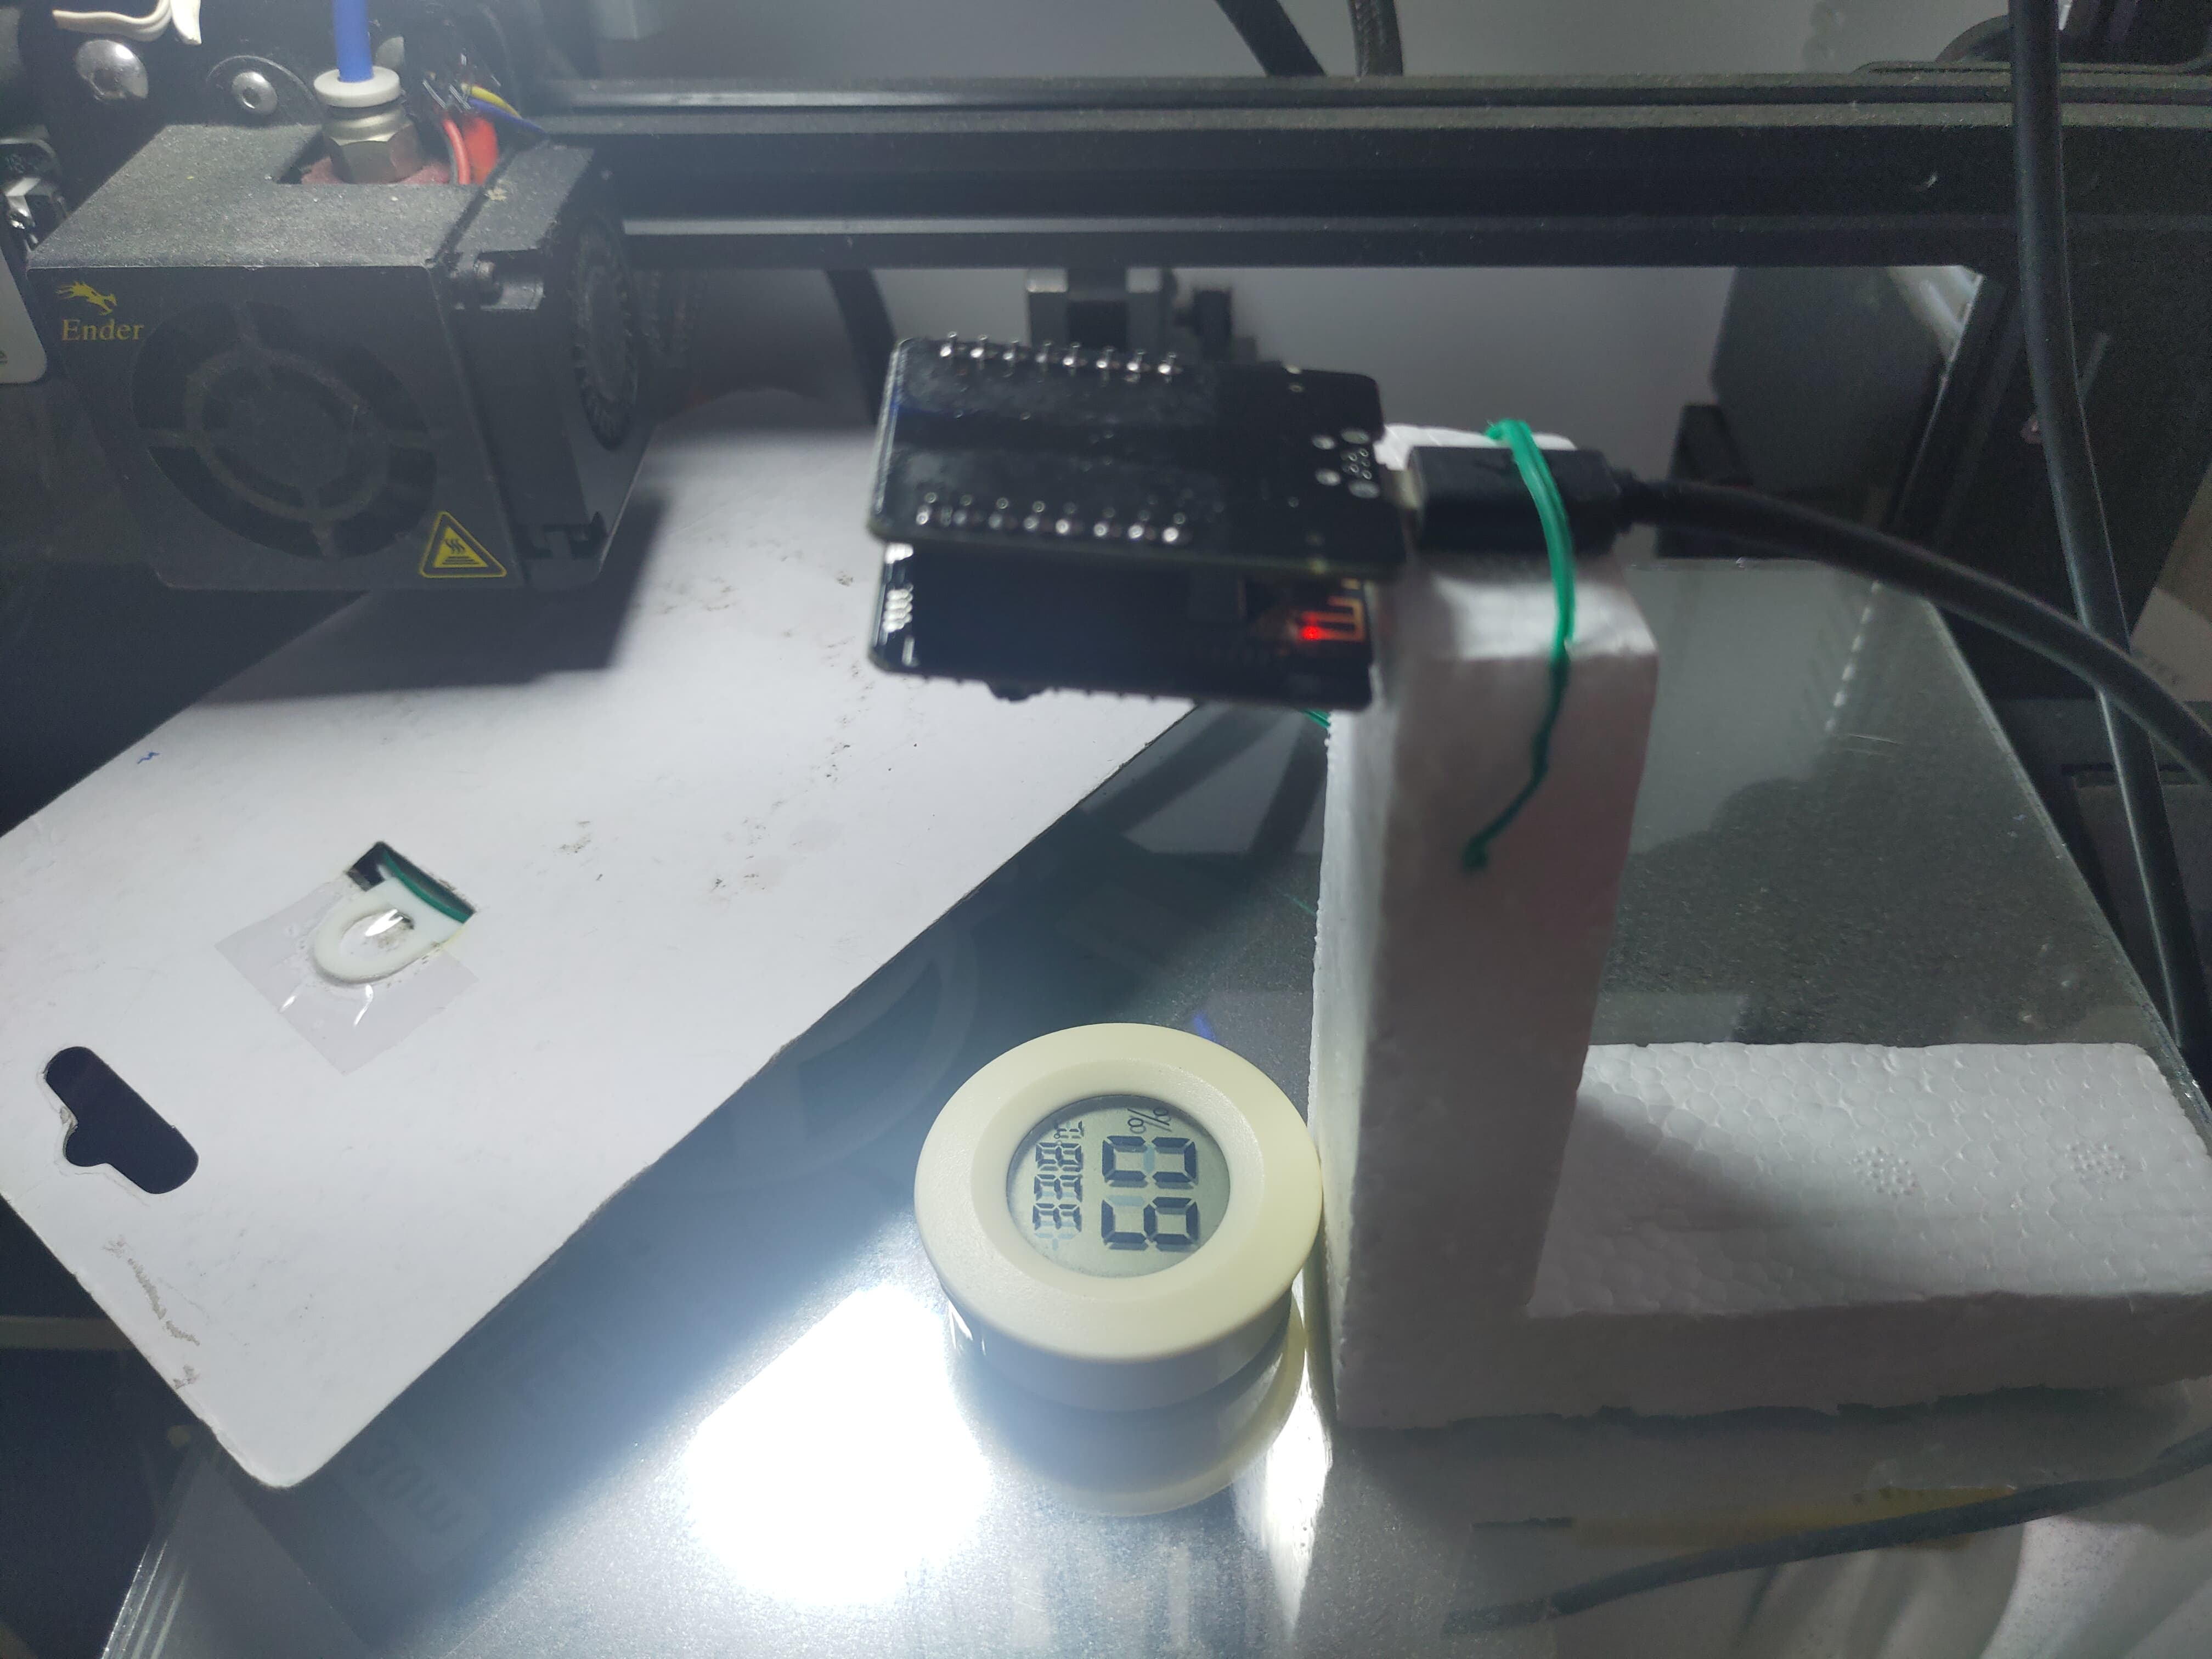
Initial Test Setup for Image Acquisition
OCR-AMR
Adjustable Mount
9 cm
Test Meter
Image Route Options for Initial Data Gathering:
Google Drive ** (tested, working setup)
Remote (Internet Path) Server

Slide 9
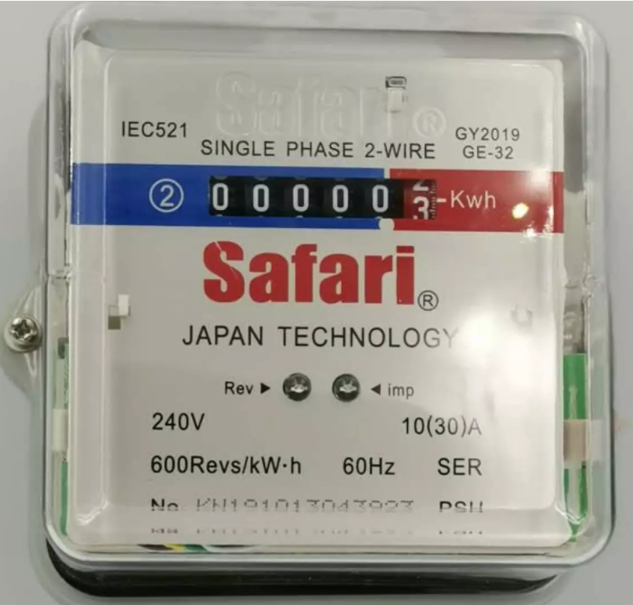
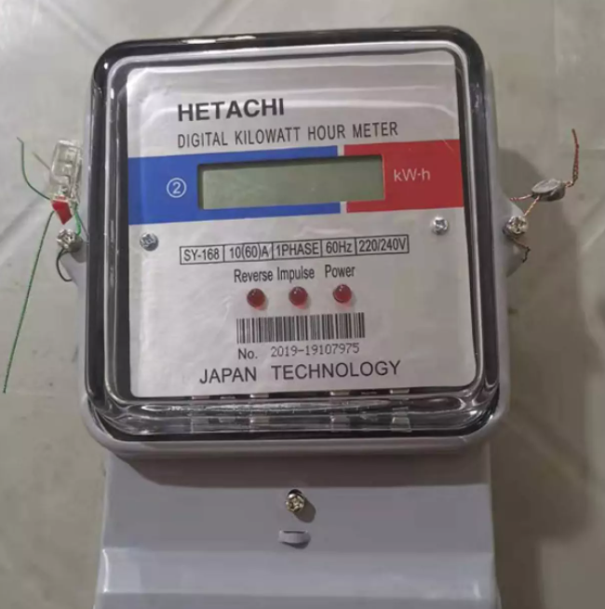
Proposed Test Submeters for Image Collection:

Slide 10
Initial Camera mount data
Sample Meralco KWH-meter : 16 cm diameter
From Initial Setup : Camera mount is around 24cm
We need short focal length with wide angle lens ( > 120 deg ) camera
Work around for testing:
Test available some wide angle lens for smartphones

Slide 11
Some Ideas
Transmits images for storage in a collection server.
Options : remotely initiated, or time-based
OCR
Sensors
Issues:
Time stamping – do we add real time clocks (RTC) to OCR-AMR devices
or time stamps are done in collection servers?
Takes x images and store it.
Options: remote initiated, or time-based

