Slide 1
Multi Layer Perceptron

Slide 2
Introduction

Slide 3

Perceptron was introduced by Frank Rosenblatt in 1957. He proposed a Perceptron learning rule based on the original
MCP(McCulloch-Pitts) neuron. A Perceptron is an algorithm for supervised learning of binary classifiers. This algorithm enables neurons to learn and processes elements in the training set one at a time.

Slide 4
Perceptron Function

Slide 5


Perceptron is a function that maps its input “x,” which is multiplied with the learned weight coefficient; an output value ”f(x)” is generated.
In the equation given above:
“w” = vector of real-valued weights
“b” = bias
“x” = vector of input x values
“m” = number of inputs to the Perceptron
The output can be represented as “1” or “0.” It can also be represented as “1” or “-1” depending on which activation function is used.

Slide 6
Types Perceptron layer

Slide 7
There are two types of Perceptrons: Single layer and Multilayer.
Single layer - Single layer perceptrons can learn only linearly separable patterns
Multilayer - Multilayer perceptrons or feedforward neural networks with two or more layers have the greater processing power

Slide 8
What are multilayer perceptrons?

Slide 9

The perceptron is very useful for classifying data sets that are linearly separable. They encounter serious limitations with data sets that do not conform to this pattern as discovered with the XOR problem. The XOR problem shows that for any classification of four points that there exists a set that are not linearly separable.
The MultiLayer Perceptron (MLPs) breaks this restriction and classifies datasets which are not linearly separable. They do this by using a more robust and complex architecture to learn regression and classification models for difficult datasets.

Slide 10
How does a multilayer perceptron work?

Slide 11
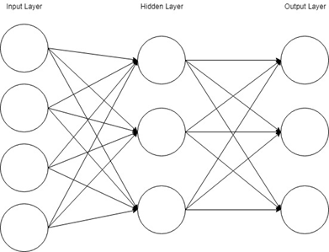
The Perceptron consists of an input layer and an output layer which are fully connected. MLPs have the same input and output layers but may have multiple hidden layers in between the aforementioned layers, as seen below.because they are not directly observable from the systems inputs and outputs.

Slide 12



