Slide 1
Package qss
Outline:
-Package
-Test
-Results
-Discussion and conclusion

Slide 2
Qss package
Inspired by the stand-alone qss solver written in C
Follows the model-integrator-quantizer structure
Usage: create a model-setting and a simulator
The Simulator instantiates and glues “database like” components and calls the integrator.
The integrator, has an instance of the simulator, organizes the show: initializes the “database” and starts integration until final time is reached. The integration calls other help files and asks the quantizer to compute next time and update the quantized variable.
The quantizer, based on the solver set in the settings, dispatches its functions to the appropriate solver (qss1, qss2,...,liqss...)

Slide 3
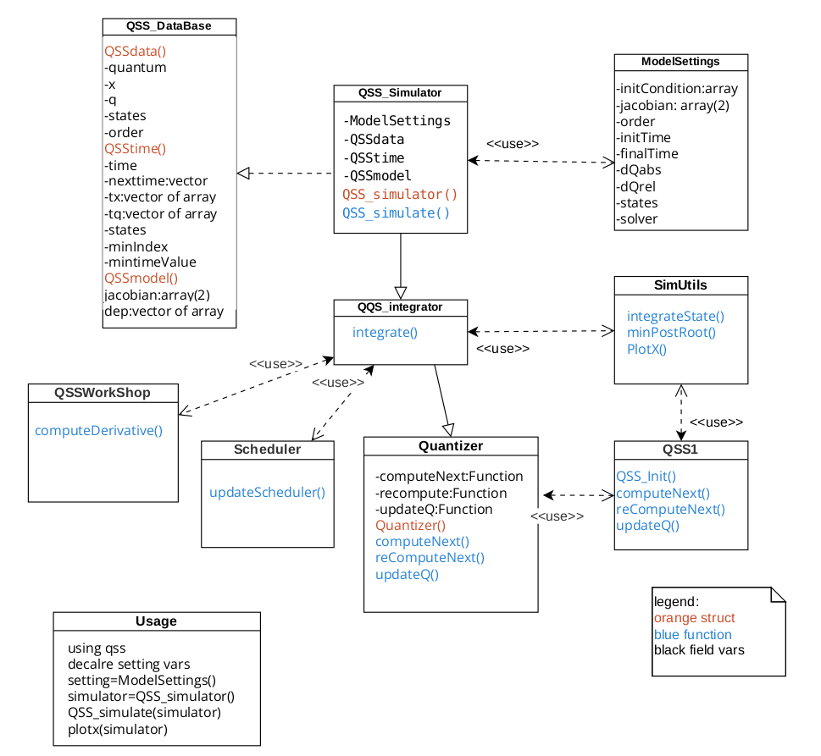
qss package

Slide 4
Data structures
Struct Data
quantum = Vector{Float64} (undef, states)
x = Vector{Array{Float64}}(undef, (order+1)*states)
q = Vector{Float64}(undef, (order+1)*states)
Struct Time
nextStateTime = Vector{Float64} (undef, states)
tx = Vector{Array{Float64}} (undef, states)
tq = Vector{Float64} (undef, states)
Struct Model
jacobian :: Array{Float64, 2}
dep :: Vector{Array{Int}}

Slide 5
Test
For an initial test, I solved a system of diff equations of 2 state vars, and compared the results against the package DifferentialEquations.
DifferentialEquations: du[1] = u[2] ; du[2] = -u[1] - u[2] tspan = (0.0,5) u0 = [1.0,2.0] sol = solve(ODEProblem(funcName,u0,tspan),abstol = 1e-6, reltol = 1e-3)
Qss: initialTime=0.0;finalTime=5.0;dQmin=1e-6;dQrel=1e-3; order=1 ;solver="qss1" initConditions=[1.0,2.0]; jacobian=[0.0 1.0; -1.0 -1.0] settings = ModelSettings(initialTime,finalTime,dQmin,dQrel,order,solver,initConditions,jacobian) simulator = QSS_simulator(settings) QSS_simulate(simulator)

Slide 6
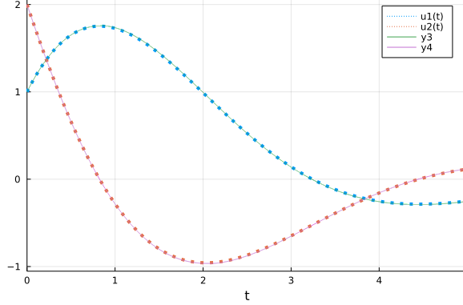
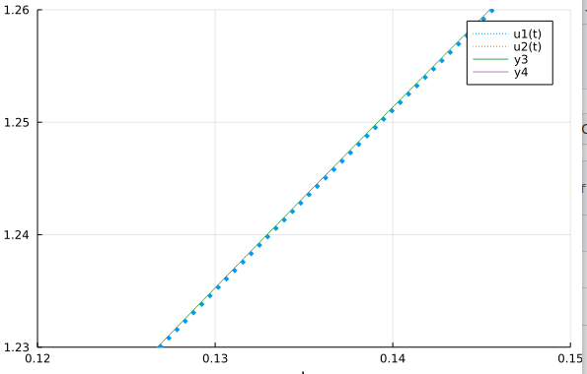
Results
qss1(continous ) vs differentialEquation (dotted)
blue: state var 1
red: state var 2
zommed in

Slide 7
Results: @btime
QSS1 Without saving the solution
Ft=0.5====>191.954 μs (25 allocations: 1.58 KiB)
Ft=5.0====>4.164 ms (25 allocations: 1.58 KiB)
Ft=15====> 9.702 ms (25 allocations: 1.58 KiB)
QSS1 With saving the solution
Ft=0.5====>1.072 ms (27661 allocations: 628.23 KiB)
Ft=5.0====>32.430 ms (777083 allocations: 18.69 MiB)
Ft=15====> 45.258 ms (1446596 allocations: 34.26 MiB)
ODE_DIFF default
Ft=0.5====>128.246 μs (575 allocations: 46.20 KiB)
Ft=5.0====>133.143 μs (657 allocations: 53.14 KiB)
Ft=15====>146.018 μs (774 allocations: 62.69 KiB)
ODE_DIFF BS3() equivalent matlab ODE23 explicit Runge-Kutta (2,3 )
Ft=0.5====>52.893 μs (327 allocations: 19.73 KiB)
Ft=5.0====>59.900 μs (403 allocations: 25.38 KiB)
Ft=15====> 73.372 μs (550 allocations: 40.42 KiB)

Slide 8
Results: @time
QSS1
Ft=0.5===>0.148370 seconds (170.63 k allocations: 9.424 MiB, 99.77% compilation time)
Ft=5.0===>0.155070 seconds (170.63 k allocations: 9.424 MiB, 96.53% compilation time)
Ft=15===>0.158298 seconds (170.63 k allocations: 9.424 MiB, 93.47% compilation time)
With saving
Ft=0.5===> 0.158821 seconds (166.49 k allocations: 8.221 MiB, 99.04% compilation time)
Ft=5.0===>0.181868 seconds (915.91 k allocations: 26.295 MiB, 79.90% compilation time)
Ft=15===>0.241866 seconds (1.59 M allocations: 41.871 MiB, 10.62% gc time, 61.25% compilation time)
ODE_DIFF
Ft=0.5===> 8.065880 seconds (10.47 M allocations: 591.129 MiB, 2.19% gc time, 99.88% compilation time)
Ft=5.0===>7.995588 seconds (10.48 M allocations: 591.609 MiB, 2.21% gc time, 99.88% compilation time)
Ft=15===>8.425649 seconds (10.48 M allocations: 591.618 MiB, 2.08% gc time, 99.87% compilation time)

Slide 9
Observation-Discussion
The current qss1 is worse than the solution of the DiffEqua package in @btime while it is better in @time. We observe that in DiffEqua most of computation is pushed to compile time.(so we should increase compilation-time and decrease run-time)
Solve(odeProblem) is order 2 at least whereas qss1 is order1
It was mentioned in the litterature that qss methods are not better than classic methods unless the system contains discontinuities.

Slide 10
Discussion
The QSS solver does what is is supposed to do but poorly:
While the prototype’s design was inspired by the stand-alone QSS solver, i should look at the differentialEquation.jl package to improve its perfomance.
Profiling
If else branching costs 20 clock cycles; function calls cost 50 clock cycles...default inlining is happening
RAM “reads” are also time expensive, Stack and heap
SIMD, muladdMacro.jl...
Having the quantizer “dispatch” which qss type to use is taking more allocations than when i use if-else-statement. Should i drop the elegant solution?

Slide 11
@generated @inbounds @inline
@generated function smallest(arg1::F, arg2::F, args::F...) where F <: AbstractFloat
ex = quote m = arg1 < arg2 ? arg1 : arg2 end
for i in 1:length(args)
ex = quote
$ex #value of last m
m = args[$i] < m ? args[$i] : m
#@inbounds m = args[$i] < m ? args[$i] : m #removed gave better performance!
end
end
ex #|> flatten
end
function smallest2(arg1::Float64, arg2::Float64, args::Float64...)
m = arg1 < arg2 ? arg1 : arg2
for i in 1:length(args)
m = args[i] < m ? args[i] : m
end
m
end
function test() for i=1:40000 push!(x,-i*1.2) end end
@btime smallest(1.0,2.0,x...)#@generated LoadError: syntax: invalid syntax (memory-error out of gc handles)
@btime smallest2(1.0,2.0,x...)# 904.642 μs (40004 allocations: 937.67 KiB)
function test() for i=1:4000 push!(x,-i*1.2) end end
@btime smallest(1.0,2.0,x...)# 128.055 μs (4004 allocations: 93.92 KiB)
@btime smallest2(1.0,2.0,x...)# 120.540 μs (4004 allocations: 93.92 KiB)
The same thing for @inline function quadraticsmallestpositiveroot(a::F, b::F, c::F)

Slide 12
Future tasks
Currently the qss package is just a prototype:
I will have to see if it is more efficient to use the “withoutsaving” approach and add a “saveat” feature.
Should we also save the derivatives?
The client should be able for query the solution as such: sol1(0.321). So an interpolation feature should be added.
Next, the package should implement other solvers besides qss1, accounts for input signals and discontinuities.
What range of t are we interested in: order of t?

