Slide 1
Studio 3
Substitution Model, Recursion, Order of Growth

Slide 2
Welcome!
Name (any preferred name?)
Any prior programming experience?
Why CS?
Hobby / fun fact?

Slide 3

Avenger…?
I’m just a senior who took the course last year!
I will try my best to guide you through!
“I am here for you” - Prof Martin’s education paradigm
Not a “teacher”, this is my first time teaching CS as well!
Learning process for all of us
I might be wrong, but we get to discuss during studio!

Slide 4
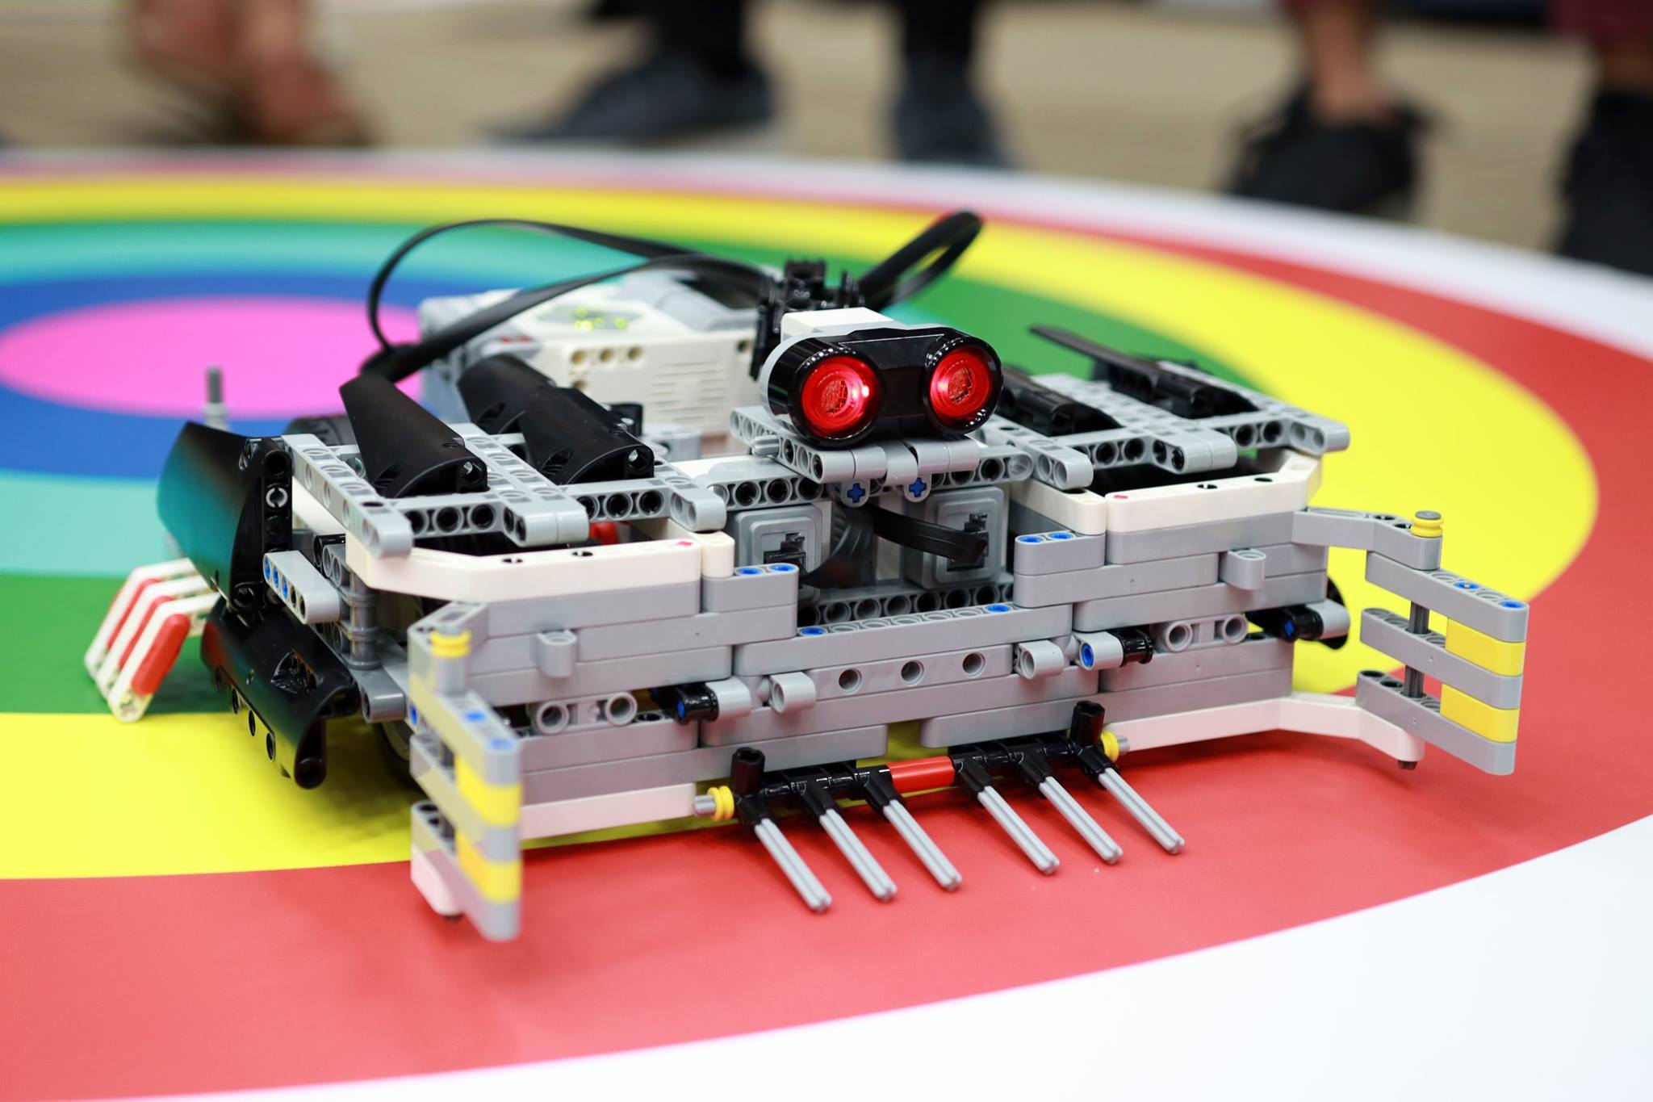
What is CS1101S about?
NOT a coding course!
About programming methodology
*Computational thinking*, how to solve problems through programming?
How does a computer program run?
Workload can be quite heavy (quests are optional!)
(Unfortunately) might be the most fun CS course in a while

Slide 5

Got questions?
T05 studio Telegram chat
Ed forum (best way to reach the profs)
Friends
PM me (if it’s inconvenient to ask in the group)
I’m a struggling cs major too 😭
Other people may have the same questions!

Slide 6
Expectations
Try the studio sheets before coming (it’s usually not too difficult)
We still have in-class sheets + extra questions to go through
Studios will be discussion-based
Try to ask and answer questions. Communication is important!
Let me know if you can’t make it for any sessions. I need to submit the MC for you.
Plagiarism is a big NO NO

Slide 7
Recap

Slide 8
Elements of Programming
Boolean operations
true && true >>>true
true && false >>>false
false && true >>>false
false && false >>>false
true || true >>>true
true || false >>>true
false || true >>>true
false || false >>>false

Slide 9
Elements of Programming
Boolean operations
true && true >>>true
true && false >>>false
false && true >>>false
false && false >>>false
true || true >>>true
true || false >>>true
false || true >>>true
false || false >>>false

Slide 10
Elements of Programming
Boolean operations
true && true >>>true
true && false >>>false
false && true >>>false
false && false >>>false
true || true >>>true
true || false >>>true
false || true >>>true
false || false >>>false

Slide 11
Elements of Programming
Short-circuit evaluation
&& (AND), || (OR) in Source (and Javascript) are short-circuit operators
true || is_CS1101S_fun()
false && is_CS1101S_fun()

Slide 12
Substitution Model
What is It?
A mental model to understand how programs with immutable data is run.
https://share.sourceacademy.nus.edu.sg/substitution

Slide 13
Substitution Model
Normal Order Reduction vs Applicative Order Reduction
Normal Order -> “expand then evaluate”
Applicative Order -> “evaluate then apply”
Evaluate -> arguments must be in their most “primitive” form before function is applied
Used in Source, JavaScript, and many other languages

Slide 14
Substitution Model
Normal Order Reduction vs Applicative Order Reduction
function foo(x) {
return x * x;
}
function bar(x) {
return foo(x) + 1;
}
bar(5 + 3);

Slide 15
Substitution Model
Normal Order Reduction vs Applicative Order Reduction
function foo(x) {
return x * x;
}
function bar(x) {
return foo(x) + 1;
}
bar(5 + 3);
bar(5 + 3);

Slide 16
Substitution Model
Normal Order Reduction vs Applicative Order Reduction
function foo(x) {
return x * x;
}
function bar(x) {
return foo(x) + 1;
}
bar(5 + 3);
bar(5 + 3);
foo(5 + 3) + 1;

Slide 17
Substitution Model
Normal Order Reduction vs Applicative Order Reduction
function foo(x) {
return x * x;
}
function bar(x) {
return foo(x) + 1;
}
bar(5 + 3);
bar(5 + 3);
foo(5 + 3) + 1;
(5 + 3) * (5 + 3) + 1;

Slide 18
Substitution Model
Normal Order Reduction vs Applicative Order Reduction
function foo(x) {
return x * x;
}
function bar(x) {
return foo(x) + 1;
}
bar(5 + 3);
bar(5 + 3);
foo(5 + 3) + 1;
(5 + 3) * (5 + 3) + 1;
8 * (5 + 3) + 1;

Slide 19
Substitution Model
Normal Order Reduction vs Applicative Order Reduction
function foo(x) {
return x * x;
}
function bar(x) {
return foo(x) + 1;
}
bar(5 + 3);
bar(5 + 3);
foo(5 + 3) + 1;
(5 + 3) * (5 + 3) + 1;
8 * (5 + 3) + 1;
8 * 8 + 1;

Slide 20
Substitution Model
Normal Order Reduction vs Applicative Order Reduction
function foo(x) {
return x * x;
}
function bar(x) {
return foo(x) + 1;
}
bar(5 + 3);
bar(5 + 3);
foo(5 + 3) + 1;
(5 + 3) * (5 + 3) + 1;
8 * (5 + 3) + 1;
8 * 8 + 1;
64 + 1;

Slide 21
Substitution Model
Normal Order Reduction vs Applicative Order Reduction
function foo(x) {
return x * x;
}
function bar(x) {
return foo(x) + 1;
}
bar(5 + 3);
bar(5 + 3);
foo(5 + 3) + 1;
(5 + 3) * (5 + 3) + 1;
8 * (5 + 3) + 1;
8 * 8 + 1;
64 + 1;
65;

Slide 22
Substitution Model
Normal Order Reduction vs Applicative Order Reduction
function foo(x) {
return x * x;
}
function bar(x) {
return foo(x) + 1;
}
bar(5 + 3);
bar(5 + 3);
foo(5 + 3) + 1;
(5 + 3) * (5 + 3) + 1;
8 * (5 + 3) + 1;
8 * 8 + 1;
64 + 1;
65;
bar(5 + 3);

Slide 23
Substitution Model
Normal Order Reduction vs Applicative Order Reduction
function foo(x) {
return x * x;
}
function bar(x) {
return foo(x) + 1;
}
bar(5 + 3);
bar(5 + 3);
foo(5 + 3) + 1;
(5 + 3) * (5 + 3) + 1;
8 * (5 + 3) + 1;
8 * 8 + 1;
64 + 1;
65;
bar(5 + 3);
bar(8);

Slide 24
Substitution Model
Normal Order Reduction vs Applicative Order Reduction
function foo(x) {
return x * x;
}
function bar(x) {
return foo(x) + 1;
}
bar(5 + 3);
bar(5 + 3);
foo(5 + 3) + 1;
(5 + 3) * (5 + 3) + 1;
8 * (5 + 3) + 1;
8 * 8 + 1;
64 + 1;
65;
bar(5 + 3);
bar(8);
foo(8) + 1;

Slide 25
Substitution Model
Normal Order Reduction vs Applicative Order Reduction
function foo(x) {
return x * x;
}
function bar(x) {
return foo(x) + 1;
}
bar(5 + 3);
bar(5 + 3);
foo(5 + 3) + 1;
(5 + 3) * (5 + 3) + 1;
8 * (5 + 3) + 1;
8 * 8 + 1;
64 + 1;
65;
bar(5 + 3);
bar(8);
foo(8) + 1;
8 * 8 + 1;

Slide 26
Substitution Model
Normal Order Reduction vs Applicative Order Reduction
function foo(x) {
return x * x;
}
function bar(x) {
return foo(x) + 1;
}
bar(5 + 3);
bar(5 + 3);
foo(5 + 3) + 1;
(5 + 3) * (5 + 3) + 1;
8 * (5 + 3) + 1;
8 * 8 + 1;
64 + 1;
65;
bar(5 + 3);
bar(8);
foo(8) + 1;
8 * 8 + 1;
64 + 1;

Slide 27
Substitution Model
Normal Order Reduction vs Applicative Order Reduction
function foo(x) {
return x * x;
}
function bar(x) {
return foo(x) + 1;
}
bar(5 + 3);
bar(5 + 3);
foo(5 + 3) + 1;
(5 + 3) * (5 + 3) + 1;
8 * (5 + 3) + 1;
8 * 8 + 1;
64 + 1;
65;
bar(5 + 3);
bar(8);
foo(8) + 1;
8 * 8 + 1;
64 + 1;
65;

Slide 28
Substitution Model
“Rune Trials”
function transform_mosaic(r1, r2, r3, r4, transform) {
return transform(mosaic(r1, r2, r3, r4));
}

Slide 29
Substitution Model
“Rune Trials”
function transform_mosaic(r1, r2, r3, r4, transform) {
return transform(mosaic(r1, r2, r3, r4));
}
What if we change the parameter name into a pre-declared function?
function transform_mosaic(r1, r2, r3, r4, make_cross) {
return make_cross(mosaic(r1, r2, r3, r4));
}

Slide 30
Recursion
What is it?
A way of solving computational problem where the solution depends on solutions to smaller instances of the same problem
Problem
Smaller problem + Smaller problem
(even smaller problem + even smaller problem) + …
…
Trivial problem + Trivial problem + Trivial problem + ...

Slide 31
Recursion
Defining a recursive solution
Base case – the smallest problem (step 1)
Because you need somewhere to stop!
Recursive Step – how to get from step n to n + 1
Because you need to combine the solutions to your smaller problems!
This is sufficient because of how you have defined the subproblems

Slide 32
Recursion
Iterative Process vs Recursive Process
Not to be confused with a “recursive” function
That’s just a function that calls itself
Can give rise to either iterative or recursive process

Slide 33
Recursion
Iterative Process vs Recursive Process
Recursive process
Number of deferred operations grows with input
Space needed grows as well
Iterative process
number of deferred operations does not grow with input
Space needed does not grow
https://share.sourceacademy.nus.edu.sg/recursivevsiterative

Slide 34
Recursion
Iterative Process vs Recursive Process
Does this produce a recursive or iterative process?
function foo(x) {
return (x === 0) ? 0 : 1 + foo(0);
}

Slide 35
Recursion
Iterative Process vs Recursive Process
Every function that produces a recursive process can be rewritten to produce an iterative process

Slide 36
Recursion
Iterative Process vs Recursive Process
Every function that produces a recursive process can be rewritten to produce an iterative process
Just have to define a slightly different subproblem
The easier/intuitive solution can be either iterative or recursive depending on the problem
DFS -> recursive
BFS -> iterative

Slide 37
Order of Growth
What is it?
How the resource requirement (in time/space) grows as the size of the problem grows
Not about the absolute performance!
Think in terms of graph

Slide 38
Order of Growth
What is it?
Constants don’t matter
Minor terms don’t matter
O(3n^2 + n + 5) = O(n^2)
Why?

Slide 39
Order of Growth
Quiz
Assume a resource function r(n) with order of growth Θ(nlogn). Are the following statements true or false?
r(n) has order of growth Θ(n^2)
r(n) has order of growth O(n^2)
r(n) has order of growth Ω(n^2)

Slide 40
Order of Growth
Quiz
Assume a resource function r(n) with order of growth Θ(nlogn). Are the following statements true or false?
r(n) has order of growth Θ(n^2) FALSE
r(n) has order of growth O(n^2)
r(n) has order of growth Ω(n^2)

Slide 41
Order of Growth
Quiz
Assume a resource function r(n) with order of growth Θ(nlogn). Are the following statements true or false?
r(n) has order of growth Θ(n^2) FALSE
r(n) has order of growth O(n^2) TRUE
r(n) has order of growth Ω(n^2)

Slide 42
Order of Growth
Quiz
Assume a resource function r(n) with order of growth Θ(nlogn). Are the following statements true or false?
r(n) has order of growth Θ(n^2) FALSE
r(n) has order of growth O(n^2) TRUE
r(n) has order of growth Ω(n^2) FALSE

Slide 43
Order of Growth
Quiz
Assume a resource function r(n). Are the following statements true or false?
r(n) has order of growth Θ(r(n))
r(n) has order of growth O(r(n))
r(n) has order of growth Ω(r(n))

Slide 44
Order of Growth
Quiz
Assume a resource function r(n). Are the following statements true or false?
r(n) has order of growth Θ(r(n)) TRUE
r(n) has order of growth O(r(n)) TRUE
r(n) has order of growth Ω(r(n)) TRUE

Slide 45
Studio Sheet

