Slide 1
Studio 4
HOF, Scope

Slide 2
Mastery Check 1
Anytime between RA1 and Midterm
Done in pairs
30min/pair
Topics:
Scope
HOF
Substitution Model & Iterative/Recursive processes

Slide 3
Recap

Slide 4
Lambda Expressions
What is It?
Functions can be anonymous
(parameters) => expression
Now you can do things like:
const id = x => x;

Slide 5
Higher Order Functions
What is It?
Functions can take in another function and/or return function
const curry = x => y => x + y;

Slide 6
Higher Order Functions
What is It?
Functions can take in another function and/or return function
const curry = x => y => x + y;

Slide 7
Higher Order Functions
What is It?
Functions can take in another function and/or return function
const curry = x => y => x + y;

Slide 8
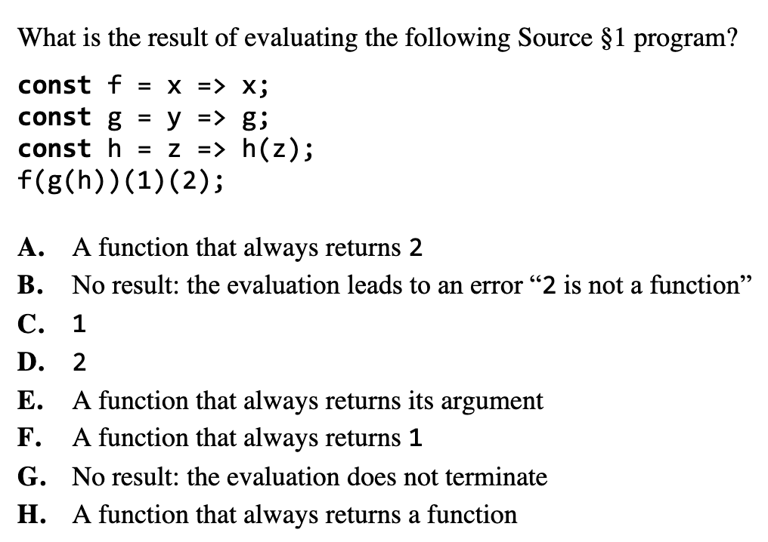
Higher Order Functions
Let’s try!

Slide 9
Scope of names
What is It?
A name occurrence refers to the closest surrounding declaration
Interpreter looks for the name in the current scope
If it does not exist, interpreter recursively search in outer scopes until the name is found, or the global scope is reached
If name is not found in the global scope, interpreter will throw error: “Name <xxx> not declared.”

Slide 10
Scope of names
Exercise
const fun = x => x => x + x;
fun(1)(2);

Slide 11
Scope of names
Exercise
const fun = x => x => x + x;
fun(1)(2);
4

Slide 12
Studio Sheet

Slide 13
In class sheet
Some visualizations
Number ->
-> Number
function
y = f(x)

Slide 14
In class sheet
Some visualizations
Number ->
-> Number
function
y = f(f(f(x)))

Slide 15
In class sheet
Some visualizations
Function ->
-> Function
thrice

Slide 16
In class sheet
Some visualizations
Function ->
-> Function
thrice
->
Number ->
-> Number
Number ->
-> Number

Slide 17
In class sheet
Some visualizations
Function ->
-> Function
thrice
->
Number ->
+1
-> Number
Number ->
+1
+1
+1
-> Number
add1
thrice(add1) = add3

Slide 18
In class sheet
Some visualizations
Function ->
-> Function
thrice
->
Function ->
-> Function
Function ->
-> Function
thrice
thrice(thrice)

Slide 19
In class sheet
Some visualizations
add1 ->
-> ???
thrice(thrice)

Slide 20
In class sheet
Some visualizations
add1 ->
-> ???
thrice(thrice)
->
Number ->
+1
-> Number
Number ->
+1
+1
+1
-> Number
add1
thrice(add1) = add3

Slide 21
In class sheet
Some visualizations
add3
add1 ->
-> ???
thrice(thrice)
->
Number ->
+1
-> Number
Number ->
+1
+1
+1
-> Number
add1
thrice(add1) = add3

Slide 22
In class sheet
Some visualizations
add3
add1 ->
-> ???
thrice(thrice)
+1
+1
+1
+1
+1
->
+1
+1
+1
+1
+1
+1
+1
+1
+1
+1
+1
+1

Slide 23
In class sheet
Some visualizations
add3
add9
add1 ->
-> ???
thrice(thrice)
+1
+1
+1
+1
+1
->
+1
+1
+1
+1
+1
+1
+1
+1
+1
+1
+1
+1

Slide 24
In class sheet
Some visualizations
add3
add9
add1 ->
-> add27
thrice(thrice)

Slide 25
In class sheet
Additional questions
What do these evaluate to? Why?
thrice(thrice(add1))(6);
((twice(thrice))(add1))(6);
((thrice(twice))(add1))(6);

Slide 26
In class sheet
Additional questions
What do these evaluate to? Why?
thrice(thrice(add1))(6); 15
((twice(thrice))(add1))(6);
((thrice(twice))(add1))(6);

Slide 27
In class sheet
Additional questions
What do these evaluate to? Why?
thrice(thrice(add1))(6); 15
((twice(thrice))(add1))(6); 15
((thrice(twice))(add1))(6);

Slide 28
In class sheet
Additional questions
What do these evaluate to? Why?
thrice(thrice(add1))(6); 15
((twice(thrice))(add1))(6); 15
((thrice(twice))(add1))(6); 14

