Slide 1




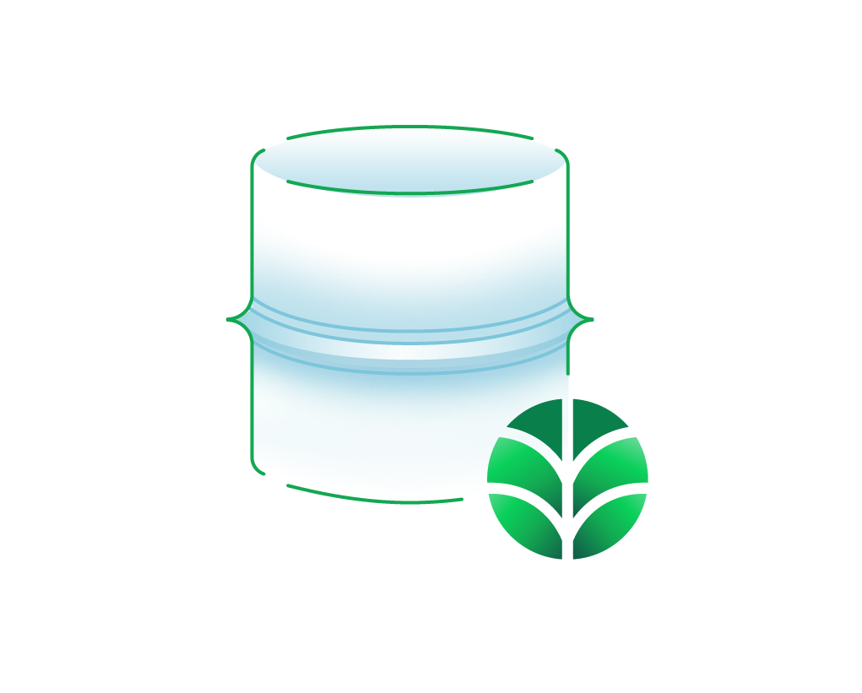

AWS Cloud
MongoDB Atlas project VPC
Availability Zone 1
Availability Zone 2
Availability Zone 1
Availability Zone 2
Availability Zone 3
VPC
Public subnet
Public subnet
VPC peering connection
NAT gateway
NAT gateway
MongoDB Atlas cluster

