Slide 1
世界模型调研总结（7.31-8.7）
——计算机系 大一 王关栋

Slide 2
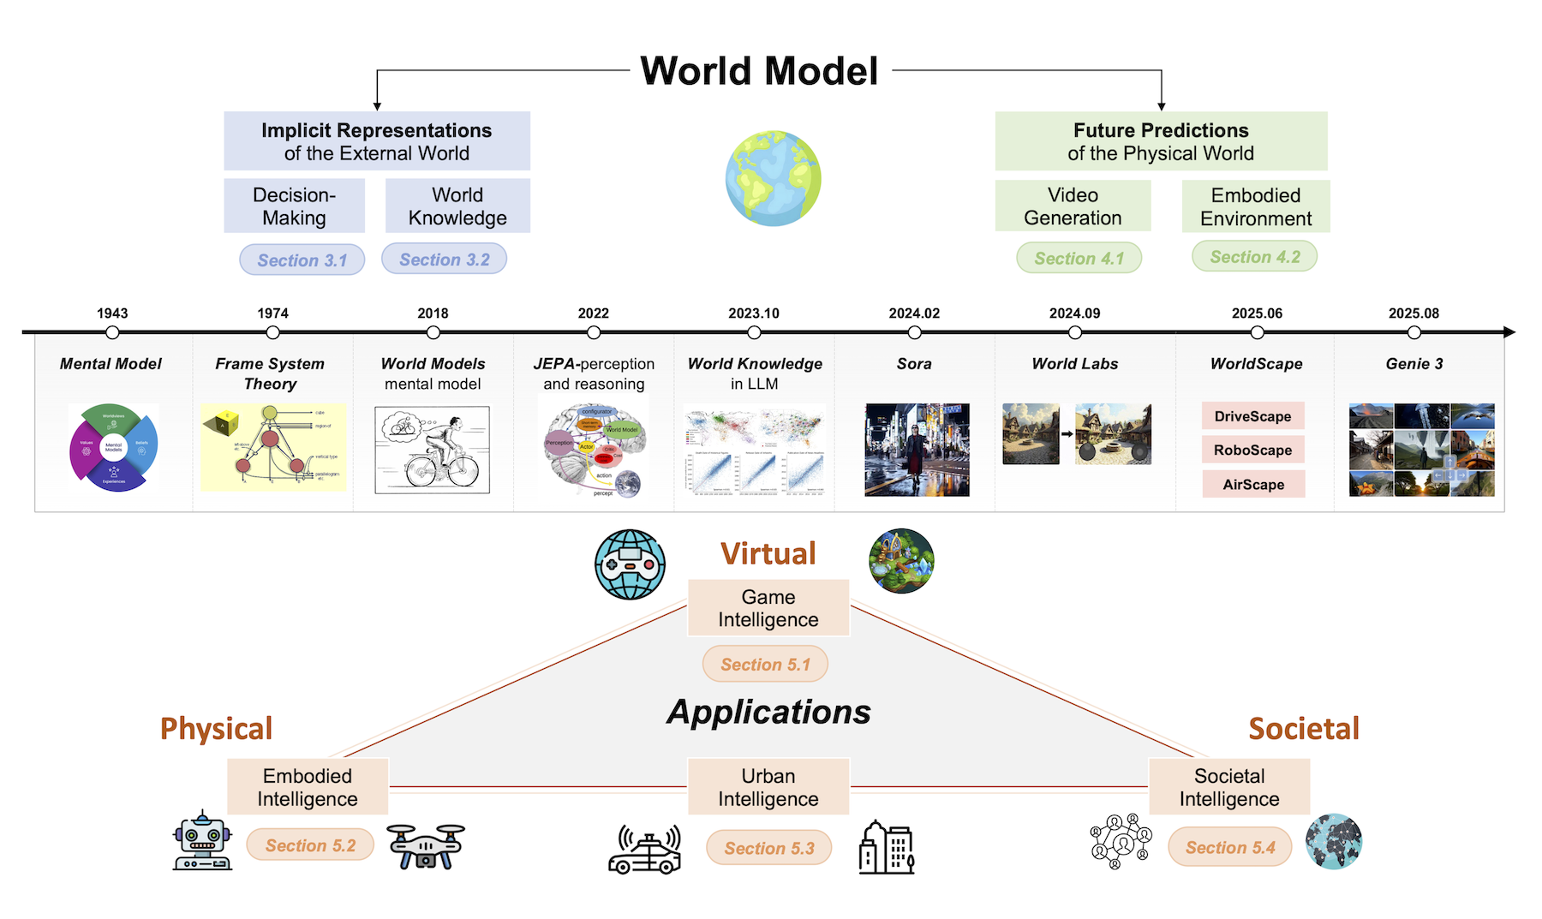
Structure

Slide 3
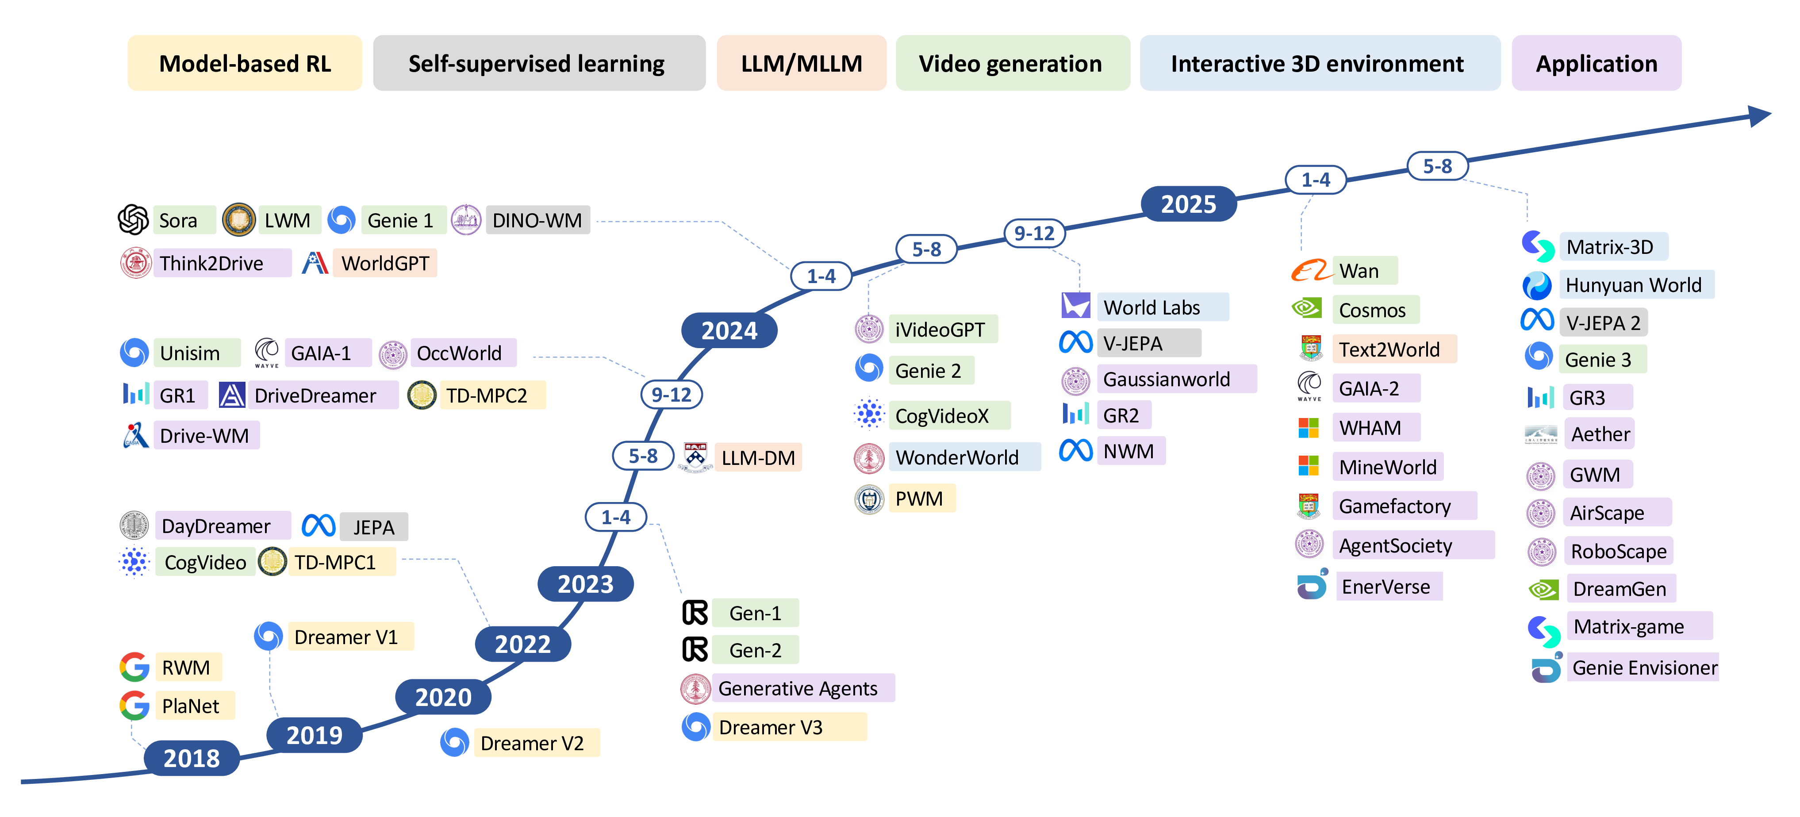
Roadmap
https://github.com/tsinghua-fib-lab/World-Model/blob/main/asset/roadmap.png, arXiv:2411.14499 [cs.CL]

Slide 4
Li Feifei’s Taxonomy
01
renderer
output observations
02
simulator
output states
mix
03
planner
output actions
https://x.com/drfeifei/status/2062247238143996275

Slide 5
Renderer
Sora(2024.2)——Genie1(2024.2)——Hunyuan World(2025.7)——Marble(2025.11)
feature: 2D to 3D, vivid, interactive
tech:
  Vision: Diffusion Model, Diffusion Transformer
  3D Spatial: 3D Gaussian splatting, 3D-RoPE
  Multimodel: Emu3, Transfusion
  Compution: Mamba, RingAttention
drawback: lack physical accuracy, high compute overhead, data scarcity

Slide 6
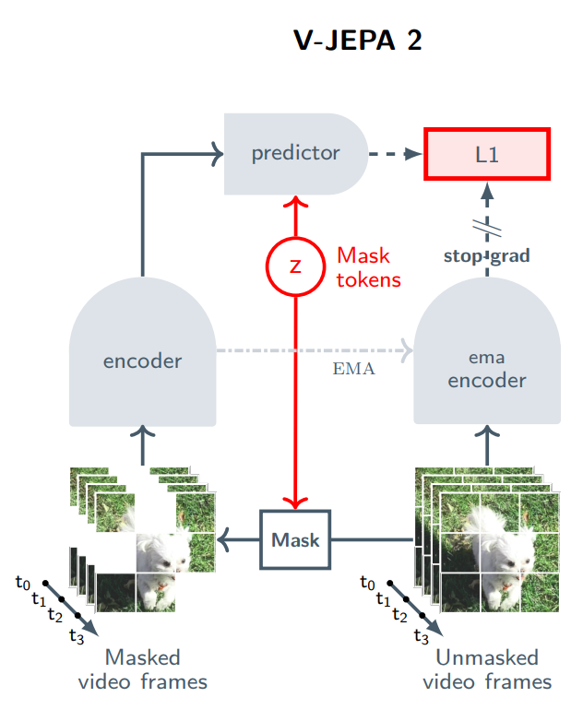
Simulator (linchpin)
JEPA Series: I-JEPA, V-JEPA, A-JEPA, LLM-JEPA…
learn and predict in latent space instead of pixel space
Cosmos, Marble, Genesis…
drawback: sim-to-real, discontinuous physics,
    error accumulation, inference latency
arXiv:2506.09985 [cs.AI]

Slide 7
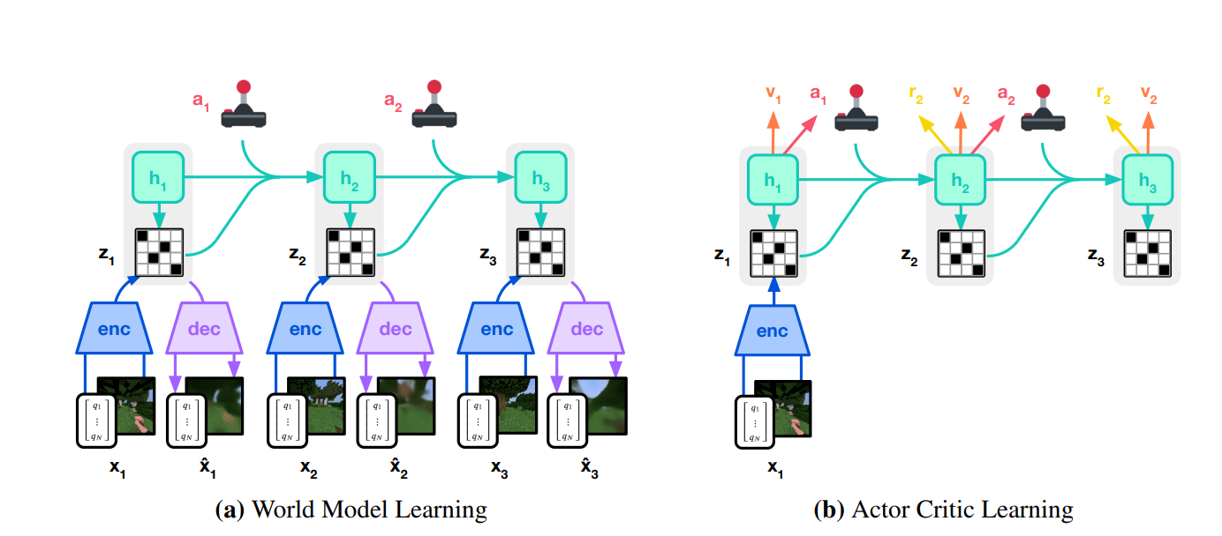
Planner
Dreamer Series: plan in the dream
Embodied intelligence
tech: diffusion policy, unified VLA tokenization
    drawback: long-step planning, inference latency, lack precision
arXiv:2301.04104 [cs.AI]

Slide 8
Application
Game Intelligence
Embodied Intelligence
Autonomous Driving
Societal Intelligence

Slide 9
Key problems & Future
data scarcity —— systhesize & train
computational bottleneck —— latent space(JEPA), hierarchical, compression

Slide 10
Appendix
“Self-Supervised Learning from Images with a Joint-Embedding Predictive Architecture”, arXiv:2301.08243 [cs.CV]
“V-JEPA 2: Self-Supervised Video Models Enable Understanding, Prediction and Planning”, arXiv:2506.09985 [cs.AI]
“Mastering Diverse Domains through World Models”, arXiv:2301.04104 [cs.AI]
“Genie: Generative Interactive Environments”, arXiv:2402.15391 [cs.LG]
“World Models”, arXiv:1803.10122 [cs.LG]
“Understanding World or Predicting Future? A Comprehensive Survey of World Models”, arXiv:2411.14499 [cs.CL]
“Scalable Diffusion Models with Transformers”, arXiv:2212.09748 [cs.CV]
“Dynamic 3D Gaussian Tracking for Graph-Based Neural Dynamics Modeling”, arXiv:2410.18912 [cs.RO]
“A Functional Taxonomy of World Models”, https://x.com/drfeifei/status/2062247238143996275
“The Model That Dreams the World”, https://moe-capital.com/blog-home/the-model-that-dreams-the-world

Slide 11
时间匆忙，请批评指正！

