Slide 1
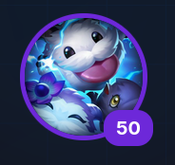

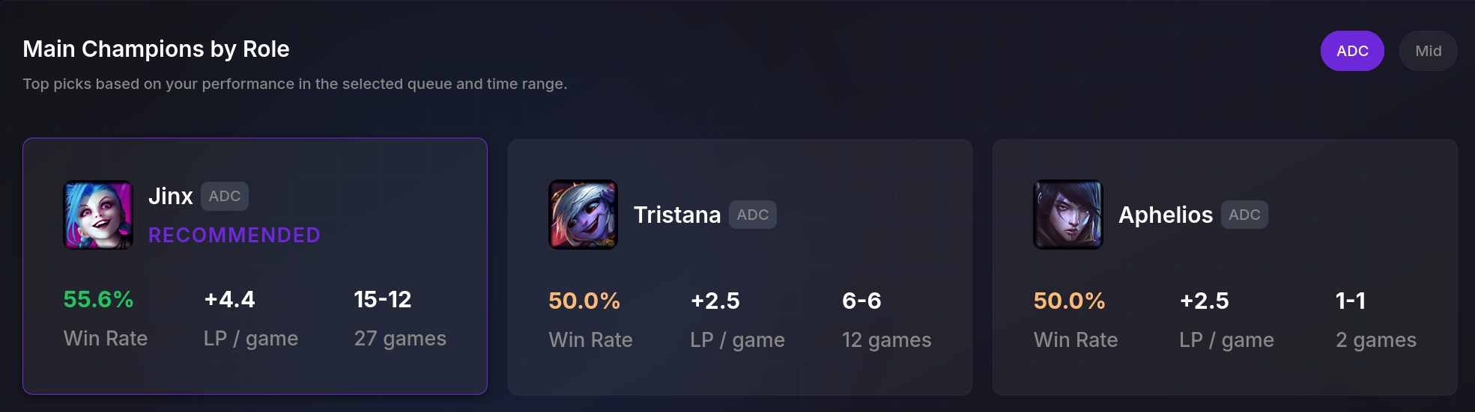
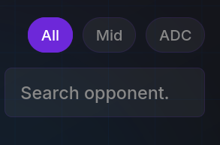
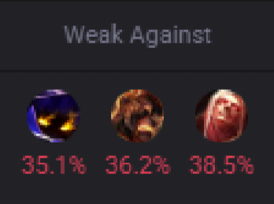
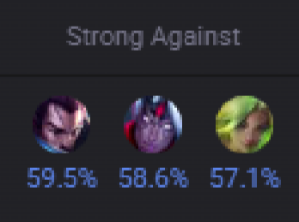
Mongoose.gg
Champ Select
Matches
Solo
Duo(pro)
Team(pro)
Goals(pro)
doendw

Slide 2
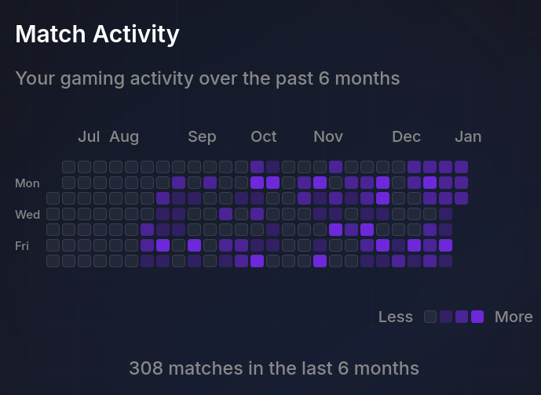
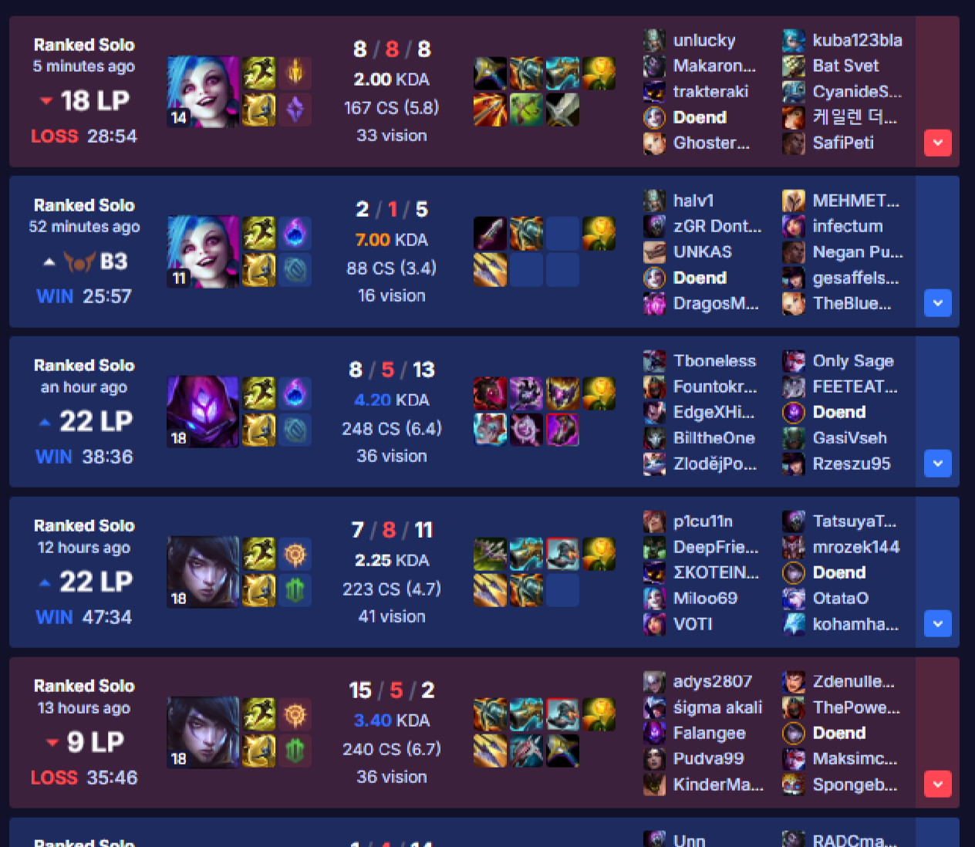
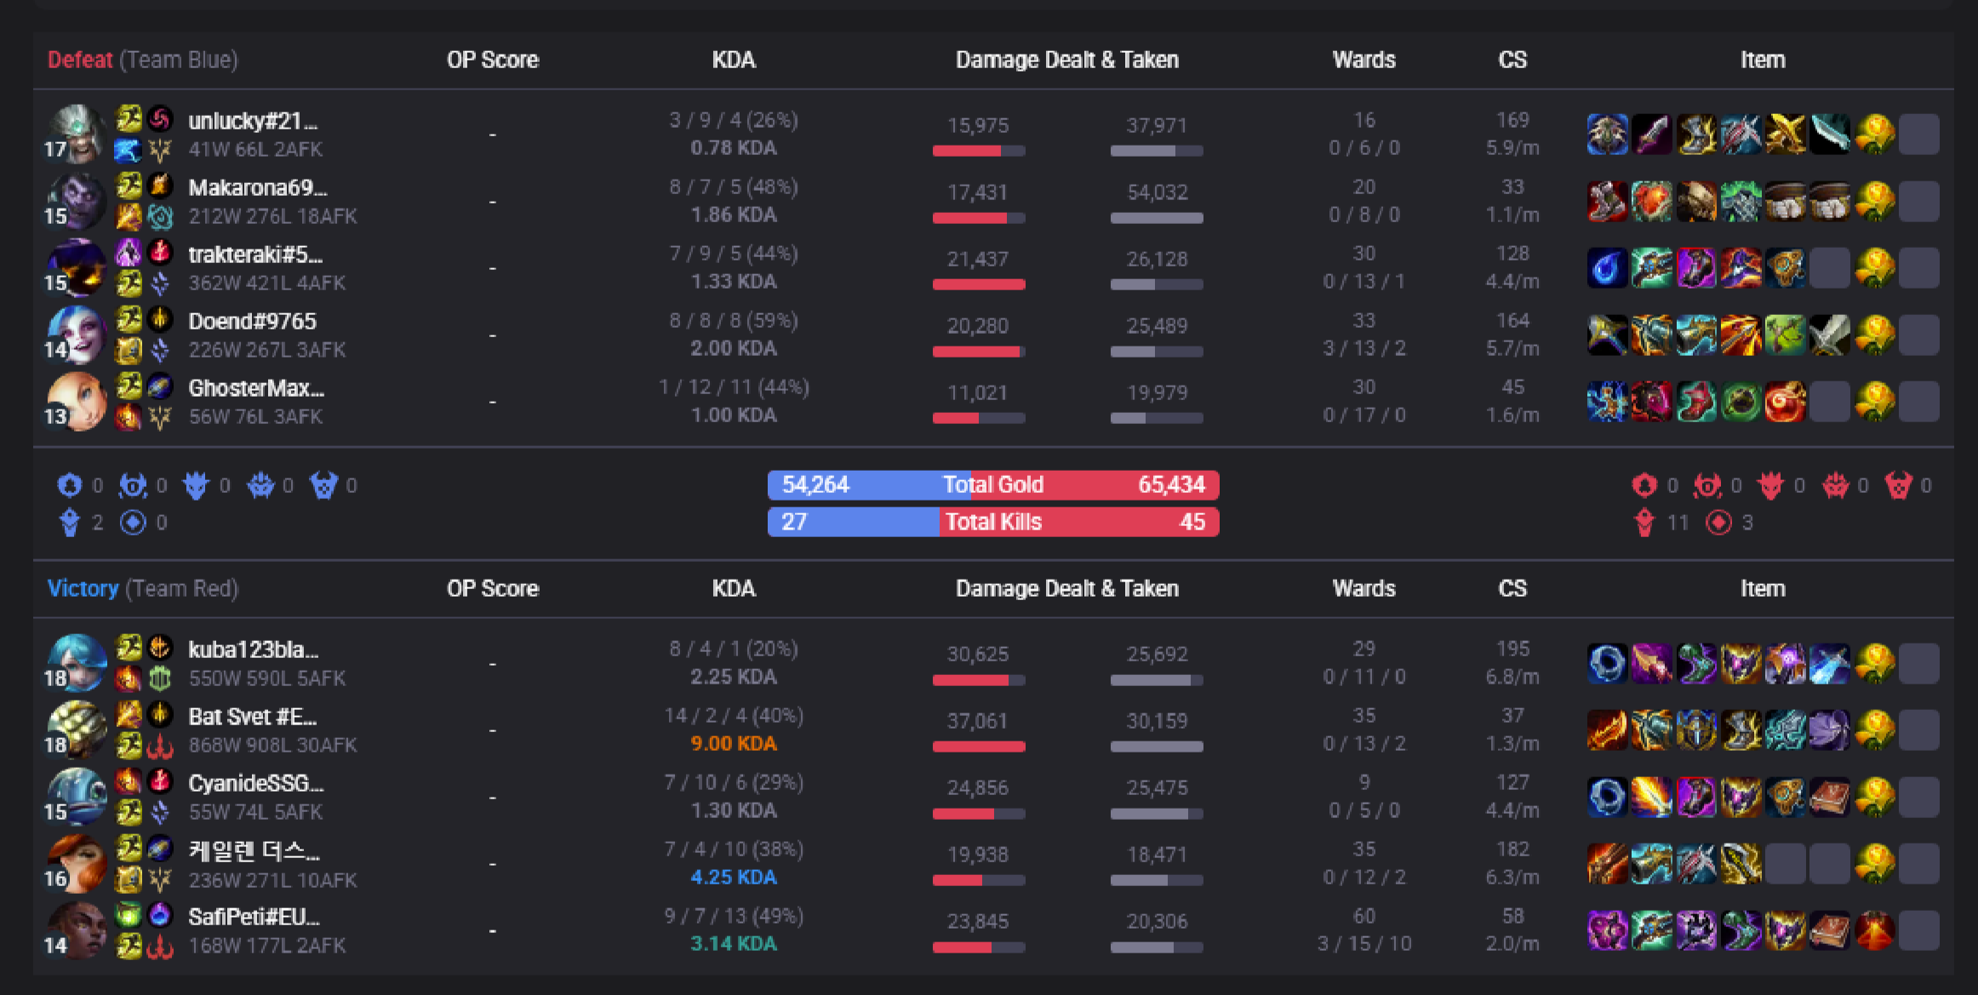
Mongoose.gg
Champ Select
Matches
Solo
Duo(pro)
Team(pro)
Goals(pro)
doendw
AI Suggestion
Consider not sucking so much and uninstall league and go play roblox
Goals
100 farm at 10 minutes
Stay below 7 deaths
Kill participation at 80%

Slide 3
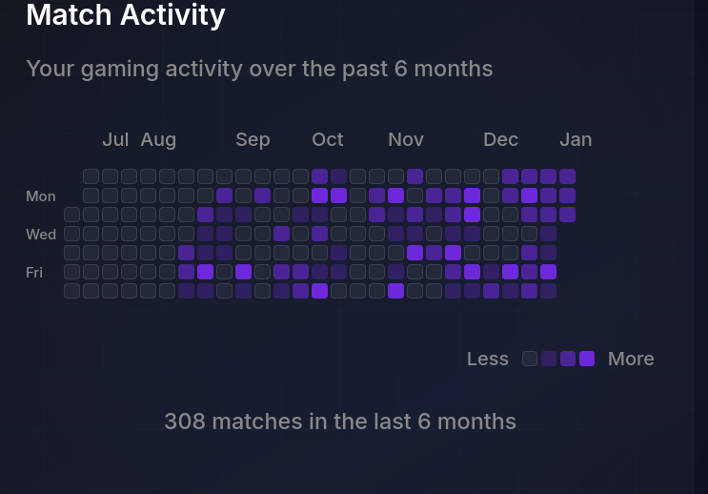
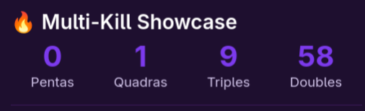

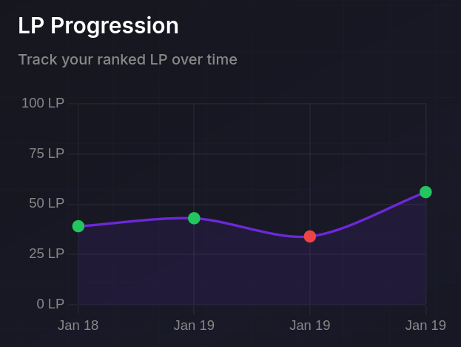
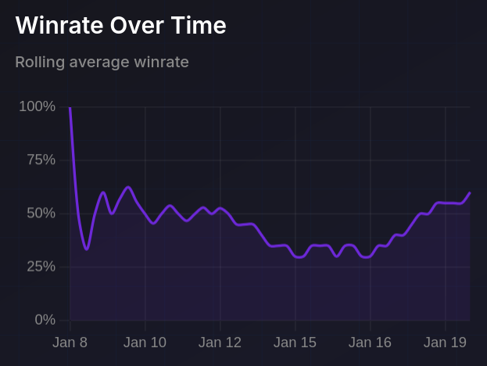
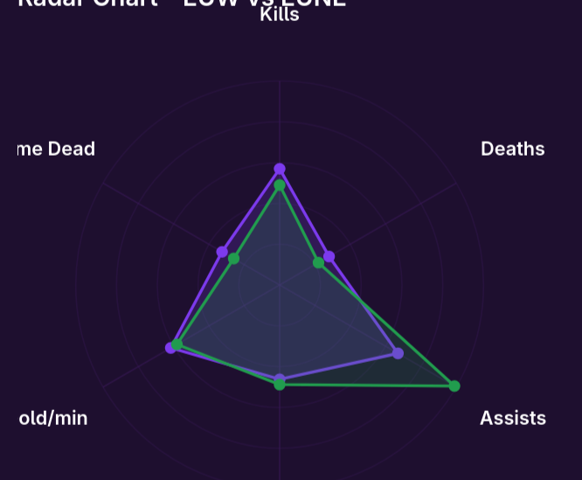
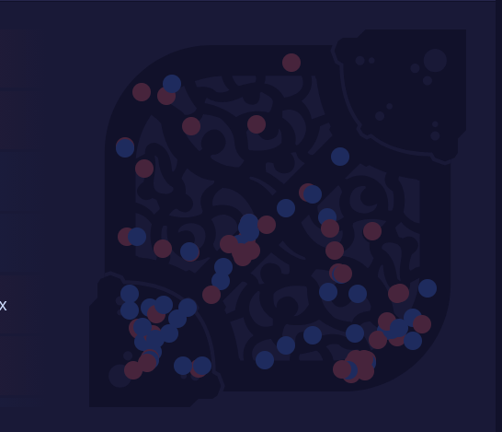
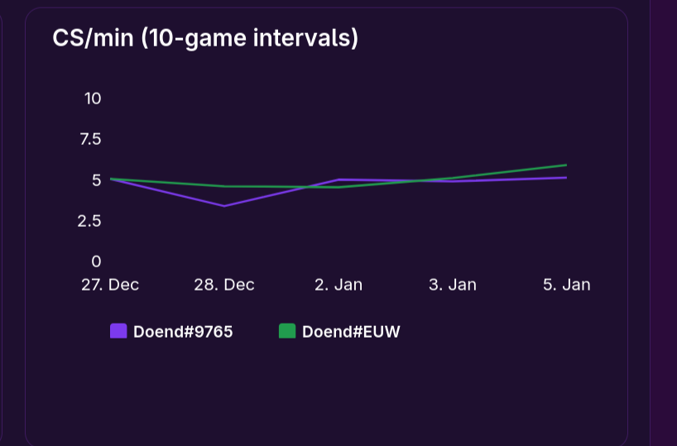
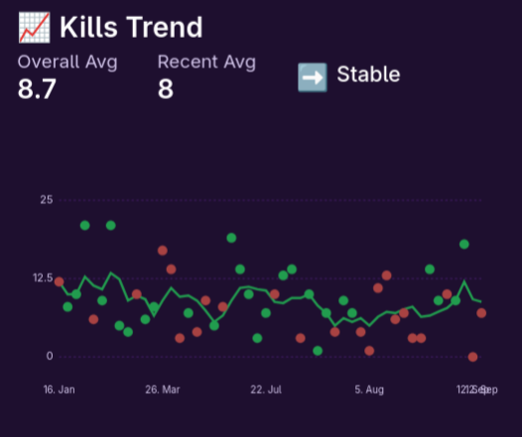
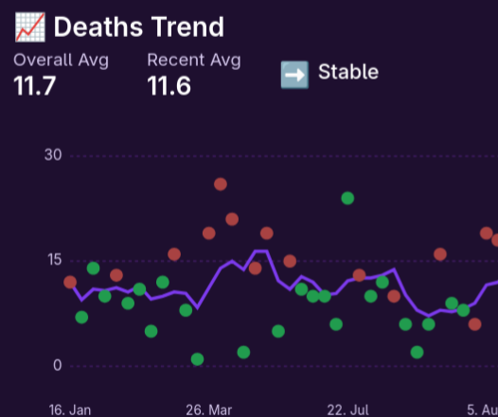
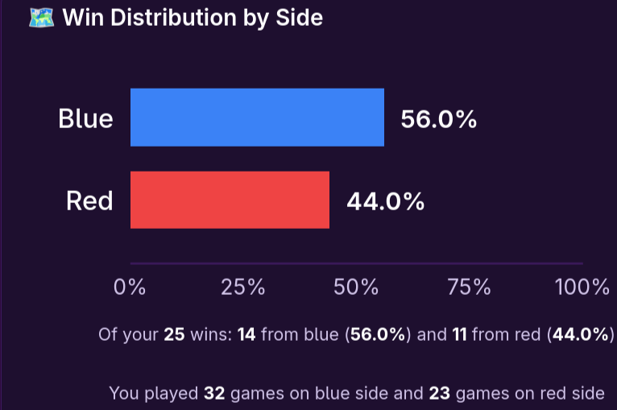
Mongoose.gg
Champ Select
Matches
Duo(pro)
Team(pro)
Goals(pro)
doendw
Solo
doendw
Goal progression
Ranked Solo/duo
Danger zones
Ranked Flex

Slide 4
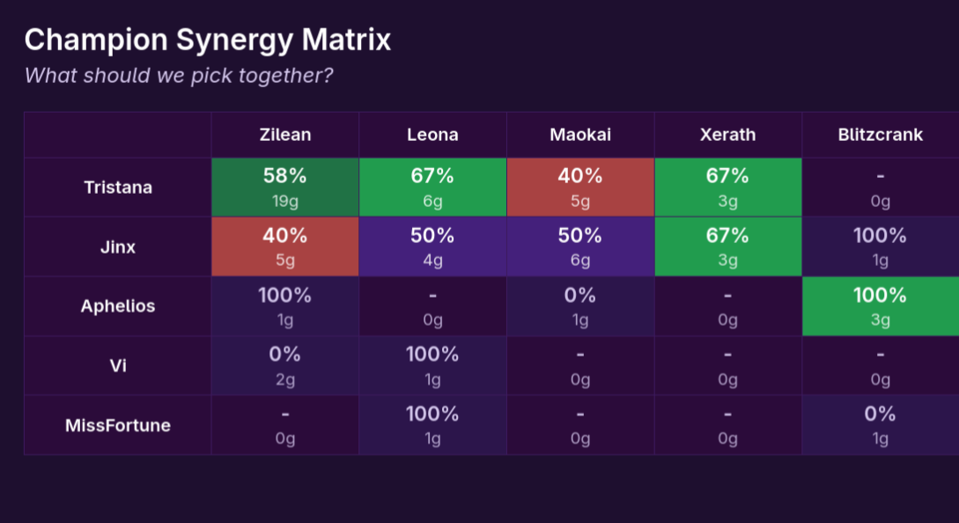
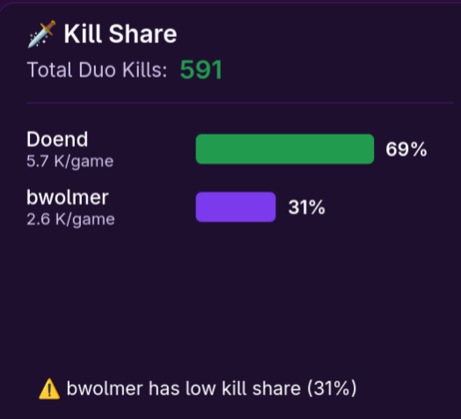
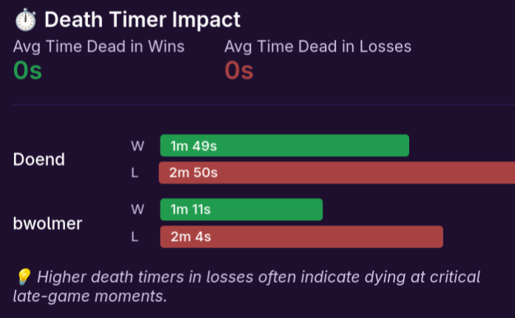
Mongoose.gg
Champ Select
Matches
Solo
Duo (pro)
Team(pro)
Goals(pro)
doendw
Goals
100 farm at 10 minutes
Stay below 7 deaths
Kill participation at 80%

Slide 5
Mongoose.gg
Champ Select
Matches
Solo
Duo(pro)
Team(pro)
Goals(pro)
doendw

Slide 6
Mongoose.gg
Champ Select
Matches
Solo
Duo(pro)
Team(pro)
Goals(pro)
doendw
Goal progression

Slide 7
Mongoose.gg
Champ Select
Matches
Solo
Duo(pro)
Team(pro)
Goals(pro)
User

Slide 8
Mongoose.gg
Champ Select
Matches
Solo
Duo(pro)
Team(pro)
Goals(pro)
User

Slide 9
Ranked Flex
Mongoose.gg
Goal progression
Champ Select
Matches
Solo
Duo(pro)
Danger zones
Team(pro)
Goals(pro)
Ranked Solo/duo
User

Slide 10
Mongoose.gg
Champ Select
Matches
Solo
Duo (pro)
Team(pro)
Goals(pro)

Slide 11
Mongoose.gg
Champ Select
Matches
Solo
Duo(pro)
Team(pro)
Goals(pro)

Slide 12
Mongoose.gg
Champ Select
Matches
Solo
Duo(pro)
Team(pro)
Goals(pro)

