Slide 1
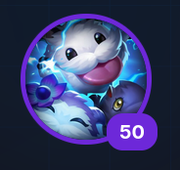

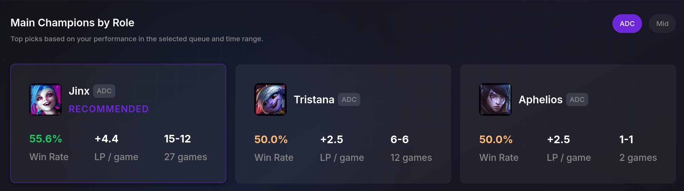
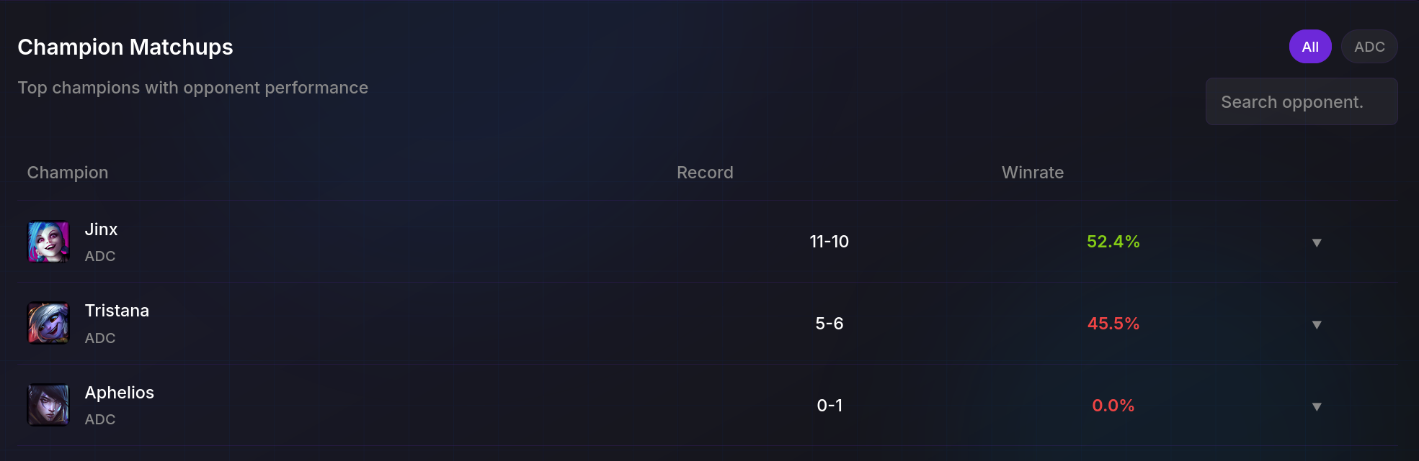
Mongoose.gg
doendw
Overall
Overall
Champion select
Matches

Slide 2
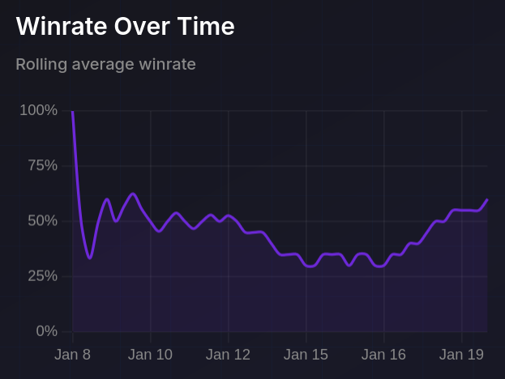

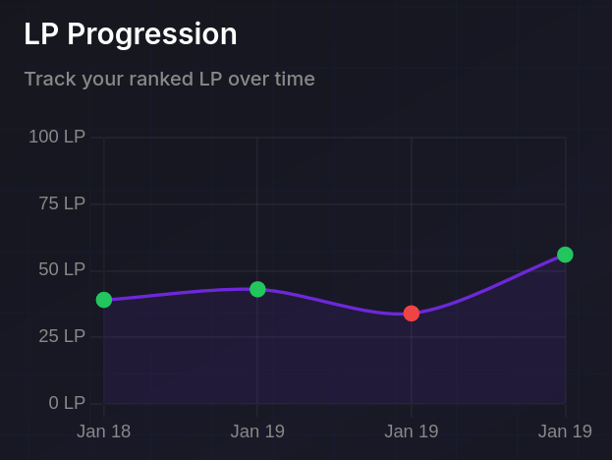
Mongoose.gg
Overall
Champ select
Runes
Matches
doendw
Ranked Solo/duo
Ranked Flex

Slide 3
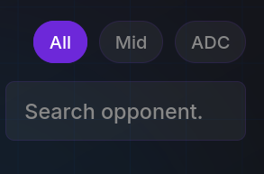
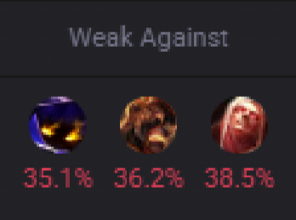
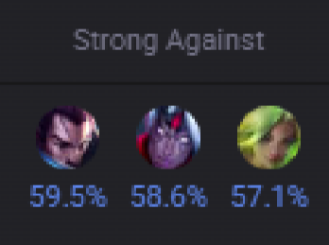
Mongoose.gg
Overall
Champ select
Runes
Matches
doendw

