Slide 1
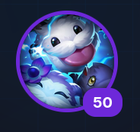

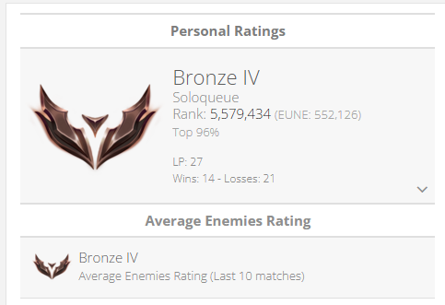
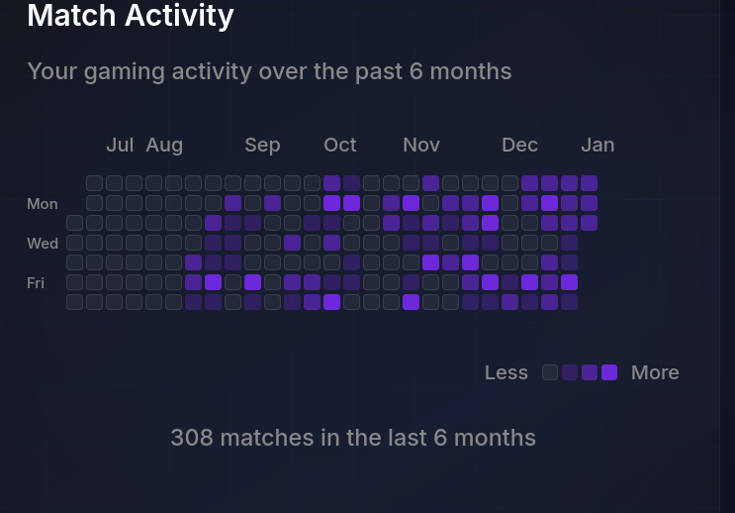
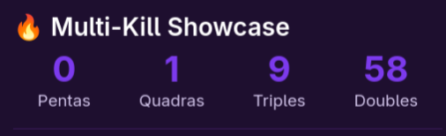
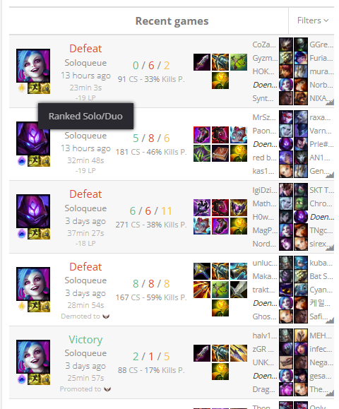
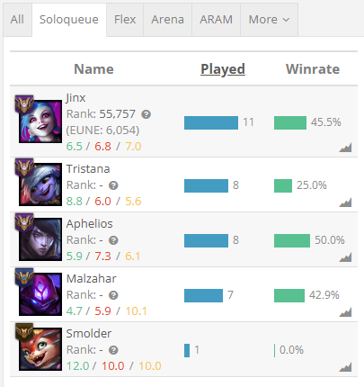
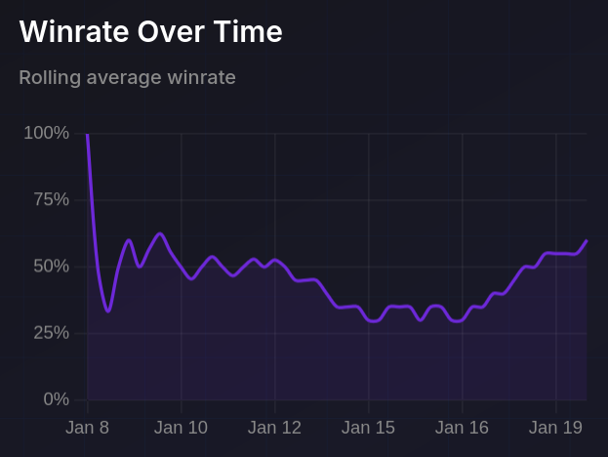
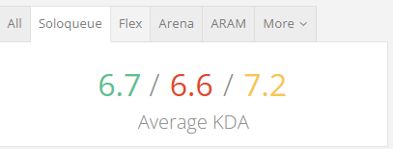
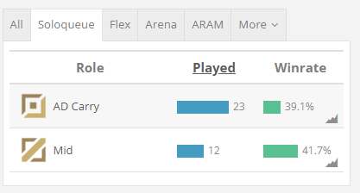
Mongoose.gg
Home
Live
Solo
Duo(pro)
Team(pro)
Goals(pro)
doendw
Goal progression

Slide 2
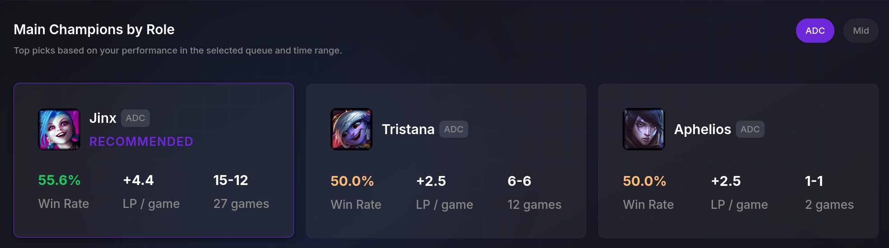
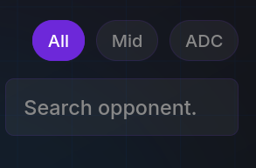
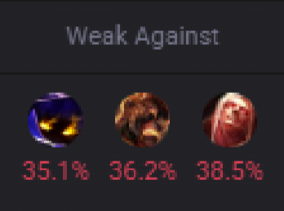
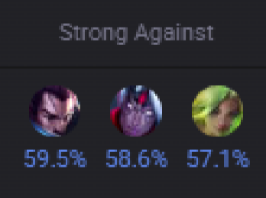
Mongoose.gg
Champ Select
Matches
Solo
Duo(pro)
Team(pro)
Goals(pro)
doendw
Ban based on data

Slide 3
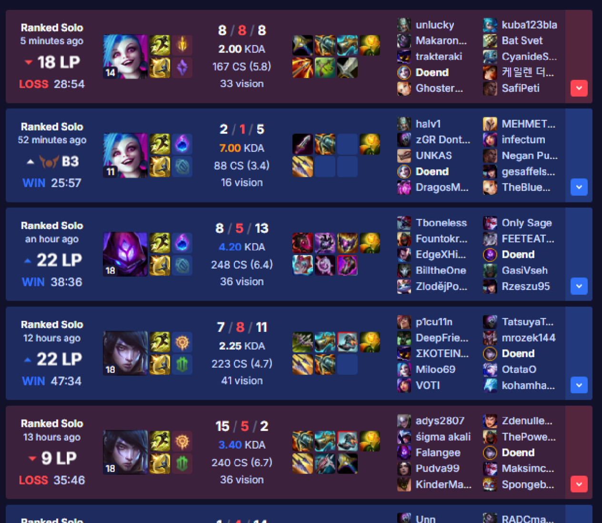
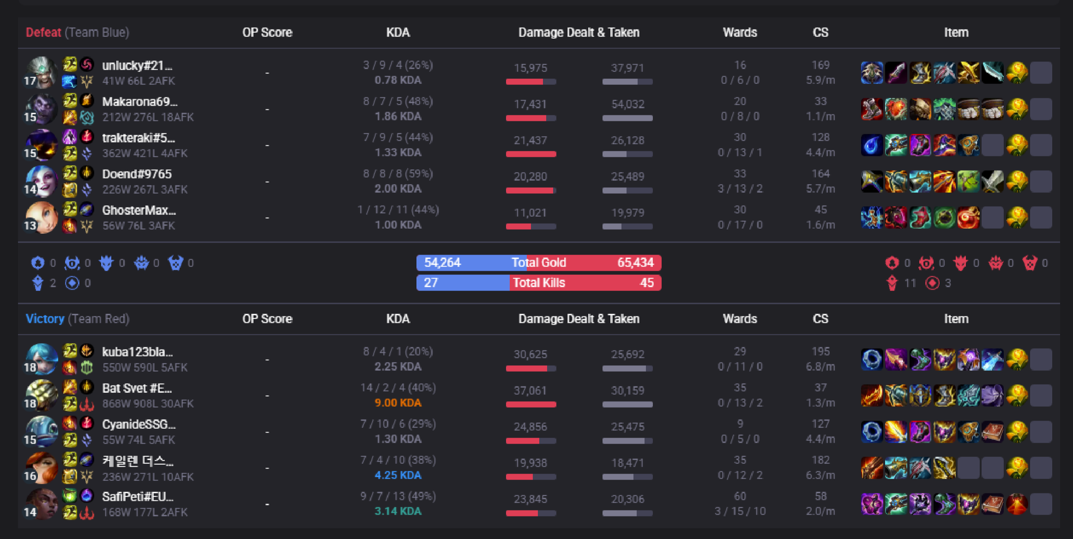
Mongoose.gg
Champ Select
Matches
Solo
Duo(pro)
Team(pro)
Goals(pro)
doendw
AI Suggestion
Consider not sucking so much and uninstall league and go play roblox
Goals
100 farm at 10 minutes
Stay below 7 deaths
Kill participation at 80%

Slide 4
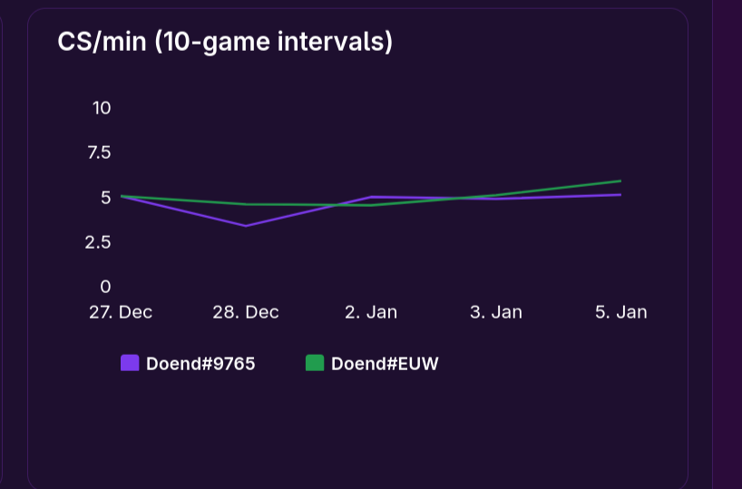

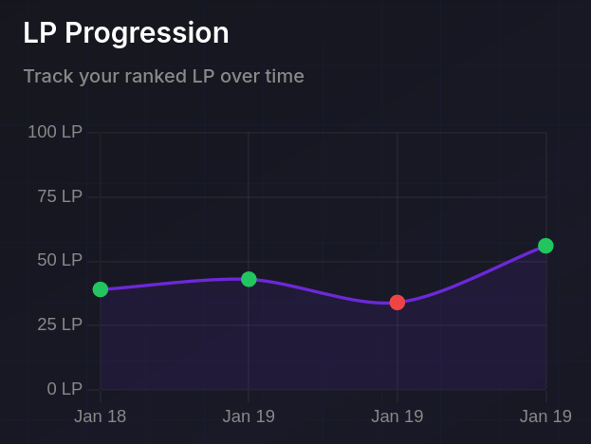
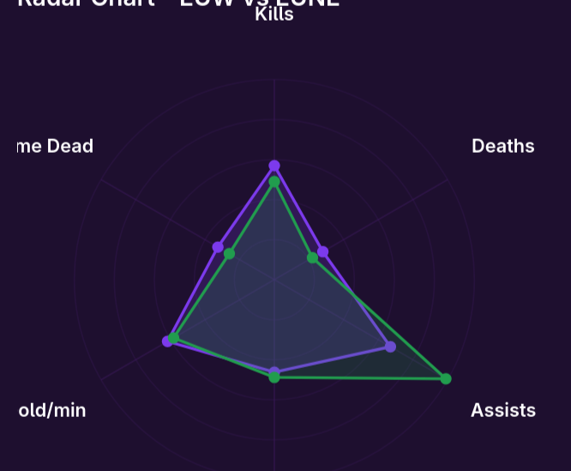
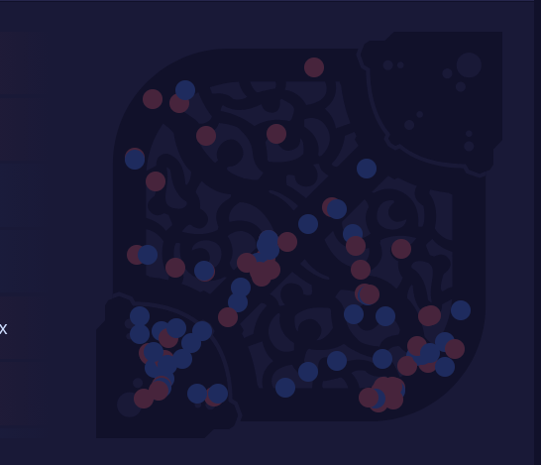
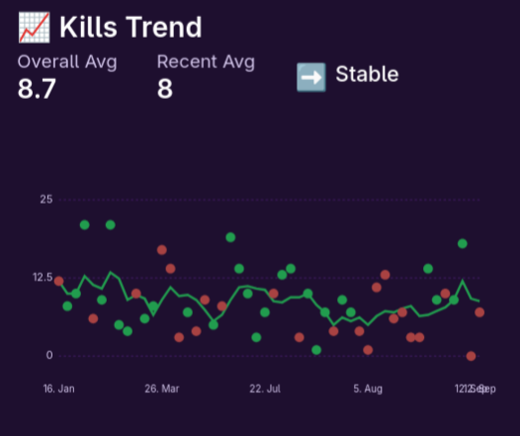
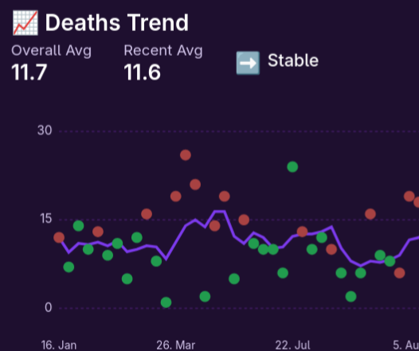
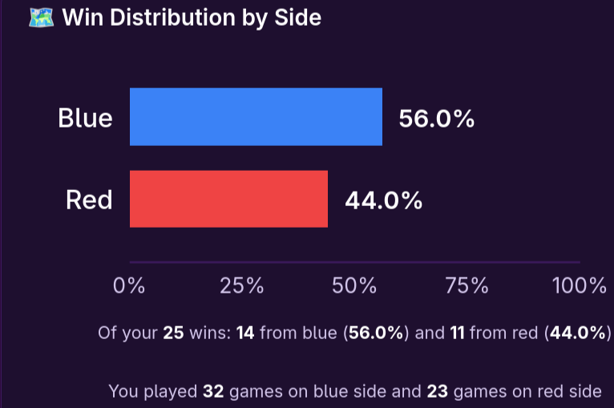
Mongoose.gg
Champ Select
Matches
Duo(pro)
Team(pro)
Goals(pro)
doendw
Solo
doendw
Ranked Solo/duo
Danger zones
Ranked Flex

Slide 5
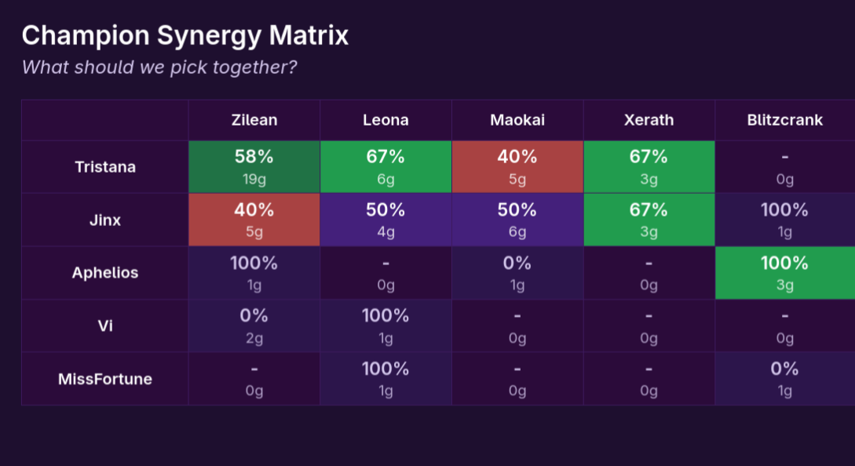
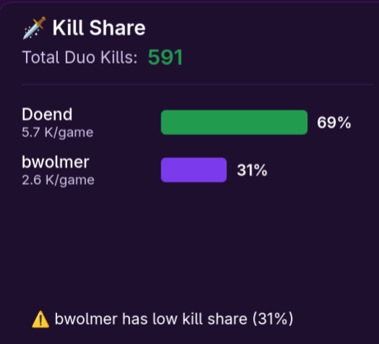
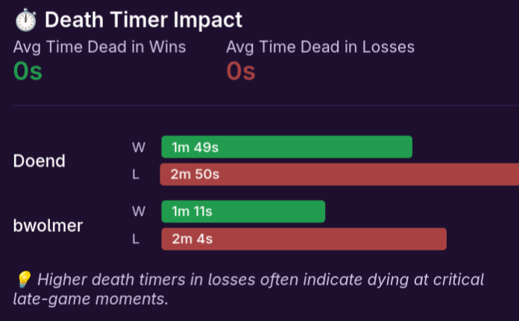
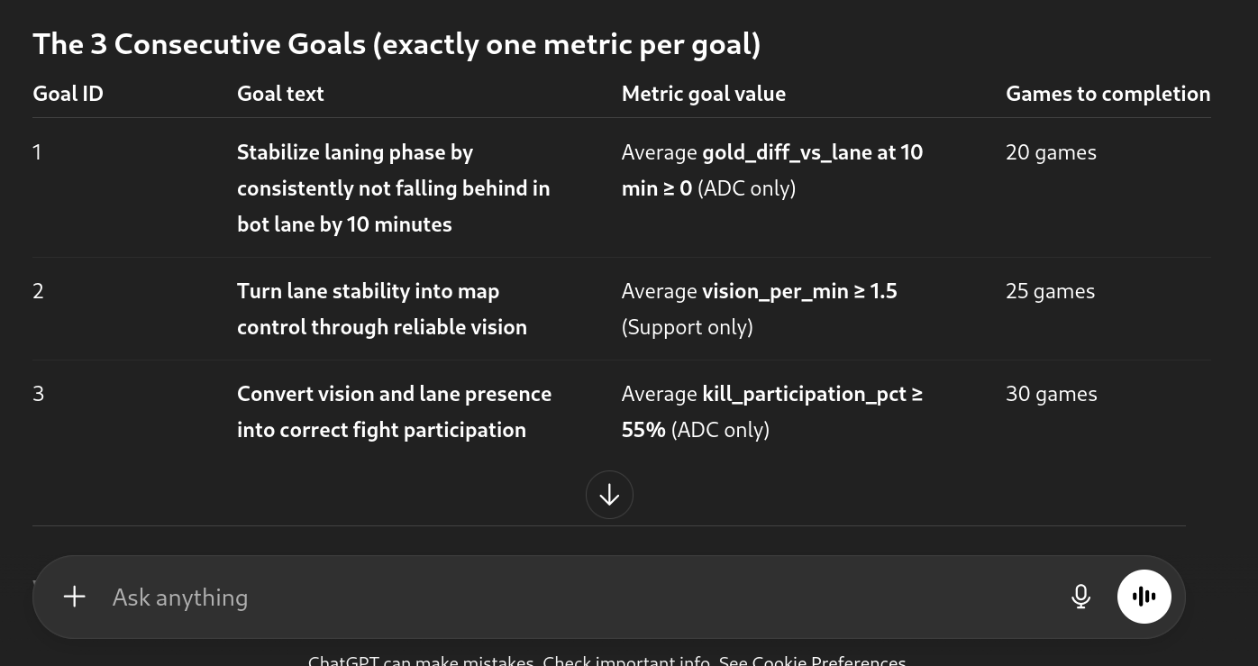
Mongoose.gg
Champ Select
Matches
Solo
Duo (pro)
Team(pro)
Goals(pro)
doendw
Goals Doend
Improve team fight placement
Raise vision & map awareness
Convert objective control into wins
Goals bwolmer
Reduce average death to 5
Raise vision & map awareness
Convert objective control into wins
Doend Goal progression
bwolmer Goal progression

Slide 6
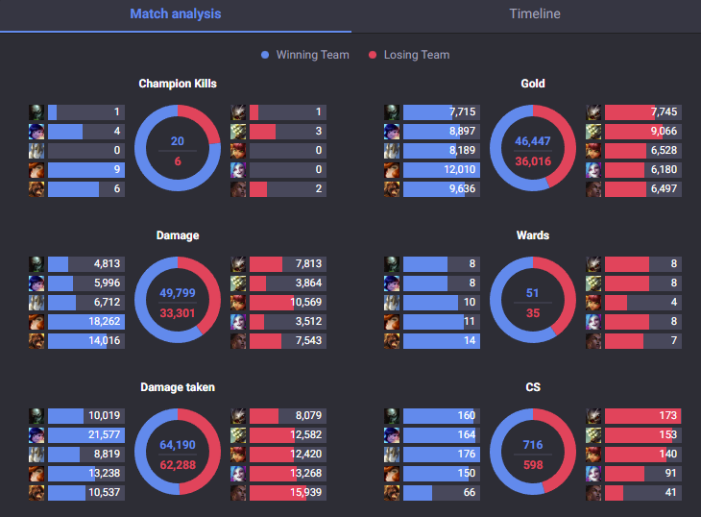
Mongoose.gg
Champ Select
Matches
Solo
Duo(pro)
Team(pro)
Goals(pro)
doendw

Slide 7
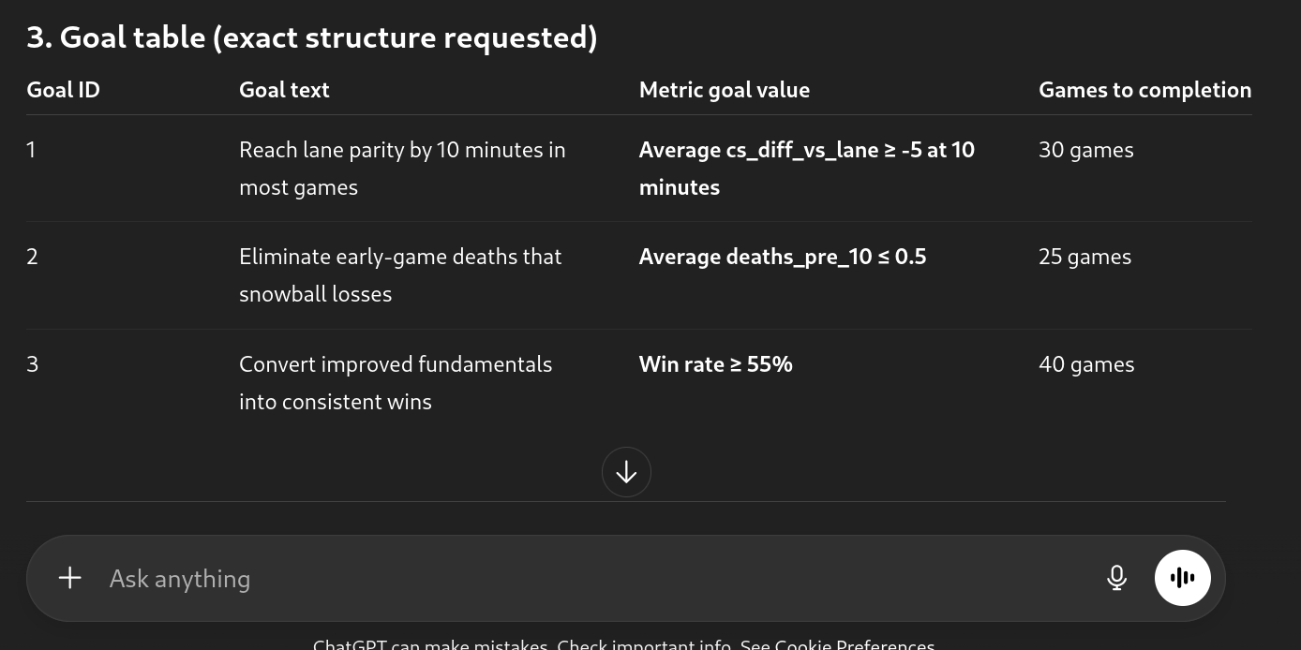
Mongoose.gg
Champ Select
Matches
Solo
Duo(pro)
Team(pro)
Goals(pro)
doendw
Solo Goal progression
Duo Goal progression
Team Goal progression
Create goal

Slide 8
Mongoose.gg
Champ Select
Matches
Solo
Duo(pro)
Team(pro)
Goals(pro)
User

Slide 9
Mongoose.gg
Champ Select
Matches
Solo
Duo(pro)
Team(pro)
Goals(pro)
User

Slide 10
Ranked Flex
Mongoose.gg
Goal progression
Champ Select
Matches
Solo
Duo(pro)
Danger zones
Team(pro)
Goals(pro)
Ranked Solo/duo
User

Slide 11
Mongoose.gg
Champ Select
Matches
Solo
Duo (pro)
Team(pro)
Goals(pro)

Slide 12
Mongoose.gg
Champ Select
Matches
Solo
Duo(pro)
Team(pro)
Goals(pro)

Slide 13
Mongoose.gg
Champ Select
Matches
Solo
Duo(pro)
Team(pro)
Goals(pro)

Slide 14
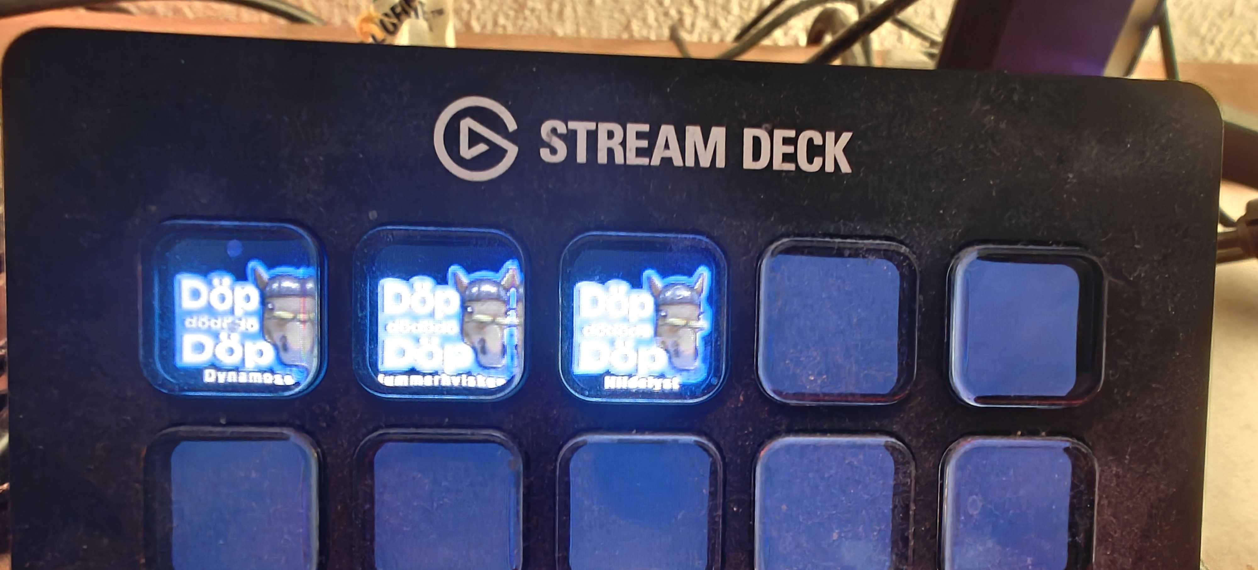
Outcome defined rune suggestion
Auto Accept, auto ban and auto pick(from selected champs or from data)
Suggestions for Windows client
Autologin, so setup account details and let it auto login to riot client

Slide 15
