Slide 1
MIPS I/O and Interrupt

Slide 2
SPIM I/O and MIPS Interrupts
The materials of this lecture can be found in A7-A8 (3rd Edition) and B7-B8 (4th Edition).

Slide 3
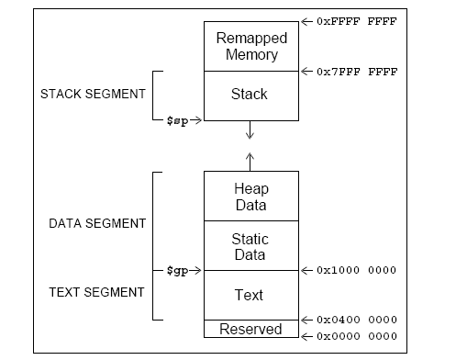
The MIPS memory
Actually, everything above 0x7fffffff is used by the system.

Slide 4
What is in there?
Special operating system functions
I/O registers mapped to memory addresses
Kernel data
…

Slide 5
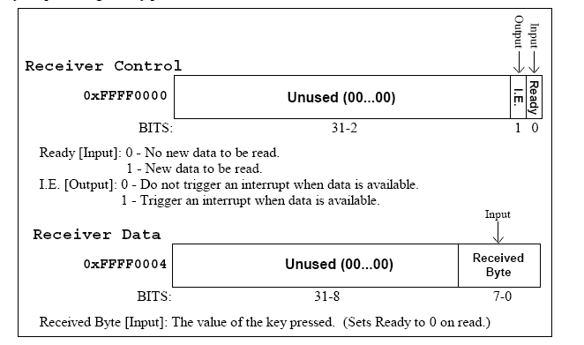
SPIM Input
SPIM allows you to read from the keyboard (which is similar to reading something from the true I/O register)

Slide 6
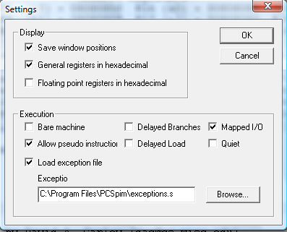
.text
.globl main
main:
addi $s0, $0, 113 # q key
lui $t0, 0xFFFF # $t0 = 0xFFFF0000;
waitloop:
lw $t1, 0($t0)
andi $t1, $t1, 0x0001
beq $t1, $zero, waitloop
lw $a0, 4($t0)
beq $a0, $s0, done
li $v0,1
syscall
li $v0,4
la $a0, new_line
syscall
j waitloop
done:
li $v0, 10 # exit
syscall
.data
new_line: .asciiz "\n”
Remember to select ``mapped I/O’’ in PCSpim settings.
To set it, select ``Simulator’’ then ``Settings…’’

Slide 7
SPIM output
Similar to the input, SPIM has two memory locations for output
  0xffff0008: Transmitter control.
    Bit 1: interrupt enable
    Bit 0: ready
  0xffff000c: Transmitter data.
    Bit 0-7: data byte

Slide 8
SPIM output
If you need to show something on the console, do the following:
  Check if ready bit is 1. If yes, proceed. Otherwise, wait.
  Write to the data. The ready bit will be reset to 0, and will be set to 1 after the byte is transmitted.

Slide 9
question
Is this the most efficient way to do it?
Remember that the processor usually has a lot of things to do simultaneously

Slide 10
Interrupt
The key problem is that the time when the input occurs cannot be predicted by your program
Wouldn’t it be nice if you could “focus on what you are doing” while be “interrupted” if some inputs come?

Slide 11
MIPS interrupt
For external interrupt, your code is executing, and if an event happens that must be processed,
  The address of the instruction that is about to be executed is saved into a special register called EPC
  PC is set to be 0x80000180, the starting address of the interrupt handler
  Then, after processing this interrupt, call “eret” to set the value of the PC to the value stored in EPC

Slide 12
MIPS Interrupt
Is it okay to use $t0 in the interrupt? Note the difference between an interrupt and a function call.
  For a function call, the caller is aware of the function call, so, it is not expecting the value of $t0 to be the same after the call.
  For an interrupt, the user program is running and got interrupted. The user may not know about the interruption at all, so if you changed $t0 inside an interrupt, the user program may take the wrong value of $t0 and keep on calculating, which will result in errors.
Interrupt handlers should be short, because the processor often have multiple types of interrupts. It could happen that while you are processing interrupt A and interrupt B is triggered. Usually, in an interrupt handler, you disable other interrupts. To make sure that interrupt B can be processed in time, the handler for A should not take too long.

Slide 13
MIPS interrupt
Coprocessor 0 is a part of the CPU to handle interrupts. In SPIM, Coprocessor 0 contains the
  BadVAddr (8), storing the memory address causing the exception
  Count (9), increment by 1 every 10ms by default
  Compare (11), if equals to Count, trigger an interrupt of level 5
  Status (12),
    Bit 8-15: interrupt mask. A bit being ``1’’ means that this interrupt is enabled.
    Bit 4: user mode. With SPIM, always 1.
    Bit 1: exception level (EXL). Normally ``0,’’ set to ``1’’ if an exception occurred. When ``1,’’ no further interrupt is enabled and EPC is not updated.
    Bit 0: interrupt enable. Enable (``1’’) or disable (``0’’) all interrupts.
  Cause (13)
    Bit 8-15: pending interrupts . A bit being ``1’’ means that this interrupt situation occurred, even if it is not enabled.
    Bit 2-6: Exception code. ``0’’ is hardware interrupt.
  EPC (14)
  Config (16), config the machine
These registers can be read and modified using the instructions mfc0 (move from coprocessor 0) and mtc0 (move to coprocessor 0).

Slide 14
MIPS Interrupt
$k0 and $k1 are both used as temporary variables in interrupt servicing routines.

Slide 15
Code we used (Copy and paste it to an editor)
.kdata # kernel data
s1: .word 10
s2: .word 11
new_line:
.asciiz "\n"
.text
.globl main
main:
mfc0 $a0, $12 # read from the status register
ori $a0, 0xff11 # enable all interrupts
mtc0 $a0, $12 # write back to the status register
lui $t0, 0xFFFF # $t0 = 0xFFFF0000;
ori $a0, $0, 2 # enable keyboard interrupt
sw $a0, 0($t0) # write back to 0xFFFF0000;
here:
j here # stay here forever
li $v0, 10 # exit,if it ever comes here
syscall
.ktext 0x80000180 # kernel code starts here
.set noat # tell the assembler not to use $at, not needed here actually, just to illustrae the use of the .set noat
move $k1, $at # save $at. User prorams are not supposed to touch $k0 and $k1
.set at # tell the assembler okay to use $at
sw $v0, s1 # We need to use these registers
sw $a0, s2 # not using the stack because the interrupt might be triggered by a memory reference
# using a bad value of the stack pointer
mfc0 $k0, $13 # Cause register
srl $a0, $k0, 2 # Extract ExcCode Field
andi $a0, $a0, 0x1f
bne $a0, $zero, kdone # Exception Code 0 is I/O. Only processing I/O here
lui $v0, 0xFFFF # $t0 = 0xFFFF0000;
lw $a0, 4($v0) # get the input key
li $v0,1 # print it here.
# Note: interrupt routine should return very fast, so doing something like
# print is NOT a good practice, actually!
syscall
li $v0,4 # print the new line
la $a0, new_line
syscall
kdone:
mtc0 $0, $13 # Clear Cause register
mfc0 $k0, $12 # Set Status register
andi $k0, 0xfffd # clear EXL bit
ori $k0, 0x11 # Interrupts enabled
mtc0 $k0, $12 # write back to status
lw $v0, s1 # Restore other registers
lw $a0, s2
.set noat # tell the assembler not to use $at
move $at, $k1 # Restore $at
.set at # tell the assembler okay to use $at
eret # return to EPC

