Slide 1

PRINCIPAL COMPONET ANALYSIS (PCA)
Subject: Machine Learning

Slide 2
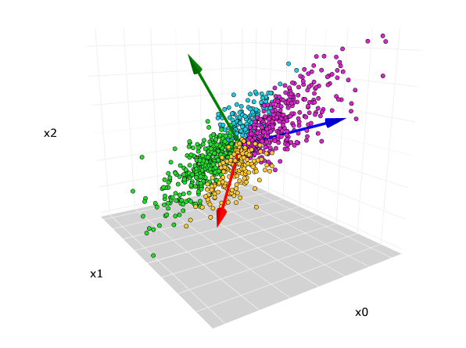
Definition
Is a statistic method that is used to reduce the dimensionality of a dataset. This technique help us to simplify a dataset and chose the smaller number of predictors to predict a variable, objective or understand in a better way a BDD
https://www.hiberus.com/crecemos-contigo/analisis-de-componentes-principales/

Slide 3

How apply PCA
Step 1: Standardization
The aim of this step is to standardize the range of the continuous initial variables so that each one of them contributes equally to the analysis.
For example, a variable that ranges between 0 and 100 will dominate over a variable that ranges between 0 and 1), which will lead to biased results. So, transforming the data to comparable scales can prevent this problem.

Slide 4
How apply PCA
Step 2: Covariance matrix computation
The first step is to calculate the covariance matrix, that show the relationship between the different characteristics and how they are different together.
Eigenvector represent the higher variability direction of the data and Eigenvalues indicates how much variability is associated with each eigenvector.
Sort the eigenvectors and eigenvalues.
Step 3: Select the principal components
Step 4: Data projection
https://builtin.com/data-science/step-step-explanation-principal-component-analysis

Slide 5
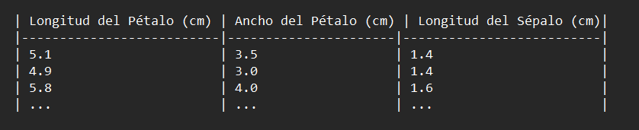
Example
Step 1
We have the following data set in centimeters
Step 2
We calculate the Mean and Standard deviation for each Feature and normalize the data using the following formula:
Step 3
If we want to retain 95% of the variability
Calculate the covariance matrix of the normalized data.
Calculate eigenvectors and eigenvalues.
Sort eigenvectors and eigenvalues.
Select principal components.
Project original data into the principal component space

Slide 6
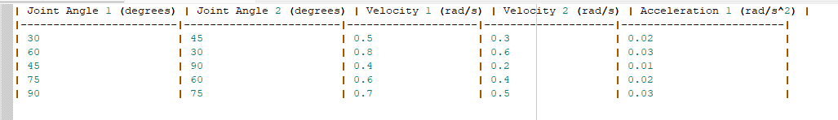
EXAMPLE
Let's consider an example where we have a dataset with five variables related to a robotic arm's movement. The variables of this dataset represent joint angles, velocities, and accelerations for different movements.
Step 1: Data Collection
Step 2: Data Preprocessing
The data is already organized in a matrix form where each row represents a different movement, and each column represents a different variable.

Slide 7

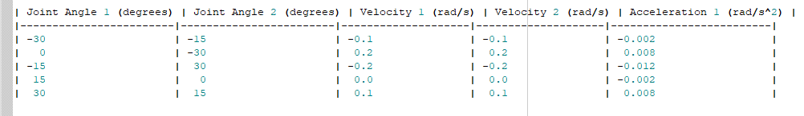
Step 3: Covariance Matrix Calculation
Calculate the covariance matrix of the standardized data. This matrix will be a 5x5 matrix. we first need to center the data by subtracting the mean of each variable from each observation.
Calculate the mean of each variable:
Center the data by subtracting the mean from each observation:

Slide 8
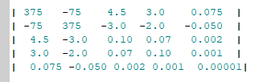
Calculate the covariance matrix:
Step 4: Eigenvalue and Eigenvector Calculation:
Compute the eigenvalues and eigenvectors of the covariance matrix.
C⋅v=λ⋅v
C is the covariance matrix.
v is the eigenvector.
λ is the eigenvalue.

Slide 9
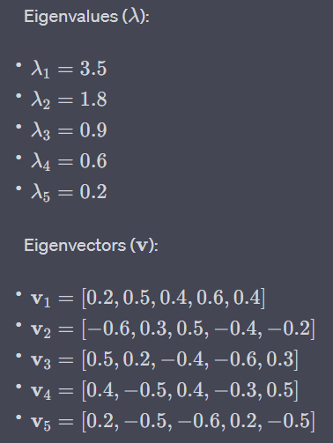
Step 5: Sort Eigenvalues:
Sort the eigenvalues in descending order. This indicates the importance of each principal component in explaining the variance in the data.
Step 6: Select Principal Components. Eigenvectors
Choose the top 'k' eigenvectors that correspond to the largest eigenvalues. 'k' is the number of principal components you want to retain.

Slide 10
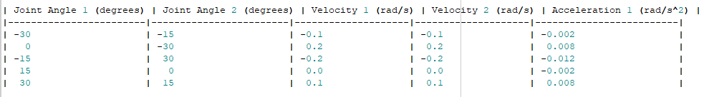
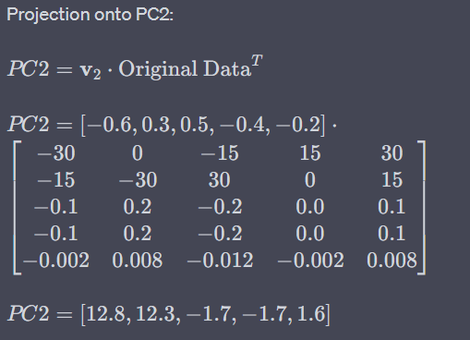
Step 7: Project Data
Transform the original data into the new coordinate system defined by the selected principal components. This is done by multiplying the data matrix by the matrix of selected eigenvectors. In this case we'll use the eigenvectors that correspond to the top 'k' eigenvalues.
The eigenvectors we obtained were:
1=v1​=[0.2,0.5,0.4,0.6,0.4]
2=v2​=[−0.6,0.3,0.5,−0.4,−0.2]
Calculate the projections onto the first two principal components.

