Slide 1
Employee Data Analysis using Excel
A.Monisha
312205916
Commerce
Vidhya Sagar women's college, Chengalpattu.
STUDENT NAME:
REGISTER NO:
DEPARTMENT:
COLLEGE:

Slide 2
PROJECT TITLE
Employee Performance Analysis using Excel

Slide 3


AGENDA
Problem Statement
Project Overview
End Users
Our Solution and Proposition
Dataset Description
Modelling Approach
Results and Discussion
Conclusion
3/21/2024 Annual Review

Slide 4

PROBLEM STATEMENT
A problem statement is a concise description of an issue to be addressed. It typically includes the following:Current Situation: Briefly describe the existing problem or challenge.Impact: Explain why this problem is significant and needs to be solved.Goal: State the desired outcome or what solving the problem would achieve.

Slide 5

PROJECT OVERVIEW
A project overview is a brief summary that provides a snapshot of the project’s key elements. It typically includes:
Objective: What is the primary goal or purpose of the project?
Scope: What are the boundaries of the project, including key deliverables and timelines?
Stakeholders: Who are the key people involved, such as team members, clients, or partners?
.

Slide 6

WHO ARE THE END USERS?
End users are the individuals or groups who will ultimately use the product, service, or system being developed. They are the target audience for whom the solution is designed.

Slide 7

OUR SOLUTION AND ITS VALUE PROPOSITION
"Our mobile app provides personalized content recommendations, helping users discover relevant content faster and more conveniently. It stands out by using advanced AI algorithms to tailor suggestions, leading to a more engaging and satisfying user experience. This results in higher user retention and satisfaction, giving our customers more value for their time spent on the app."

Slide 8
Dataset Description
A dataset description provides details about the data used in a project. Here’s what it typically includes:Source: Where the data comes from (e.g., internal company databases, public datasets, user-generated content).Size: The number of records, entries, or the overall volume of data (e.g., "100,000 rows," "1 GB").Structure: The format and organization of the data (e.g., tables, CSV files, JSON). Include the number of columns and types of data (e.g., text, numbers, dates).

Slide 9

THE "WOW" IN OUR SOLUTION
Innovative
Efficiency
Impact
User experience
Scalability
3/21/2024 Annual Review

Slide 10
MODELLING
Modeling is the process of creating a simplified representation or abstraction of a real-world system or phenomenon. It involves identifying key features and relationships to make predictions, test hypotheses, or understand complex systems. Models can be mathematical, statistical, physical, or conceptual, depending on the field.

Slide 11
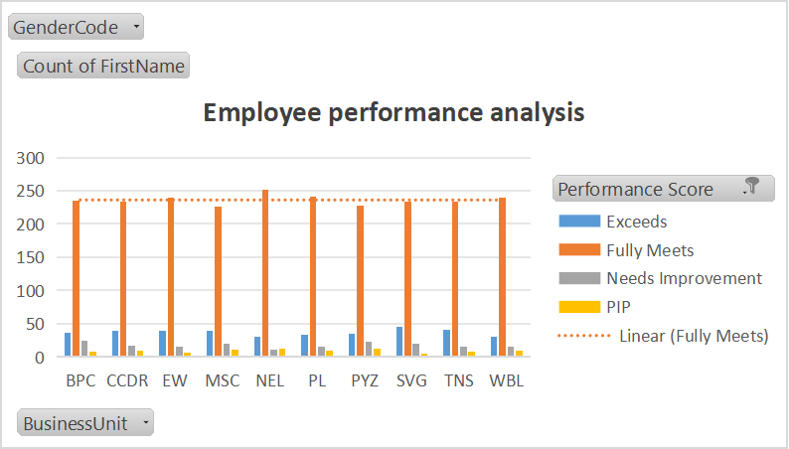
RESULTS

Slide 12
conclusion
analyzing employee performance using Excel provides a structured and efficient way to evaluate key metrics like attendance, task completion, and overall productivity. By leveraging functions, charts, pivot tables, and dashboards, Excel simplifies the process of identifying trends and making data-driven decisions. This analysis can help improve management strategies, boost employee performance, and contribute to overall organizational success.

