Slide 1
Deep Neural Networks
Multilayer Perceptron

Slide 2
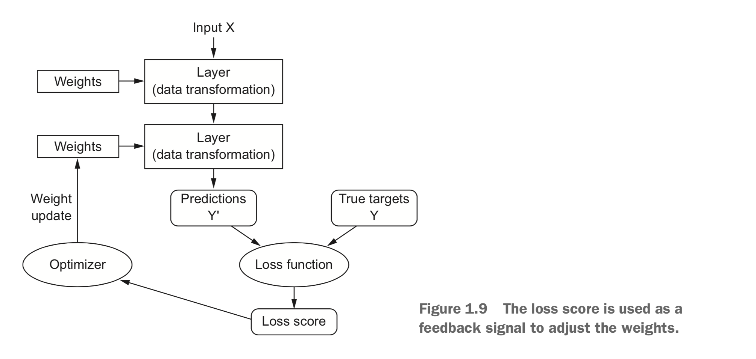
Recap

Slide 3
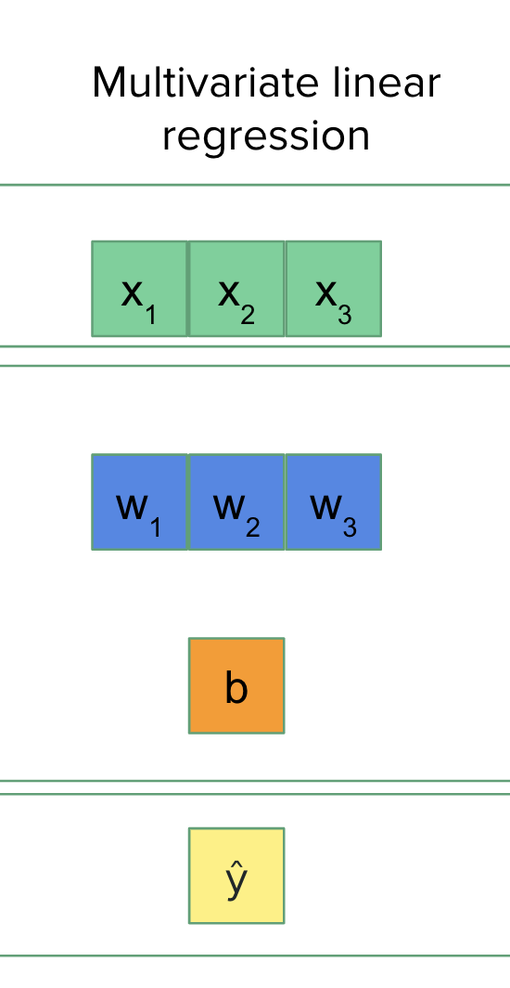
Multivariate (binary) classification
From regression to classification
x₁
“area”
w₁
b
x • w + b -> ŷ
Multiple input features,
single output
Useful for regression, but also for binary classification. Just define an activation function and threshold:
Two classes, A and B:
ŷ >= threshold; class A
ŷ < threshold; class B
Threshold serves as decision boundary
x₂
w₂
Σ
f()
ŷ
“year”
“Price”
x₃
w₃
“altitude”

Slide 4
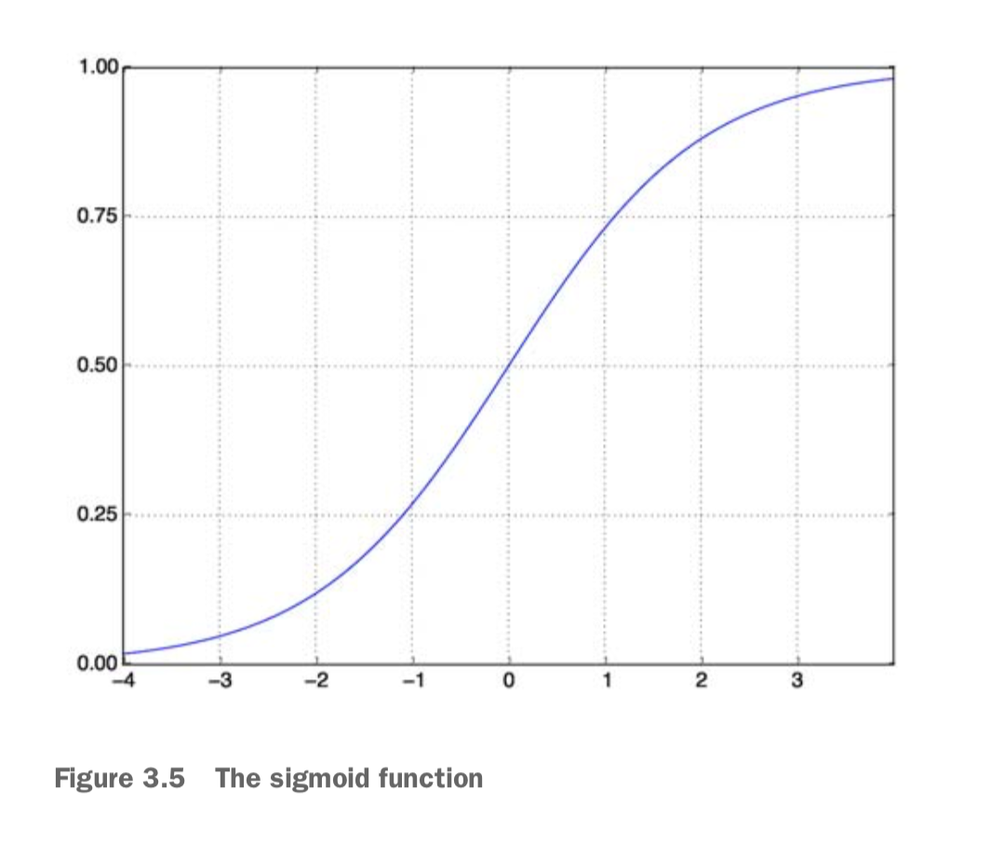
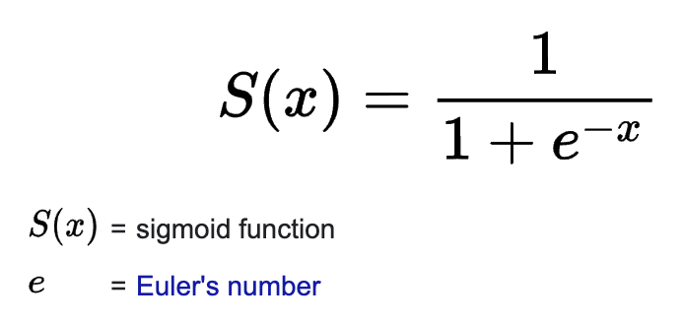
Threshold for decision boundary
Ŷ (in regression) is unbounded: [-inf, +inf]
Apply “squashing function” to output
Feed output through sigmoid, which maps [-inf, +inf] to [0, 1]
Also known as “non-linear” activation function
Threshold is typically 0.5

Slide 5
Multivariate multiclass logistic regression
Many scalars -> many scalars (that represent classes)
Suppose we want to classification instead of regression (“cheap” vs “expensive” >< actual price).
Simple: each class gets its own “perceptron”!
Now:
ŷ becomes a vector!
b becomes a vector!
W becomes a matrix!
x₀
w_{0, 0}
“area”
b₀
“Cheap”
w_{0, 1}
Σ
ŷ₀
x₁
w_{1, 0}
b₁
“year”
w_{1, 1}
Σ
ŷ₁
w_{2, 0}
x₂
“Expensive”
“altitude”
w_{2, 1}

Slide 6
Always: X * W + b (but the shapes shift)
Univariate linear
regression
Multivariate linear
regression
Multivariate multiclass logistic regression
input
x
x₀
x₁
x₂
x₀
x₁
x₂
w_{0, 0}
w_{0, 1}
w_{0, 2}
w
w₁
w₂
w₃
w_{1, 0}
w_{1, 1}
w_{1,2}
parameters
b
b
b₀
b₁
output
ŷ
ŷ
ŷ₀
ŷ₁

Slide 7
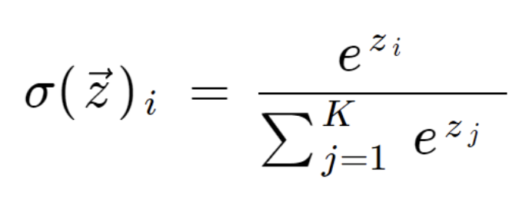
Issue 1: activation function for outputs
Ŷ is a vector now, with entry Ŷ_{i} for each of n classes
Even if with the sigmoid, it is hard to compare outputs for different classes
Solution: apply normalization through softmax activation function
Turns Ŷ into (pseudo-)probabilities that sum to 1
(Mathematically, the sigmoid is a special case of the softmax)
Math isn’t crucial: just remember, sigmoid is for one output; softmax for multiclass

Slide 8
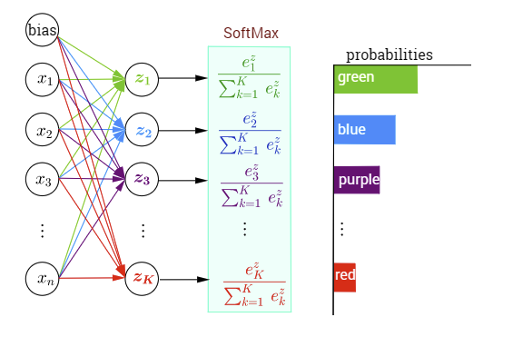
Softmax

Slide 9
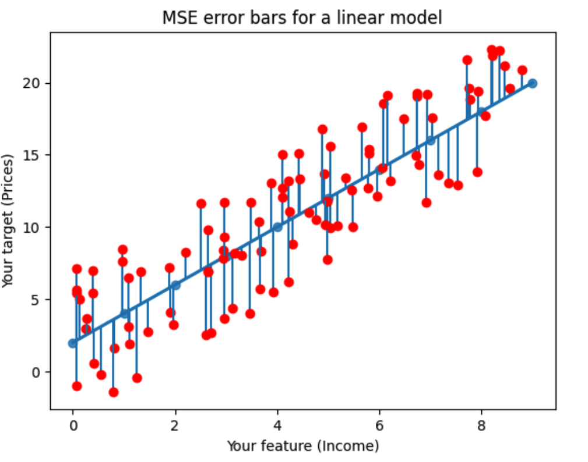
Issue 2: MSE
Loss function measures difference between two vectors: (predicted) Ŷ and (true) Y
MSE measures the average of the squared differences between Ŷ and Y
MSE might still work but suboptimal for non-regression problems

Slide 10
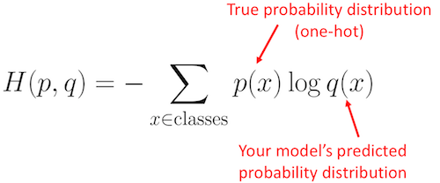
Solution: cross-entropy
Use categorical cross-entropy for classification!
Well-known measure from information theory
Has a binary variant
Remember, MSE is for regression, Cross-Entropy for classification
p(ground-truth class) = 1 and p(non ground-truth class) = 0

Slide 11
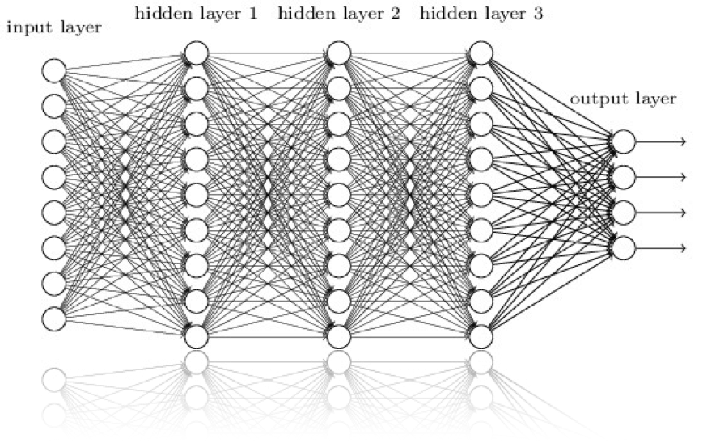
Remember this beast?
You can now code this
Plain stack of dense layers
‘hidden’, ‘intermediary’, ...
Layers feed into one another
(Famous “chain rule” is applicable in derivation)
Why?
Learn combinations of features
Recombine lower-level features into higher level features

Slide 12
Terminology for classical MLP
Input layer:
consists of neurons that correspond directly to the features of the input data
passes the raw data to the next layer without performing any computations (no weights)
Hidden layers:
process the input data received from the previous layer by performing transformations (based on weights, biases, and activation functions)
Output layer:
consists of neurons that correspond directly to the number of outputs (generates the final result)
is similar to hidden layers; the key difference lies in the activation function used, which is chosen based on the task: sigmoid or softmax for classification and linear (“nothing”) for regression

Slide 13
Terminology in PyTorch
Linear layer:
it processes input features to output features in a linear manner using weights and biases (the same as a hidden layer from the previous slide)
Adding an activation function is optional but essential if non-linear transformations are needed to capture complex patterns.
No input layers:
the input layer is not a true computational layer since it lacks weights or biases and serves only as a placeholder to pass data into the first hidden (or linear) layer.
we can omit the terminology of an "input layer" when discussing linear layers
Output layer:
the last linear layer followed by a suitable activation function

Slide 14
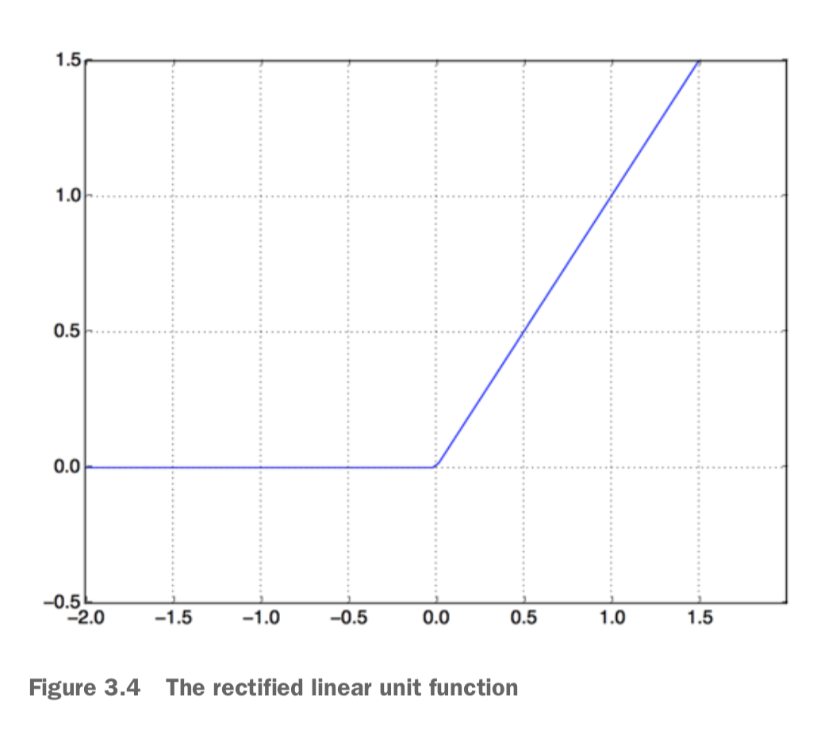
Non-linearity
Output of intermediary layers also need activation function
Until recently, sigmoid (or similar) was used
New, much simpler non-linearity was discovered (Nair & Hinton 2010)
Non-rectified linear unit = ReLU
Typically used for activations for hidden layers

Slide 15
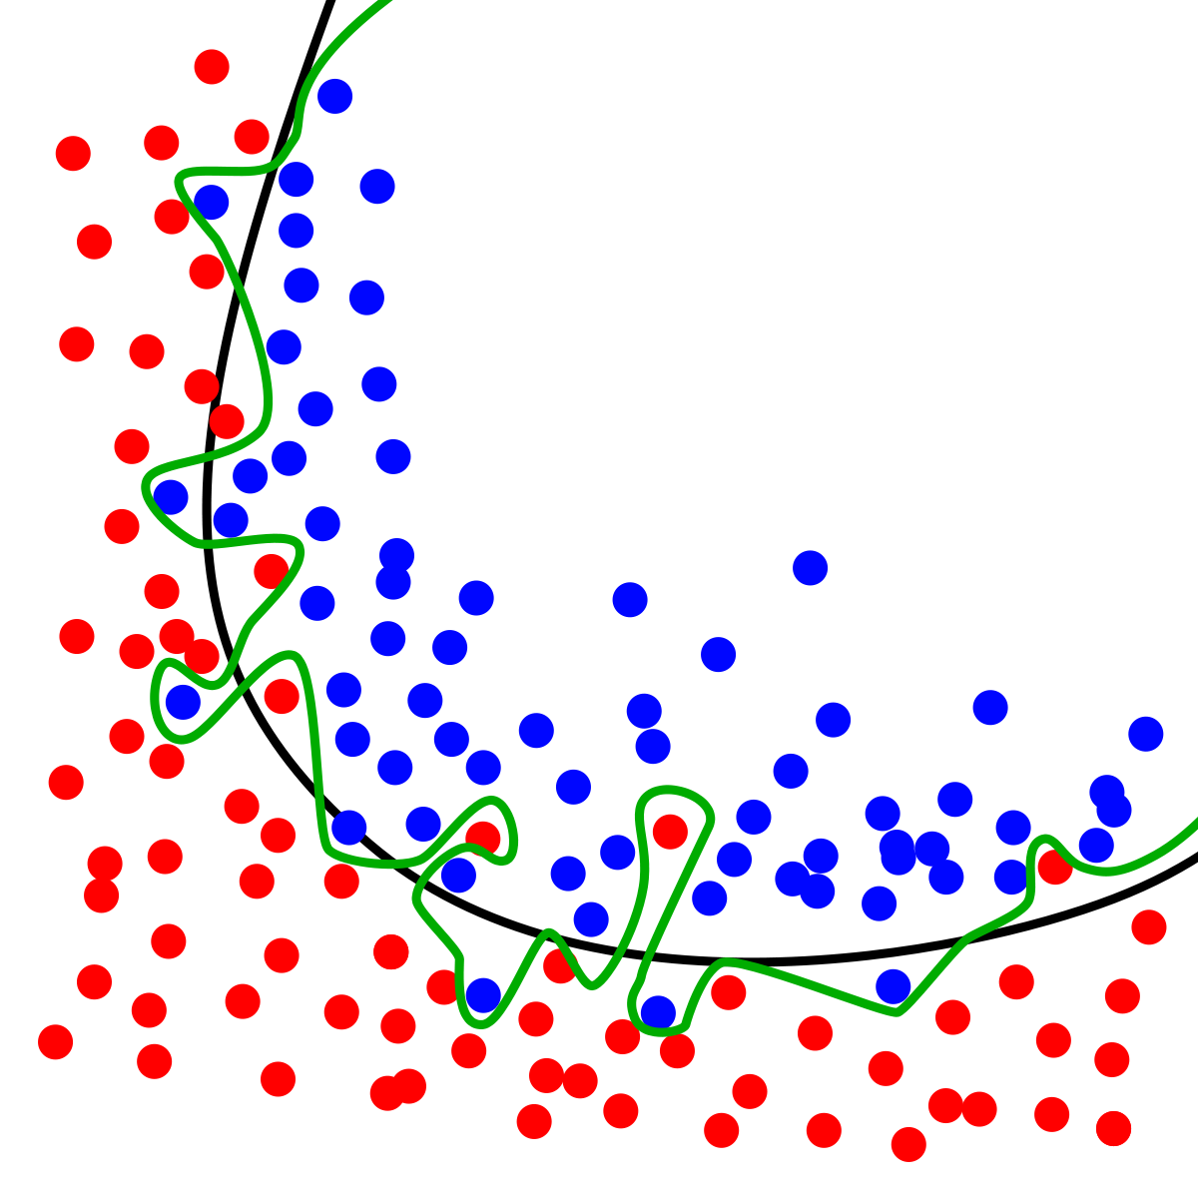
Issue of overfitting
Model is fitting the training data really well…
So well, that is doesn’t generalize anymore to other data
Need for regularization strategies that keep the optimization in check
We’ll cover two (among many):
early stopping
Dropout (next week)

Slide 16
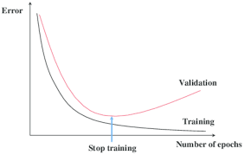
Early stopping
Conceptually simple
Continually monitor performance (loss, not accuracy etc.) on dev (or val) set
Stop training if there’s no progress anymore (for a while) on dev set
(Never mind whether train loss is still decreasing!)
Stop training at a suitable point (“sweet spot”)
Importance of a large and high-quality dev set (this isn’t “wasted” data)
Loss curves are important diagnostic instrument

Slide 17
1- Highlights of the notebook
IMDB movie dataset (ships with keras)
2 x 25,000 “polarized” reviews
Comes with train and test split
Balanced for positive and negative labels
Sentiment analysis: positive or negative (binary classification task)
First deep models: stacks of dense layers
Sigmoid activation function (to squash the output)
Use of post hoc evaluation metrics (as opposed to MSE loss)
Rationale behind batching (because the dataset is large)

Slide 18
2-Highlight of the notebook
New multiclass text classification dataset:
Reuters newswire dataset (ships with keras)
11,228 newswire in 46 topics (allows default test split)
Controversial: topics aren’t known [https://github.com/keras-team/keras/issues/12072]
But some people matched them
The softmax activation function (to convert ŷ into pseudo-probabilities)
Categorical cross-entropy as a loss function for classification
New non-linearity: ReLU (rectified linear unit)
Monitor loss (on the dev test) and prevent overfitting
Plot loss curves, using keras “History” object
Apply early stopping

