Slide 1
Deeper models:
tips and tricks
Preventing overfitting II

Slide 2
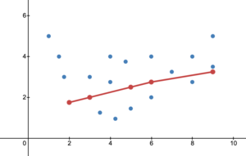
Underfitting
Typically happens when your model does not have enough capacity to model the training data; possible reasons:
The model is too simple (like linear) -> add more layers, more neurons (bigger capacity)
Training loss did not reach saturation -> train more
Rare in modern neural networks: overfitting is bigger issue

Slide 3
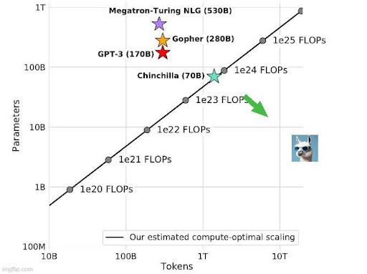
Increasing model capacity
Will almost always lead to better training performance
But comes with two drawbacks:
Larger networks are slower and more difficult to train:
need for faster optimizers (cf. SGD): Adam has adaptive learning rate
however, SGD might lead to better results, but it is slower to converge
Almost inevitably lead to overfitting at some point

Slide 4
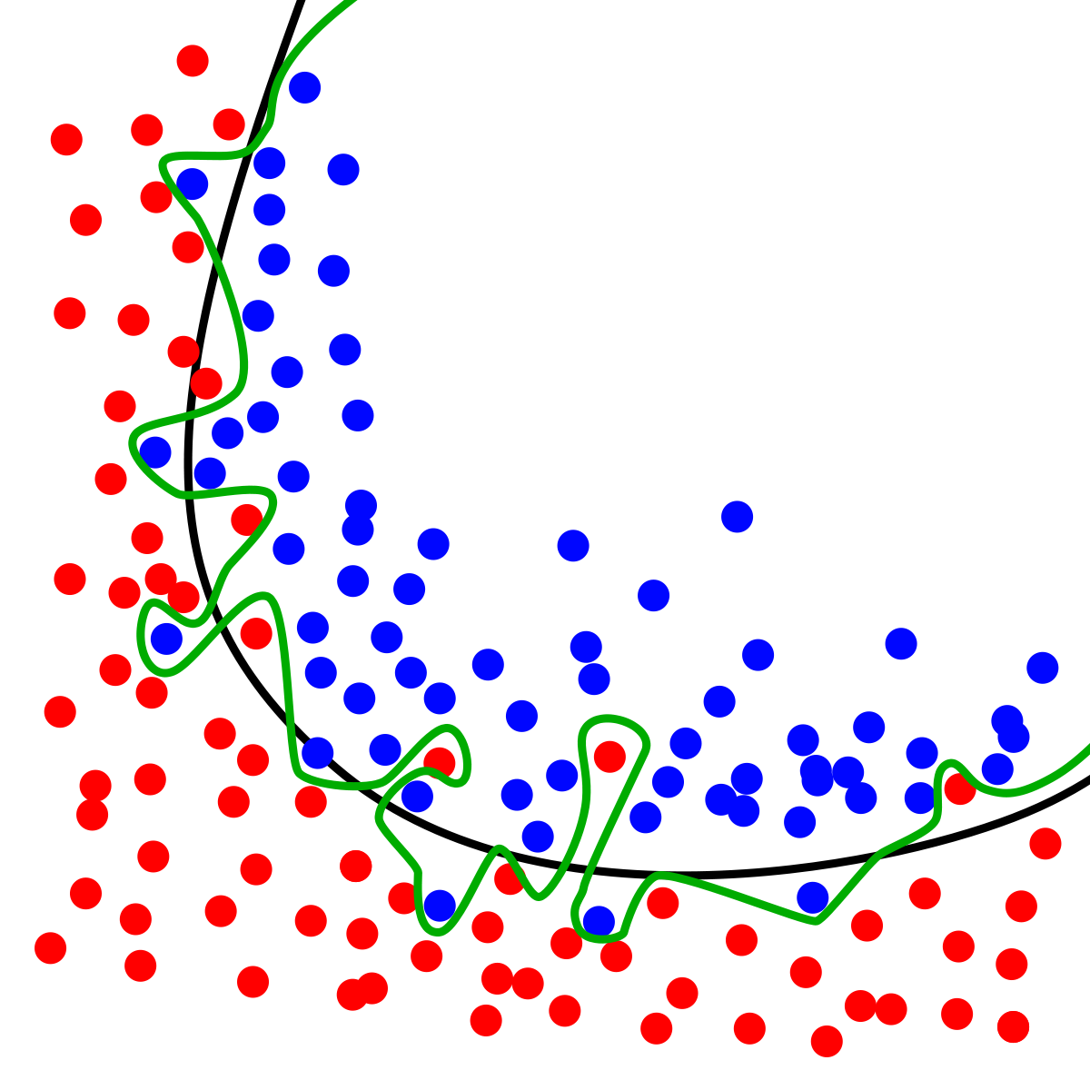
Issue of overfitting
Model is fitting the training data really well… (cf. memorization)
So well, that it doesn’t generalize anymore to other data
Need for regularization strategies that keep the optimization in check
We’ll cover:
early stopping (covered)
Reduction number of weights
Dropout
Weights regularization
Data augmentation
Transfer learning

Slide 5
Dropout: rationale
Overfitting is closely related to memorization
The model is verbatimly storing the exact, individual instances in memory
And thus isn’t generalizing anymore or abstracting over the instances
(Difficult to combat, because this is effective to drive down the loss!)
Often a problem with large models for small datasets: the larger the model, the more memorization capacity
Making a model just smaller (e.g. less layers, less dimensions, etc.) can be useful! Limiting memorization capacity can be difficult
Alternative = dropout: hides some information from the model, which makes it harder and memorize the instances

Slide 6
Dropout: practice
During training, randomly mask or hide some of the neurons on a hidden layer by setting them to zero (do not mask output layer)
Pretty extreme values: at least 50% of neurons or more are “dropped out”
Next layer only gets to see part of the input (and has to learn how to deal with that)
Forces the network to distribute information over different neurons, because you never know which neurons are going to get dropped
Regularization: no extreme reliance on particular features (since they could well be dropped)
During testing, no dropout is applied and full representations are used again.
Effect: training is slower, but overfitting is also reduced (because it takes much longer before memorization can kick in)

Slide 7
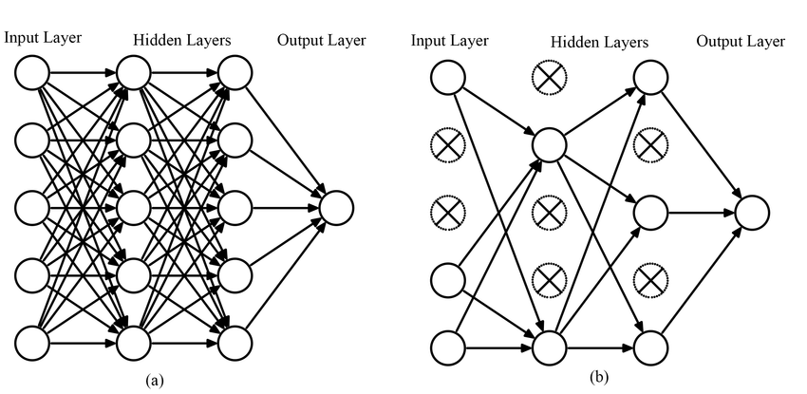
Visualization

Slide 8
Weights regularization
Disencourage the model from working with large, “extreme” weight values (which might lead to overfitting)
Rationale: weights regularization: add the sum of the actual of (square/absolute) weights to the loss
Straightforward penalization of large weights: find optimal solutions with smallest weights (small values makes the distribution of weight more regular/better)
L2 : ∑ (w_{i})²
L1 : ∑ |w_{i}|

Slide 9
Adam optimizer
Finds individual learning rates for each individual parameter
Faster to train a network (compared to SGD): important when we a train a deep network! However, Adam sometimes finds worse solutions than SGD
Has become “standard” optimizer across deep learning
Drop-in replacement in PyTorch (lr of 0.001 is good default)

Slide 10
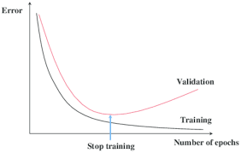
Rules of thumb
Don’t care about final training performance: it’s the dev performance that matters in the end (so create a good dev set)
Make sure that your training loss (initially) goes down (diagnostic instrument for checking whether code is working)
Validation and training curves will eventually part ways: this is inevitable, but you’ll want to postpone that moment as much as possible

Slide 11
Highlights of the notebook
Increase (and decrease) model capacity (e.g. larger and deeper layers)
Apply Adam for faster fitting
Apply Dropout and weights regularization for slowing down training and preventing overfitting

