Slide 1
Convolutional neural network (CNN)

Slide 2
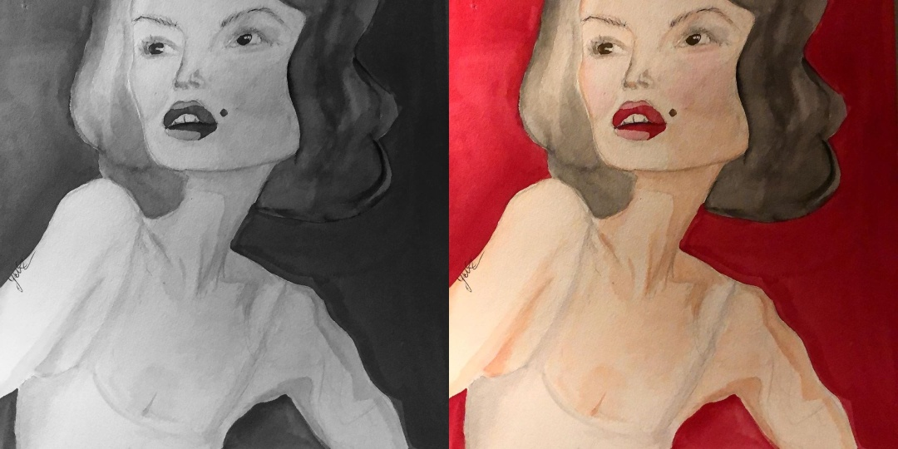
Images
Grayscale: one channel with values of 0–255
RGB (Red, Green, Blue): three color channels with values of 0–255

Slide 3
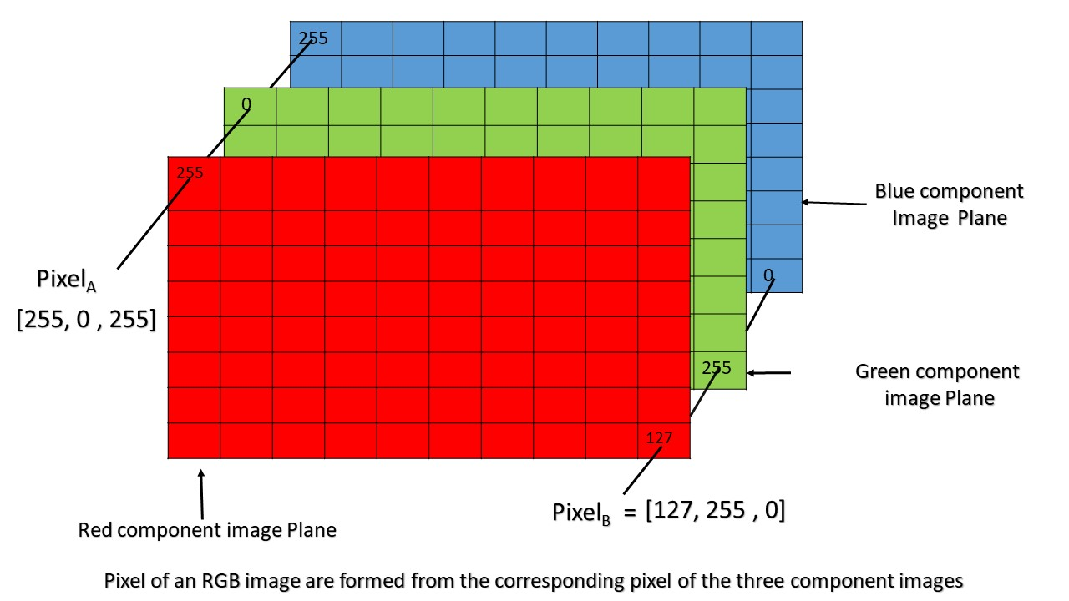
What is image? Matrices (=channels)!

Slide 4
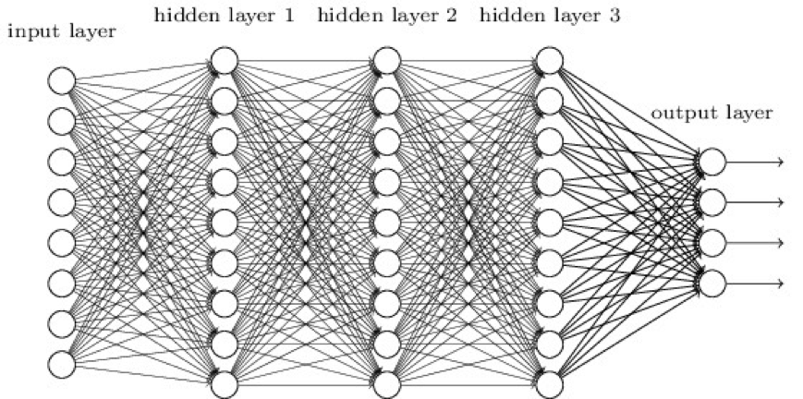
Multilayer Perceptron for Image Processing?
In theory, yes, but practically no
We can build one huge vector out of these pixels and feed them to MLP
First problem: computational inefficiency
100 × 100–pixel image (10,000 pixels) would provide at least 10,000 neurons for the input
if the next layer has just 1,000 neurons, that will give 10 million connections
Hence, large images would force us to use huge MLPs, that would not fit in any GPUs
We will need a lot of data

Slide 5
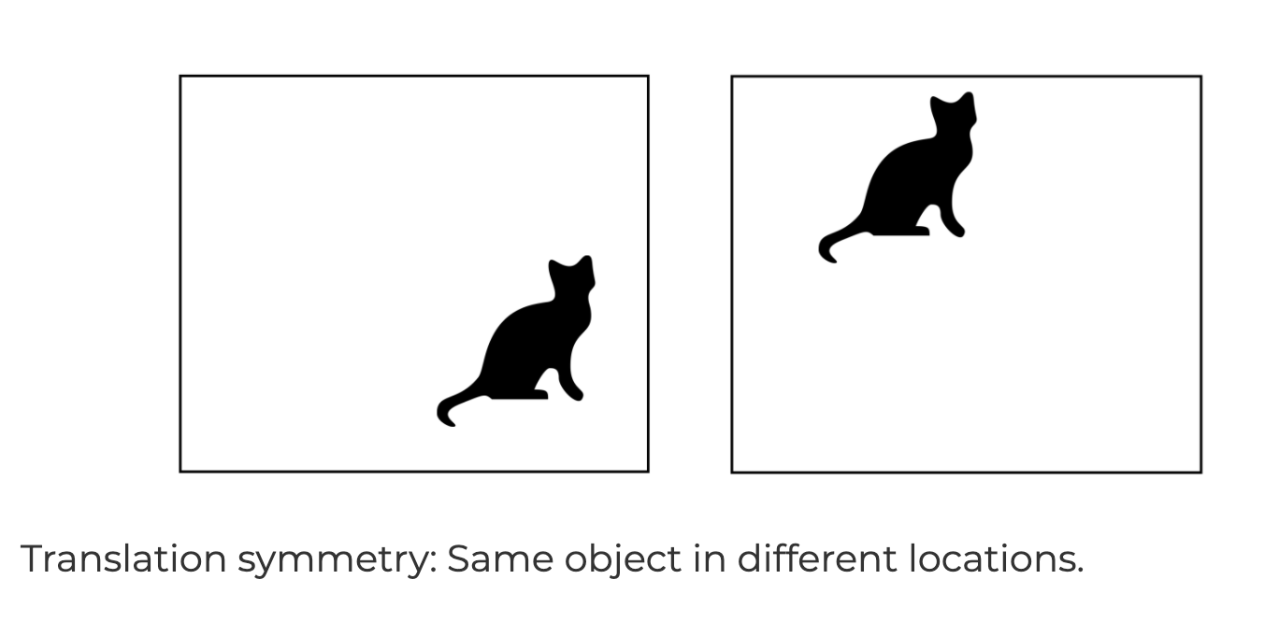
Problem of “translation” of objects in images
Network needs to handle “translations”: detect cat wherever it occurs
MLP over all pixels only recognizes cats in exact (training) location
https://penkovsky.com/neural-networks/day5/

Slide 6
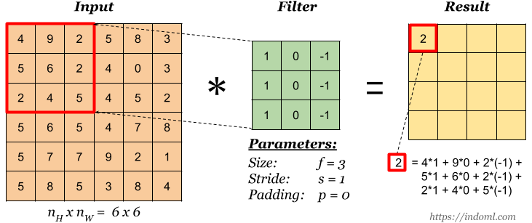
2D Convolution (= Filter, Kernal) for 1 channel
We apply 2D convolution along the input (see more examples):

Slide 7
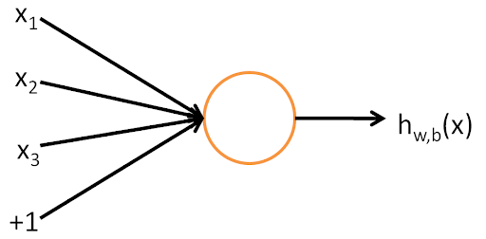
2D Convolution
Each convolution is similar to a small neuron
Convolution = filter = kernel
Terminology:
Size of kernel (receptive field) = size of its matrix
Stride: step with which we slide the filter
Depth: number of filters per layer
Feature map: it is a tensor, which we get after applying convolution

Slide 8
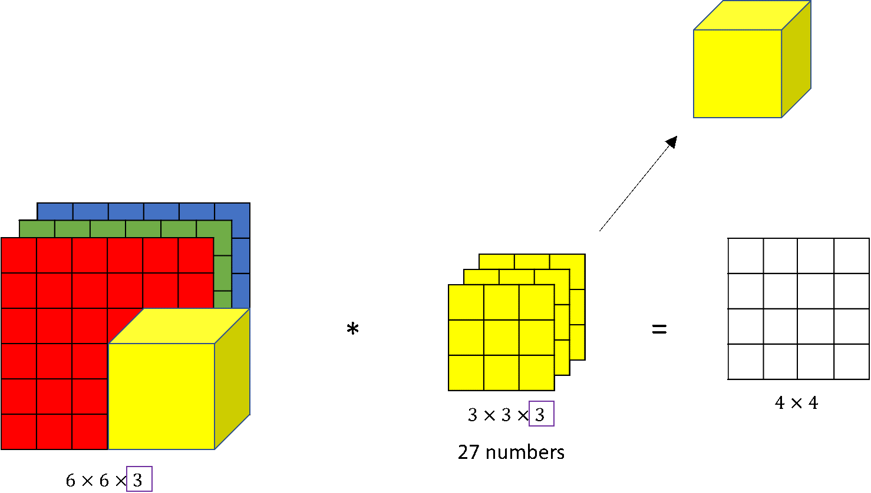
2D Convolutions (multiple channels)

Slide 9
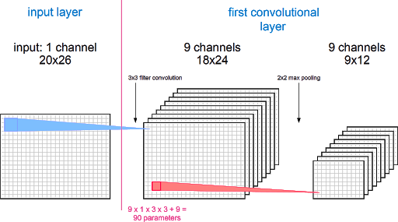
Stack of filters
One convolutional layer:
we use multiple filters simultaneously followed by an activation function
one filter produces one output channel
multiple filters produce stack of channels
We stack multiple convolutional layers (+ pooling, see later) to get a convolutional neural network.

Slide 10
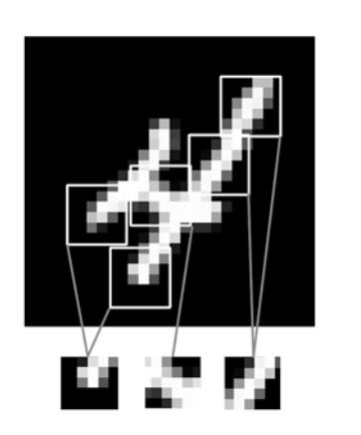
Why Convolutions (not MLP)?
they can handle translations
fewer parameters -> faster processing and less memory -> we can use deeper networks
fewer training samples to learn representations

Slide 11
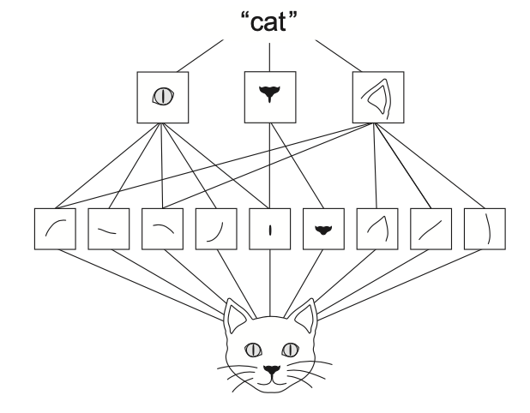
Why Convolutions (not MLP)?
Pros:
learn hierarchical patterns from images
capture complex and abstract visual concepts
Still issues with: changes in the scale, rotations, changes in colour.
Data augmentation for training data as a mitigation, examples:
Geometric transformations: rotation (rotating the image by a certain angle), flipping (horizontally or vertically), scaling (resizing the image), cropping (cropping parts of the image), etc.
Color transformations: brightness adjustment, contrast adjustment, etc.

Slide 12
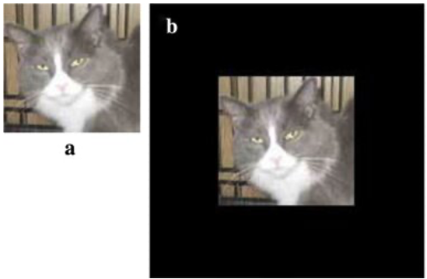
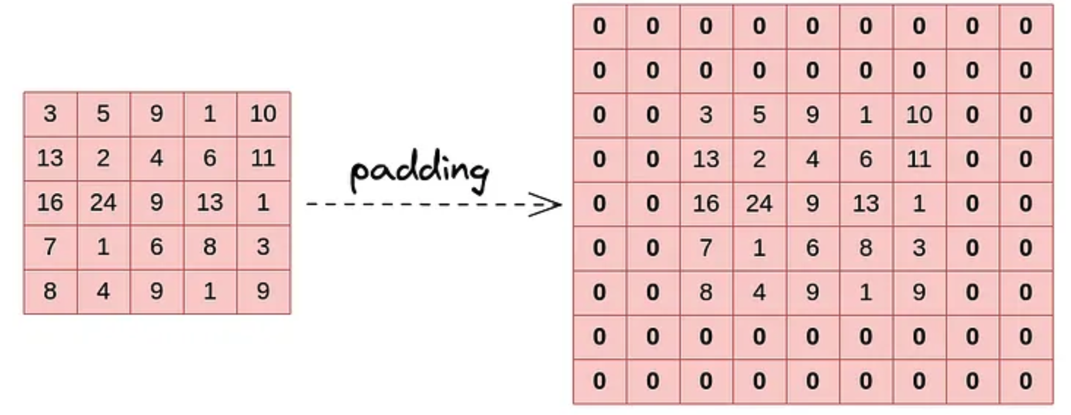
If an input image (array) is too small
If an input image (array) is too small, applying zero padding ensures it can fit the required dimensions for processing by the network (e.g., convolutional layers).
How it looks for an image (a->b):
How it looks for a matrix:

Slide 13
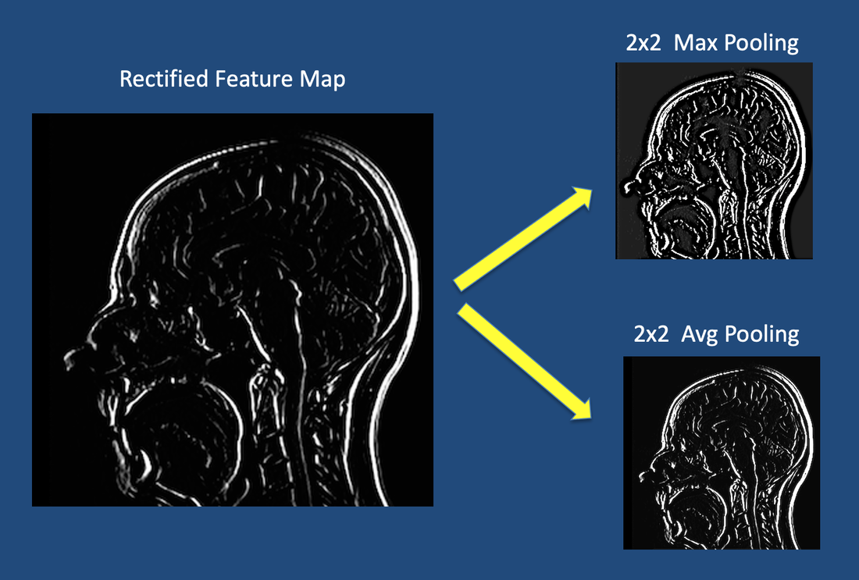
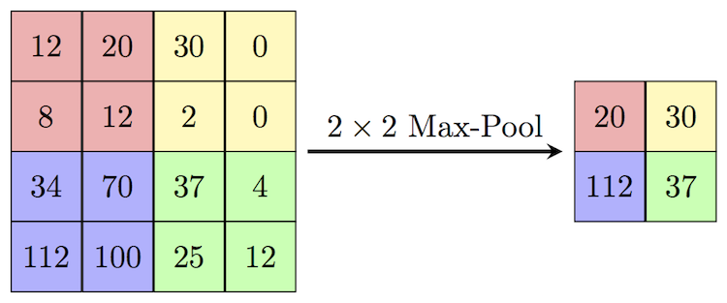
If an input image (array) is too big
Image from here.
The size of an image (array, feature map) is reduced based on the window size and stride. For each window, the maximum value within the window is selected as the output.

Slide 14
How to build such CNNs?
it is difficult (time consuming, computationally expensive)
there are many architectures around
use one of these architectures

Slide 15
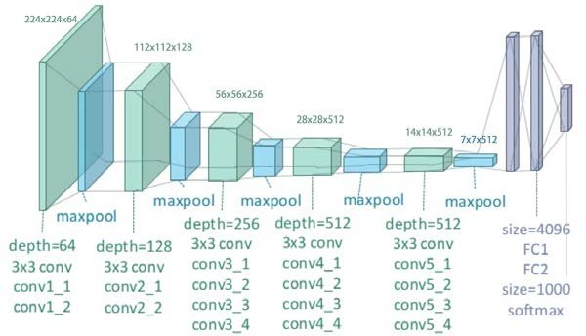
VGG
VGG (16 and 19) demonstrated that increasing the number of layers with small convolution filters significantly enhances performance in image recognition tasks.
Common practice: the number of channels (see depth in the image) grows as the number of layers increases.
MLP is used on top of the CNN to get predictions.

Slide 16
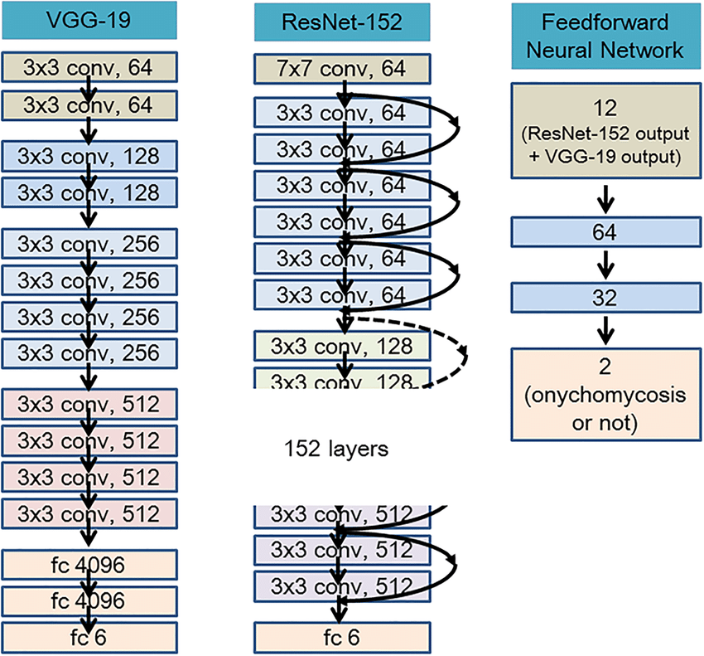
ResNet
ResNet (Residual Network) was introduced to address the vanishing gradient problem.
Its key innovation is the use of residual connections, or skip connections, which let the model pass information directly from one layer to another, skipping intermediate layers. This makes it easier to train very deep networks, even with hundreds of layers.

Slide 17
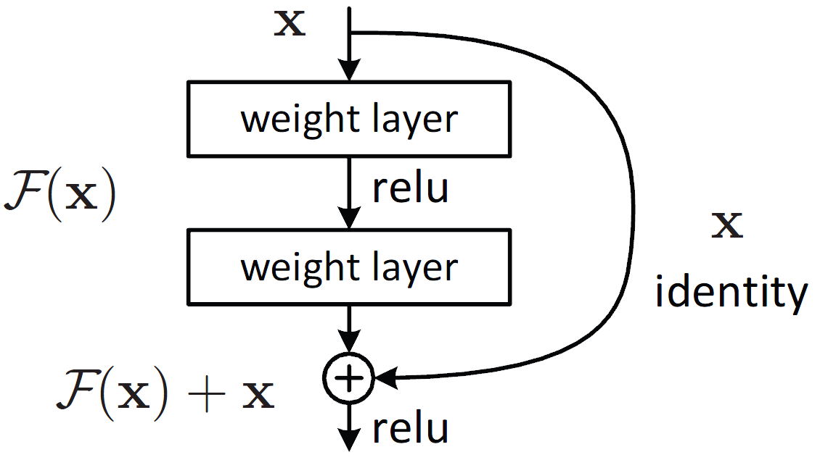
Building block of ResNet

Slide 18
Pre-training and fine-tuning
Weights learnt on big datasets can detect robust and general features
Instead of random initialization, we can re-use these weights and fine-tune them
Advantages:
faster convergence
better results (especially for small datasets )
Possible disadvantages:
If the pre-training dataset is too different (specific) from the current dataset, the results may be not very promising

Slide 19
Do we have better solutions?
Notebook:
CNNS are the most popular deep networks in computer vision
A lot of tools, architectures, pretrained models
But it seems that Transformers from NLP will replace
MNIST dataset (database of handwritten digits)
Transfer learning

