Slide 1
Embeddings

Slide 2
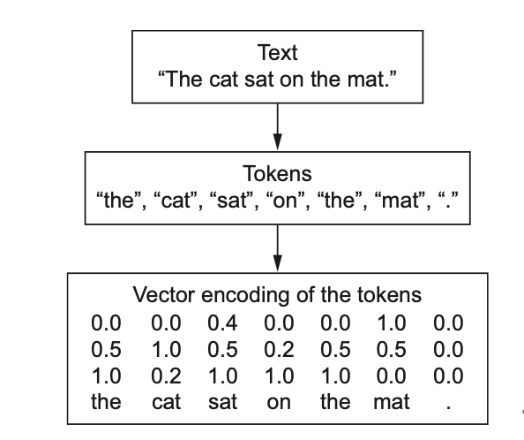
What can be the basic units?
Words
Sub-words (aka parts of words)
Characters
N-grams (overlapping groups of multiple consecutive words or characters)

Slide 3
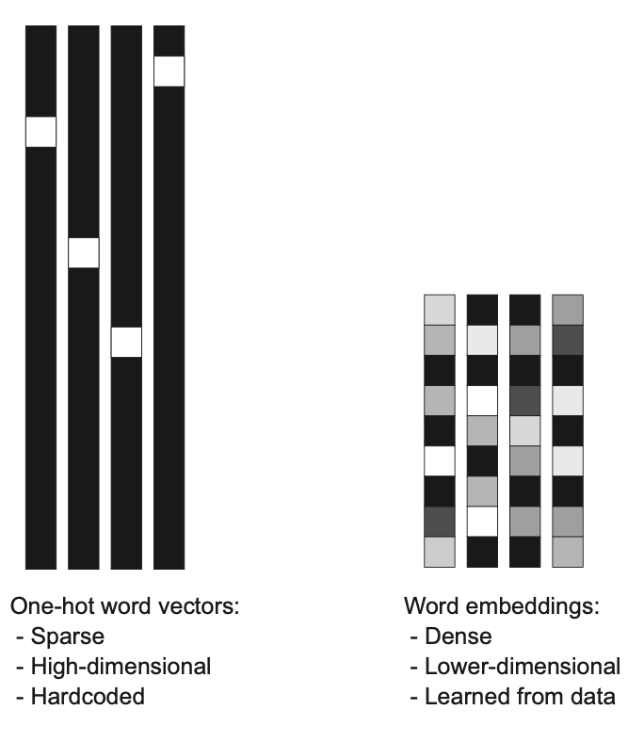
Embeddings
dense lower-dimensional vectors learned from data
learn similarities between words
can be learned jointly with the main task
can be obtained from another task (pretrained word embeddings)

Slide 4
Pretrained Embeddings
Word2Vec
Glove
fastText
BERT
…...
This topic will be covered in NLP

Slide 5
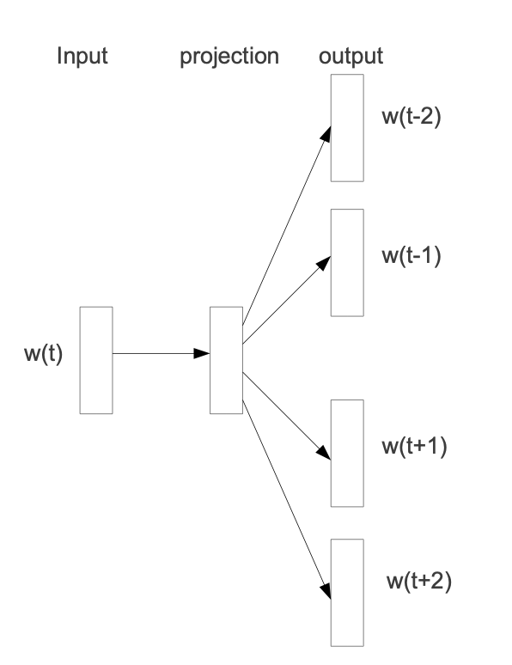
How to learn pretrained embeddings?
masked language modeling: we mask some words in text in order to predict them based on the observed words
the training objective is to learn word vector representations that are good at predicting the nearby words

Slide 6
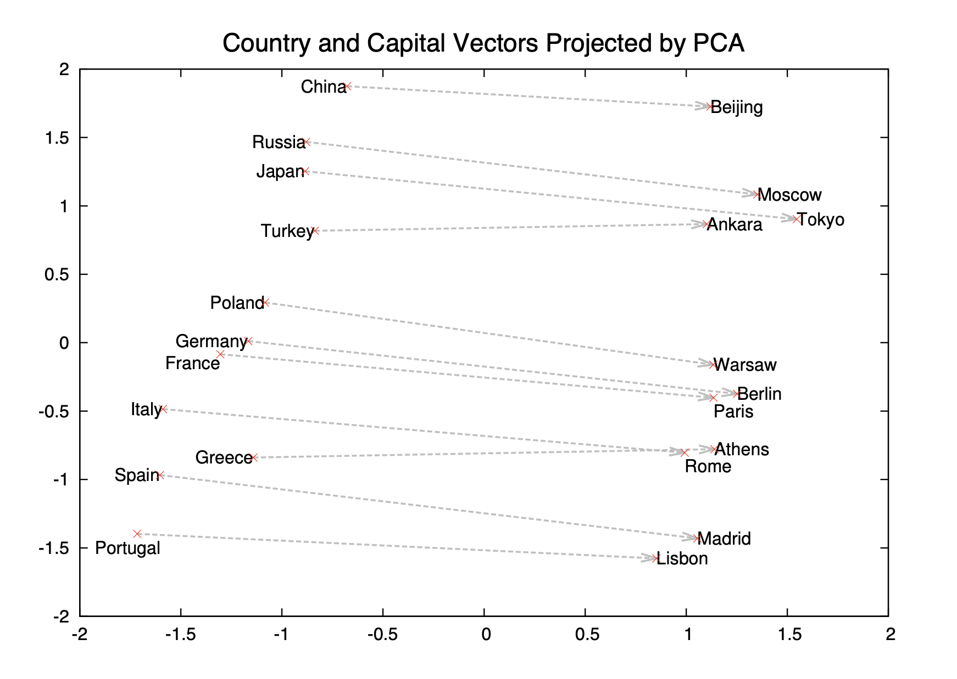
Word2Vec: example
Embeddings can learn some interesting properties:

Slide 7
Highlights of the notebook
we can simply add embedding layer that will be shown in the notebook
we will learn how to use pre-trained embeddings

