Slide 1
Temporal 1D-convolutions
Tackling time series with neural networks

Slide 2
Dataset
“Spoken digit” dataset (available from Tensorflow)
The “MNIST” for audio
Numbers 0 to 9 (10 class-classification problem)
5 speakers
2,500 recordings
(50 of each digit per speaker)
Examples: https://www.tensorflow.org/datasets/catalog/spoken_digit
Challenge:
8th kHz (samples per second): 18262 (!) features to process for one instance…
And granularity is important! Simple downsampling isn’t possible
Not a very large dataset (cf. train/dev/test)
(cf. multiple hours required for speech recognition)

Slide 3
Rationale?
Time-invariant feature detection is crucial
A consonant must be detected wherever it occurs…
Across all 8000 time steps
Slide 1D-filters over the entire sequences
Build a stack of filters that recombine input from lower levels into higher-level features
Naive view of feature learning:
Primitive shapes of changes in air pressure to detect e.g. consonants
Consonants + vowels = syllables
Combinations of syllables = words

Slide 4
Slide limited-width filter over speech signal
Animation is for 1 filter, typical 1D conv has multiple filters
https://e2eml.school/convolution_one_d.html

Slide 5
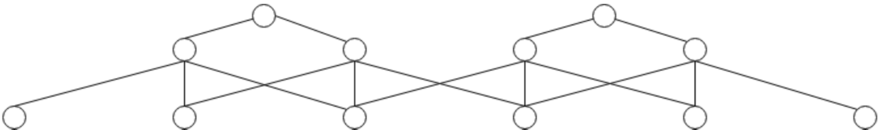
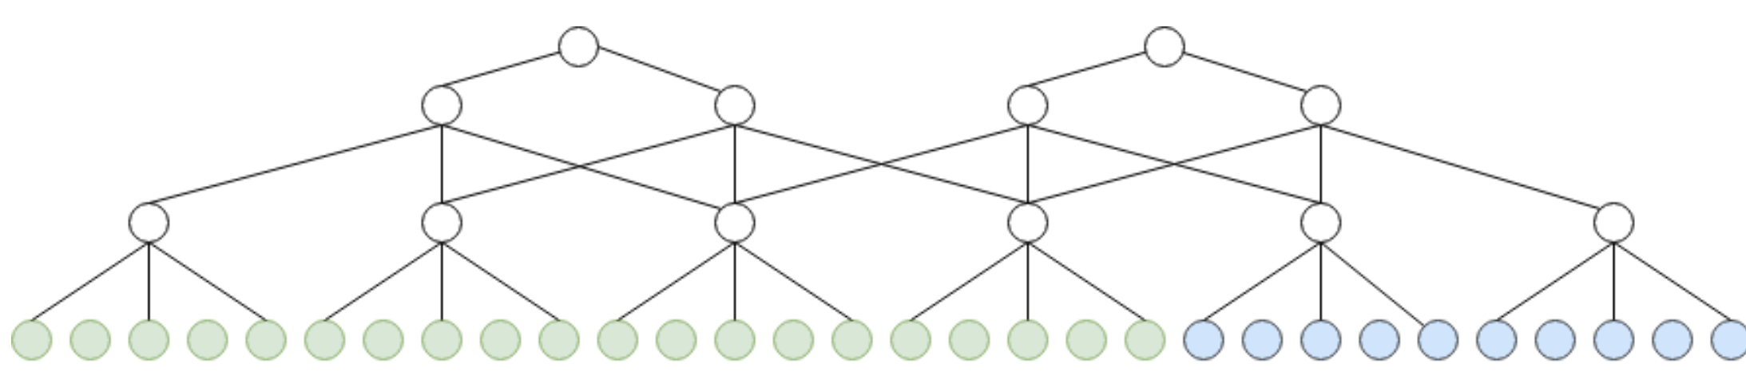
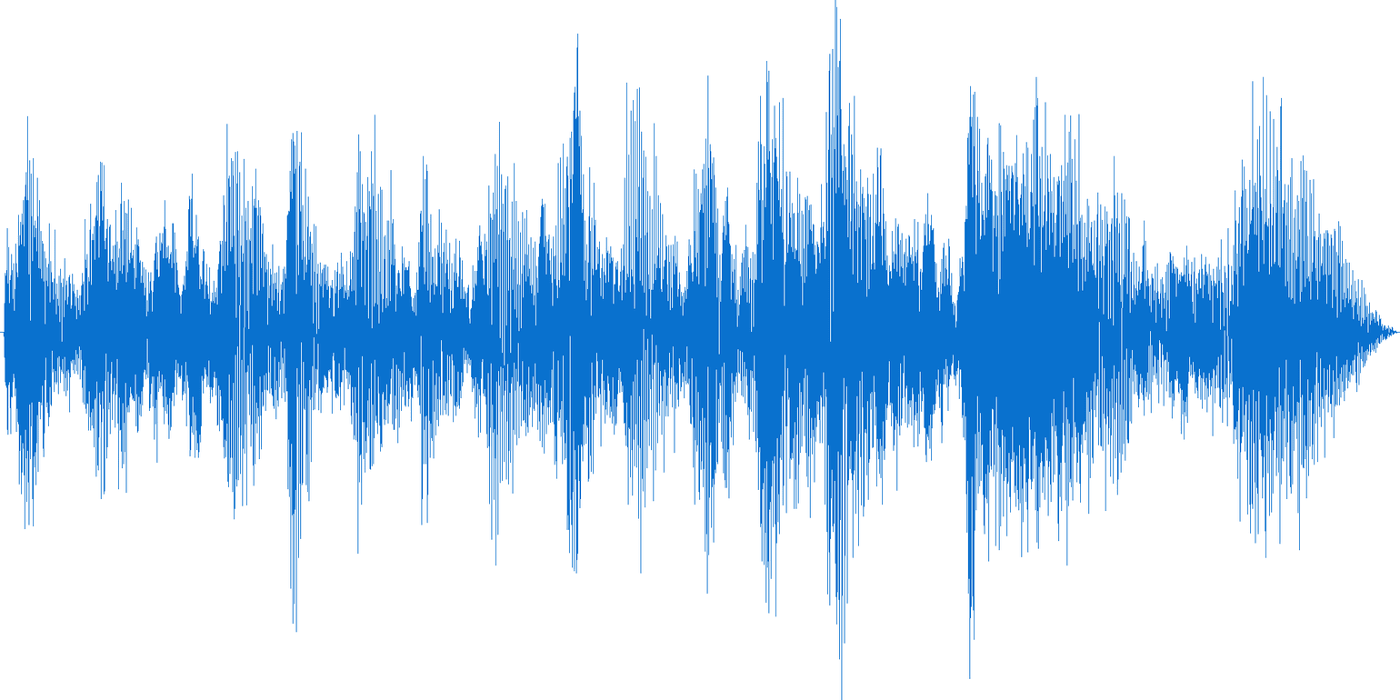
Think “pyramid”:
Goal: gradually decrease temporal dimensionality of original time series
Class “three”

Slide 6
Run-off-the-mill architecture
(Very similar to image architecture, but 1D)
Stack of “blocks”:
Couple of convolutional layers
Followed by pooling layer (e.g. max pool)
Dense part:
Flatten layer (to get a vector)
Couple of Dense layers
Classification layer

