Slide 1
K - MEANS
P : 080 4928 5000 | E : enquiry@acadgild.com

Slide 2
What is K-MEANS?
Clustering algorithm in which n observations are divided into k clusters in which each observation belongs to the cluster with the nearest mean.
The mean of the cluster serves as a prototype of the cluster.
The maximum intra-cluster distance must be less than the minimum inter-cluster distance.
The distance is calculated in many cases is the Euclidean Distance, but can be problem-dependent.
Heuristic algorithm that depends on initialization for convergence.

Slide 3
LOYD’S ALGORITHM
The algorithm has 2 main steps which it repeats:
Assign a point to a cluster based on minimum distance with cluster mean.
Update the cluster mean to include the new point added to the cluster.

Slide 4
ELKAN’S ALGORITHM
Avoids many distance calculations by using the triangular inequality when assigning points to clusters.
Uses 2 key observations:
If the distance between a point (x) and its current center (c1) is less than half of the distance between the current center (c1) and a different center (c2), then c2 can be skipped when a new assignment for x is searched.
If a center c1 is updated to c2, then the new distance between a point (x) and the center c2 is bounded from below and above by:
|| x – c1||_{p} - || b c1 – c2 ||_{p} <= || x – c2 ||_{p} <= || x – c2 ||_{p} + || c1 + c2 ||_{p}

Slide 5
INITIALIZATION
Forgy method initializes k random points as means and performs the 2 main steps – spreads out initial means.
Random partition method randomly assigns a cluster to each point and proceeds – initial clusters tend to be around the center of the dataset.

Slide 6
THE DATASET
http://archive.ics.uci.edu/ml/datasets/Car+Evaluation
buying buying price
maint price of the maintenance
doors number of doors
persons capacity in terms of persons to carry
lug_boot the size of luggage boot
safety estimated safety of the car
CAR car acceptability

Slide 7
CONSIDERATIONS
Time Complexity – Linear in terms of the number of data points to cluster.
Shape of Clusters – When the natural clusters are spherical in shape, K-Means does well.
Repeatability – K-Means starts with a random choice of cluster centers, therefore the clusters formed may be different for different runs of the algorithm. Thus, results may not be repeatable.
K value – K-Means requires prior knowledge of a good value for the number of clusters.

Slide 8
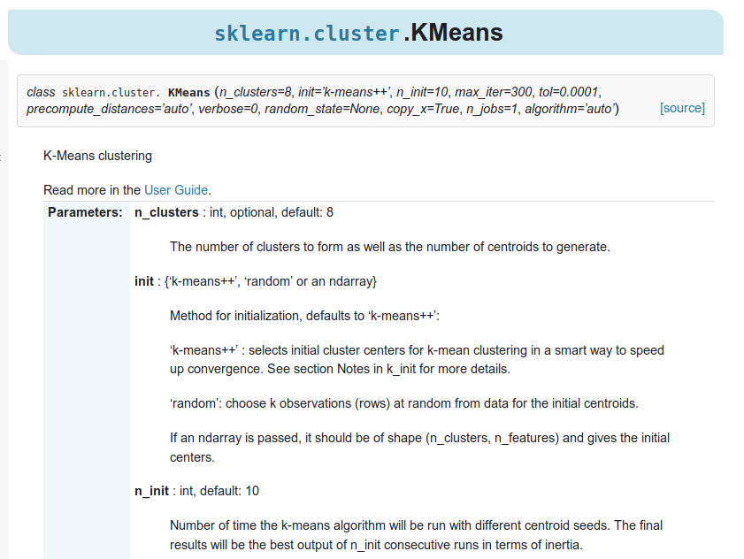

Slide 9
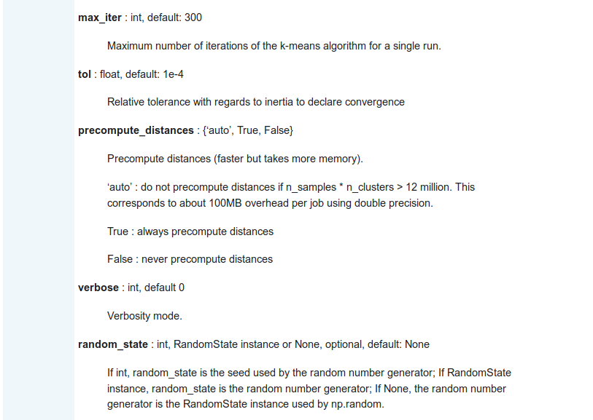

Slide 10
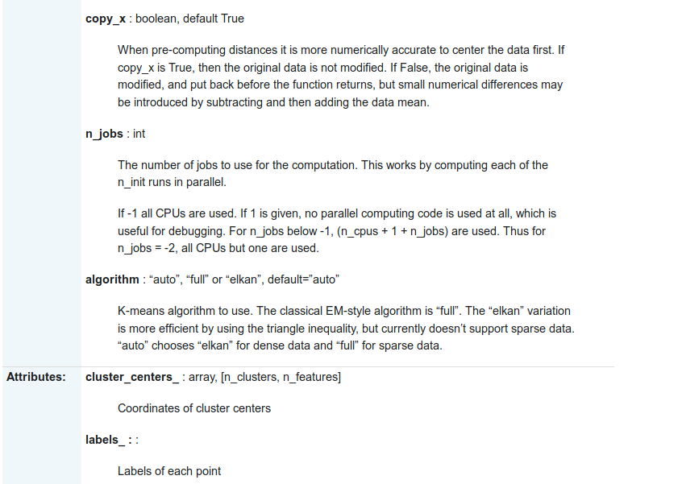

Slide 11


Slide 12
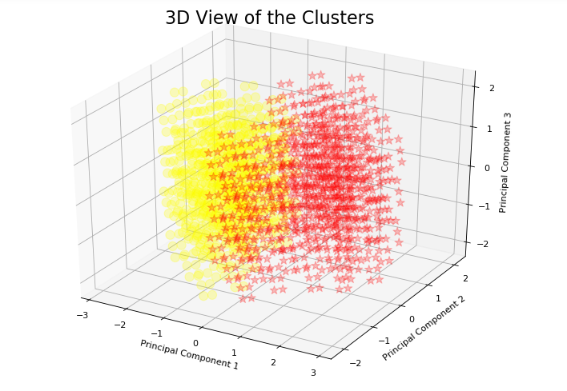
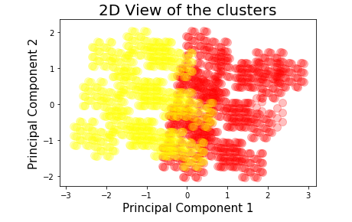

Slide 13
THANK YOU

