Slide 1
K NEAREST NEIGHBORS
P : 080 4928 5000 | E : enquiry@acadgild.com

Slide 2
What is KNN?
In classification, an object is classified by a majority vote of its neighbors, with the object being assigned to the class most common among its k neighbors.
In regression, the value of the object is the average of the values of its k nearest neighbors.
Weights can be assigned to the contributions of the neighbors so that neighbors who are closer contribute more to the average than those which are farther away.
The neighbors are taken from a set of objects whose class (classification) or value (regression) are known. This is the training set, though no training step is included.

Slide 3
CHARACTERISTICS
Competitive
Lazy
Non-parametric
When k=1, it is called nearest neighbor algorithm.
When class distribution is skewed, might not perform well. Weighting closer neighbors higher can help with that.

Slide 4
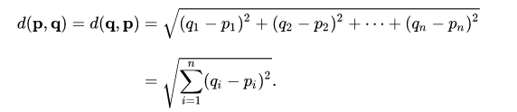
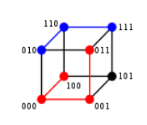
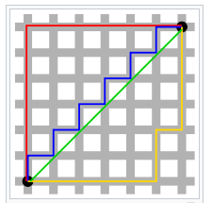

SIMILARITY MEASURES
EUCLIDEAN DISTANCE – For real values.
Also called L2 distance or L2 Norm
HAMMING DISTANCE – For categorical values.
The Hamming distance between two strings of equal length is the number of positions in
which the corresponding symbols differ.
MANHATTAN DISTANCE – L1 Norm – Distance between two points is the sum of the absolute differences in their cartesian coordinates.
MINKOWSKI DISTANCE – Generalization of the Euclidean distance and Manhattan distance in vector space.

Slide 5
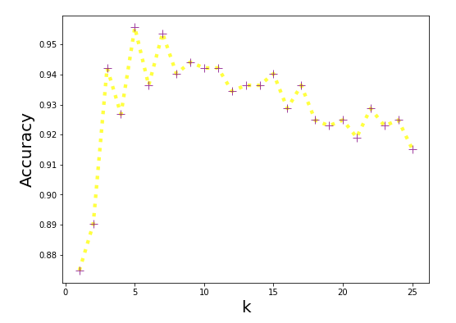
DECIDING ON THE VALUE OF K
Large value of k will lead to overfitting and too low value will lead to underfitting. Hyperparameter optimization techniques – parameter sweep, random search, grid search, Gradient Optimization, Evolutionary Optimization can be used to find an optimal value of k.

Slide 6
BRUTE FORCE
In the generic k-NN model, each time a prediction is to be made for a data point, first this data point’s distance from all other points is to be calculated and then only nearest k-points can be discovered for voting. This approach is also known as brute-force approach.

Slide 7
BALL TREE
Space partitioning data structure that partitions data into a nested set of hyperspheres known as “balls”. Constructed on data as pre-processing step to speed up KNN.
Binary tree in which every node defines a D-dimensional hyersphere, or ball, containing a subset of the points to be searched.
Initially, data is divided into 2 hyperspheres or “balls” with each data point belonging to one of the two balls whose centroid lies closer to it.
Data is subsequently divided further into more “balls”.

Slide 8
BALL TREE IN KNN
Nodes are examined in depth-first order, starting at the root. The algorithm maintains a max-first priority queue Q of the k nearest points encountered so far. At each node B, it may perform one of three operations, before returning the updated Q:
If the distance from the test point ‘t’ to the current node B is greater than the furthest point in Q, ignore B and return Q.
If B is a leaf node, scan through every point enumerated in B and update the nearest-neighbor queue appropriately. Return the updated queue.
If B is an internal node, call the algorithm recursively on B's two children, searching the child whose center is closer to ‘t’ first.

Slide 9
K-D TREE
Also K-Dimensional Tree.
Sorted hierarchical data structure.
The dimension having the greatest variance is chosen, and the data is divided into 2 branches based on which side of the median based on the dimension the data point lies.
In the next step, based on a different dimension with the next highest variance, the splitting happens on median value.

Slide 10
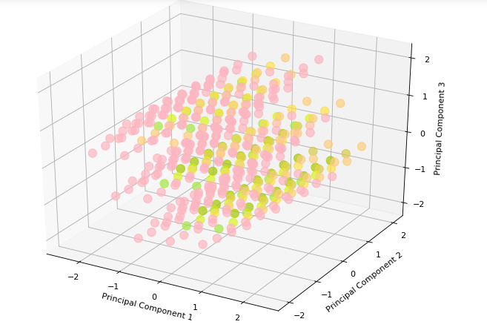
THE DATASET
http://archive.ics.uci.edu/ml/datasets/Car+Evaluation

Slide 11
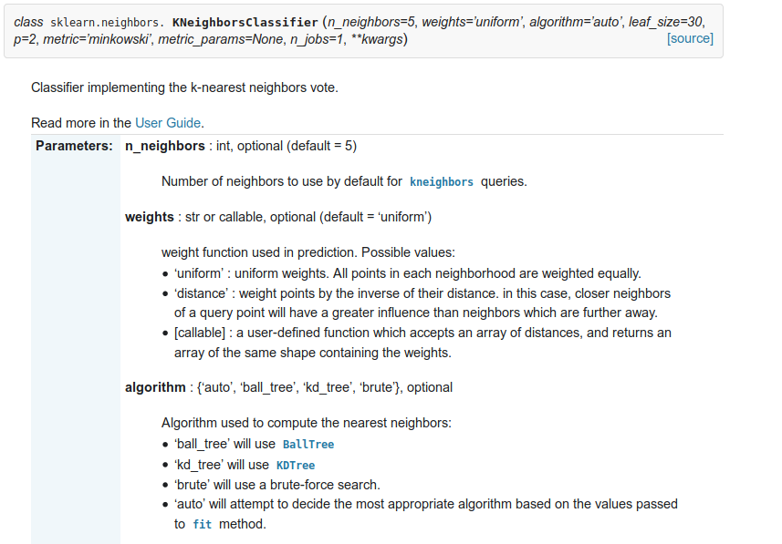

Slide 12
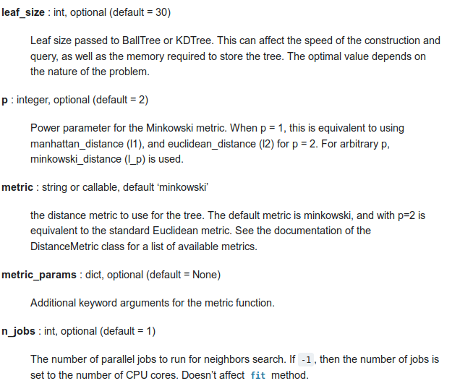

Slide 13
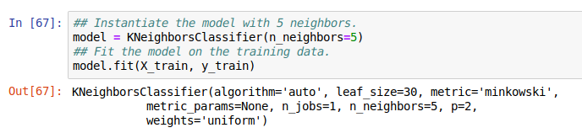

Slide 14
THANK YOU

