Slide 1
METRICS TO EVALUATE ALGORITHM PERFORMANCE
P : 080 4928 5000 | E : enquiry@acadgild.com

Slide 2
ClaSSIFICATION METRICS
Accuracy
Area under the ROC curve
Confusion Matrix

Slide 3
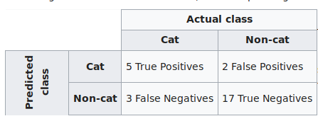
CONFUSION MATRIX
Row – Instance of predicted class.
Column – Instance of actual class.

Slide 4
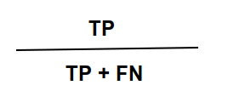
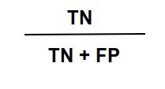
Sensitivity – True Positive Rate – recall – proportion of actual positives that are identified as such.
Specificity – True Negative Rate – proportion of actual negatives that are identified as such.

Slide 5
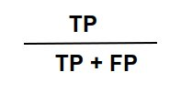
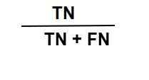
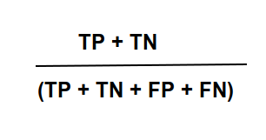
Precision – Positive Predictive Power (PPV)
Proportion of positive identifications that
are correct
Negative Predictive Power (NPV)
Accuracy – Proportion of records correctly
classified

Slide 6
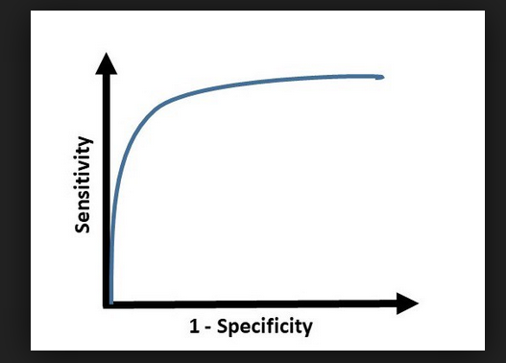
ROC – Receiver Operating Characteristic Curve graphically represents the trade-off between the True Positive Rate or Recall and the False Positive Rate or Fallout.
TPR – Sensitivity
FPR – (1 – Specificity)

Slide 7
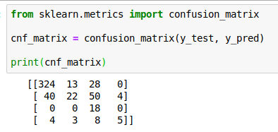
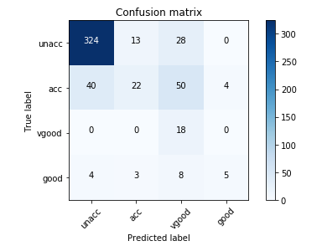

Slide 8
THANK YOU

