Slide 1
NAIVE BAYESIAN ALGORITHM
P : 080 4928 5000 | E : enquiry@acadgild.com

Slide 2
NAIVE BAYESIAN ALGORITHM
Supervised, classification algorithm.
Family of probabilistic classifiers based on Bayes theorem.
Assumes that features are independent of each other – therefore called Naive.
Parameter estimation by Maximum Likelihood Estimation.
Alleviates the curse of dimensionality such as the need for data sets that increase exponentially with number of features by the assumption of feature independence.
It computes instance probabilities for each possibilities of output label and assigns the label for which the probability is the highest.

Slide 3



BAYE’S THEOREM
P(A | B) – conditional probability – probability that A occurs given B is true.
P(B | A) – conditional probability – probability that B occurs given A is true.
P(A) – probability of observing A
P(B) – probability of observing B
P(A) and P(B) are independent of each other.
For prior probabilities, either uniform values or calculation from training samples is computed.
The denominator is the same for all classes and ignored.
The likelihood term is maximized using Expectation Maximization.

Slide 4
MAXIMUM LIKELIHOOD ESTIMATION
Method of estimating the parameters of a statistical model, given observations.
Idea is to maximize the probability that the model is defined by certain parameter values, given the observations.
A sequence of MLEs on increasing number of observations will converge to the true values of the population.
Suppose that we are interested in the life-spans of persian cats, but are unable to record that of every persian cat in a population. Assuming that the lifespans are normally distributed with some unknown mean and variance, the mean and variance can be estimated with MLE while only knowing the heights of some sample of the overall population. MLE would accomplish that by taking the mean and variance as parameters and finding particular parametric values that make the observed results the most probable given the normal model.

Slide 5
ASSUMPTIONS
Presence of each feature – independent of every other feature.
When data is continuous – normal distribution. This is Gaussian Naive Bayes.
In the multinomial event model – the bag of words assumption is used – positional independence - instead the frequency of occurrence of a word is added as a feature of the document. This is Multinomial Naive Bayes.
In the multivariate Bernoulli event model – features are independent booleans representing the occurrence of a feature.

Slide 6
ADVANTAGES
Fast.
When independence assumption holds true, needs less data.
Inspite of independence assumption, classification performance good.
Used for real-time prediction, multi-class prediction, text classification, sentiment analysis, Spam Filtering and Recommendation Engines.

Slide 7
REGULARIZATION
When frequency count is 0, all probability calculations might become 0, therefore a pseudocount is used instead of 0.
When the pseudocount is 1, it is called Laplace smoothing.
It is called Lidstone smoothing in the general case.

Slide 8
EXAMPLE DATASET
http://archive.ics.uci.edu/ml/datasets/Car+Evaluation
Attributes:
========
buying Buying price (v-high, high, med, low)
maint Price of maintenance (v-high, high, med, low)
doors Number of doors (2, 3, 4, 5-more)
persons Capacity in terms of persons to carry (2, 4, more)
lug_boot The size of the luggage boot (small, med, big)
safety Estimated safety of car (low, med, high)
Acceptability Acceptability of the car

Slide 9
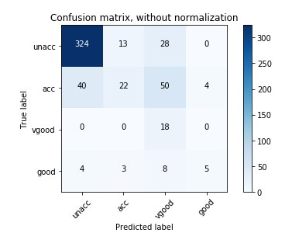
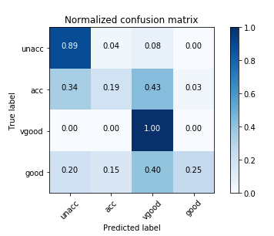
CONFUSION MATRIX FROM PREDICTED VALUES

Slide 10
THANK YOU

